Slide 1
SEMII 2.06A/B
Identify ambush strategies to use at other events
Develop viral sport/event marketing strategies

Slide 2
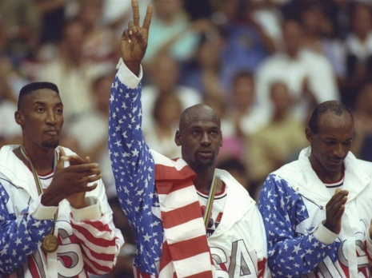
What is Ambush Marketing?
Ambush marketing is an emotionally-charged phrase that refers to the practice of appearing to align a brand with an event for which that brand has not paid for the right to be a sponsor.

Slide 3
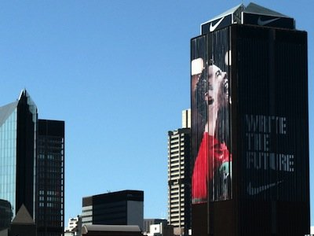
Reasons Businesses Use Ambush Marketing
It’s effective
It attracts consumers at the expense of its competitors
It is cheaper than being an official sponsor
For some smaller companies, it is the only way to be tied in with a large sport event

Slide 4
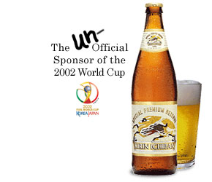
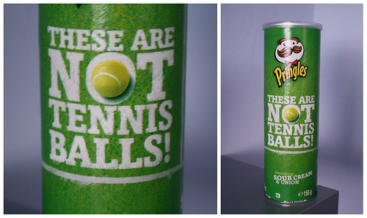
Ambush Marketing used as a Marketing Strategy
A brand associates itself with a sport/event
Used to gain market share
May sponsor an athlete or team, but not the entire event
Handing out free apparel or items with the company name on it

Slide 5

Impact of Ambush Marketing on Sponsorships
It could hurt the ambushing company in future sponsorships
It hurts event/sport organizations ability to demand high sponsorship prices
It frustrates official sponsors that have paid top dollar for the right to sponsor an event.

Slide 6
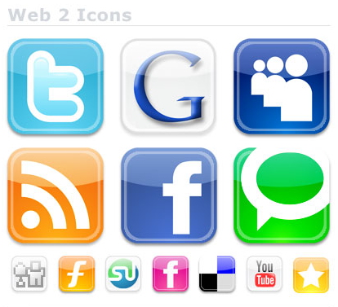
What is Viral Marketing?
any marketing strategy that encourages users to pass on the marketing materials or message to others. Also known as “word-of-mouth marketing”
This creates an exponential growth pattern, not unlike that of the flu virus, as the material is forwarded from friend to friend, allowing the message to reach millions, if done right.

Slide 7
Importance of viral marketing
It is the least expensive option for advertising purposes
It can make or break a company
Consumers want to hear what the public has to say about a company – it is much more reliable than a paid advertisement

Slide 8
Principles of viral marketing
1 - Free Products or Services
  The majority of viral marketing strategies give away something for free. Free ringtones. Free samples. Free games. A core principle of viral marketing, is delayed gratification. You may be giving away free product initially, but understanding that the attention and buzz you can generate from your campaign will pay off in spades down the road.
2 – Spreads Easily
  YouTube, Facebook, Twitter, etc.
3 – Easy to Scale
  Make sure your marketing campaign pays off.
4 – Use a Common Human Motivation
  Should appeal to basic human nature: fear, humor, love. People need to connect with your marketing scheme.
5 – Content is everything
  if people are not interested, your campaign will never take off
6 – Keep it Simple
Old Spice Guy Responds to Fans

Slide 9
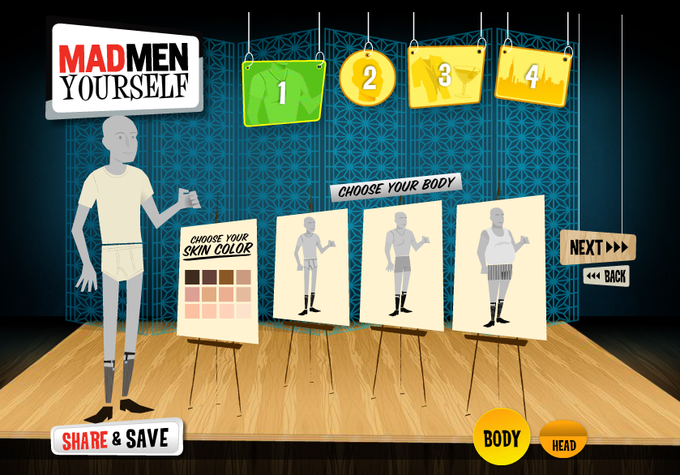
Mad Men Yourself
To help create buzz around the third season of Mad Men, AMC launched Mad Men Yourself, an avatar creator that allowed you to make a stylized '60s version of yourself. The site received half a million visitors in the first week and the Season 3 premiere saw record ratings. Perhaps the most impressive part about this campaign is it's still going strong five years later, receiving updates with every new season.

