Slide 1
2.04 Conduct post-sales follow-up activities to foster ongoing relationships with customers

Slide 2
a. Explain the importance of servicing sponsors.
b. Identify techniques that can be used to service sponsors.
c. Discuss considerations in selecting ways to service sponsors.
d. Demonstrate procedures for servicing sponsors.

Slide 3
The importance of effective servicing
The importance is the lifetime $ value that can be generated from a satisfied client or sponsor.

Slide 4
Here is an everyday example to illustrate the point.
If you owned a coffee shop and a new customer walked in, what level of service would you give them?
If you see them simply as another customer buying a $3 coffee and don’t deliver great service, and in doing so give them a reason to go elsewhere, you could miss out on around $3000 from just that one customer over two years (two coffees a day at $3 a coffee, 5 days a week over 50 weeks for two years- yes it does add up!)
Multiply that over a number of customers and you have the difference between a thriving business and going bust.

Slide 5
Ultimately, the level of service you deliver will determine the lifetime value you derive

Slide 6
Where servicing sits in the sales process
Too often people see the process as:
sell
service (implement)
re sell
This is not the right way to go about it.

Slide 7
Effective servicing takes place at two levels
Servicing at an organization level
1. Deliver what you promised
At a bare minimum you have to deliver what you said you would.
2. Understand and show interest in their business
If your client or sponsor for example is a printing company, find out what issues are impacting the printing industry and engage them in a conversation as to how the challenges will impact their business.

Slide 8
3. Help them to achieve their business outcomes
You might deliver great hospitality as part of the sponsorship agreement or great features through your software, however to really service effectively, help them to integrate those features into their normal business activities to derive real benefits and outcomes.
For example, if a sponsor or client has used hospitality entitlements to entertain their prospects, discuss how they are going to follow up on those newly formed relationships to lead their, now warm, prospects through their sales pipeline and provide advice on how best to do so.

Slide 9
4. Show Initiative
Send articles to your client or sponsor relating to their industry or competitors.
5. Move from being a seller to a trusted advisor
Move from being simply a seller of sponsorships or services to being their trusted advisor. You know you have achieved this when they share information with you about what is really going on in their business and seek your thoughts on how to deal with those challenges.

Slide 10
Servicing at a personal level
At a personal level, make the experience of working with you enjoyable; make them feel special by providing unique experiences that they value and relevant to them.

Slide 11
Tools for guaranteeing servicing success
1. A Joint Implementation plan
This sets up the relationship for success, by outlining who is doing what and when to achieve the desired outcomes.
2. Leveraging workshops
This will identify what else both parties can do to drive additional value from the relationship.

Slide 12
3. Joint sponsor or client workshops
Bring clients and sponsors together to explore opportunities to do business with each other.
4. Effective questioning
Use your questioning skills to determine their satisfaction regarding what you are delivering.

Slide 13


Slide 14
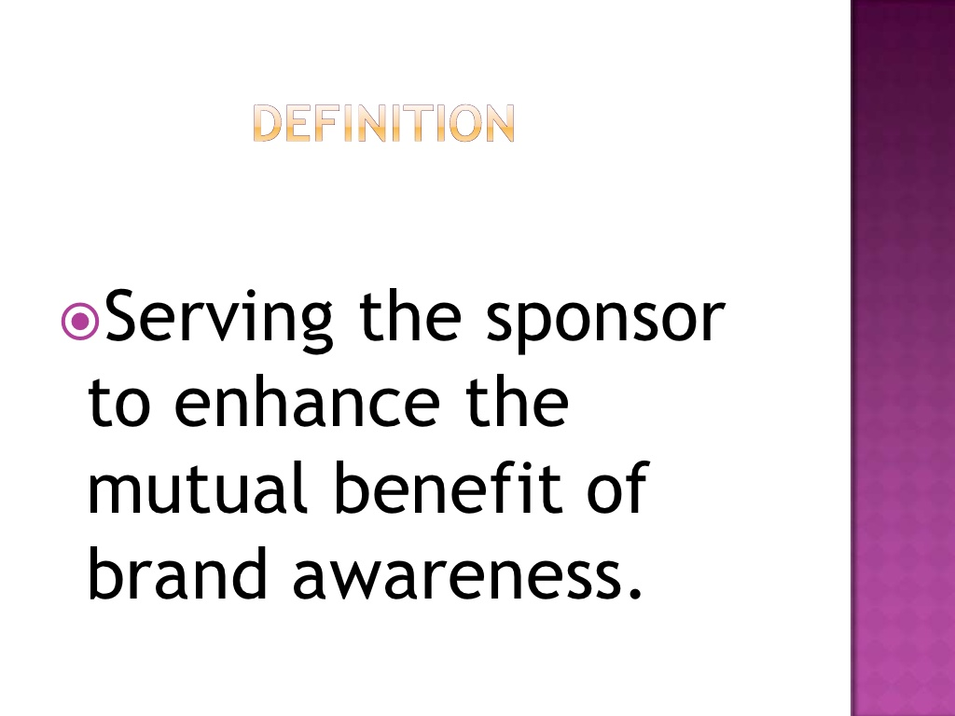

Slide 15
Guiding Precepts
Follow the sponsorship plan
Look for opportunities to expand the
sponsor’s returns
Communicate with the sponsor and your
sport organization

Slide 16
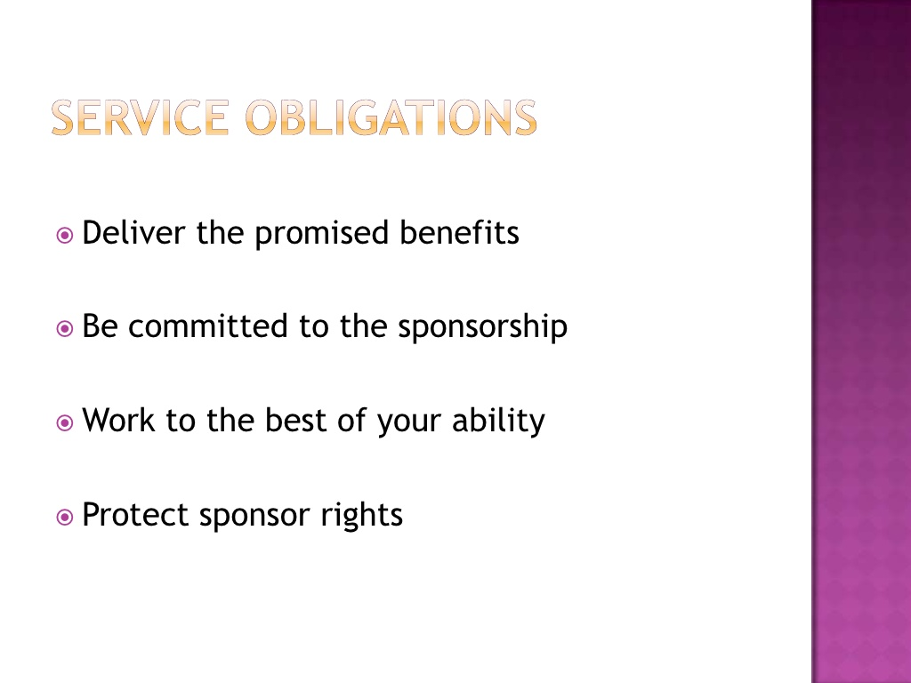

Slide 17
Service Obligations (Cont’d)
Promote your sponsor whenever practical
Always give recognition to the sponsor
Share promotion ideas with the sponsor
Keep your sponsor informed of happenings
in your sport organization

Slide 18
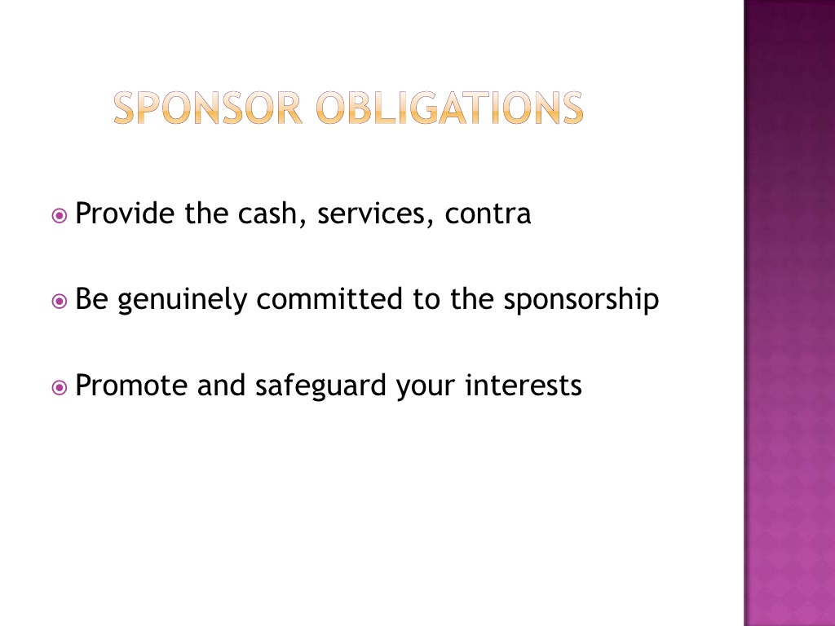

Slide 19
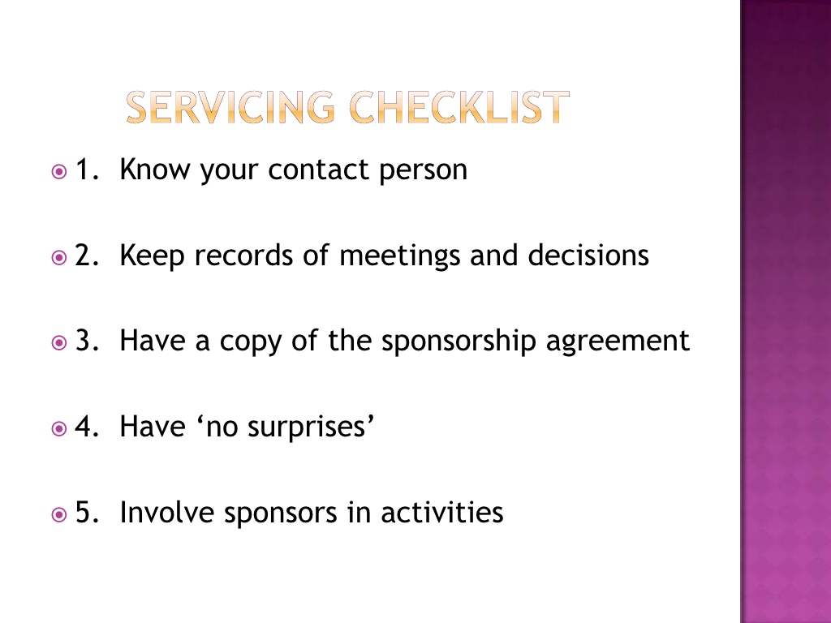

Slide 20
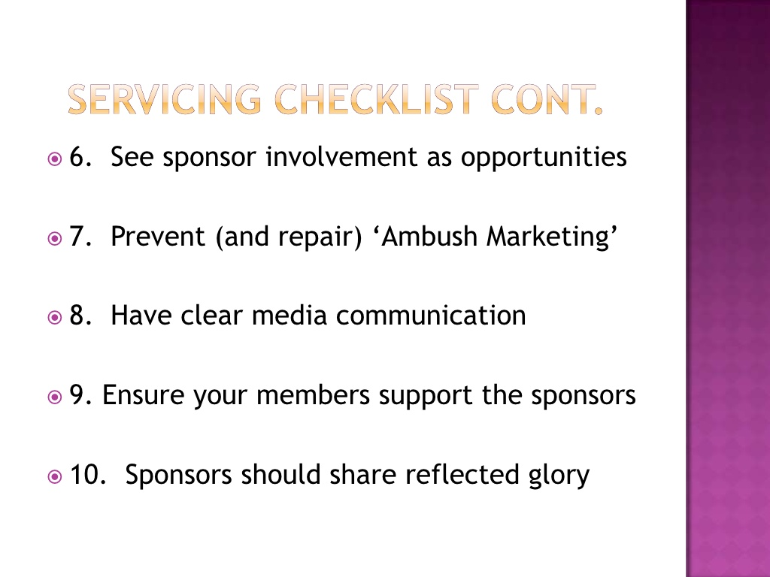

Slide 21
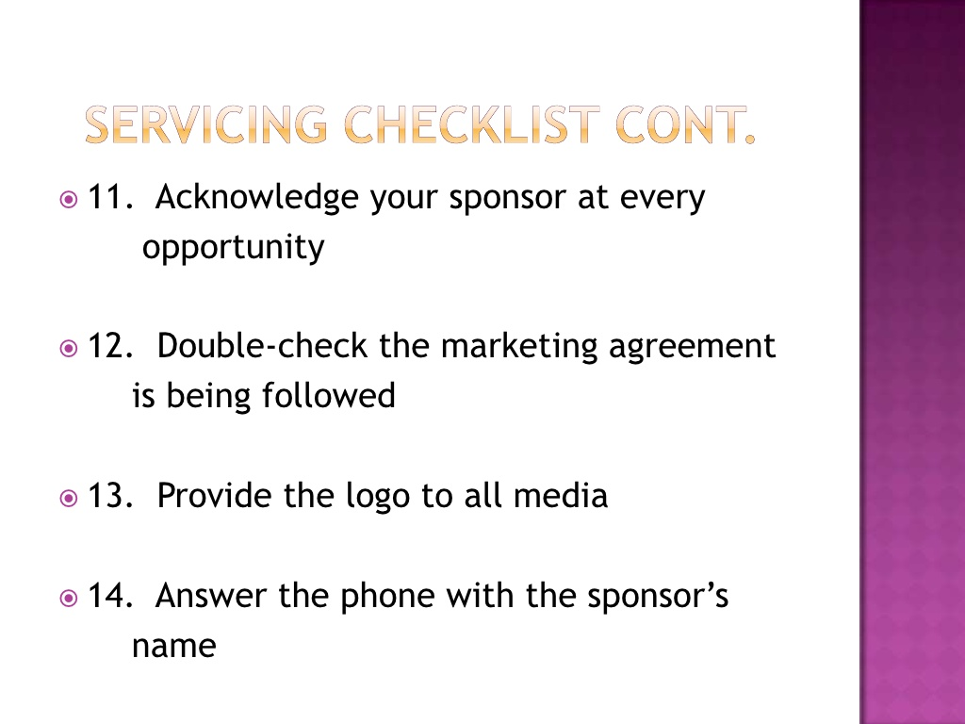

Slide 22
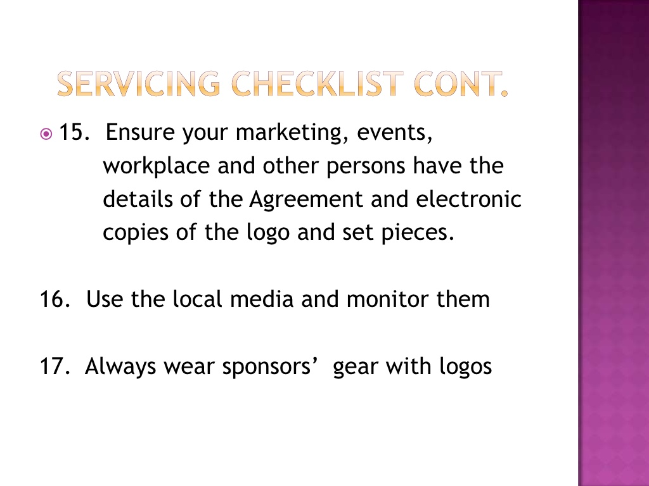

Slide 23
Servicing Checklist (Cont’d)
18. Use everything to publicize sponsor
brands – gear, reception area, letterhead,
bags…
19. Be professional and be loyal
20. Check signage placement
21. Research brand awareness

Slide 24
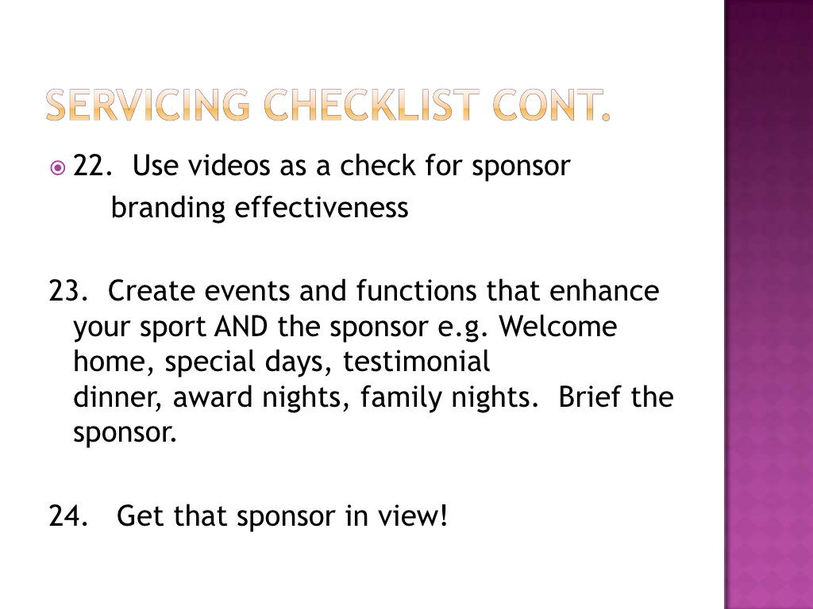

Slide 25
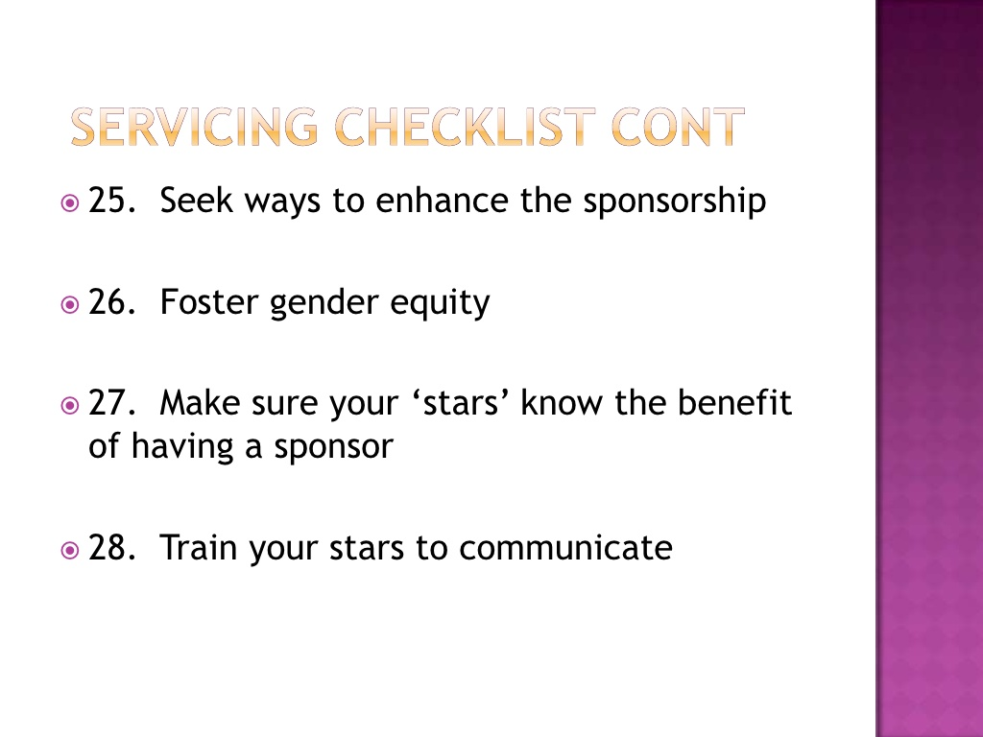

Slide 26
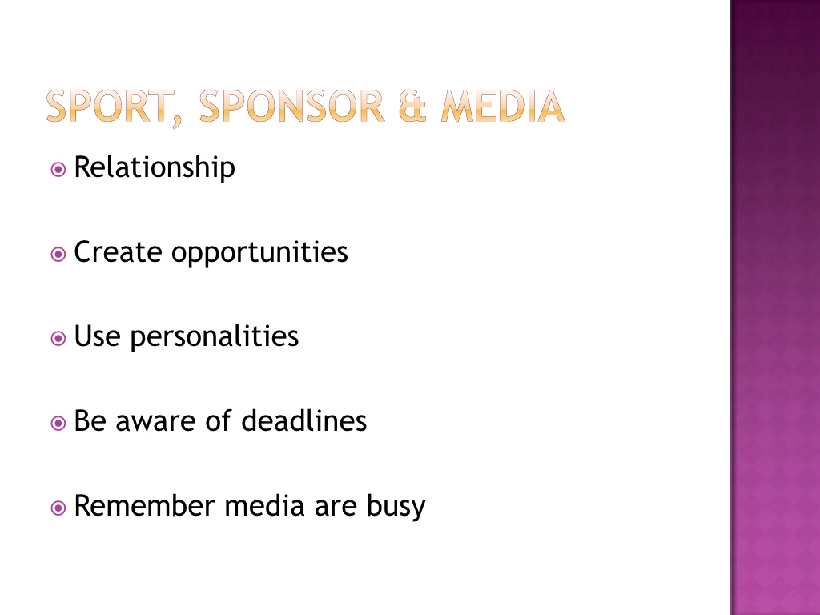

Slide 27
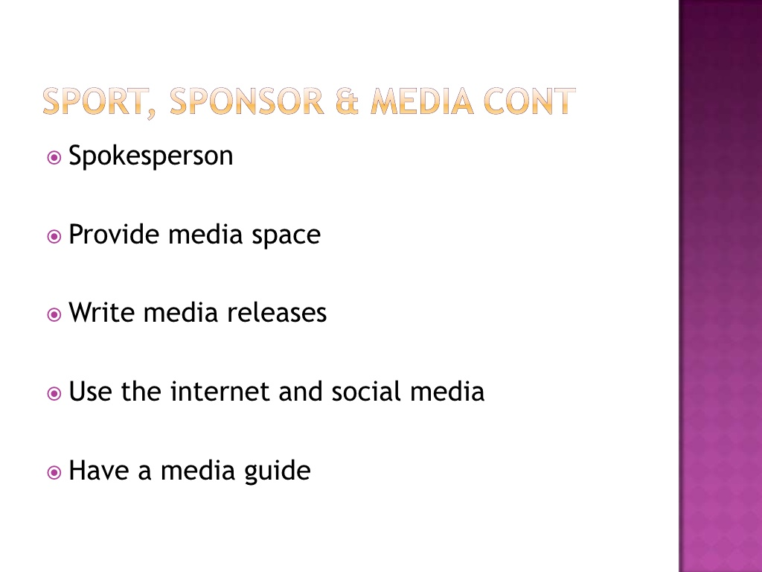

Slide 28
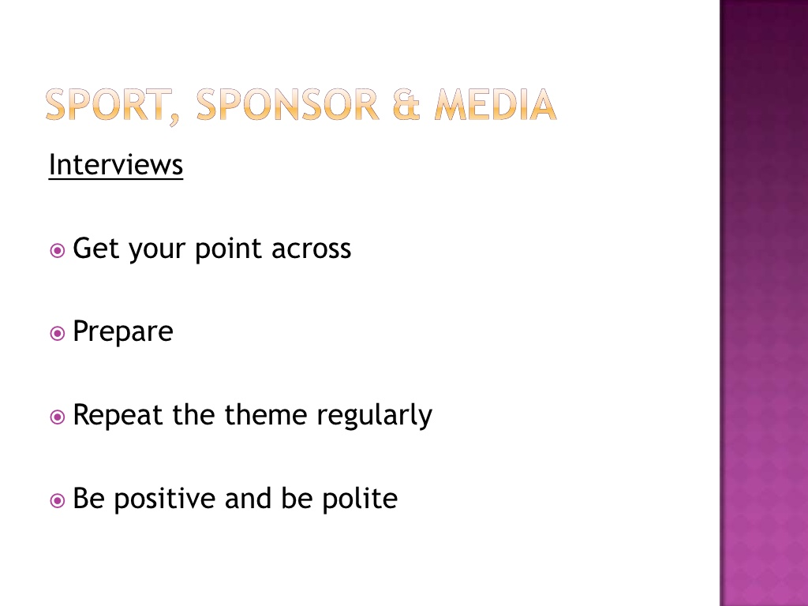

Slide 29
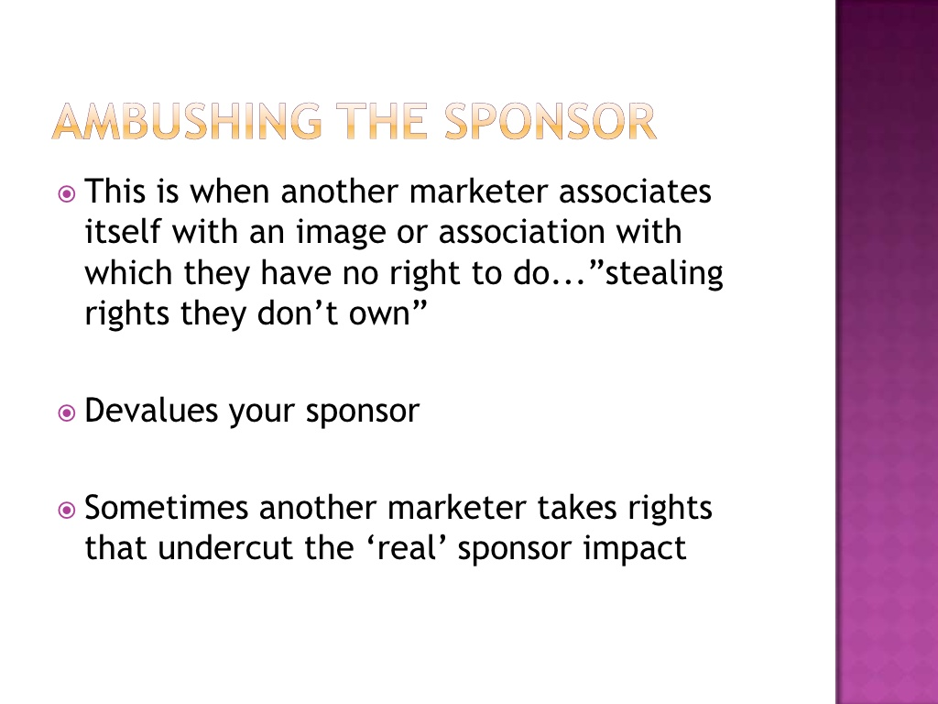

Slide 30
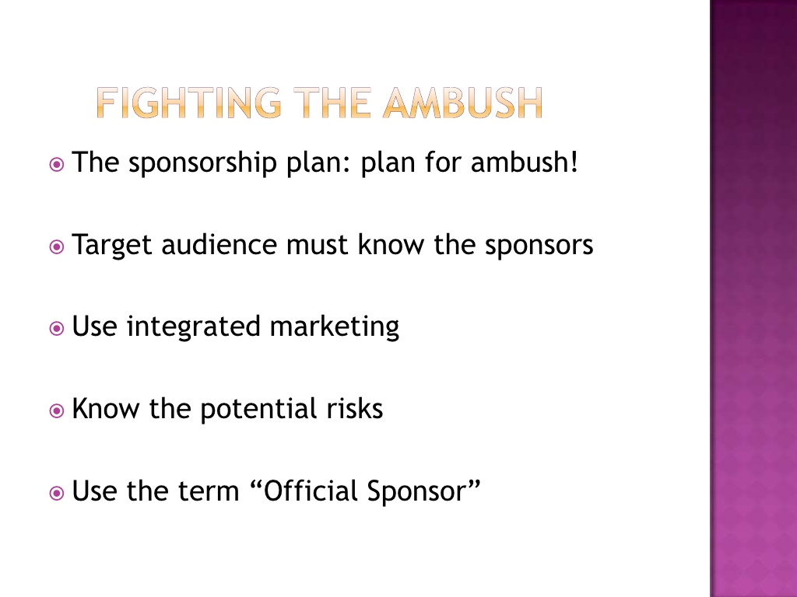

Slide 31
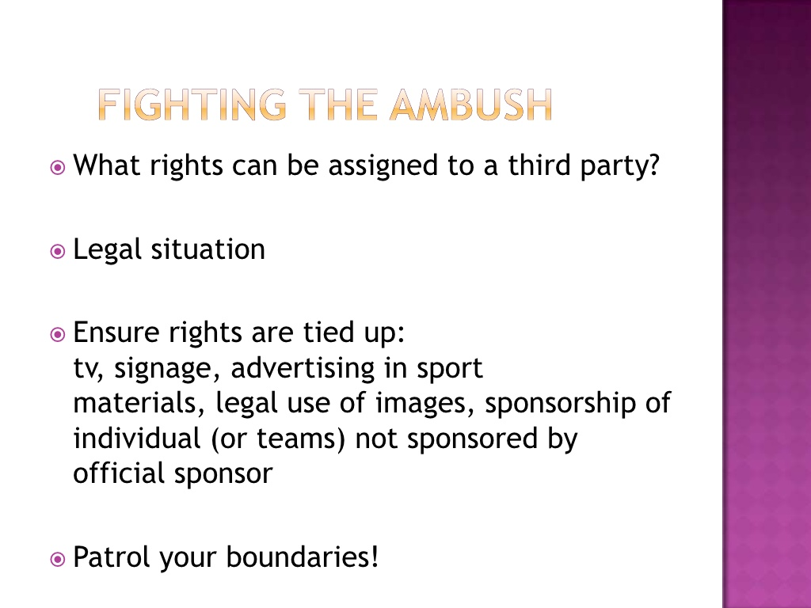

Slide 32
Resources
http://www.richardwoodward.com.au/how-to-service-sponsors-clients-effectively/
www.slideshare.net/robinmcconnell/servicing-the-sponsor

