Slide 1
Sports & Entertainment Marketing II
1.14 Employ sales processes and techniques to enhance customer relationships and to increase the likelihood of making sales

Slide 2
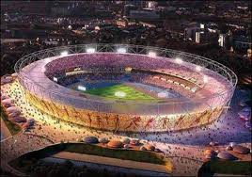
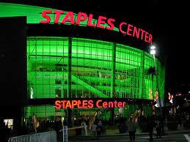
Considerations in “Selling” a Venue
The sportscape is the physical surroundings of a venue that impact spectators’ desire to attend, stay at, and ultimately return to a venue and/or event.

Slide 3
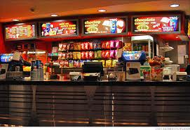
Factors that Impact the Sportscape of the Venue
Newness of the venue
Aesthetics or beauty of the venue
Seat comfort
Ease of layout
Cleanliness of venue
Perceived crowding
Adequate parking, access to public transportation
Reasonably priced concessions

Slide 4
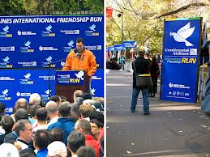
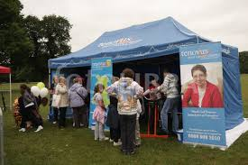
Incentives to Offer When “Selling” a Venue
Sponsor naming rights for venue
Signage and exclusive advertising
Information booths/tents (a source of sales leads)
Activity centers promoting the sponsor’s goods/services
Exclusive sales rights of sponsor’s products or services

Slide 5
Procedures to Follow when “Selling” a Venue
Emphasize:
  Sportscape of the venue
  Match-up between event’s needs and venue’s assets
  Signage promoting sponsor
  Sponsor as sole advertiser
  Naming rights given to sponsor
  Uniqueness of venue
  Ability to match sponsor’s objective’s with venue layout
  Giveaways (e.g., special seating, event apparel, VIP lounge, etc.)

