Slide 1
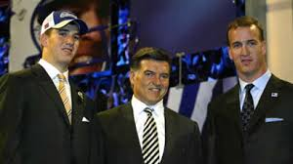
1.01 Explain the role of Agents in Sports & Entertainment
1.02 Describe legal issues affecting the marketing of Sport/Entertainment products
1.03 Discuss the impact of unions on the
S & E industries.

Slide 2
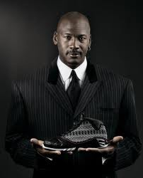
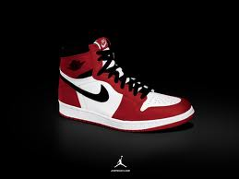
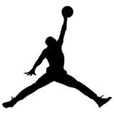
Athlete and Entertainer Issues
Athletes & Entertainers seek to make themselves a brand
  Michael Jordan created a brand image for himself.
  Ex. Air Jordan shoes, clothing, and accessories are sold in local retail stores

Slide 3
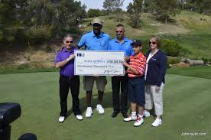
Athletes & Entertainers
Want to create an image for themselves.
Sometimes they organize or endorse charity tournaments.
To help with time, place, budget, promotion, concessions, sponsorship, prizes, etc. they hire marketing firms.

Slide 4
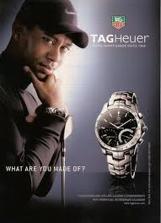
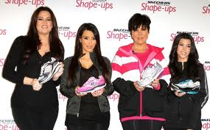
Athlete and Entertainer Issues
Consumer buying may be influenced by the endorsers of a product.
  Athletes and entertainers control what products they endorse.
  Athletes & entertainers have the ability to influence the market.

Slide 5

Athlete and Entertainer Issues
Agents represent athletes and entertainers in negotiations.
Agents understand the legal concepts behind contracts.
Agents are paid a percentage of earnings and understand the legalities of contracts.
Handlers are used to deal with difficult clients.
http://www.youtube.com/watch?v=rTbT5zHGors&feature=fvwrel
http://www.youtube.com/watch?v=qxNpnXYngLg&feature=related

Slide 6
Athletes and Entertainers
  Sports Agent 1
  Sports Agent 2

Slide 7
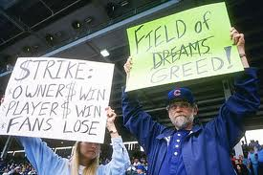
Athlete and Entertainer Issues (continued)
Contract disputes with management often result in negative connotations from the media.
Disputes affect the value and image of the athlete or entertainer.
  Ex. MLB contract disputes in the mid-90’s resulted in a player strike. It was not until the homerun race between Mark McGwire and Sammy Sosa that baseball reclaimed a substantial fan base.

Slide 8

Athlete and Entertainer Issues (continued)
Free agency allows players to explore options of moving to another team with little or no financial penalty.
  Higher player/personnel costs result from bidding wars for certain players.
Salary caps limit the amount a team may spend on contracts.
  Less profitable teams are protected from continual losses.
  A luxury tax is paid by teams that exceed the salary cap in the NBA and is split between less profitable teams.

Slide 9

Ethics
Recognizing the difference between right and wrong, then choosing what is right. Ethical decisions can be COMPLEX.
Guides how an organization behaves.
Subjective , unique to an individual– not right or wrong but pertaining to the individual situation

Slide 10

Social Responsibility
Dictates that corporations must be responsible members of society.
Companies need to be active and positive members of the community.
The goal is to embrace responsibility for the company's actions and encourage a positive impact through its activities on the environment, consumers, employees, communities, and the public.

Slide 11

Analyze Ethical Practices
&
Codes of Conduct
Organizations must be above reproach and hold themselves to high standards.
Corporations adopt Codes of conduct: regulations regarding worker conduct
Codes of conduct improve:
-public perception
-business operations
Notes:
Above reproach – meaning nobody should be able to question your actions

Slide 12
Discuss legal issues associated with marketing products.
  http://video.google.com/videoplay?docid=-6934706929798894407#
Certain products are protected from reproduction or use unless permission is granted by the owner.
Intellectual property is a person’s thoughts or creations. Protecting intellectual property is important because:
  Substantial profit is a reflection of a good idea.
  Businesses who originate an idea and protect it usually maximize profits.

Slide 13



Discuss legal issues associated with marketing products. (cont..)
Patents are granted for an invention or an improvement on a product. Patents are granted for a limited period of time.
Trademarks and service marks.
  A word, phrase, symbol, or design that identifies and distinguishes the company from others.
  Granted legal protection through the United States Patent and Trademark Office.

Slide 14



Discuss legal issues associated with marketing products. (cont..)
Copyrights are granted to creators of:
  Literary works (novels, poems, newspapers).
  Artistic works (photography, paintings).
  Broadcasts (television, radio, Internet).
  Films.
  Original musical composition.
Industrial designs apply to structural designs, aesthetics, or the look of a product.
Certification marks are used to protect and certify the way products are made. (process)

Slide 15


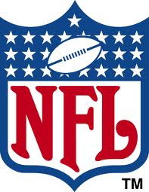

Discuss legal issues associated with marketing products. (cont..)
Collective marks are symbols used for a group or organization.
Most sports and entertainment companies need to retain legal counsel to navigate and protect their company.
The Lanham Trademark Act is designed to protect trademarks, certification marks, and collective marks.
  http://vimeo.com/5021350
Teams or leagues such as the NFL, NBA, and Duke University own their logos.
Notes:
http://dainmcquarrie.com/tag/trademark-infringement/

Slide 16

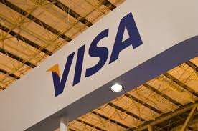
Exclusivity
  Exclusivity A right purchased by a sponsor to be the sole provider of a particular type of good or service for a sport/event

Slide 17
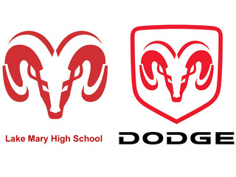
Discuss legal issues associated with marketing products. (cont..)
  Trademark Infringement – violation of the exclusive rights attaching to a trademark without the authorization of a trademark owner, meaning it is also an unfair and anticompetitive trade practice.
Notes:
http://dainmcquarrie.com/tag/trademark-infringement/

Slide 18



Discuss legal issues associated with marketing products. (cont..)
The owners of logos (Licensors) can license others to use their logo to sell merchandise.
  http://130.94.59.83/en/brandlicensing.html
Billions of dollars of merchandise are sold without licensing.
  Trademark infringement is using a trademark without authorization.
  Team owners see this as potential loss of revenue.
  May result in higher prices for legally registered merchandise.

Slide 19
Using an Athlete’s Identity
You may use their identity in a book, TV news show, newspaper, or magazine, but marketers must learn where to draw the line between freedom of expression and violations of rights of privacy or publicity.
You may not use their identity on your advertisements without their consent!

Slide 20

Sherman Antitrust Act
Federal legislation to protect industries from having one competitor that discourages competition within the industry.
MLB is the only branch of sports identified as exempt from the Sherman Antitrust Act.

Slide 21
Collective bargaining can be used in most sports with the exception of Major League Baseball.
Excludes MLB because of the Sherman Antitrust Act ruling.
Gives players the right to organize, use the agent of choice and protect themselves.
Collective bargaining agreements are agreements between players’ associations (or unions) and team ownership/management.
http://www.youtube.com/watch?v=E9KwH7zRpDU

Slide 22

Collective Bargaining
(continued)
Collective bargaining gives players the right to organize, use the agent of choice and protect themselves. Also includes:
  A minimum salary
  Player’s rights
  Medical disability insurance
  Labor rules
  Length of contract
  Restrictions of certain activities or behaviors.
  Rules for agents
  Player and team travel (CB Explained )

Slide 23
Players’ Associations
The labor unions that represent athletes and function the same as unions in other industries.
They help aid athletes in issues such as salaries, contracts, and profit sharing.
The sports’ leagues represent the owners and managers and their goals = control costs.

Slide 24
STRIKE!
When negotiations between a players’ union and the owners’ organization cannot be reached, the players might vote to determine if they should go on strike.
This leads to no revenue being generated, employees not working, and a decrease in consumer spending.

Slide 25
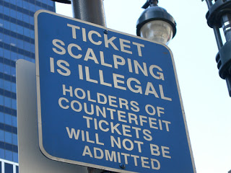
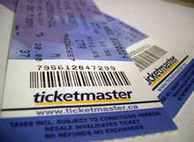
Counterfeit tickets
Fake tickets often sold by scalpers or over the Internet
Buy tickets in advance to ensure they are real and buy them from official ticket outlets.

