Slide 1
Understand product management, business law, economics, professional development, marketing-information management, information management, promotion, and selling for the sport and event industries.
Objective 1.01 A Describe the Responsibilities of a Sports Agent

Slide 2
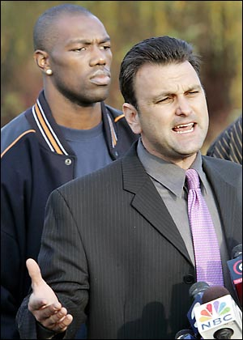
Objective 1.01 A Describe the Responsibilities of a Sports Agent

Slide 3
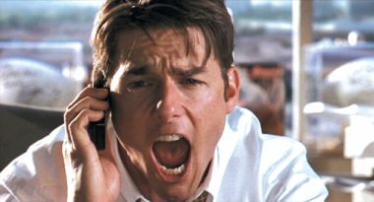
Some people have a knack for building structures. Others have a knack for building contacts and a network of friends.
If you are one of the latter and you also have an interest in sports, you may find a career as a sports agent to be particularly rewarding.

Slide 4
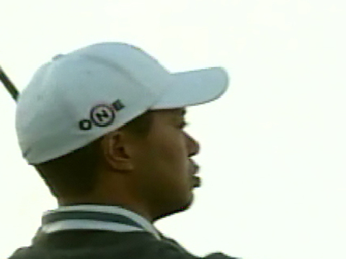
Sports agents represent the interest of athletes, particularly in contract negotiations. They also handle other matters including sponsorships, public relations, and financial planning, just to name a few of the issues.

Slide 5

Many of the top sports agents also are attorneys. Because contract negotiations are such an important aspect of the job, it is important for agents to have a legal foundation.

Slide 6

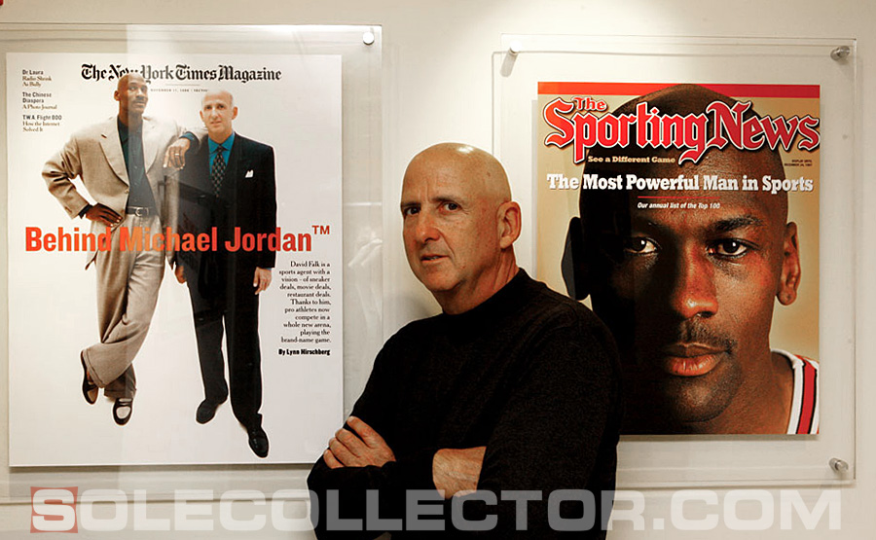
Agents who do not have a law degree may hire lawyers to review contracts. Typically leagues or players’ associations require agents to be certified in order to represent players.

Slide 7
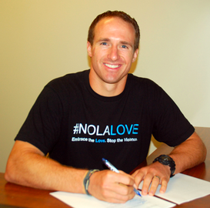
Typically the biggest responsibility for a sports agent is to negotiate a contract for the players the agent represents. With that in mind, it is important for the sports agent to understand the market for players in the sport or sports involved. The agent needs to have an understanding of what the players are worth.

Slide 8
Besides negotiating the amount of money a player is to be paid, the sports agent needs to know about other important factors for the represented player.

Slide 9
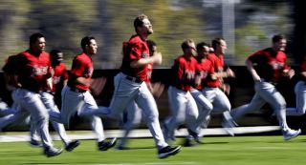
Perhaps it is important for a player to get to camp earlier—which could possibly mean sacrificing some money—in order to establish himself and be eligible for more money down the line.
Perhaps a player prefers playing in a certain city.
Or, perhaps a player finds a contract with lucrative bonuses to be an attractive motivator.

Slide 10
The agent’s job is to know the player he/she represents and craft the best possible deal for that player.
Agents also may work with the player to develop sponsorship and advertising opportunities.
Also, a high-profile player may rely on the agent, to some extent, for public relations responsibilities.

Slide 11
To carry out these responsibilities, the agent has to stay on top of all business developments in a sport.
The agent has to be aware of other players’ contracts, team needs, the approach of teams in terms of contracts, and many other developments within a given sport.
Because of this, agents have to be excellent at communication skills.

Slide 12

There is a wide pay range for sports agents, who typically receive payment as a percentage of the contracts they negotiate. That payment is usually between 3 percent and 5 percent of the contract negotiated for the player.
Some agents charge by the hour for advice, charge a flat fee, or use a combination of payment forms.
Agents annually make anywhere from $50,000 up to $1-million or more. Only 5% make more than $100,000 per year.

Slide 13
Objective 1.01 B Rules and Regulations Governing Sports Agents

Slide 14
Attorneys now make up more than 50% of all sports agents that have an active client list. With an influx of attorneys into the realm of sports agentry, what exactly are the consequences? For one, athletes will expect more out of their agents.

Slide 15

If you are an attorney you may be bound by the Model Rules of Professional Conduct. The Model Rules of Professional Conduct (MRPC) are a bunch of rules that the ABA (American Bar Association) put together in order to mandate what is permissible and non-permissible for a lawyer to do. All you have to do is offer some legal advice, and you may be bound by the ethical requirements promulgated by the MRPC.

Slide 16
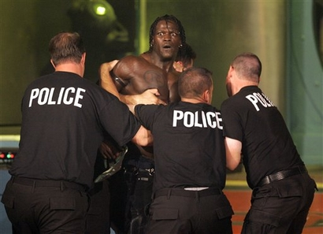
Example: Let’s say that you are an agent who runs a semi-large agency with about fifty clients. One of your clients just happens to “make it rain“,gets into a scuffle with a bouncer, and gets charged with the intentional tort of battery. The client comes to you asking what he should do in order to remedy the situation. You offer him legal advice, as slight as it may be. Welcome yourself to the world bound by the MRPC.

Slide 17
Rule 1.7, Conflict of Interest
You represent 3 athletes on the same team and these athletes are playing a sport other than baseball (the league is bound by a salary cap). A conflict of interest can clearly be established by someone bringing suit. By getting one client a certain amount of money, you are restricting the amount that the team has for your other players. The team may even have to cut those other players based on the contract you sign for said player.

Slide 18
There is a way to get around this conflict. Of course, you believe (reasonably!) that you will be able to provide competent and diligent representation to each client.
What if you represent a coach and an athlete on the same team? It may get a little more unreasonable to believe that you can represent both entities to your full ability

Slide 19
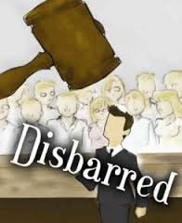
If you are bound by the MRPC and you violate any rules (there are many others that may be applicable for sports agents), you run the risk of being disciplined by the bar. Discipline may include:
o Disbarment – not permanent in most states. Re-apply usually in 5 yrs.
o Suspension – ABA recommends between 6 months & 3 yrs.
o Public reprimand – aka censure or public censure.
o Private reprimand – aka admonition. When lawyer is negligent, small injury to others, and small likelihood of repetition.
o Probation – can be stand-alone sanction, with #2-4, or as a condition of reinstatement.

Slide 20
Objective 1.01 C Advantages in Having a Sports Agent
Most sports agents have a back ground in law, which is good for the pure fact that you want an attorney on your side if you sign endorsement contracts. The contracts are usually written in such a way that the layman (ordinary person) would not understand what they were getting into.
So with the aid of an attorney that can speak, read, and understand this legaleaze, you should make out fairly well

Slide 21
Athletes earn money directly from team salaries and indirectly from product endorsements and merchandising. As an athlete, not only do you not have the time to seek out the people to set these deals up, but chances are you don't even know where to find these opportunities. Agents network for a living and have experience representing other players. They can set up all the deals to earn you money from endorsements and merchandising.
Read more: http://www.ehow.com/info_8028910_pros-cons-sports-agent.html#ixzz2rFR3QVtZ

Slide 22
Issues, such as salary negotiations, networking and self-promotion all take away time you could have spent in the gym or on the field to stay sharp or improve your skills. If you spend too much time managing your career, you may end up as a less than desirable athlete.
Read more: http://www.ehow.com/info_8028910_pros-cons-sports-agent.html#ixzz2rFQj9DV1

Slide 23
Objective 1.01 D Problems Associated with Sports Agents.
The first drawback to having a sports agent is that they make money by taking a cut of the money you earn. Additionally, there are a lot of agents on the market; with whom you sign a contract can have significant effects on your career. If you pick a bad agent, you could find yourself on worse teams with worse deals than you feel your skill deserves.
Read more: http://www.ehow.com/info_8028910_pros-cons-sports-agent.html#ixzz2rFRY9yq0

Slide 24
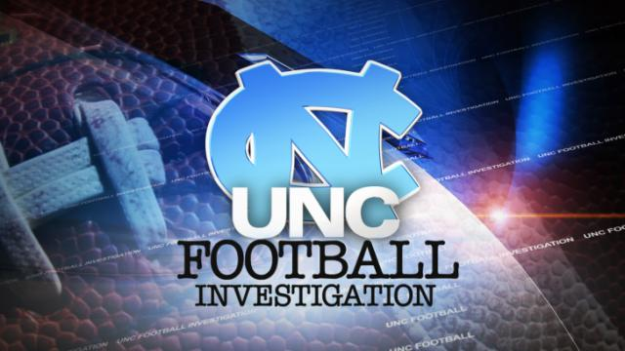
If an amateur athlete signs with a sports agent that athlete loses amateur status. If the athlete is part of the NCAA, the athlete loses eligibility to play for any college in that sport.
NCAA sanctions can be put on schools that allow a player that has signed with or accepted gifts from an agent. Those sanctions could include probation, loss of scholarships, and being ineligible for bowl games or playoff appearance.

Slide 25
Videos
http://www.youtube.com/watch?v=rTbT5zHGors&feature=fvwrel
http://www.youtube.com/watch?v=qxNpnXYngLg&feature=related
  Sports Agent 1

