Slide 1
EXPLAIN AND SELECT VENUE SIGNAGE
4.06

Slide 2
PURPOSE of SIGNAGE
INCREASES BRAND AWARENESS
  Ex: Logo signage on outfield stadium wall during televised game
Provide useful information to audience
Keep audience engaged
Increase revenue through PROMOTIONS
  Business strives to EXPOSE LOGO IN THE BEST PLACE to MAXIMIZE REPEAT OR LONG-TERM EXPOSURE

Slide 3
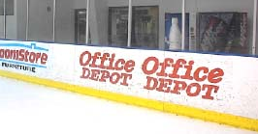
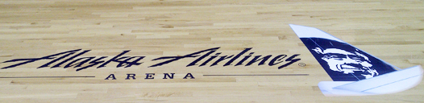
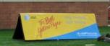
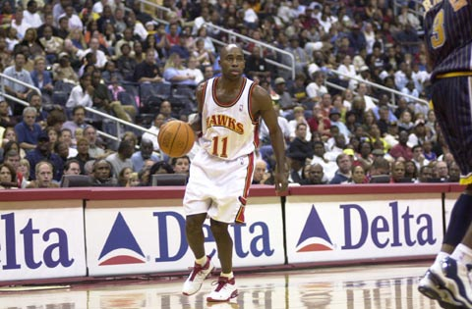
TYPES of SIGNAGE
Banners
Dasher Boards
Floor graphics
Sideline billboards
A-frames
ELECTRONIC MESSAGE BOARDS
Rotational courtside messages

Slide 4
LOCATION of PROMOTIONAL SIGNAGE
Scoreboard
Sideline
RACECARS
  Logos on the hood of a racecar maximizes logo exposure to TV and race audience
Equipment
Uniform/attire

Slide 5
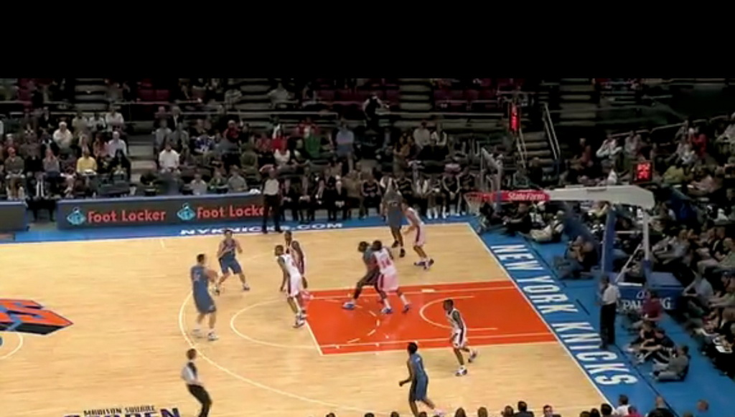
What promotional signage do you see?

Slide 6
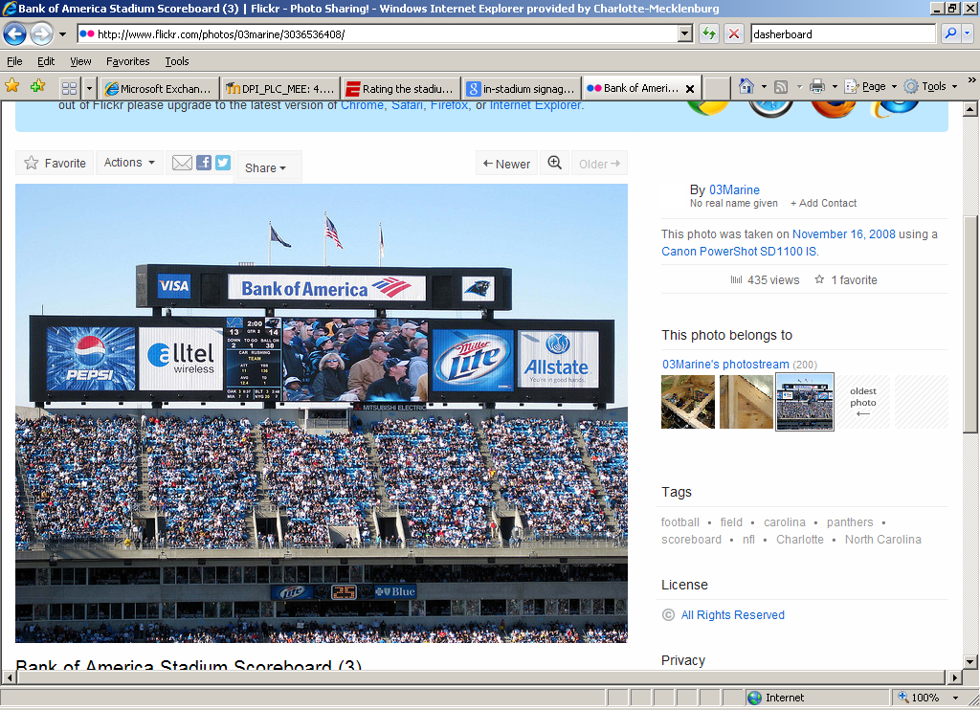
What promotional signage do you see?

