Slide 1
SEM1 3.02
A - Promotion
PE - Understand promotional channels used to communicate with targeted audiences.
PI - Explain advertising media used in the sport/event industries.

Slide 2

Define Advertising Media
Advertising:
  Any paid form of non-personal communication
  Has an identified sponsor
  Used to inform, persuade, and remind consumers about a good or service
Media:
  The form of communication
  Examples: TV, Radio, Newspaper, Online

Slide 3

Types of Advertising
Institutional Promotion:
  Designed to sell the reputation of the company or organization. Not to sell a specific product.
Product Promotion:
  Designed to sell a specific product
  or service.

Slide 4
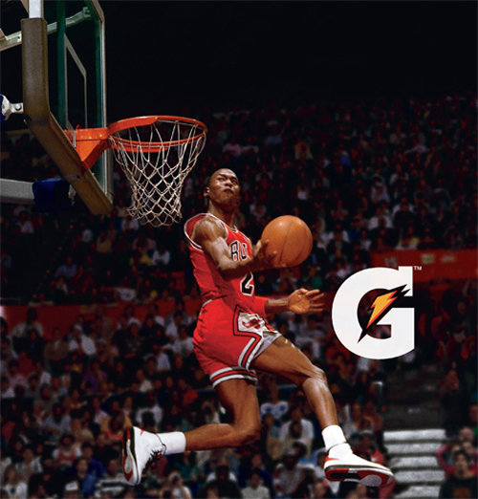
Types of Advertising
Endorsement:
  A celebrity or athlete is a paid spokesman for a product or company.
Testimonial:
  Typically a non-celebrity, that explains the advantages and positive experience they have had with a product or company.

Slide 5

Types of Advertising Media
1. Publication Media
2. Broadcast Media
3. Direct-Mail
4. Online (Web) Media
5. Out-of-Home Media
6. Specialty Media
7. “Other Promotional” Media

Slide 6

Types of Publication Media
Publication (Print) Media
  Written form of communication
Types:
  Newspapers
  Magazines
  Journals

Slide 7

Types of Newspaper Advertising
Newspapers come in many varieties such as National, Regional, City, and Local
Coupon Ad
Sale Ad
Informational Ad

Slide 8

Newspaper Advertising:
Advantages and Disadvantages
Advantages:
Low cost, quick, and easy to produce
Visual and Verbal communication
Variety of advertisement size and pricing
Reaches customers daily
Target a specific geographic market.
  Ex: Charlotte Observer and South Charlotte Weekly
Disadvantages:
Wasted circulation.
Short lifespan. Discarded shortly after reading.
Poorer color and print quality

Slide 9
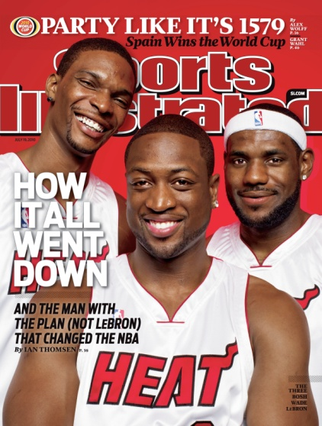
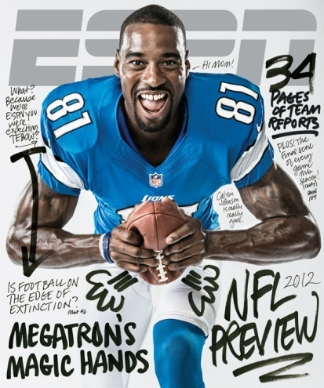
Categorize types of Magazines
Sports
News
Special Interest
Fashion
Entertainment
Travel and Leisure
Educational
Regional
Comic
Home and Garden
Animals
Shopping
Fitness
Health

Slide 10
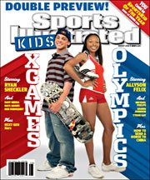

Magazine Advertising
Advantages and Disadvantages
Advantages:
Wider circulation.
Readers tend to keep magazines for a long time.
High quality color and pictures
Target market based on demographics.
  Ex: Sports Illustrated for Kids
Target market based on interests. (Psychographic)
  Ex: Golf Digest
Disadvantages:
Professional Preparation needed - raising the costs
Lengthy preparation times - information is less timely
Expensive

Slide 11

Types of Broadcast Media
Broadcast Media is any visual or auditory form of communication.
Types:
- Radio
- Television
- Satellite Radio

Slide 12
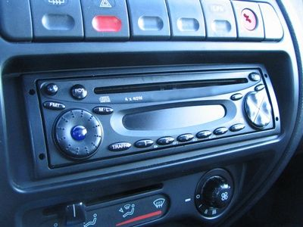
Radio Advertising:
Advantages and Disadvantages
Advantages:
Consumers listen in cars, home and at work
Low costs
Short preparation time
Target specific geographic markets
Target specific demographic markets
Ex: Spanish-speaking stations
Target specific psychographic markets
Ex: Sports, Country, Top 40
Disadvantages:
Does not provide a visual impact
Message has short lifespan
Commercial Clutter
I-pods, I-pads, E-books, Cell phones . . . Who is listening to radio?

Slide 13
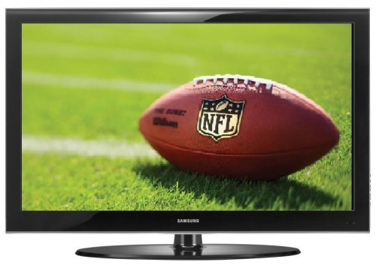
Television Advertising:
Advantages and Disadvantages
Advantages:
Consumers are reading less, and watching more.
TV Ad show accurate color and details in HD!
The product is seen in “action.”
National Ads reach an extremely large audience.
  Ex: During the Super Bowl
Local and Regional channels allow for target marketing.
  Ex: Fox Sports South, Charlotte’s News Channel 14
Interest specific channels allow for target marketing.
  Ex: The Big10 Network, NFL Network, Food Network
Disadvantages:
Very High Costs
Message has short lifespan
Lengthy productions times

Slide 14
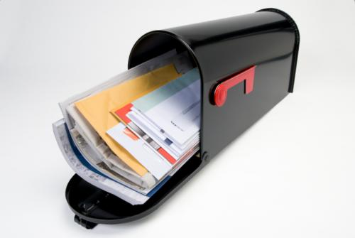
Types of Direct-Mail Advertising
Direct Mail: Advertising that is distributed directly to the potential consumer through the mail.
Types:
Personalized Letters
Catalogs
Brochures
Coupon Mailers
Company Newsletters
Postcards
Invitation Letters
Awards and Prize Letters
Bill Enclosures
Offers and Sales

Slide 15
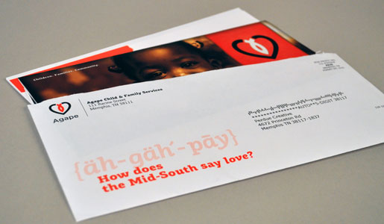
Direct Mail Advertising:
Advantages and Disadvantages
Advantages:
Little wasted circulation
Can be very cost effective
Target market can be segmented in many ways
  Customer Specific
  Personally address the customer
Results are easy to measure
Disadvantages:
Can be considered “junk mail”
Increasing cost of postage

Slide 16

Explain Advertising on the Web
Advertising messages that appear on the internet.
Banner Ads
Pop-up Ads
Email Ads
Commercials (Before watching a video online)
Roll-over
Social Media

Slide 17

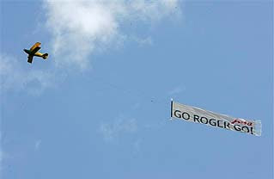
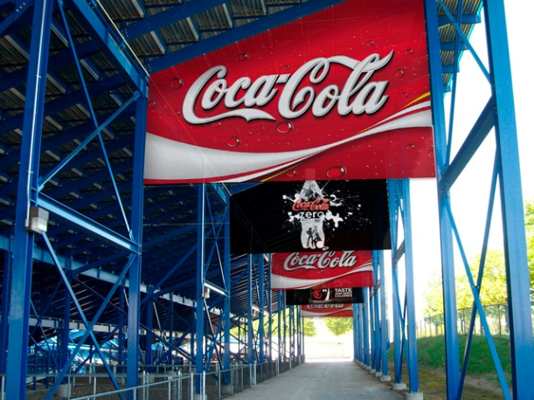
Types of Out-of-Home Media
Any type of message that reaches the customer outside of their home.
Types:
Signs
Billboards
Public Transit
Airplane Banners
Stadium Signage

Slide 18
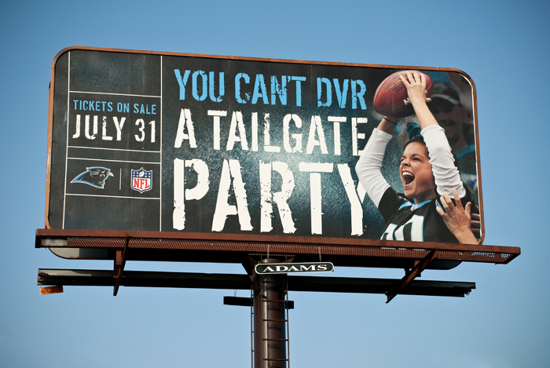
Out-of-Home Advertising:
Advantages and Disadvantages
Advantages:
Repetitive Viewing.
Target specific geographic area.
Exposure 24/7.
Disadvantages:
Only a short message.
  - Due to low exposure time.
Limited segmentation.

Slide 19
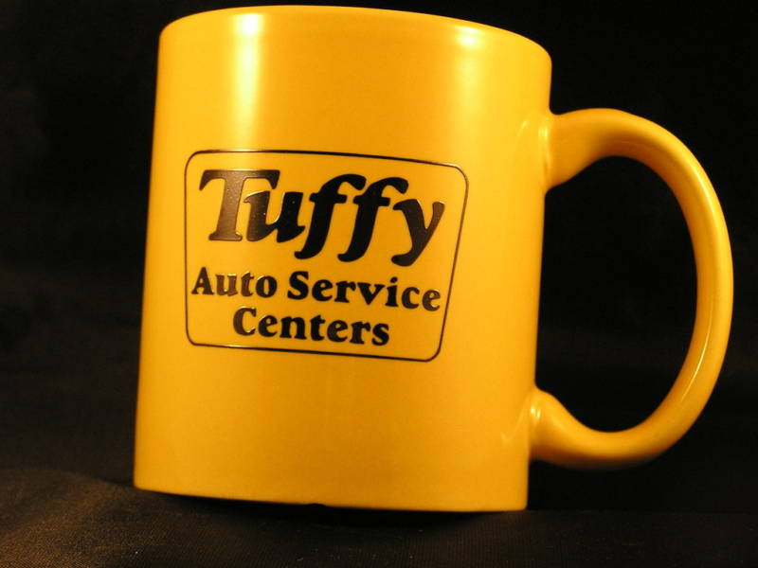
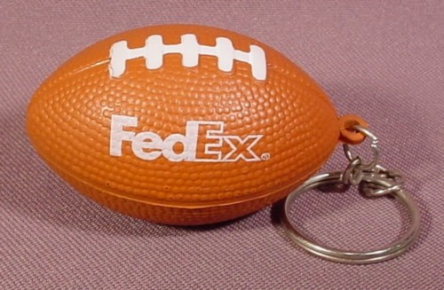
Types of Specialty Advertising
Promotional messages on everyday items.
- Typically inexpensive.
Wide Variety of forms:
  Pens/Pencils
  Coffee Mugs
  Key Chains
  Hats
  T-shirts
  Bags
  Calendars
  Sports Equipment
  http://www.qualitylogoproducts.com/lib/20-weirdest-promotional-products.htm

Slide 20
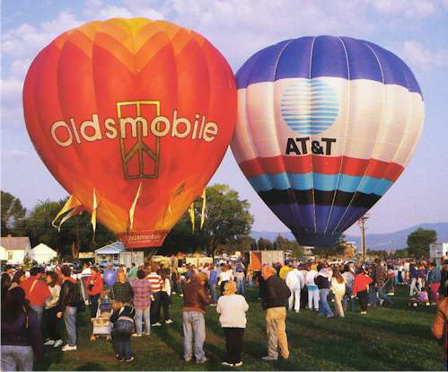
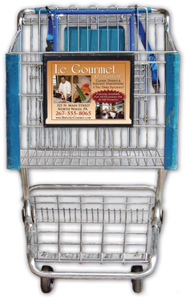
Examples of “Other Promotional” Media
http://neadcorp.com/vid/
  Grocery store carts
http://www.adventureballoon.com/advertising.htm
  Hot air balloons

Slide 21
“Other Promotional” Media
advantages
disadvantages
Reach target market in a friendly, casual manner
Low cost per contact
Market segmentation use is very good
Customization
Message is ignored
Consumers are not focused on your subject matter
May not be your target market consumers
Lack of good method to measure effectiveness

Slide 22
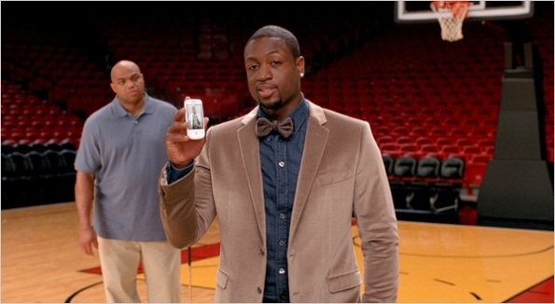

Trends in Advertising Media
Social Media
  Twitter and Facebook advertising
Advertising on sports uniforms
  NBA just approved for 2012-13 season
Commercials before YouTube Video

