Slide 1
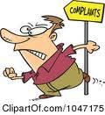


SEM1 1.08 A - Customer Relations
PE - Resolve conflicts with/for customers to encourage repeat business
PI – Handle difficult customers
PI – Handle customer/client complaints

Slide 2


Define the term complaint
Complaint is a customer’s dissatisfaction expressed orally, silently or in writing
  Some customers actually express the true reasons
  Others do not tell the real reasons
    These customers normally conceal the real complaint by stating another believable, but secondary, reason for the dissatisfaction
    Example:
    Customer returns a pair of shoes due to the color of the shoe but the real reason was the high price
    Salesperson must skillfully question and inspect the product to discover the real complaint

Slide 3


Identify the costs associated with customer complaints
Loss of sales – present and future
  One dissatisfied customer may tell 10 other potential customers
Damaged image – store, product & sales personnel
Additional recordkeeping and paperwork-equals TIME
Markdowns on returned goods – ½ of returned product is sold but at a reduced prices
Increased interest payments – companies must borrow money to buy goods, more time means less profit

Slide 4
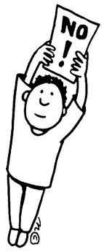


Identify the reasons for customer complaints
Some complaints are justified, while others aren’t
3 major reasons/areas of customer complaints
  Products - poor quality, improper labeling or improper buying decisions
  Personnel – high pressure, rudeness, insufficient product information, inaccuracy or unsatisfactory service (make sure you determine customer needs and wants)
  Business – Number and type of services offered (refusing to accept a credit card) or refusal to accept a return due to policy

Slide 5


Describe the benefits of customer complaints
Goodwill
  Properly settling complaints will promote goodwill (positive feeling towards the business)
Increased sales
  Opportunity to satisfy
  May make additional sales
  Repeat customers and may tell others
Buying information
  Use previous complaint information to prevent future complaints

Slide 6

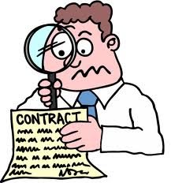
Explain the importance of appropriately handling customer complaints
Should be immediate
Should be effective
Should offer customer satisfaction
Should follow company policy
Should follow company procedure

Slide 7



Demonstrate procedures for handling customer complaints
Develop company procedures
  Step by step
    Listen for the reason of the complaint
    Thank the customer
    Restate the complaint
    Investigate the problem
    Explain company policy
      “Not company policy” is NOT an option
    Take action
      Satisfy the customer!

Slide 8

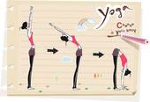
Explain procedures for handling customer complaints
Develop company policy
  General rules followed by personnel
  Avoids misunderstandings
  Apply fair & consistent treatment of customers
  Policy goals should be fair and targeted towards customer satisfaction
Develop consistent yet flexible company policies
  Management decisions
  Sales personnel decisions

Slide 9
WHEN HANDLING COMPLAINTS A
SALESPERSON MUST REMEMBER:
Take action based on the solutions that are possible within the business's policies
Prevent customer complaints by accurately determining each customer's needs
  Suggesting appropriate products to meet those needs
General Steps to successfully handling a customer complaint
  Salesperson must fully understand a customer's complaint
  Decide if the complaint is justified
  Investigate the problem to determine how the situation can be handled within company policy
Notes:
9

