Slide 1
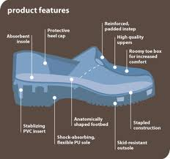
SEM1 1.05 A - Selling
PE - Acquire product knowledge to communicate product benefits and to ensure appropriateness of product for the customer
PI – Determine sport/event features and benefits
PI – Describe factors that motivate people to participate in/attend sport/events

Slide 2
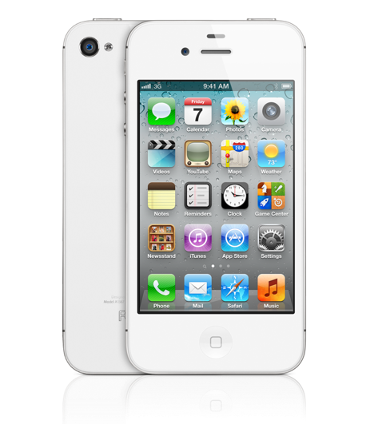
What do you see?

Slide 3

What do you see?

Slide 4
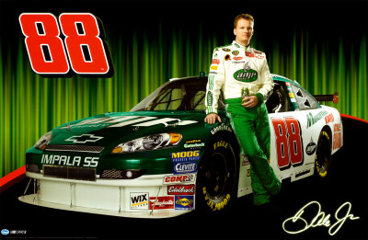
What do you see?

Slide 5
Feature and Benefit
Feature:
  Describes an actual part of a product or service
Benefit:
  Describes how a product or service will directly offer a user a solution
  Answers the question “What’s in it for me?”
  For every feature, there should be a corresponding benefit for a consumer

Slide 6
Define and Identify:
Obvious Benefits and Unique Benefits
Obvious Benefits:
  Easy to recognize
    Example: Alloy Rims vs Factory Grade – Status Symbol
    Example: 4G – Connectivity Availabiltiy
    Example: NASCAR- 200+ MPH wins races!
Unique Benefits:
  Specific to the product or service
    Example: Iphone 4S “Suri” – Handsfree
    Example: Victoria Beckham Edition – Exclusive style
    Example: NASCAR – Safety seats – Specially made for the driver

Slide 7
Define and Identify: Hidden Benefits &Feature Benefit Selling
  Hidden Benefits:
    Implied but not obvious
    Example: Hybrid Cars = Better gas mileage
    Example: Sketchers Shape-Ups = Ergonomics
    Example: NASCAR – Provided research for automobile creation and innovation
    Feature Benefit Selling
    Providing product features to satisfy consumers by offering them a benefit they need or want

Slide 8
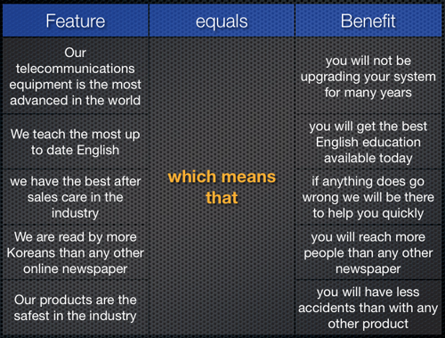
Feature-Benefit Chart

Slide 9
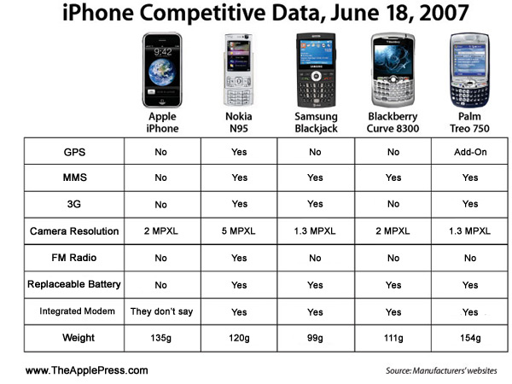
Feature-Benefit Chart Example

Slide 10



Identify sources of feature/benefit information
Consumer Reports
Company Websites
Angie’s List
Blogs
Government Websites (ie: FDA)
Social Media
Twitter

Slide 11

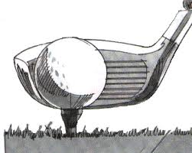
Distinguish between features and benefits for services versus those for tangible sport/event products
Service
Product
Example: Sports Spa/Gym
  Features: Massages, Yoga Classes, Weight lifting classes
  Benefits: Better health, fewer injuries, better performance
Example: Golf Clubs
  Features: Loft, weight, graphite vs. steel, woods vs. irons
  Benefits: Control, durability, backspin, low score

Slide 12
Describe how to prepare a feature-benefit chart for a product
Identify each feature
Align each feature with benefit(s)
  Keeping in mind your target market/customers

Slide 13

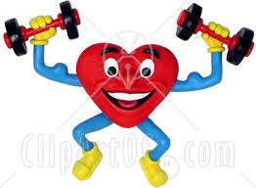

Explain the importance of understanding why people participate in/attend sports/events
Target marketing – help to key on your customers
Assist in market(ing) planning – where to market
Economic analysis
Health

Slide 14



Describe techniques for identifying sport/event motivators
Surveys
Social Media
Blogs
Face to face
Blind sampling
Focus groups
Promotions

Slide 15


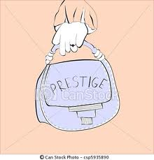
Describe ways that salespeople can use sport/event motivators to sell products
Sample
Discounts
Testimonials
Endorsement
Exclusive
Prestige
Patronage

Slide 16
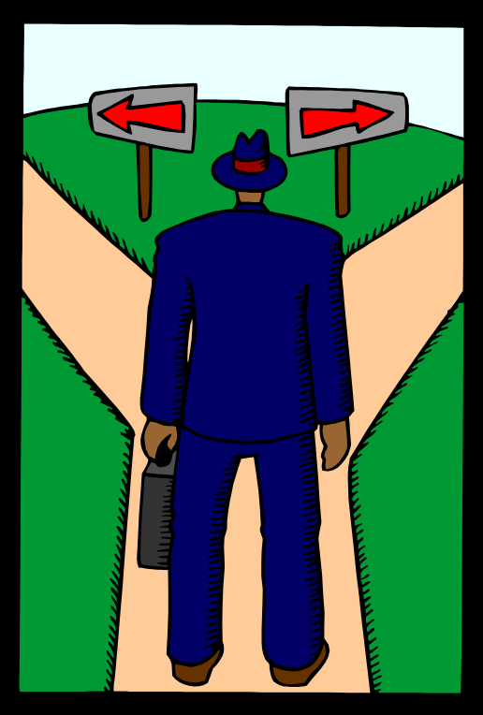
1.05 Analyze Factors that Influence the Consumer’s Decision-Making Process.

Slide 17
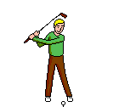

Distinguish between Spectator and Participant consumers.

Slide 18
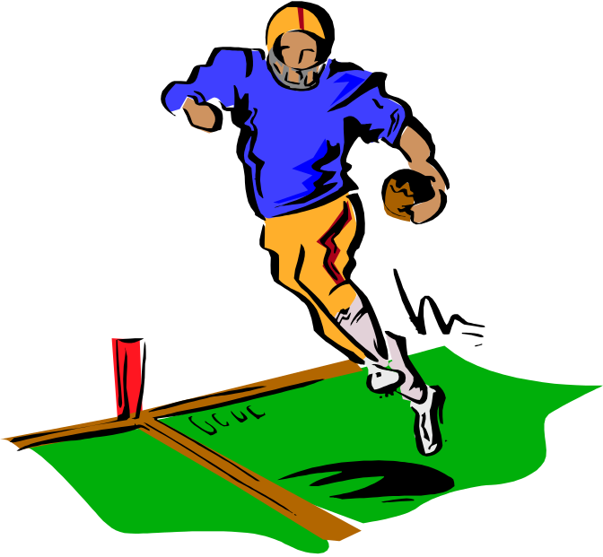
Spectator Consumer
Observes an event for entertainment
Example: Friends attend a Carolina Panther’s game.

Slide 19

Participant Consumer
Is actually involved in an event.
Example: Mrs. Is plays in a community softball league.

Slide 20


Factors that influence spectator and participant consumer’s decision-making process
Intrinsic factors: personal reasons for attending an event
Attitude or personal preference
Perception of the event
Spectator consumer example: Sue had a stressful week and needed a diversion. She went with friends to a UNC-Wilmington basketball game.
Participant consumer example: John likes playing tennis because he enjoys the game and can demonstrate his extraordinary skills.

Slide 21


Consumer Decision
Making Process
Extrinsic factors: other influences on a person’s decision to attend an event.
These factors include:
1) People
2) Situations
Spectator consumer example: Mary’s grandparents are visiting from out of town. They would like to see the new soccer complex in Greensboro, so she takes them to a game.
Participant consumer example: Tom and Robin belong to the local country club and share similar lifestyles with their neighbors. They play golf at the club because they like being seen in public with their friends.

Slide 22


Consumer Decision
Making Process
Occasional factors: rare or special reasons to attend an event.
  Location
  Time of the Event
  Weather
  Spectator consumer example: While visiting Myrtle Beach, Shannon chooses to attend Carrot Top’s performance at the Alabama Theater
  Participant consumer example: Luke’s friend is in town and loves to play racquetball. Luke does not play the sport but attempts to play anyway.

Slide 23

Levels of Consumer Motivation
Uninformed
Informed
Preference
Action

Slide 24


Uninformed
Consumers are unaware of the product’s existence.
Promotional objective: to inform the consumer about features and benefits of the product.

Slide 25

Informed
Consumers become aware of the products existence.
Promotional objective: inform the consumer about features and benefits of the product.

Slide 26

Preference
Consumers identify with a particular product.
Promotional objective: to create goodwill and differentiate the product from others.

Slide 27

Action
Consumers make a purchase.
Promotional objective: reinforce the buying decision.
The desire to attend an event must be translated into the purchasing of tickets.

