Slide 1
1.01
Acquire information about the sport/event industry to aid in making career choices

Slide 2
TERMS TO KNOW
SPORT MEDIA: Any sporting event or news broadcasting through a media outlet
  Baseball game broadcasted on the radio
SPORTING GOODS: Equipment and Apparel essentials to the sport event itself
  Football
NON-SPORT EVENT: Any event that does not incorporate sports
  Plays, concerts, festivals

Slide 3
Sport Industry
Attracts what TYPE OF MARKETS
UNIQUE
INCLUDE BOTH SPECTATORS AND PARTICIPANTS
  Consumers of sports products can participate in AND view a wide range of sports
    Example: Football
      FANTASY
      Attend a Pro Game
      Flag Football

Slide 4
Major Characteristics of SEM
Provides PRODUCTS THAT ARE DIFFERENT FOR EACH CONSUMER
  Industry is UNIQUE because of the type of products it produces
    In most cases, the PRODUCTS ARE PRODUCED AND CONSUMED AT THE SAME TIME because they are activities or games
      Example: Baseball game (losing team fans vs. winning team fans)

Slide 5
CORE BENEFITS to Customers who Purchase Sports Products
ENTERTAINMENT
HEALTH
ACHIEVEMENT
  Industry is UNIQUE:
    Appeals to variety of people for many different reasons
  Example: Playing Sports
    Entertaining for what type of athlete?
    Healthy for what type of athlete?
    Provides achievement to what type of athlete?

Slide 6
Types of Businesses in SEM
  Franchises
  Advertising
  Sporting Goods
  Media
Notes:
Kaser, K. & Oelkers, D.B., (2001). Sports and entertainment marketing [pp. 9,
14-17, 18-22]. Mason, OH: South-Western

Slide 7
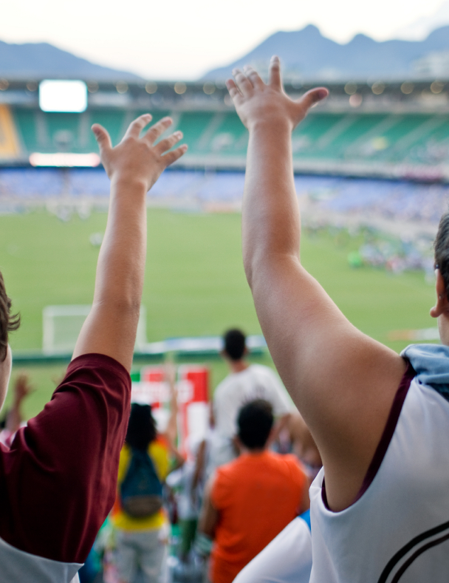

Sports

Slide 8
Sports SEGMENTS
Professional Teams
Professional Individual Sports
Amateur Sports
  AAU (Amateur Athletic Union)
Collegiate Teams

Slide 9
VENUES
  Professional Team Venues/Stadiums
  Health Clubs
  Recreation
    Example: Parks, aerobics, playing ball in neighborhood
  Camps

Slide 10
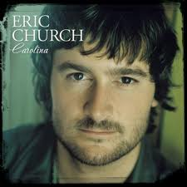
Entertainment and Events

Slide 11

ENTERTAINMENT SEGMENTS
Music
  Ex: Mosley Music Group
Movie
  Ex: Warner Brothers, Actors
Theme Parks
Radio
Television

Slide 12

ENTERTAINMENT INDUSTRIES
Dramatic Arts
  Plays, stand-up comedy
Video Game
Fine Arts and Science
  Museums, Discovery Center
Literacy
  Library, Internet (Amazon.com)
Casinos

Slide 13
ECONOMIC IMPACT and SEM

Slide 14
FINANCIAL/ECONOMIC IMPACT
FISCAL IMPACT: Government Revenue generated from hosting an event
  Sales Tax, Food-Service Tax, Parking Fees
DIRECT IMPACT:
  Expenditure * Number of visitors * Nights of event
INDIRECT IMPACT:
  Direct Expenditures PER INDUSTRY (Food, etc.)
Total Impact:
  Direct + Indirect

Slide 15
SEM Contributes to ECONOMIC
GROWTH IN COMMUNITIES
  More job creation
  More tourism
  More consumer spending
  More money for local businesses
Notes:
Kaser, K. & Oelkers, D.B. (2001). Sports and entertainment marketing
[pp. 30, 36-37]. Mason, OH: South-Western.
Kern, W.S. (2000). The economics of sports [chapter 1]. Retrieved Aug 23, 2010 from http://www.upjohninst.org/publications/ch1/kern-sports.pdf
Pic: http://de.academic.ru/pictures/dewiki/67/CamdenYards_2005-05-08.jpg

Slide 16

SEM Contributes to ECONOMIC GROWTH in COMMUNITIES
ATTRACTING TOURIST DOLLARS
Increase in local business
Increased TAX revenue (FISCAL)
Teams draw huge crowds of fans
  Many come from out of town
  Stay in hotels
  Eat at local restaurants

Slide 17
SEM Contributes to ECONOMIC GROWTH in COMMUNITIES
INCREASED JOB CREATION
  New team/event= needs employees
    Example: Sales personnel, facility maintenance.
More employment means more people are spending money= MORE CONSUMER SPENDING

Slide 18
Factors Contributing to the
GROWTH of SEM
  Increase of participants in the industries
  Increase of followers/spectators/attendance
  Increase of media coverage
  Internationalization/ Globalization
Notes:
Lindauer, Chris. "History and Evolution of SEM." sportscareerconsulting.com. Sports Career Consulting, 17 Dec 2005. Web. 20 Aug 2010. <http://www.sportscareerconsulting.com/request.php?772>.

Slide 19
Negative Impacts of SEM on Community
  DIVERT RESOURCES FROM OTHER PRIORITIES
                -Ex: (education, roads, public safety)
  Community can be "held hostage" by a team
Notes:
http://www.chriscreamer.com/images/logos/6/256/full/3097.gif

Slide 20
Trends
  Organizational Control of Athletes
  Globalization
  BRANDING
  New Medias
Notes:
Kayhle, Lynn. "Sports And Special Events Marketing." Marketing Power. American Marketing Association, 2007. Web. 20 Aug 2010. <http://www.marketingpower.com/Community/ARC/Pages/Connections/SIGs/SportsandSpecialEventsMarketing/Trends.aspx>.
Pics: http://www.strayboots.com/userfiles/image/espn_logo(1).jpg
http://shanebaiotto.com/images/logos_images/logo_full/nfl.gif

