Slide 1
4.00
Acquire a foundational knowledge of promotion to understand its nature and scope
4.01A Explain the role of promotion as a marketing function

Slide 2
Define the term promotion
Promotion is a marketing function needed to communicate information about goods, services, images, and/or ideas to achieve a desired outcome.
It is the element of the marketing mix that encourages customers to buy or have certain views or opinions

Slide 3
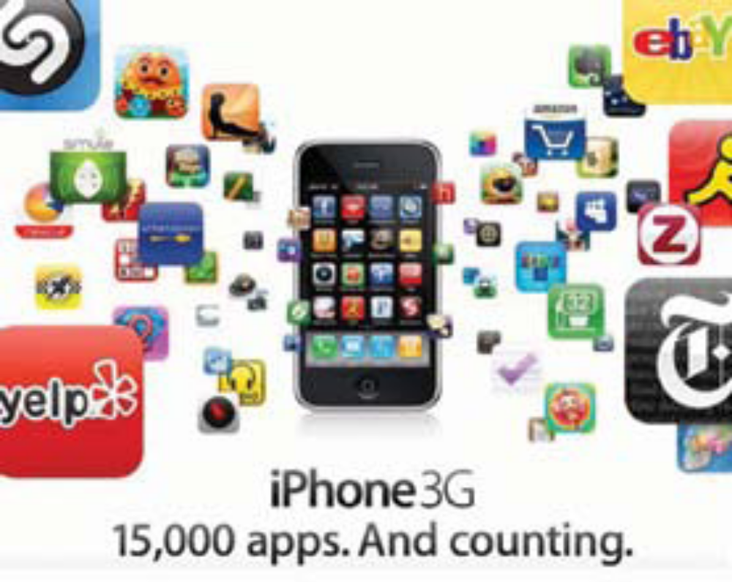
Apple is promoting numerous types of applications that appeal to the teen market
For the under-20’s crowd, cool is all about the technology

Slide 4
Who uses promotion?
Any organization that has something to sell uses promotion at one time or another.
  Large and small businesses
  Government agencies
  Special interest groups
  Producers
  Intermediaries
  individuals

Slide 5
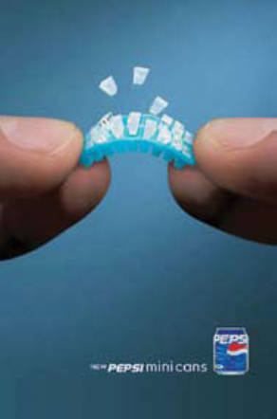
Who uses promotion?
Businesses that sell gaming systems, MP3 players, shoes, cars, and soft drinks rely heavily on promotion.
They develop creative promotions to reach a wide audience and sell their products
This results in the familiarity of the product.

Slide 6





What companies are these?

Slide 7
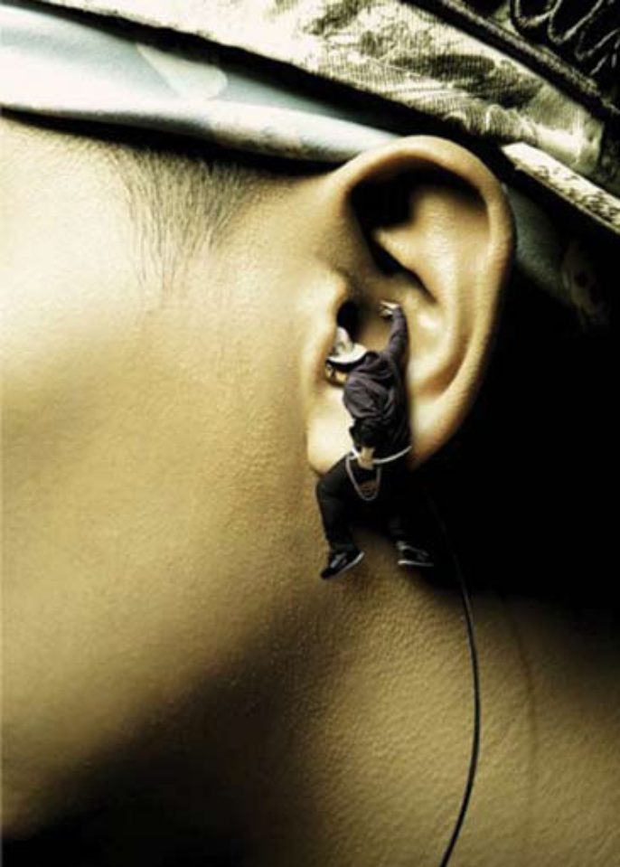
Characteristics of effective promotion
Persuasive
Relevant
Appropriate
Factual
Repetitive
Coordinated

Slide 8

Benefits of using promotion
Increased Sales: the most obvious way businesses benefit from promotion
  Promotion is used to spread the word to customers and to convince them to buy
Strong position: used to position the company the way they want customers to see them
Increased customer loyalty: want customers to identify with images projected through promotion .
  AEO and Hollister project an image of style and fashion.

Slide 9
Benefits of using promotion
Increased product/company awareness: helps customers learn that products exist and where they are available
Better informed, more satisfied customers: happens when businesses promote product benefits, features and prices
Increased employment opportunities: benefits the economy by providing job opportunities
Increased media support: helps to pay for mass media – TV, radio, newspapers, magazines, Internet, etc

Slide 10
Costs associated with the use of promotion
Some are free or nearly free – issuing a press release about a new or improved product
Advertising fees
Costs for sales promotions
Contests, salaries
Considering the costs ahead of time helps marketers to create reasonable promotional budgets

Slide 11

Types of promotional objectives
Inform
  Communicate important information about new or improved products
Persuade
  Competitive products
  Company image
Remind
  Established products
  Established companies

Slide 12
Relationship of promotion and marketing
Promotion can be described as marketing communication
  It sends a marketing message to a target audience
A business communicates a message to the customer – inform customer about goods, services or ideas – persuade them to buy – customer gives feedback by buying or not buying

