Slide 1
3.02 Position products/services to acquire desired business image.
Marketing

Slide 2
Define:
Competitive Advantage – the set of unique features of a company and its products that are perceived by the target market as significant and superior to the competition.
Positioning – developing a specific marketing mix to influence potential customers’ overall perception of a brand, product line or organization in general.

Slide 3
Describe the purpose of positioning.
Marketers use positioning to find a place for the product in the marketplace and to distinguish the product from competitors.
The actual position is how the customers see the product. The positioning and the actual position of the product are the same, if marketing has been successful.

Slide 4
Relationship between the target market and positioning
The objective is for marketers to position their products to appeal to the desires and perceptions of a target market.

Slide 5
Relationship between the competition and positioning.
It is important to use positioning to your advantage. You want to position your product so that customers will continue to purchase from you rather than the competition.
The pricing, promotion, product development, and distribution strategies are all planned with an eye toward the competition.

Slide 6
Market Position
unique image of a product or service in a consumer’s mind relative to similar competitive offerings.

Slide 7
6 common bases for positioning:
Attribute- one way of positioning a product is to highlight a product feature or attribute.
Price and Quality – this position strategy may stress high price as a sign of quality, or emphasize low price as an indication of value.
Use or Application – stressing unique uses or applications can be an effective means of positioning a product.

Slide 8
6 common bases for positioning:
Product User – this positioning strategy encourages use of a product or service by associating a personality or type of user with the product.
Product Classification – when positioning according to product class, the objective is to associate the product with a particular category of products.
Competitor – sometimes marketers make an effort to demonstrate how they are positioned against the competitors that hold a strong market position.

Slide 9
Positioning strategy
Outlines how a company is going to present its product or service to the consumer and how it will compete in the marketplace.

Slide 10
Positioning strategies usually revolve around three major areas:
Consumer perception – are the images consumers have of competing goods and services in the marketplace.
Competitors in the marketplace – The ideal situation are when consumers perceive a business’s products to be superior to its competitors’ products or services.
    A great deal of marketing efforts is used in competitive positioning.
Changes in the business environment – organizations need to be aware of changes in the business environment that might effect the position of their products or services.
    This includes new products, changing consumer needs, new technology, negative publicity, and resources availability.

Slide 11
3.02 – Continued

Slide 12




Characteristics of a good brand name.
The name should:
  Describe the product’s benefits and uses
  Be easy to read, pronounce, and remember
  Create appealing images
  Be distinctive
  Be adaptable
  Be legally available for use
  Be appropriate for packaging and advertising

Slide 13
Levels of Brand Loyalty
Brand Recognition – is when consumers become aware of a brand and know a bit about it.
Brand Preference – when consumers prefer to purchase a certain product brand based on their positive experience with the brand.
Brand Insistence – when the consumer insist on “their” brand and will not accept substitutes.

Slide 14
Types of Brand Strategies
Brand Positioning – means the way consumers see the brand as compared to a competitive brand.
Brand extension – in which an existing brand name is used for a new or improved product line. Starbucks extends its coffee line to include ice cream and candy bars.
Brand licensing - allows one company to use another’s brand name, logo, or character for a fee.
    For example, Tommy Hilfiger may let them use his name on jewelry or perfume.
Co-branding. – occurs when companies join forces to increase recognition, customer loyalty, and sales of both brands.
    For example, KFC and Pizza Hut in the same building, etc. It benefits both companies and increases their profits.

Slide 15
Describe considerations for International Branding
Marketers must research their brands to determine whether they would be acceptable in different countries.
    How would the brand be pronounced in Italian, Spanish, German, etc.
    Is the brand name a culturally taboo in certain areas of the world.

Slide 16
Explain the Impact of the Internet on Branding
If a company wants its brand to be successful it must have a web presence.
Most companies must determine what URLs are available. They need to search out or create URLs, and web addresses that represent their brands.
It is also more common for companies to promote their product using social media sites such as Facebook and Twitter to keep up with consumers of a younger demographic.

Slide 17
Discuss employees’ Role in Branding
It is important for employees to take an active role in the branding process. Employees are the “face” of the company. Most customers interact with the employees. The interactions with the company help shape their opinions of the brand. The company needs to promote its brand image to the employees so the employees can live the brand vision and promote it to customers.

Slide 18
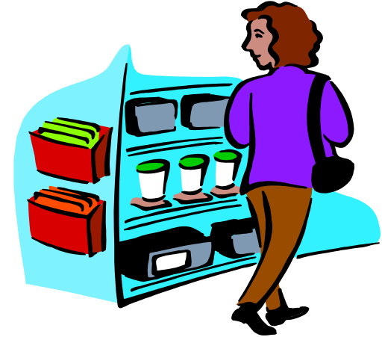
3.02 – Forms of Branding

Slide 19



Forms of Branding
A brand is a design, name, symbol, term or word that distinguishes and identifies a company and/or products or services

Slide 20
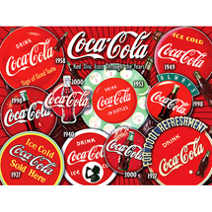

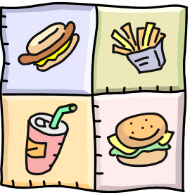

Forms of Branding
A corporate brand represents the entire company or organization
For example, Coca-Cola, Ford, McDonalds, Kraft or Microsoft

Slide 21

Forms of Branding
A product brand represents a specific product of a company or organization
For example, Diet Vanilla Coke, Big Mac, or Windows XP

Slide 22
Forms of Branding
A private distributor brand, also called a store brand
For example, Radio Shack brand of batteries, Lowe’s brand of macaroni and cheese

Slide 23
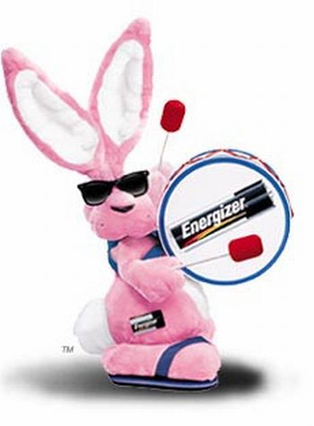
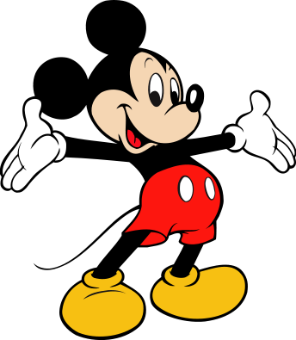
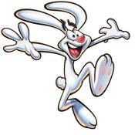

Trade character:
Personified symbol that represents the brand name

