Slide 1
Indicator 2.03 - Resolve conflicts with/for customers to encourage repeat business
MARKETING

Slide 2
Discussion
Give examples of times you have encountered difficult customers at your job. What happened? What was the outcome?
                OR
Give examples of when YOU have been the difficult customer. What happened? What was the outcome?

Slide 3

Why learn to handle difficult customers?
Good for your employer – saving a customer
Good for the customer – they will be happier
Good for you – you learn how to handle challenges

Slide 4
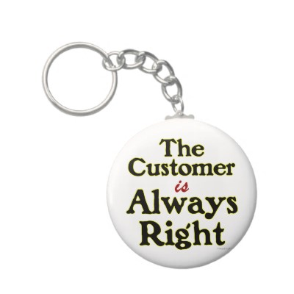
Stew’s Rules
Rule #1 – The customer is always right!
Rule #2 – If the customer is ever wrong, reread Rule #1

Slide 5
There is always a reason for the way a customer behaves..
You just may not always know what it is and not always be able to figure it out
It may be that:
  They are having a bad day
  Their mind is on things that have nothing to do with your business

Slide 6
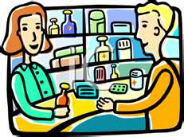
Difficult Customers
No such thing as a “typical” difficult customer
Come in all shapes and sizes
No business is exempt from encountering them

Slide 7

You must effectively deal with difficult customers
Rise to the occasion, so they will come back again
Every business needs returning customers to generate profits

Slide 8
Types of Difficult Customers
Disagreeable
Domineering/Superior
Suspicious
Slow/Methodical
Dishonest

Slide 9
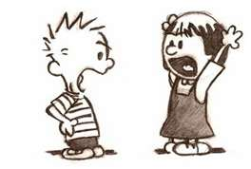
Disagreeable Customers
Argumentative
Impatient
Leave-me-alone
Irritable/Moody
Insulting
Complaining

Slide 10
How to handle Disagreeable Customers
Argumentative – ask, simple polite questions
Impatient – agree first on common points
Leave-me-alone – be patient
Irritable/Moody – be positive
Insulting – be neutral
Complaining – respect their thoughts

Slide 11

Domineering/Superior Customers
Bark orders
Want things done THEIR way because they know best
Handle them by letting them have their say

Slide 12
Suspicious Customers
Slow/Methodical Customers
Doubts the salesperson’s knowledge
Handle by explaining and demonstrating good service
Indifferent
Indecisive
Handle by not overwhelming them

Slide 13

Dishonest Customers
Customers who lie
  Handle by not jumping to quick conclusions
Examples:
  Switching racks
  Changing prices
  Etc.

Slide 14
Staying in CONTROL
C is for calm.
O is for observe.
N is for needs.
T is for think.
R is for reassuring.
O is for opportunity.
L is for listen.

Slide 15
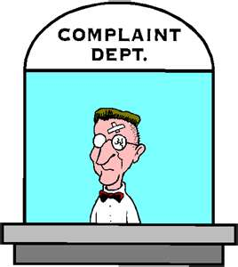
Handling Customer Complaints
Complaints are a not necessarily a bad thing!
Complaints give the business an opportunity to learn something that might improve service and stop the problem from reoccurring
Only 4-8% of customers share their concern ~non-complainers are a problem because the business never has a chance to address the issue

Slide 16
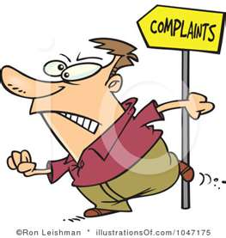
Reasons for customer complaints
Genuine error
  Faulty item
  Bad service
  Product quality
Misunderstandings
  Poorly written instructions
Suggestions for improvement
Etc.

Slide 17
Costs, Benefits, and Importance of Appropriately Handling Complaints
It is much cheaper to retain a customer than replace them – do not lose sales because of a improperly handled complaint!
Appropriately handling complains allows customer’s voices to be heard – they feel of importance to the company therefore building loyalty,

Slide 18
Procedures for Handling Complaints
Listen – completely and openly
Take the customer aside – to ease tension
Restate – to show you understand
Get help – if needed, from a supervisor
Establish a plan – Agree on a plan of action and follow through

