Slide 1
Indicator 2.01 – Acquire the foundational knowledge of selling and understand its nature and scope.
Marketing

Slide 2
WHAT IS SELLING?
Responding to a consumer needs and wants through planned, personalized communication in order to influence purchase decisions and ensure satisfaction.
  Planned – learn about the product
  Personalized – interaction with the customer
  Influence – help the customer make decisions
  Satisfaction – means repeat business

Slide 3
WHO SELLS?
EVERY BUSINESS SELLS!
Manufacturers sell to wholesalers and retailers
Wholesalers sell to retailers
Retailers sell to consumers
Service- selling organizations
Example: John decided to manufacturer door bells. He went to a bank and convinced the loan officer to give him a loan to start his business. After the obtained the loan he began producing doorbells. He then sold them to Wal-Mart, who sold them to consumers.

Slide 4
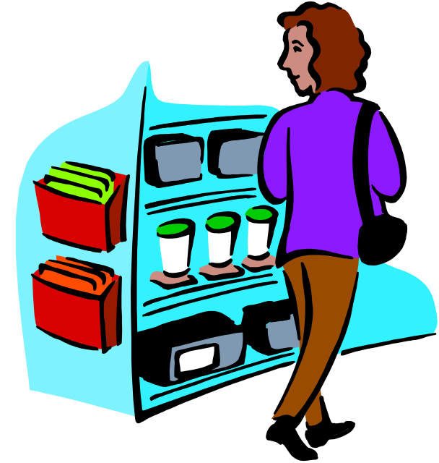
WHY DO CONSUMERS BUY?
To obtain the goods and services they desire or must have to exist (ultimate consumption)
For resale
For use in business operations
  Used in the production of other goods
  Used to operate the business

Slide 5

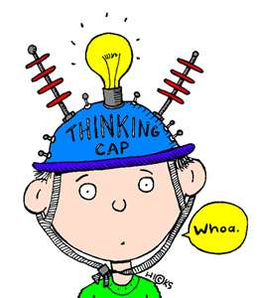
BUYING MOTIVES
Emotional – based on emotion (ex. Social approval, recognition, power, love, prestige)
Rational – conscious, logical reasons for purchase (ex. Saves time or money, quality, service)

Slide 6
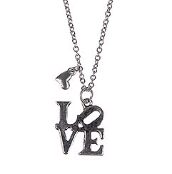
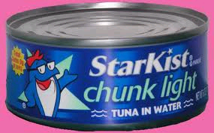
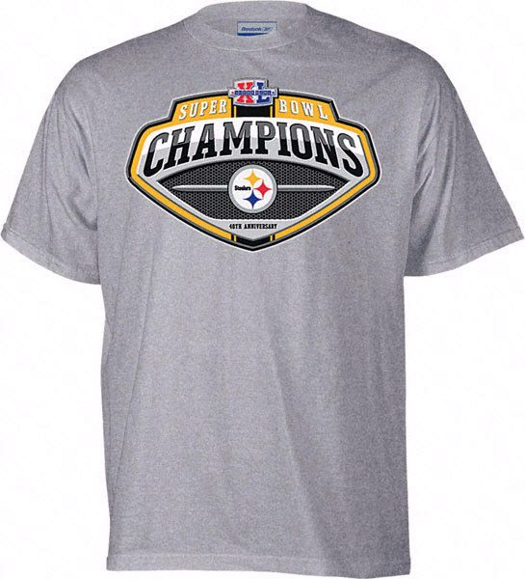
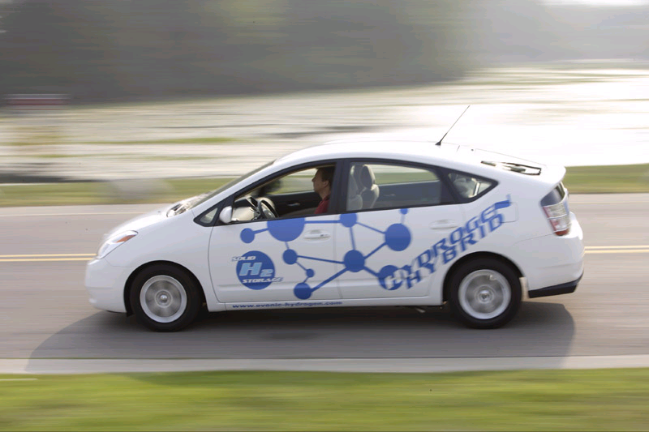
Which Buying Motive?

Slide 7


WHAT IS SOLD?
Tangible items – GOODS
  Can be touched, tasted, seen, smelled, and/or heard
Intangible items – SERVICES
  Productive activities we pay others to perform

Slide 8

WHERE CAN SELLING OCCUR?
Everywhere you have person-to-person contact
  Over the phone
  Over the Internet
  Store
  On your doorstep
  Etc.

Slide 9
HOW ARE PRODUCTS SOLD?
Directly to the user – Direct Distribution
  Examples:
    Doctors sell their services directly to their patients
    Farmers sell their produce directly to consumers at roadside stands
Indirectly through intermediaries (wholesalers, retailer, agents, etc.) – Indirect Distribution
  Examples:
    A real estate agent sells a house
    Food lion purchases Pepsi to resale to consumers

Slide 10
ROLE OF SELLING IN OUR ECONOMY
Keeps the economy moving
    Flow of buying and selling
Promotes competition
Affect employment
    More sales = growing business = more hires
Adds utility
    Usefulness of the product
Helps determine customers needs
    Two way communication
Creates a desire for products
    Appeal to reasons that customers buy

Slide 11
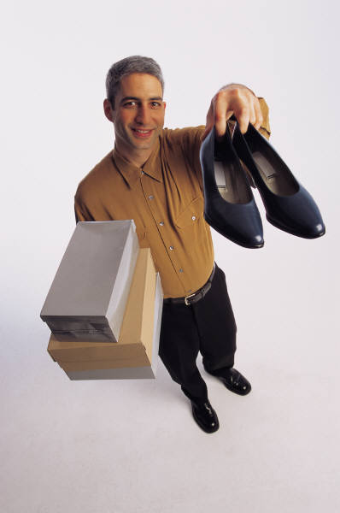
CHARACTERISTICS OF A GOOD SALESPERSON
Product knowledge
Ethical standards
Selling skills
Belief in selling as a service
Personal appearance
Communication skills
Creativity
Self-confidence

Slide 12
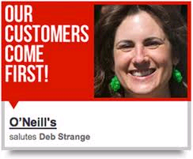
CUSTOMER SERVICE
PROCESS V. FUNCTION
Customer Service Process– an attitude that customer satisfaction always comes first
Customer Services Function – a department or a function of an organization that responds to complaints from customers

Slide 13
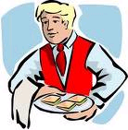
HOW CAN CUSTOMER SERVICE HELP YOU BEAT YOUR COMPETITION?
Over time, the quality of products can be easily matched among competitors. Therefore customer service becomes key!

Slide 14
FACTORS that influence customer expectations of customer service.
Past Experiences
    Customers expect the same or higher quality than before and they compare to past service given by your competitors
Word-of-Mouth
  Customers expect the same quality service others have received
Advertising
  Customers expect you to make good on advertising claims of quality service
Personal Needs
  Salespeople must “read” customers and cater to their personal needs

Slide 15
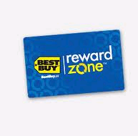
CUSTOMER SERVICE = RELATIONSHIPS
Maintain Relationships
  Happy customers will return and refer you to their friends
  It is more expensive to replace a customer than it is to maintain one
  Create Loyalty through Rewards

Slide 16

CUSTOMER SERVICE IN THE
PRE-SALE
Pre-sales are all of the effort needed to prepare to make a sale BEFORE the customer is acquired.
  Obtain/maintain data of customers
  Gain product knowledge
  Stay abreast of the market

Slide 17
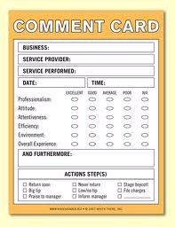
CUSTOMER SERVICE IN THE
POST-SALE
Efforts after the sale to ensure the customer is happy.
  Follow-up
      Ensure satisfaction, call, card, email
      Handle inquiries and complaints, keep customers satisfies
      Ask for referrals
      Keeping a client file
      Evaluate sales efforts
  Post Sales Surveys / Comment Cards

Slide 18
SELLING ACTIVITY POLICIES
Selling policies: guidelines for selling. How will products be sold?
    How are sales tracked? Receipt, online, customer information?
    What is the customer given at the completion of the transaction?
    Are there any government rules or regulations that must be followed?

Slide 19
TERMS OF SALE POLICIES
Terms-of-sale policies: What conditions apply to each type of sale? (Think airline tickets, e-Bay, close-outs)
    Age, condition of customer (think “bar”), single or double occupancy.
    Conditions for returns (What will be allowed?) What if the dress has been worn?
    Deadlines for returning products (used or new car purchases, haircuts)
    Method of refund (including money vs. store credit)

Slide 20
SERVICE POLICIES
Service policies: guidelines for servicing customers.
    What is included in the sale of the product?
    Warranties (implied or explicit)
    Delivery.
    Training.

Slide 21
WHY ARE SELLING POLICIES IMPORTANT?
Selling policies standardize sales.
Ensures that the company and the customers understand how products are sold.
Protects the company, legally.

Slide 22
WHY ARE SELLING POLICIES NEEDED?
Proves that all customers are treated the same way
Increases efficiency of the sales people.

Slide 23
EXTERNAL factors that affect selling policies
City, county, state and/or Federal regulations.
Competitors’ actions.
Changes in customer expectations.
Changes in costs of producing the products.

Slide 24
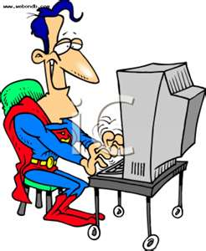
INTERNAL factors that affect selling policies
Sales quotas.
New management.
Changes in goals.

Slide 25
REGULATORY factors that affect selling policies
The distribution channel might require specific policies in exchange for using that channel (e-Bay for example).
Implicit warranties.

Slide 26
PROBLEMS with selling policies
Policies cover specific circumstances, so some situations will not fit the current policies.
Mis-interpretation by a salesperson.
Some customers will ask for exceptions to policies in exchange for increased business or because of a history with your company.

