Slide 1
Indicator 1.04 – Employ marketing information to develop a marketing plan
Marketing 1

Slide 2
THE MARKETING MIX
Includes four basic strategies called the 4 P’s or elements of marketing. For each strategy, decisions have to be made for each product the business offers to best reach their target market.
Product
Place
Price
Promotion

Slide 3
The 4 P’s
Product - decisions include what to make or obtain as the business’s product mix.
    Level of quality, features, branding, packaging, service, and warranty are items to decide and develop for each product.

Slide 4
The 4 P’s
Place - decisions include where the customer can obtain the products. Many businesses utilize multiple channels of distribution.
    For example, store locations, website, and catalogs are the standard for most retailers today. Decisions of direct distribution or indirect distribution (intermediaries/middlemen) must be made.

Slide 5
The 4 P’s
Price - decisions include determining what a customer is willing to pay
    What competition is charging, determining seasonal discounts and allowances, and credit terms.

Slide 6
The 4 P’s
Promotion - decisions include the promotional mix (advertising, sales promotion, selling, and publicity)
    These decisions are based on the budget a business sets for the promotional mix.

Slide 7
IMPORTANCE OF THE 4 P’S
Product is important to obtain or develop the best product mix within your market and your target market.
Place is important because it is the avenues you come into contact with your customers. This is the element that has direct impact on loyalty and repeat customers.
Price is important because it establishes your profit and set the quality level of your products/services.
Promotion is important because it communicates with your customers so they know about your product mix.

Slide 8
RELATIONSHIP OF GOALS, TACTICS, & STRATEGIES TO THE MARKETING MIX
Mission Statement – the guiding principle for all business decisions and provides direction for planning.
  Goals/Objectives – established on a yearly basis and support the mission statement. Goals must be measurable and have a deadline.
    Strategies – are then developed to accomplish goals and it reflects the method to achieve the goal (what to do).
      Tactics – are then developed to accomplish the strategies; it is the how things will be done, daily actions.

Slide 9
MARKETING STRATEGIES CHANGE……
What factors cause that change?
  Different Goals
  Economic conditions change
  Political or influence of governmental agencies changes
  Demand changes reflecting new consumer attitudes
  Environmental changes
  Advancements in technology
  Actions of Competitors

Slide 10
WHY ARE MARKETING STRATEGIES IMPORTANT IN THE MARKETING MIX?
Marketing plan is created with marketing strategies for the marketing mix. Marketing strategies are important because they are the framework of conducting business. They guide the allocation of a business’s resources. It unites the marketing activities throughout the business and everyone is on the same page. Eliminates chaos and confusion.

Slide 11
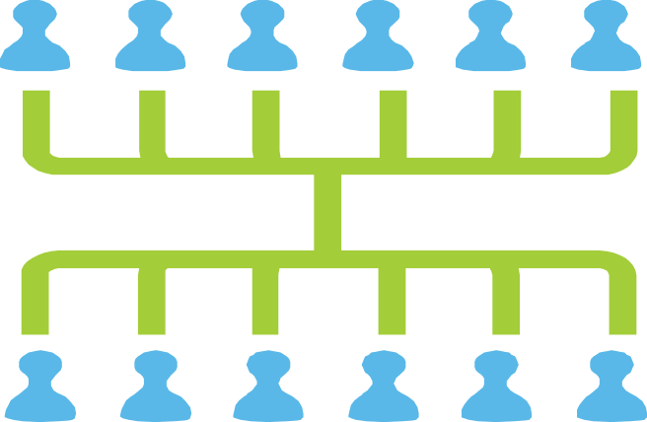
MASS MARKETING
Mass Market is when the group is considered as a whole with all the marketing activities; using a single marketing plan.
  Ex. Chewing gum & light bulbs

Slide 12
MASS MARKETING
Advantages
  Don’t have to pay for the production of similar products
  Can price and distribute one type of product more easily than many
  Can send one promotional message to everyone
  Easier to manage, cost effective
  Predictable response rates
  Easy to set up.
Disadvantages:
  Diversity of the audience
  Unable to track return, low response rates
  Nonpersonal
  Beliefs that everyone is the same
  Low profit margins
  High competition

Slide 13
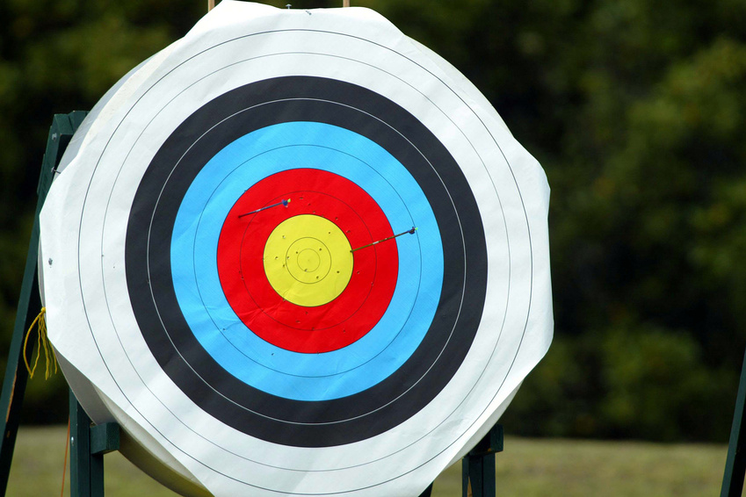
WHAT IS A TARGET MARKET?
Identified segments of the market that a business wants to have as their customers. For example, teenagers, mothers-to-be, single mothers, American Family, men .vs. women, or college freshman. Each example has wants and needs that can be targeted and utilized to develop effective strategies to reach existing and/or potential customers.

Slide 14

IMPORTANCE OF TARGET MARKETS
A target market represents the people most likely to buy what you sell. These people have something in common that solidifies their desire for your product or service. And that something distinguishes them from the market at large.

Slide 15

SEGMENTATION
Market Segmentation is the process of dividing a larger market into smaller parts.
Market segment is a subgroup of a larger market that share one or more characteristics.

Slide 16
MARKET SEGMENTATION
Advantages:
  Providing the products customers want
  Effective communication
  Higher response rate,
  Repeat and loyal customers
  Personal
Disadvantages:
  More expensive, more difficult to produce
  Expensive to set up
  Requires more marketing research

Slide 17
WHY IS MARKET SEGMENTATION BEING USED MORE?
Better matching of customer’s needs
Better profits & opportunities for growth
Repeat customers
Target market communication
More businesses operating globally creates more competition & greater market share via market segments
It is more efficient in the long run.

Slide 18
4 TYPES OF MARKET SEGMENTATION
Demographic
Psychographic
Geographic
Behavioral

Slide 19
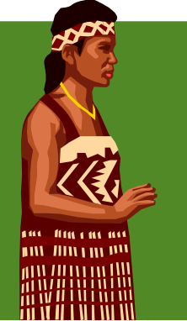


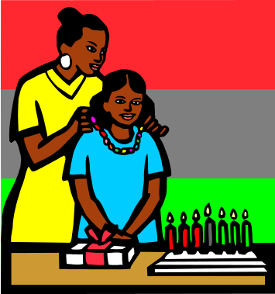
DEMOGRAPHIC SEGMENTATION
Statistics that describe a population by personal characteristics such as age, gender, income, marital status, ethnicity, education, & occupation.

Slide 20

PSYCHOGRAPHIC SEGMENTATION
Defined: Markets divided by social and psychological characteristics. (Lifestyles, morals, values, & interests)
Characteristics reflect consumer buying behaviors. The characteristics are Interests, Habits, Activities, Lifestyles, Opinions, & Hobbies. These reflect who your customers are. Businesses that use Marketing principles to guide their decision making must evaluate and reevaluate their customer’s wants and needs continuously to stay ahead in the game.

Slide 21

GEOGRAPHIC SEGMENTATION
Markets divided by where the customer lives.
It is valuable information because businesses can tailor their product mix based on location. Characteristics are nations, states, regions, counties, cities, or neighborhoods.

Slide 22

BEHAVORIAL SEGMENTATION
Segmenting a market base on the way customers use a product or behave toward a product.
Types of behavioral segmentation:
    Product Benefits
    Usage
    Loyalty
    Occasions

