Slide 1
Marketing & the Global Economy
1.01A

Slide 2
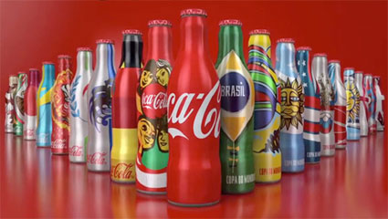
World of Coke Happiness Video Trailer
more happiness

Slide 3
What is Marketing?
Marketing is the activity, set of institutions, and processes for creating, communicating, delivering, and exchanging offerings that have value for customers, clients, partners, and society at large.
It matches up producers with the customers who want to buy their products
It finds out what customers are looking for, shares this information with producers, and helps them connect to their customers in the right way, at the right time and in the right place.

Slide 4
The Marketing Concept
The philosophy of conducting business that is based on the belief that all business activities should be aimed toward satisfying customer wants and needs while achieving company goals
Consider the customers needs first before making any marketing decisions
By focusing their actions on fulfilling the customers’ needs and wants they are more successful.

Slide 5
Marketing Activities
Planning how to carry out the marketing process
  Provides the basis for all marketing goals and actions
  Marketers write a clear plan of action, implement the plan, and evaluate it’s success
Finding out about customers
  Who are they? What do they need?
  Detailed research
Offering the products customers want

Slide 6
Marketing Activities
Determining how much to charge for the products
  Striking the right pricing balance is beneficial to both the customer and the seller
Communicating with customers (how they get their messages to customers)
  To attract customer interest
  Advertising, personal selling, publicity, sales promotion
6. Putting products where they need to be
  Where are they most likely to purchase the products?

Slide 7
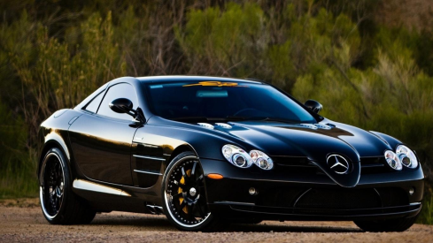

Categories of Marketed Items
Goods (durable & nondurable)
  Durable goods are tangible items that last a long time. Ex: mp3 players, automobiles, computers
  Nondurable goods are typically consumed in a short period of time. Ex: smoothies, gasoline, lipstick
Services
  Intangible activities that are performed by other people for money. Ex: haircuts, dental treatments, lawn care

Slide 8



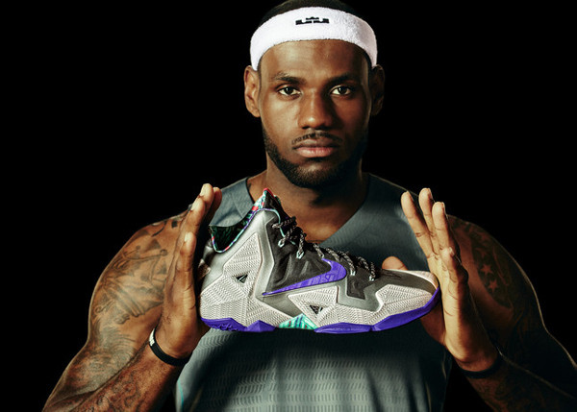
Categories of Marketing Items
Organizations
  Operation Smile
Events
  County Fair, Olympics
Places
  States, Countries, Cities
  Visit California
Ideas
  Click It or Ticket
People
  LeBron James

Slide 9
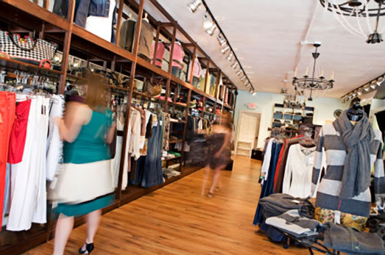
Where Does Marketing Occur?
Wherever customers are present
Online, in an office, in a store, school, at home, and thousands of other places.

Slide 10
Elements of the Marketing Concept
Customer orientation (Do it their way)
  use surveys, interview customers
  Research what customers really want
Company commitment (Do it better)
Company goals (Do it with success in mind)
  Maintain the firm’s purpose

Slide 11
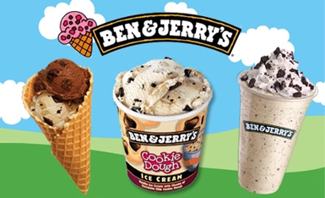
Marketing in a Private Enterprise System
  Creates awareness of products/services
  Allows access to products/services
  Gives multiple channels to purchase products/services

Slide 12
What if Marketing Did Not Exist?
  Effects on our country
    Difficulty linking producers to customers
    Businesses would suffer and possibly close
    Customers would have to figure out where to get certain goods and services
    Fewer improvements would be made to existing products
    Fewer new products would be developed
  Effects on you
    Daily routines would be different
    Products would be made, rather than bought
    Radios, TV networks, and many web sites would not exist since the earn their money by selling advertising space/time.
    Marketing shapes the little things we do.

Slide 13
Marketing Benefits in Society
  Marketing makes our lives better and allows us to live our daily lives
    Encourages competition among businesses
      New and improved products at lower prices
    US has one of the highest standards of living in the world.
  Marketing provides us with a variety of goods and services.
    Competition helps us offer a variety of goods and services
      Ex: Cell phones – offered in different colors, features, manufacturers, etc.
  Marketing encourages trade between nations
    Resources needed to produce their products are extremely valuable to marketers
    Marketers can pinpoint where specific resources can be found.
    Marketing draws countries into the process of exchanging different resources.

