Slide 1
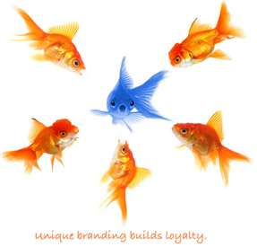
3.03 Corporate Branding
Position company to acquire desired image

Slide 2
Definitions:
Brand identity—elements that are instantly recognized as belonging to a certain company or product
Values—things that are important to you, your company or product.
Brand cues—elements that remind customers of brands and their values
Brand personality—the behavior of your brand -- ie.how it creates and maintains an emotional connection with customers

Slide 3
Touch points—opportunities businesses have to connect with customers
Brand promise—agreement that a company or product will consistently meet expectations and deliver on characteristics and value
Corporate brand—represents the entire company or organization

Slide 4
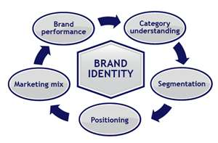
Elements that make up a brand’s identity

Slide 5

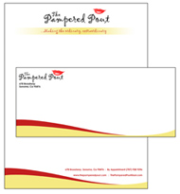
Visual elements
Anything a customer or potential customer may see referencing the company
  Company logo
  Company tag line or slogan
  Color schemes
  Typography, font styles
  Symbolism in the design
Should be specific and interwoven throughout the company
  Letterhead, business cards, email signatures
  Advertising, presentations
  packaging

Slide 6
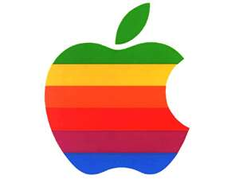
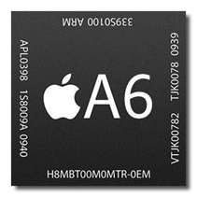
Product elements
Special product features and functions that uniquely benefit customers
  Apple brand has superior processor speed; the product and brand are interchangeable and inseparable

Slide 7
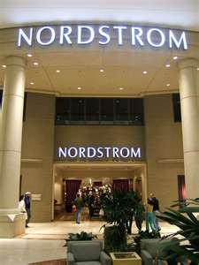
Service elements
Interactions between customers and the company and its employees
Service elements include things like:
  Response time
  Return policies
  Perception of treatment
Nordstrom Department Store –high-end products—is synonymous with exceptional customer service

Slide 8




New media elements
Managing brand identity across new platforms ie: internet
  Facebook
  Twitter
  LinkedIn
  Blogs

Slide 9
Values in brand development
Specific behaviors and attitudes that help a company achieve goals
Things that customers can expect every time they interact with a company
  Good customer service
  Easy return policy
  Guaranteed lowest rates
  Friendly smiles
  Doing the right thing because it is the right thing to do
  quality
Values reflect the company and its brands

Slide 10
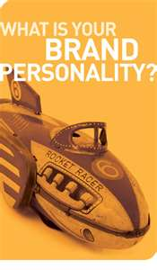
Significance of a brand’s personality
Customers are more likely to buy a brand if they perceive that it is similar to their own personality
Consumers relate to brand personalities therefore adding value to the brand

Slide 11



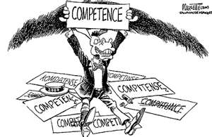

Five types of brand personalities
Excitement
Sincerity
Ruggedness
Competence
Sophistication

Slide 12
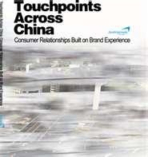
Using brand touch points

Slide 13
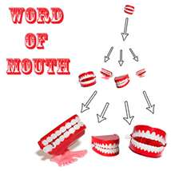
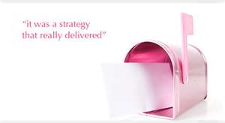


Pre-purchase touch points
Shape perceptions and expectations of the brand
Heighten brand awareness
Help potential customers understand benefits
Examples of pre-purchase touch points:
  Web-sites
  Word-of-mouth
  Direct mail
  Research
  Sponsorship
  Public relations
  advertising

Slide 14

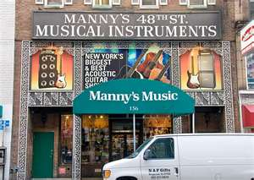

Purchase or usage touch points
Move a customer from considering a company’s brand to purchasing a product and beginning a relationship with the company and its brand
Examples:
  Direct field sales
  Physical stores
  Contact with customer representatives

Slide 15
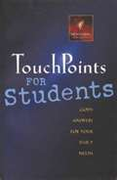

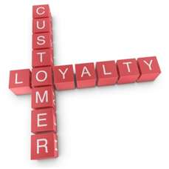



Post-purchase touch points
Come into play after the sale and maximize
the customer experience
Goals of post-purchase touch points:
  Deliver on brand promise
  Meet or exceed performance and expectations
  Increase brand loyalty
Ways to meets these goals:
  Loyalty programs
  Surveys
  Warranties
  Rebates

Slide 16


Distinguish between corporate and distributor brands
Corporate brands represent the whole company. For example McDonald’s is a corporate brand. McDonalds sells several products (BigMac, McNuggets, McMuffin, etc).
Distributor brands are also called private distributor brands or store brands. The store has its own brand that it sells to consumers. Gap is a store that sells Gap Jeans. Gap Jeans are a distributor brand they can only be purchased at a Gap store.

