Slide 1
Indicator 2.05 – Apply quality assurances to enhance product/service offerings
marketing

Slide 2
What are grades and standards?
Standards are statements that specify a product’s size, contents, and/or quality; used as a basis for comparing or judging goods or services
Grades are ratings assigned to products that tell to what extent standards are met.

Slide 3
Interrelationship between grades and standards
Standards are set. Each product is rated against these preset standards and assigned a grade. Products that don’t meet the lowest standard are scrapped, reworked or sold at a discounted price.
Example: School grading system – standards are set. You have to do this to earn an “A” in this class. Your work is compared to the standards and your grade is determined.

Slide 4
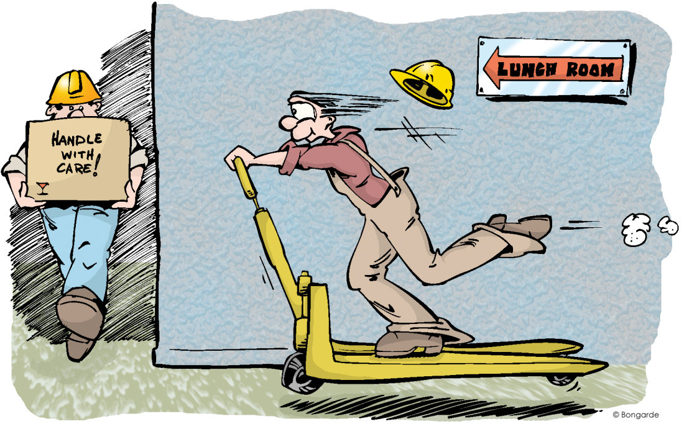
Why are standards used?
Standards are used to establish uniform, consistent products.
Example: CD’s made in the USA, Japan, and Mexico all have to fit into the same disc player

Slide 5
Grades and standards can indicate…
How the product can be used
  Ex. Grades on milk and motor oil
Where the product will be sold
  Ex. Gap, Inc. places higher quality clothes at the Gap and their lower grade clothing at Old Navy
How much the product will cost its buyer
  Ex. Buyers will pay more for top grade
Who the user can/should be
  Ex. Movie ratings indicate the audience: G, PG, PG13, and R

Slide 6
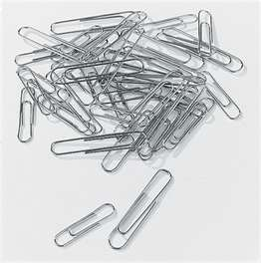
Grades and standards aid buying and selling
Their use speeds up the process because consumers can buy products without having to inspect them
Consumers rely on grades and standards for product information

Slide 7
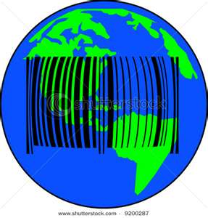
Grades and standards in global trade
The ISO 9000 are international standards for quality
This standard guarantees that manufacturers have meet certain requirements for producing and shipping their products

Slide 8
Who sets grades and standards?
Government agencies
  Ex. FDA – food and drugs, FCA – communication, County Health Dept. - restaurants
Trade and professional organizations (to promote product safety)
  Ex. AAA - motels
Businesses
  Ex. McDonalds buns have an exact size and color, Ford requires suppliers to meet certain standards when making “Q1” parts.

Slide 9
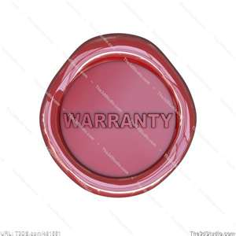
What is a warranty?
Warranty is a defined promise made by the seller to the consumer that the seller will repair or replace a product that does not perform as expected

Slide 10
Types of warranties
Express Warranty
Implied Warranty
Defined as promises expressed in a specific statement concerning the quality of the product
  Can be written or oral
Defined as an unwritten, unstated warranty understood by the consumer and the seller that a product will perform as expected
  The product will do what it is designed and recommended to do

Slide 11
Types of warranties
Full Warranty
Limited Warranty
Defined as warranties that cover the entire product
  If the product doesn’t work it must be made good in a reasonable time if not the customer can choose a replacement or refund
  No time limits on implied warranties
  The customer need only notify the warrantor in order to obtain repairs
Defined as warranties that do not contain the provisions of full warranties, may cover only certain repairs or specific parts

Slide 12
What is A guarantee?
Defined as a promise made by the seller to the consumer that the seller will refund the consumer’s purchase price if the product doesn’t perform as expected.
AKA – “Money-back guarantees”
While warranties usually apply to goods, guarantees are given for both goods and services

Slide 13
Characteristics of a effective guarantee
Unconditional
  No conditions for the customer to meet
Understandable
  Clear language and no difficulty understanding the promises
Easy for the customer to implement
  Not a lot of forms, people to see , and different locations
Easy for the customer to collect
  When possible money should be refunded on the spot

Slide 14
Purposes of warranties and guarantees
To reassure prospective customers
To protect the producer and seller
To gain repeat customers
To increase sales
To use as a promotional tool
To use as a competitive tool
To use as a image builder

Slide 15
Benefits of warranties and guarantees
Consumer Benefits
Business Benefits
Reduced anxiety about purchases
Free repairs
Service information
Legal recourse
A customer-oriented focus
Establishment of clear standards
Feedback from customers
Increased profits

Slide 16
Why are warranties and guarantees regulated and controlled by the law?
They can cause problems for producers
  Consumers misuse the product
  Customers expect problems to be fixed that are not under warranty
There have been times when companies have “guaranteed” their products without living up to the terms of the warranty or guarantee and the customer was cheated.

Slide 17
Magnuson-moss warranty act of 1975
This Act provides guidelines for businesses offering warranties and guarantees with their product.
  Protects consumers
  Makes warranties stronger & easier for consumers to understand
  Covers all consumer products & requires marketers to provide product information to consumers even before they make the purchase
  FTC has the authority to regulate warranties on products that sell for more than $15

Slide 18
Product liability
Product liability is the area of law in which manufacturers, distributors, suppliers, retailers, and others who make products available to the public are held responsible for the injuries those products cause.
3 major types of claims:
  manufacturing defect
  design defect
  a failure to warn (also known as marketing defects)

Slide 19
Product recalls
A product recall is a request to return to the maker a batch or an entire production run of a product, usually due to the discovery of safety issues. The recall is an effort to limit liability (which can cause costly legal penalties and damage in reputation)
Recalls are costly to a company because they often entail replacing the recalled product or paying for damage caused by use, although possibly less costly than consequential costs caused by damage to brand name and reduced trust in the manufacturer

Slide 20
Product recall agencies
US Coast Guard: Marine vehicles and related products (e.g. boats, personal watercraft, life jackets)
Consumer Product Safety Commission (CPSC): Consumer products (e.g. toys, household goods, bicycles, off-road vehicles, etc.)
Environmental Protection Agency (EPA): Pesticides, fertilizers, and anything harmful to the environment
Federal Aviation Administration (FAA): Aircraft
Food and Drug Administration (FDA): Food, pharmaceutical drugs, health supplements, cosmetics.
United States Department of Agriculture (USDA): Meat, poultry, eggs.
National Highway Traffic Safety Administration (NHTSA): On-road vehicles and related products (e.g. cars, trucks, vans, recreational vehicles, motorcycles, tires, motorcycle helmets, children's safety seats)

