Slide 1
Mrs. Puett

Slide 2




My name is Mary Beth Puett. I am a Caldwell County native. I attended Whitnel Elementary, Hudson Middle School, and West Caldwell High School. I was given the opportunity to attend Hibriten High School to utilize their Latin program throughout my junior and senior years.

Slide 3


I was given the “I Have a Dream” scholarship which allowed me attend CCC&TI with fully funded tuition for two years. I began my college career there and earned an Associates in Arts degree. After two years, I transferred to Appalachian State University to earn my B.S. in Special Education.

Slide 4
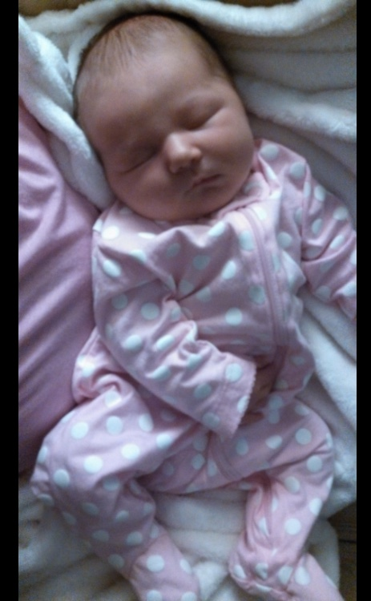
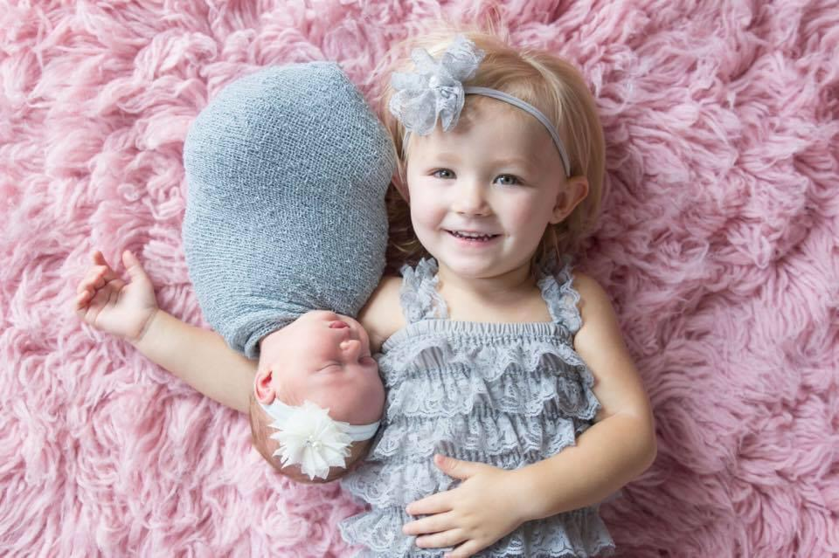
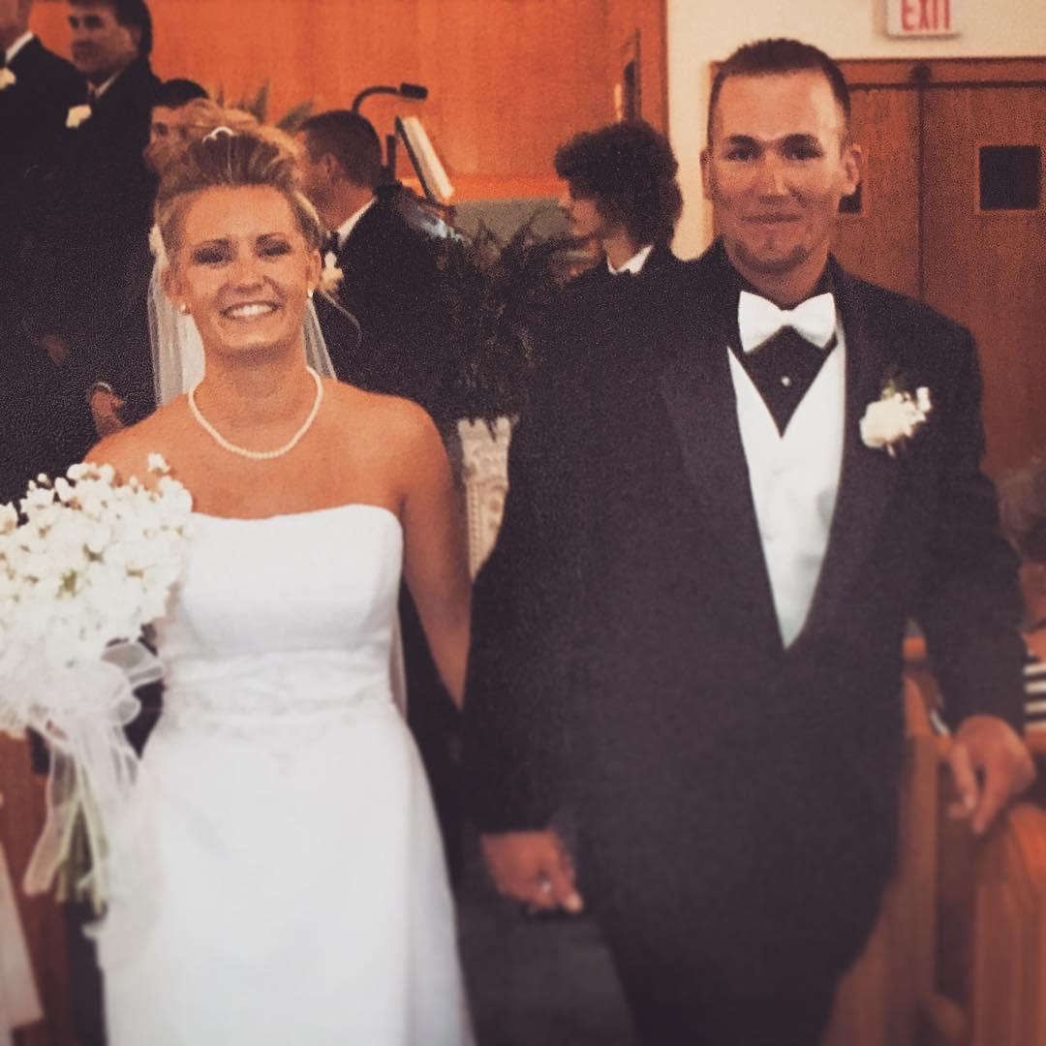
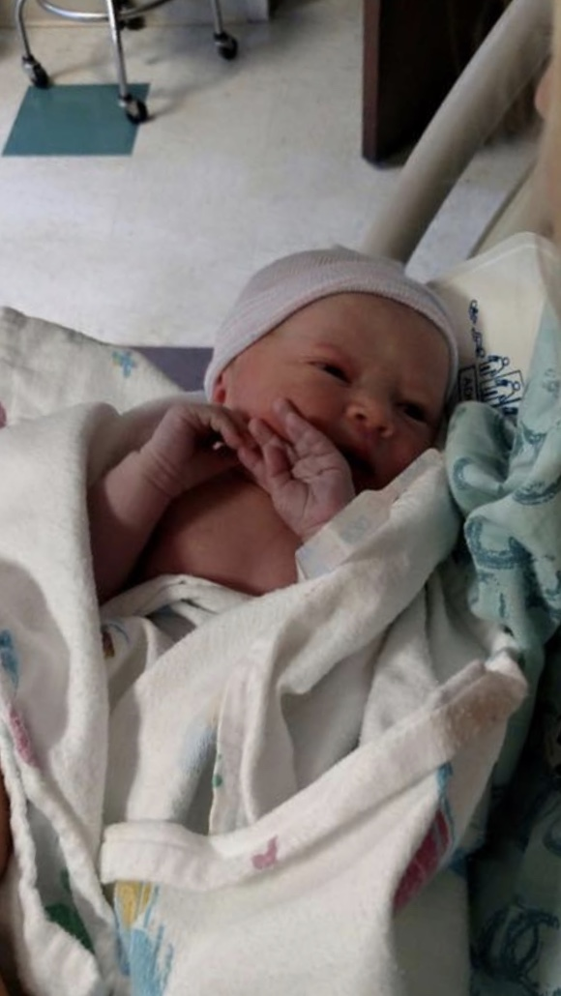
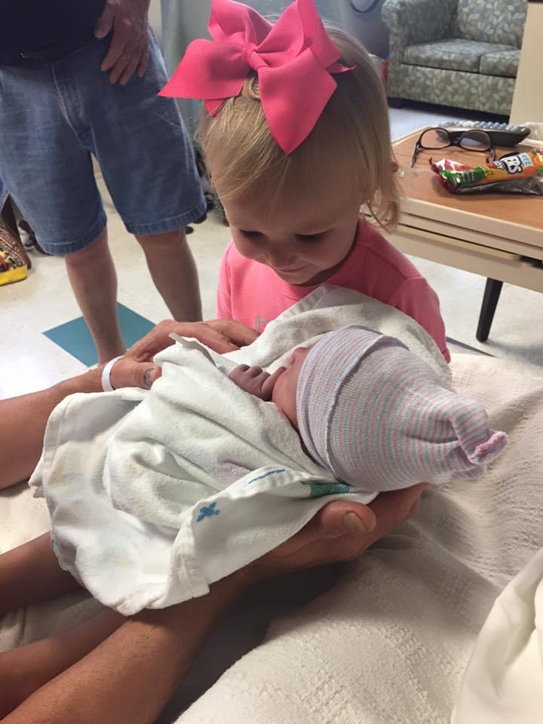
I married my husband in 2009. He and I spent 4 years together before adding our sweet little girls into the mix!

Slide 5
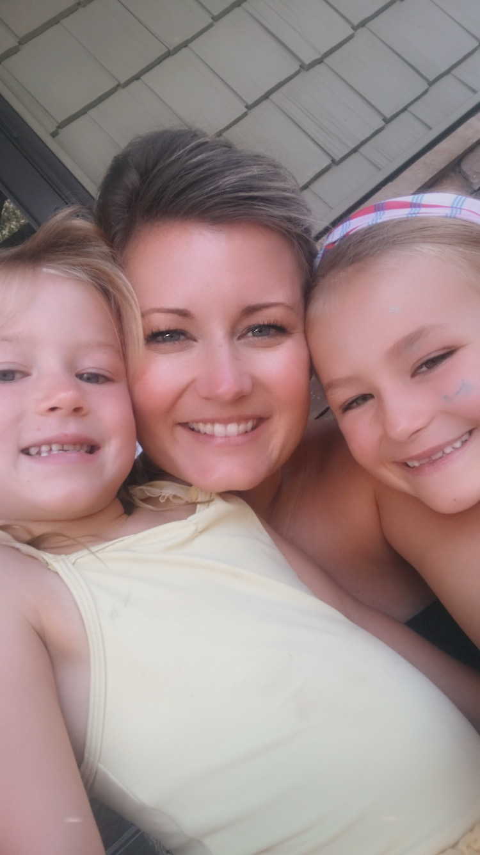
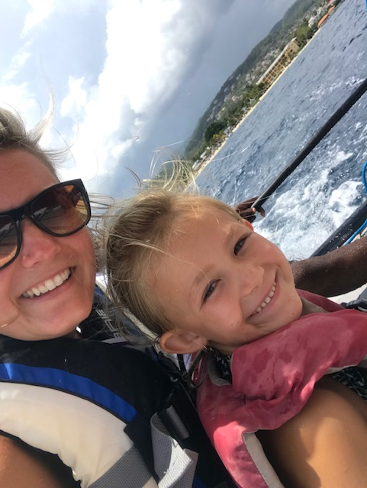
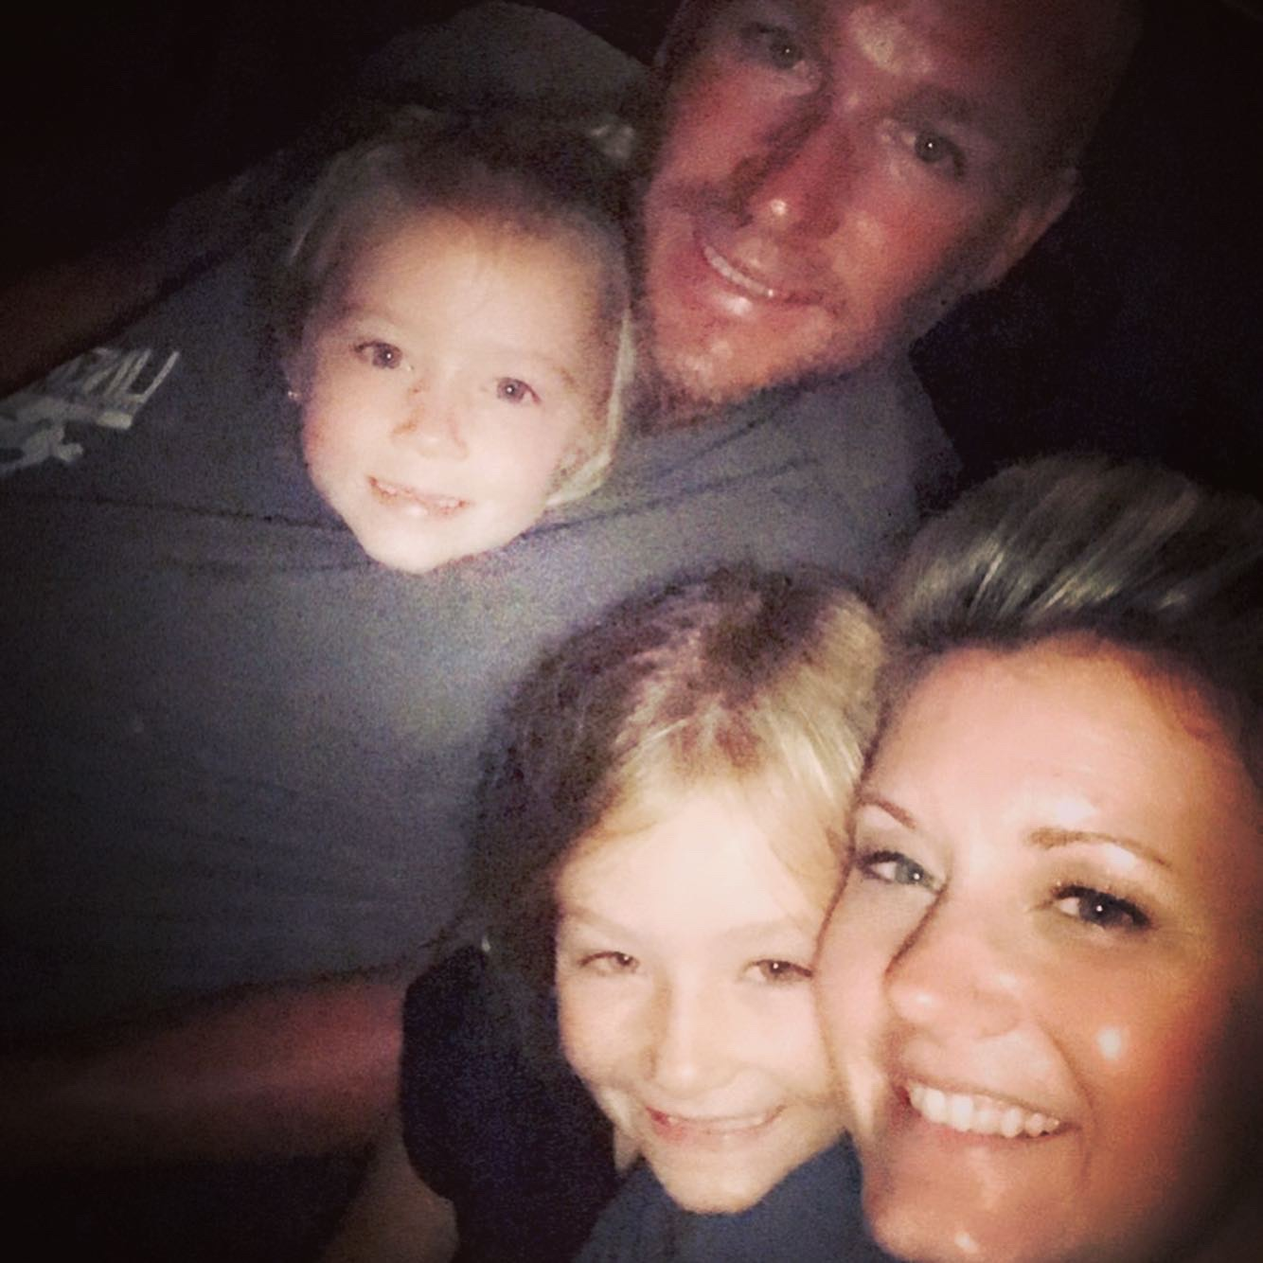
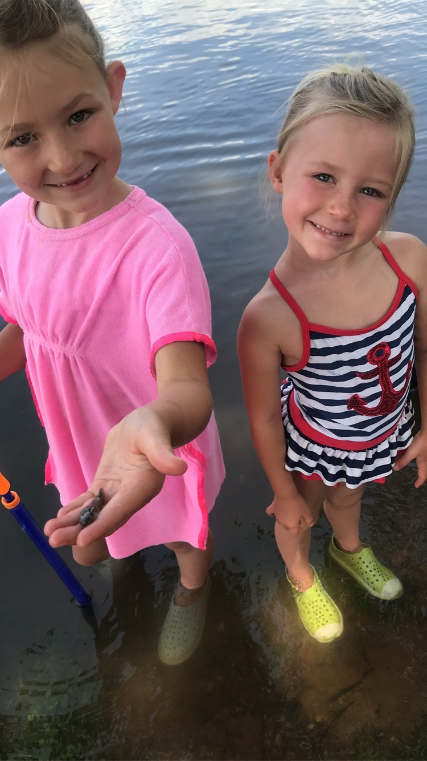
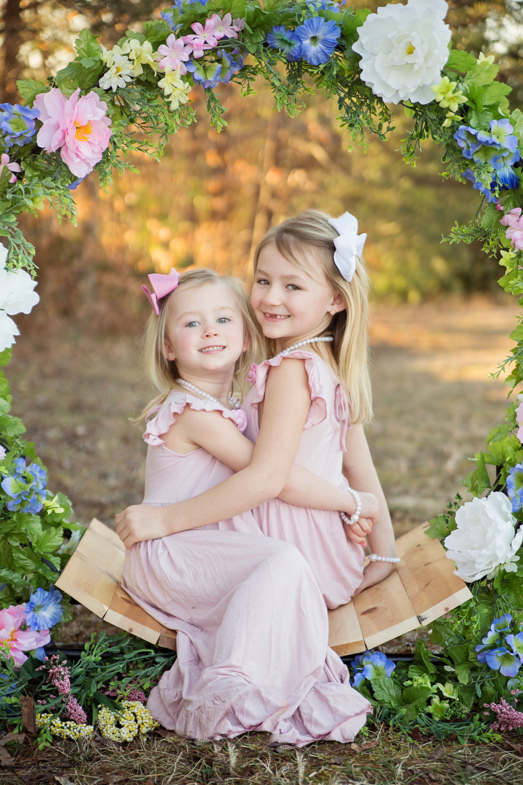
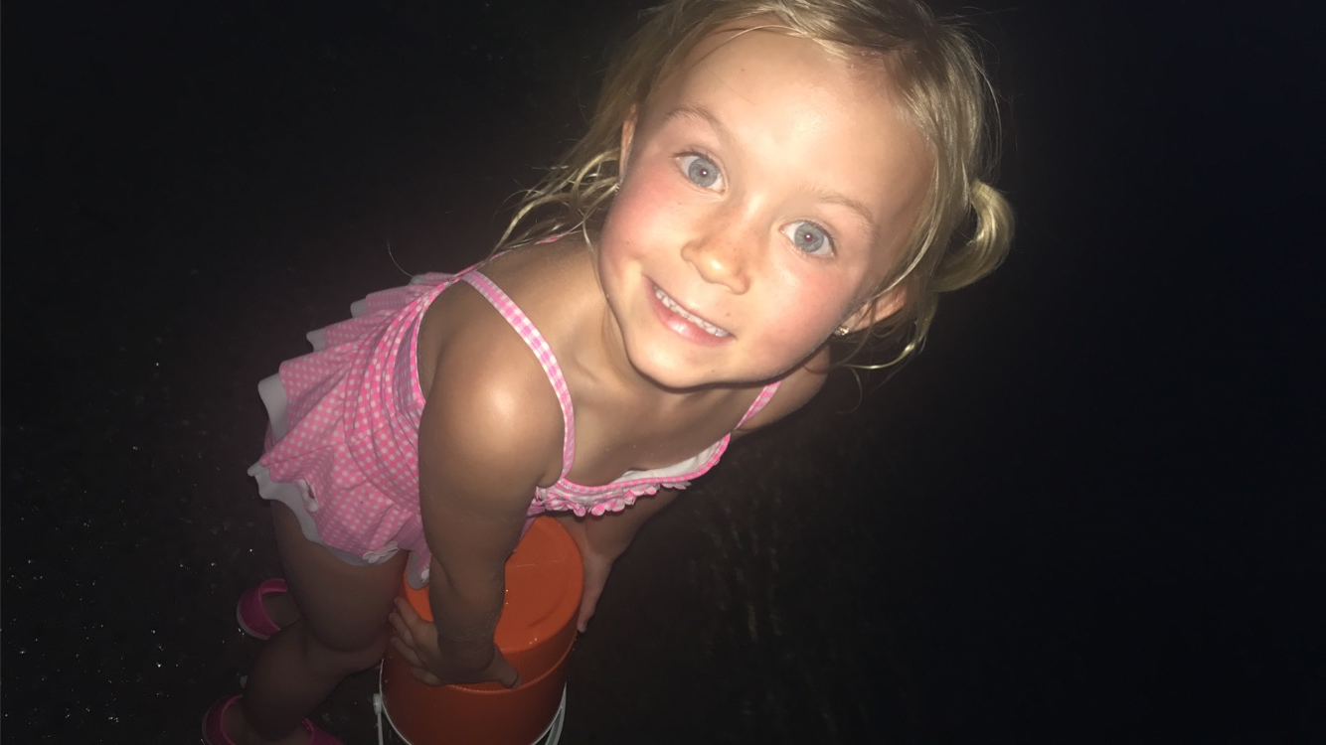

Slide 6
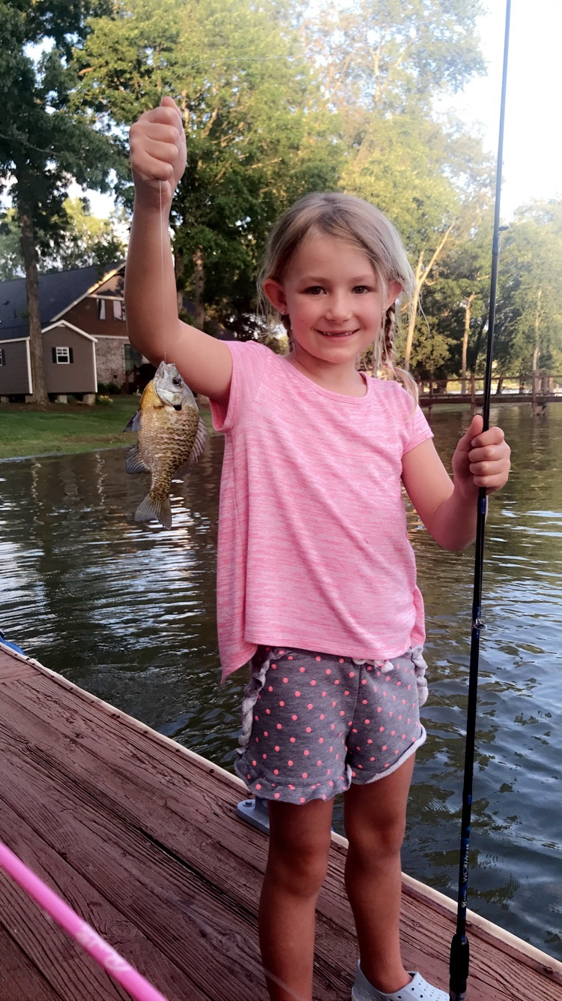
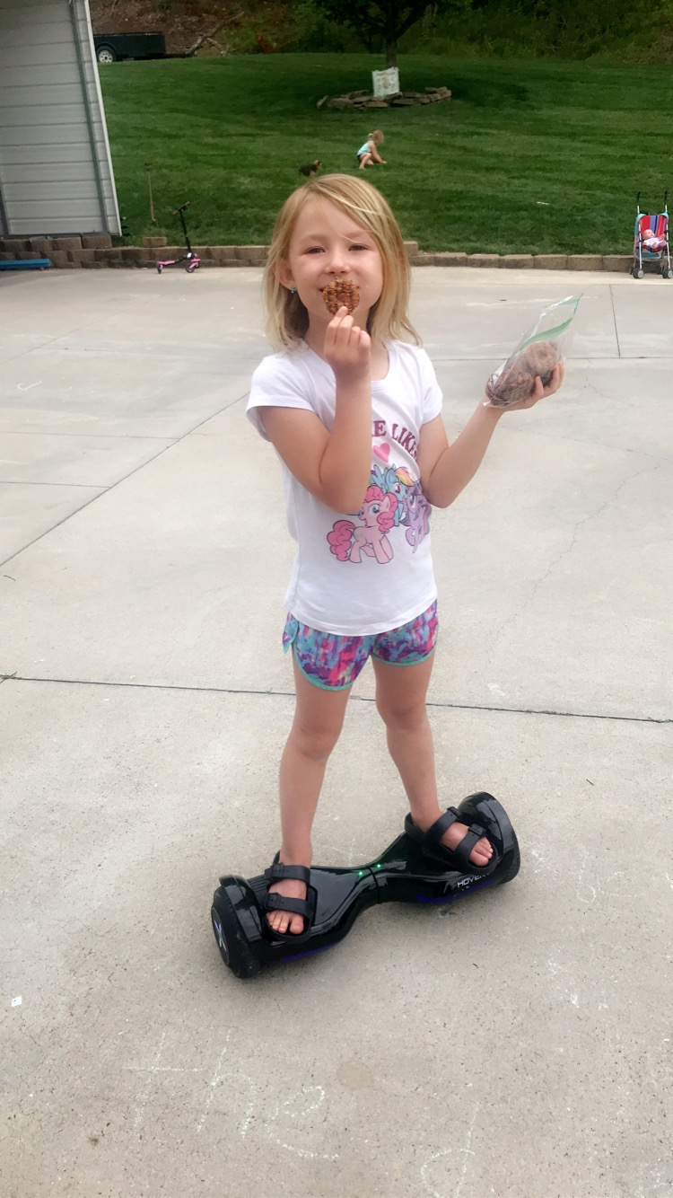
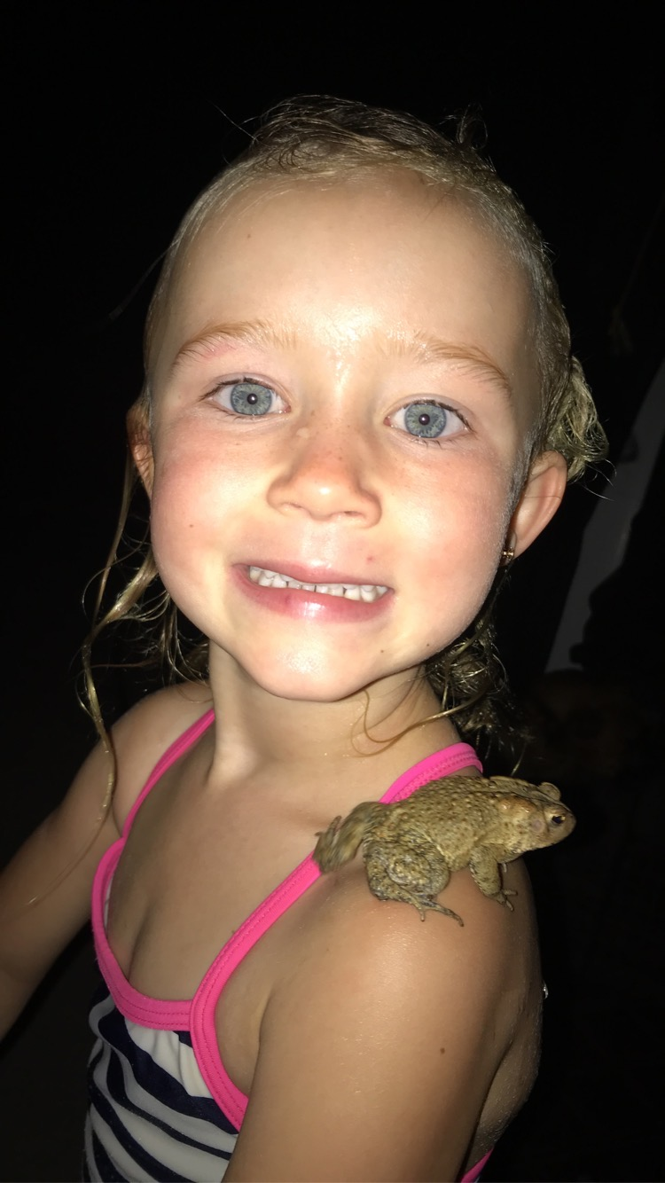
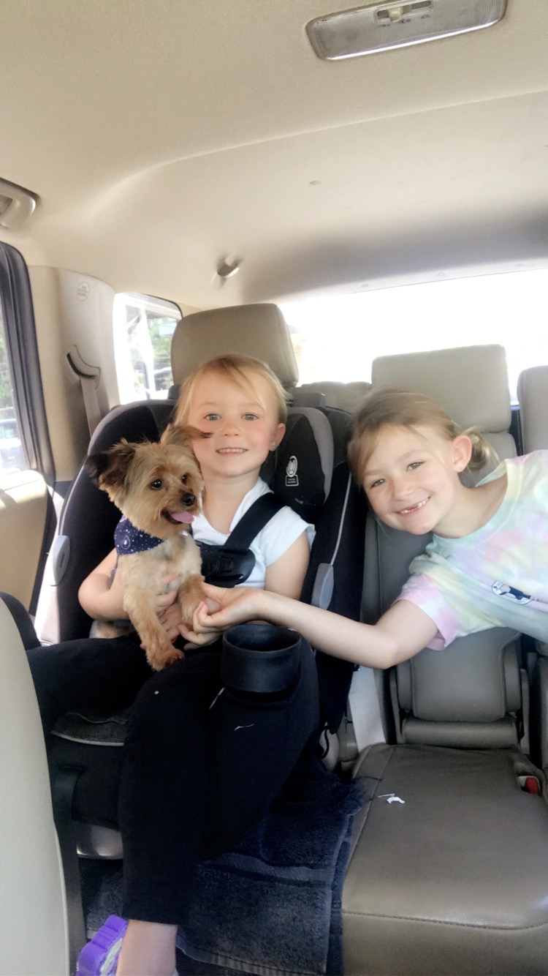
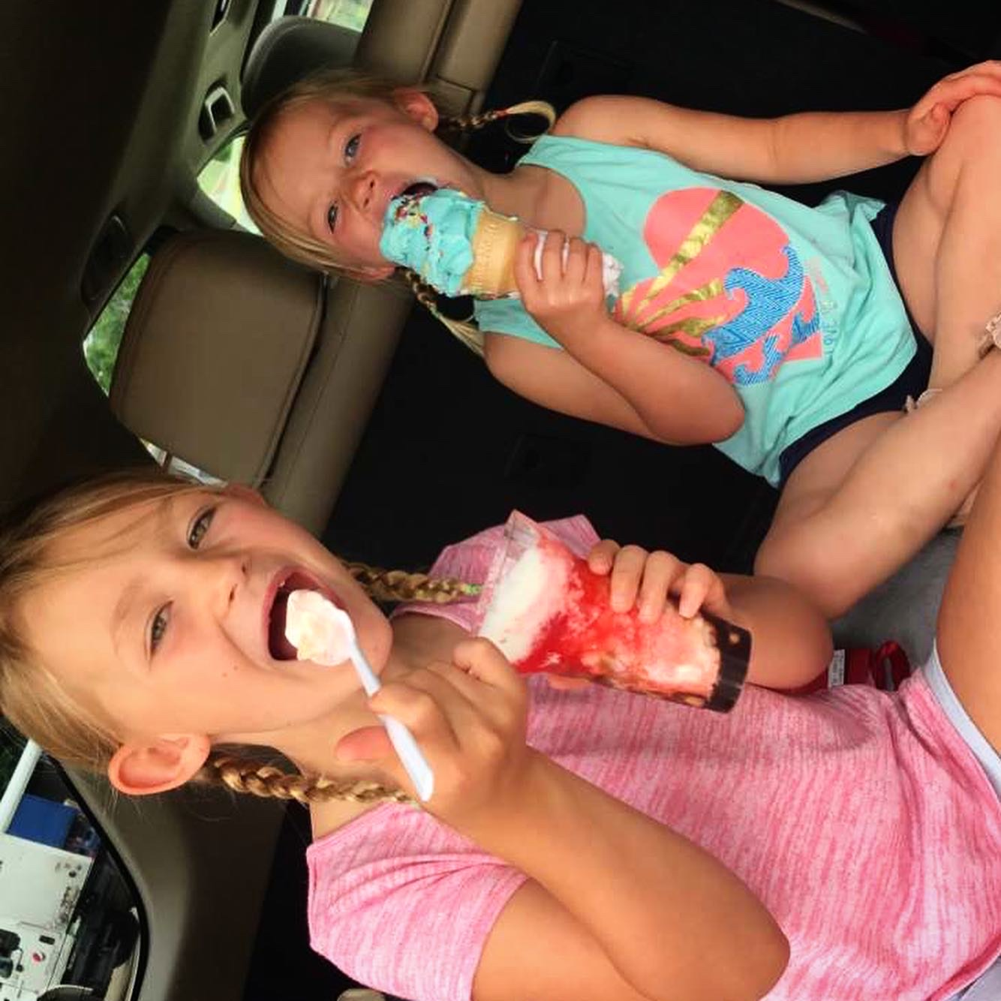
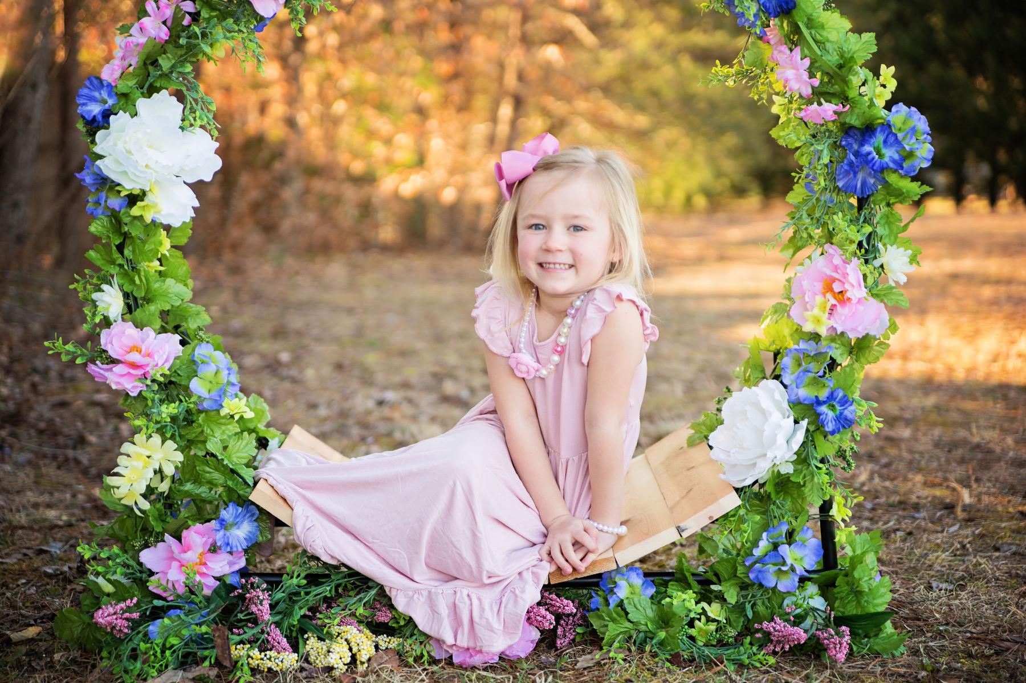

Slide 7
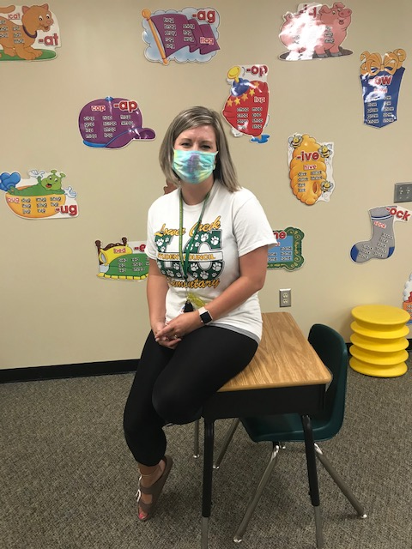
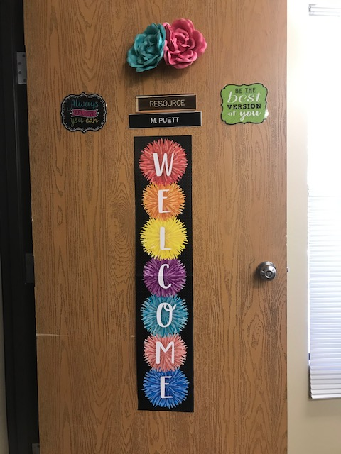
I am an Exceptional Children’s teacher. My classroom is a “resource” room. I am also a Student Council leader.

Slide 8

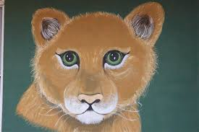
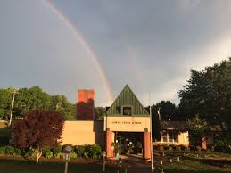
I love working at Lower Creek. I am very thankful that I get to raise my little girls as Cougars too!

