Slide 1
UNIT 8: The 1920s – otherwise known as ‘The Jazz Age’ and ‘The Roaring 20s’

Slide 2
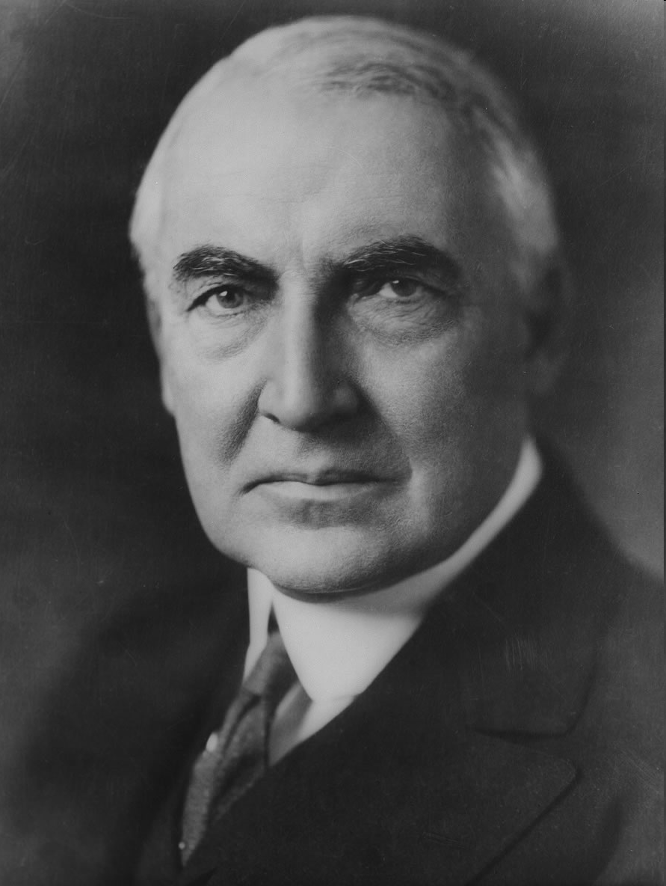
A Return to Normalcy
1920 Warren G. Harding elected
Isolationism policy re-emerges
Washington Naval Conference- proposes disarmament
Kellogg-Briand Treaty -1929 Outlaws War
Raise Tariffs
Nativism returns- National Origins Act 1921- quota system established
Discriminatory

Slide 3
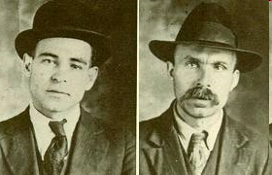
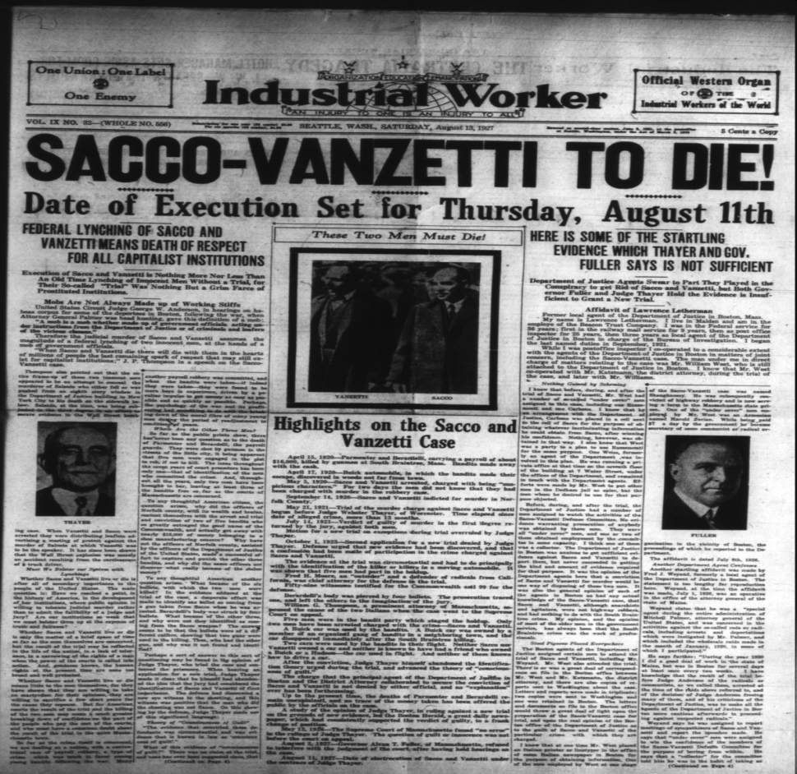
The Red Scare
Russian Revolution sparks U.S fears
Lenin and Communists
Worldwide revolution- Marx
U.S. Communist Party formed
IWW
Palmer Raids-
  Mitchell Palmer
  J. Edgar Hoover
  Hunt down “suspected” revolutionaries
  Civil liberties ignored
Sacco and Vanzetti- anarchist immigrants accused of murder-convicted and executed
KKK grows in numbers

Slide 4
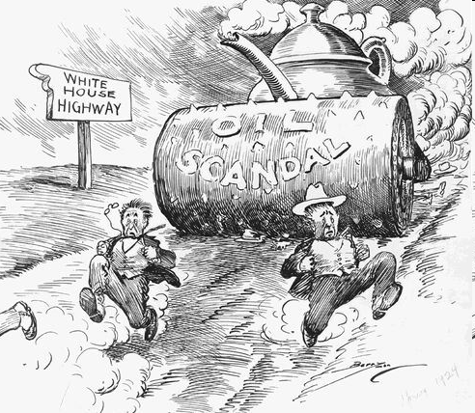
Harding and Coolidge
Labor Unrest
  Conditions still poor
  Strikes outlawed during WWI
  Boston Police Strike
  U.S. Steel Strike
  Coal Miners Strike- John L. Lewis
  Unions weaken
Prosperity returns
Appoints Hebert Hoover and Ohio Gang
Teapot Dome Scandal- Harding cabinet members lease oil rich lands to private companies for cheap- bribed
Harding dies in office
Replaced by Calvin Coolidge
Coolidge is pro business and laissez Faire
“Keep it cool with Cal”
“The Business of America is Business”

Slide 5
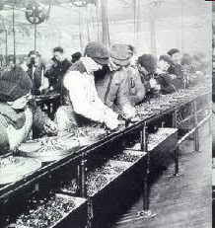
Roaring 20’s
Rural communities= strict values/ religion
Migration to urban areas change values
Less controlled
City life changes people
Automobile allows people to travel to cities and vacation
Henry Ford- Assembly Line Production
Workers are consumers
$5 day plan
People buy on the Installment plan
Increase in competition
Urban Sprawl
Electricity lights the city
Radio/advertising/ productivity all grow

Slide 6
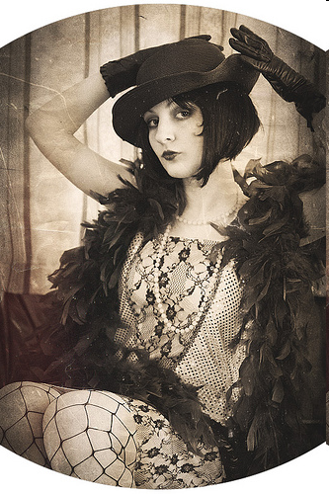
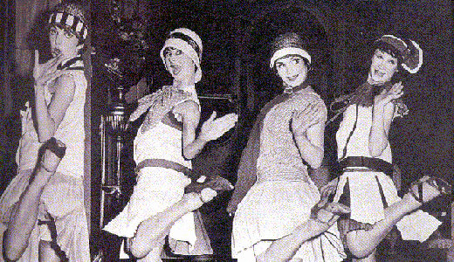
Women and the 20’s
Old role of women?
Flappers emerge- young women of modern times
New hair, dress, attitudes, behavior
Sexual double standard?
Conservative views?-Remember Cult of Domesticity
Margaret Sanger- advocates birth control= less kids

Slide 7
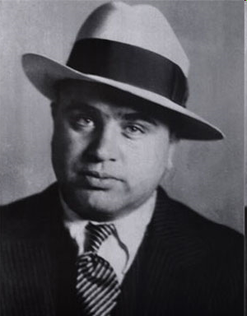
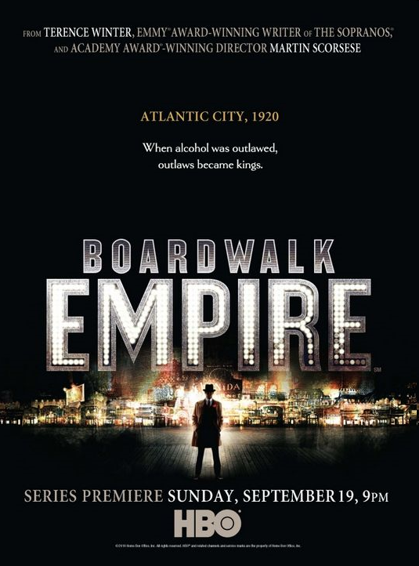
Prohibition
Alcohol banned- 18th amendment
Resentment in the new law
Govt. never truly enforces law
Speakeasies- drinking clubs
Bootleggers
Leads to the growth of organized crime/ Mob
Al Capone

Slide 8
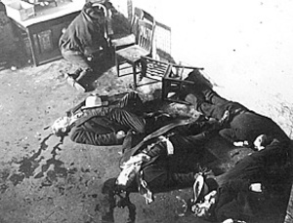
St. Valentine’s Day Massacre

Slide 9
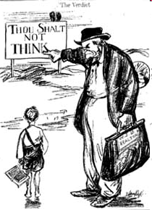
Science vs. Religion
Fundamentalism- religious movement focusing on the truth of the bible
Billy Sunday and Aimee Semple McPherson
Darwin’s Theory of Evolution
Scopes Monkey Trial-
  John Scopes arrested for teaching evolution
  Clarence Darrow- lawyer for ACLU
  William Jennings Bryan defends Bible

Slide 10
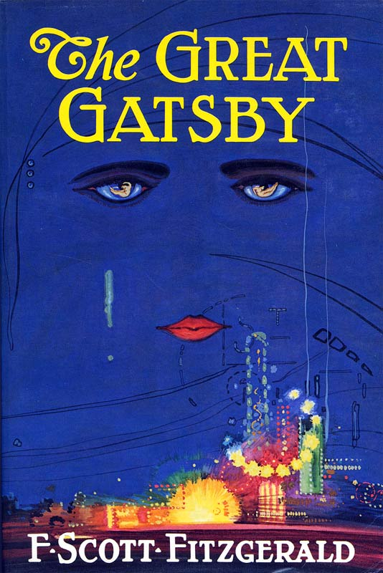
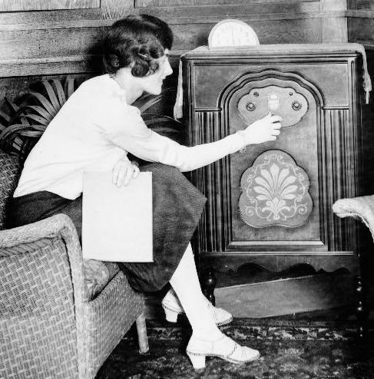
20’s Culture
Radio- Media Coverage
Music
George Gershwin- “Rhapsody in Blue”
Georgia O’Keefe-artist
Literature
Sinclair Lewis-wrote on materialism
F. Scott Fitzgerald- Wrote Gatsby
Ernest Hemingway- wrote against war

Slide 11
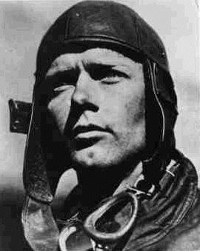
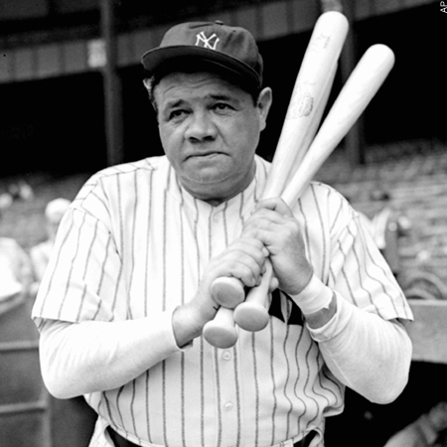
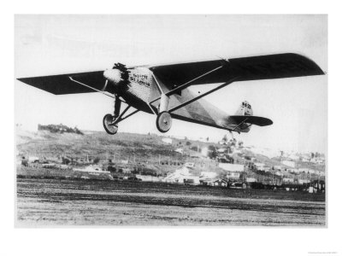
Heroes
More leisure time
Babe Ruth
The Great Bambino
Jack Dempsey-Boxing
Charles Lindbergh- flew the Spirit of St. Louis across the Atlantic Ocean
Amelia Earhart- 1st women to fly across Atlantic
Motion Pictures
  Hollywood emerges
  Charlie Chaplin- silent film actor
  Clara Bow-flapper girl
  Talking flims-1927

Slide 12
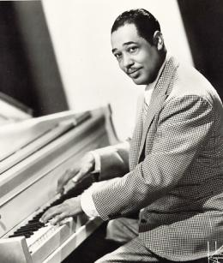
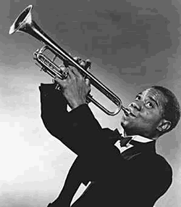
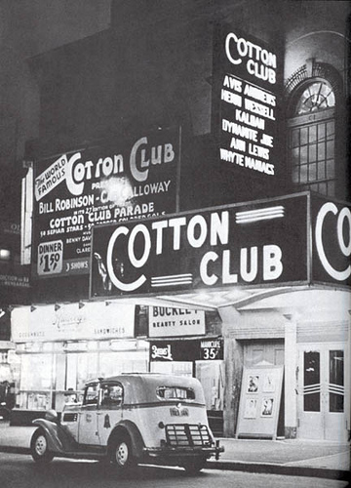
African America Life
Harlem Renaissance
  New literary and artistic movement emerges
  Celebrated African American culture
Langston Hughes- most famous writer and Poet
Louis Armstrong- most famous Jazz Musician
Others: Duke Ellington, Bessie Smith, Paul Robeson,

Slide 13
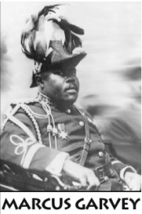
Black Nationalism
Marcus Garvey
Black separatist
Starts the Back to Africa Movement
Forms the Universal Negro Improvement Association (UNIA)
Jailed for mail fraud

Slide 14
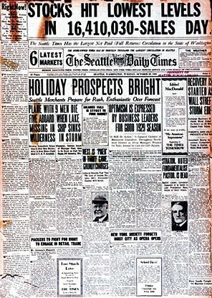
The Great Depression hits
Hoover elected President in 1928
“predicts the end of poverty”
Warning signs of Depression
Buying stock on Speculation
Buying on Margin
Stock prices are inflated
Oct 1929 prices fall
Oct. 29,1929- Black Tuesday- Stock Market crashes

Slide 15
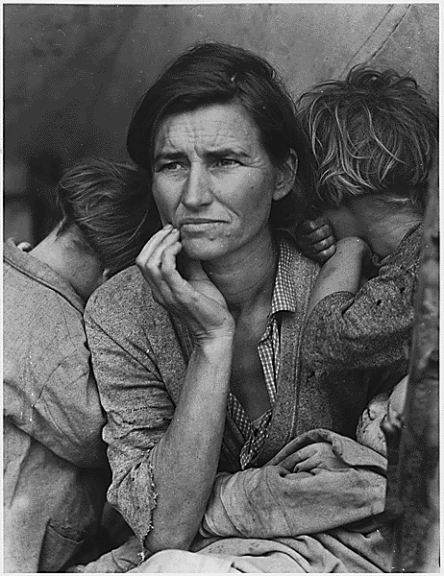
Causes of Depression
Overproduction of goods
too much credit
Less consumption of goods
Farm surplus
High tariffs
No banking regulations
Hawley-Smoot Tariff 1930- passed highest tariff in U.S. history

