Slide 1
UNIT 14: FROM THE 60S THROUGH THE 70S

Slide 2
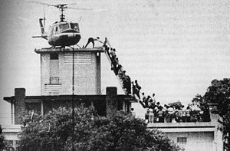
Vietnam Ends
Early 1973- U.S. leaves Nam
Paris Peace Accords
Fall of Saigon 1975
60,000 KIA/ 365,000 WIA
Vets treated unfairly upon return
26th Amendment- voting age 18
War Powers Act- President must tell Congress within 48 hrs of sending troops- has 90 days without Congress approval

Slide 3
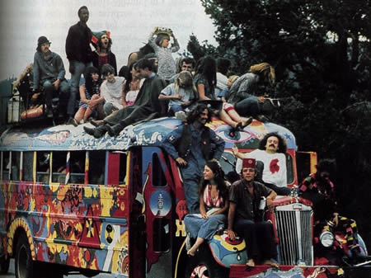
60’s Social Changes
Counterculture- Non Conformists
Hippies
Music, Drugs, Communal living, dress, sex
Turns violent- can’t grasp reality
Pop Art- Andy Warhol
Rock Music
British Invasion- Beatles and Rolling Stones
Protest Music
Woodstock-1969
Conservative Backlash
"Flower Power"

Slide 4

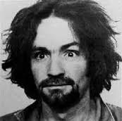
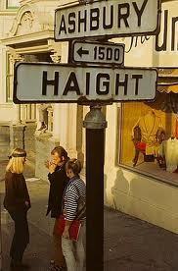
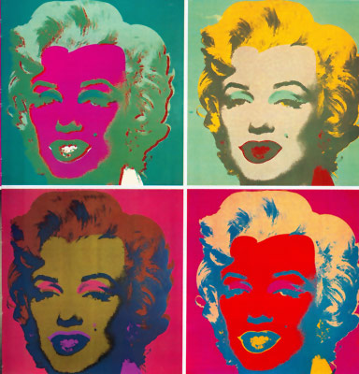
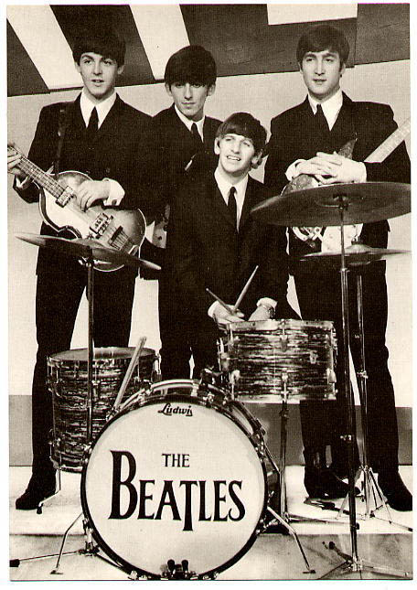
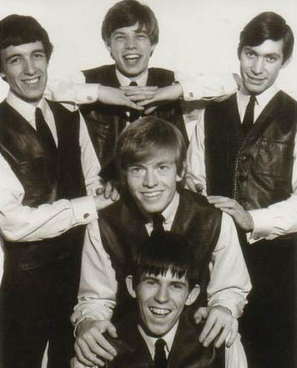
1960’s Culture

Slide 5
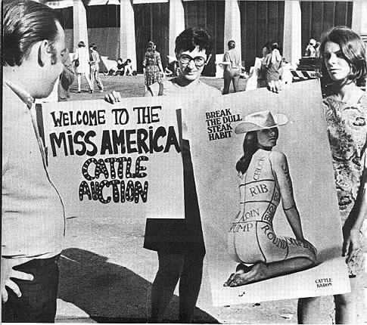
Other Social Change
Women
Freidan- Feminine Mystique
Feminism
NOW established
EEOC- Fairness in jobs
Gloria Steinem- Ms. Magazine
1972 Title IX- act that fights discrimination of women in education/sports
Roe v. Wade- 1973 Abortion case
ERA- Equal Rights Amendment
Phyllis Schlafly- opposed ERA

Slide 6
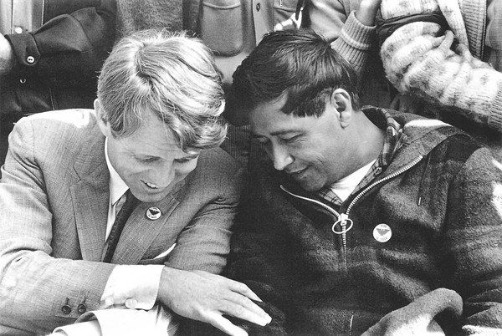

Minorities Culture change
Latinos population increase
Discrimination and poverty
Cesar Chavez- United Farm Workers
Want better education and political power
Native Americans
American Indian Movement
Win back some tribal lands and greater control over Indian affairs

Slide 7
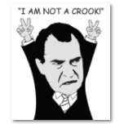
Nixon Presidency
More Conservative President
68’ and 72’
New Federalism- give some powers back to the states and local govts.
Revenue Sharing
Southern Strategy- gain white support by Southern policies(New Solid South)
Segregation and SC justices
Swann v. Char-Meck 1971

Slide 8
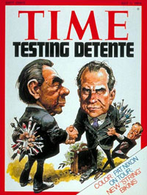
Nixon
Economy is in Stagflation
High unemployment and inflation
1973- Oil embargo by OPEC countries
Price freezes
Foreign Policy- Kissinger
Détente- easing of cold war tensions
Visits China- 1972
Visits Soviet Union
SALT Treaties- reduce missiles with Soviets

Slide 9
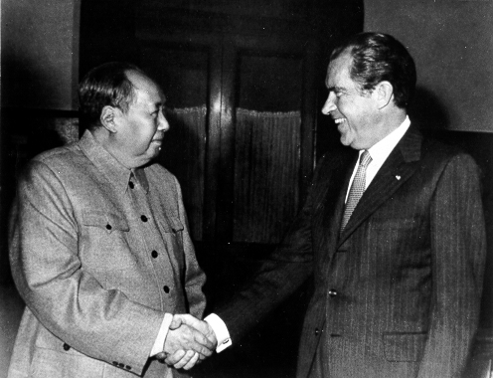
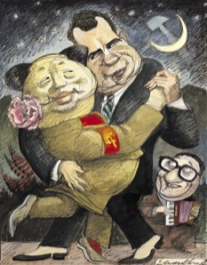
Nixon

Slide 10
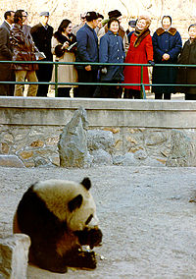
Panda Diplomacy

Slide 11
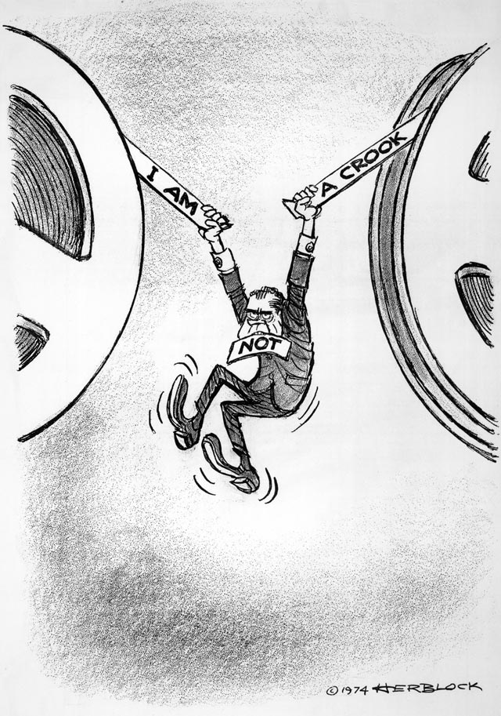
Watergate
1972 re-election
Watergate hotel broken into by Nixon’s men
CRP(CREEP)
Washington Post investigates
Bob Woodward and Carl Bernstein
Nixon wins re-election
Trials and investigations
Nixon fires prosecutors- Saturday Night Massacre
U.S. v. Nixon -1974
Nixon releases tapes-edited
Nixon resigns
Ford becomes President

Slide 12
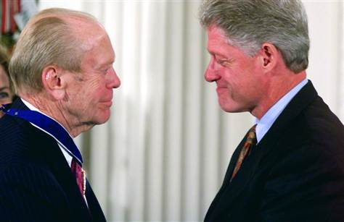
Gerald Ford
Replaces Nixon in 74
Needs to “heal the nation’s wounds
Vietnam and Watergate
Ford Pardons Nixon after taking office
Public upset- Ford thought needed to move forward
Inflation still a problem
Wants people to cut back on energy use
Win- Whip Inflation Now
Raises interest rates- Recession
Helsinki Accords- better cooperation in Europe
Create Nuclear Regulatory Commission

Slide 13

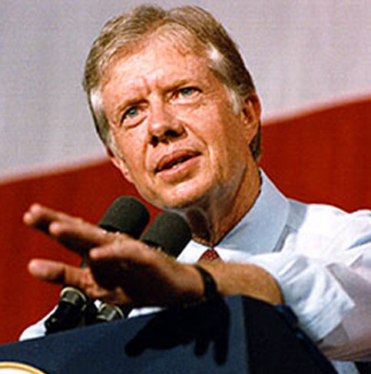
Carter takes over
Jimmy Carter- Gov. of Georgia
Honest and integrity
Wants to address energy
Creates Dept. of Energy
Doesn’t help-gets worse
Carter promotes Human Rights-leads to a renewal of Cold War
Breakdown of Détente
Gives up Panama Canal

Slide 14
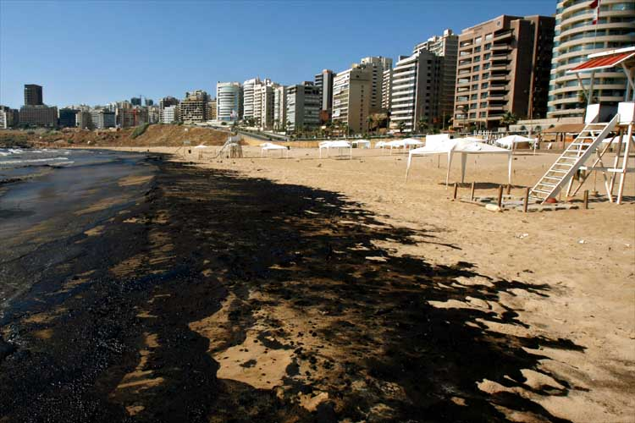
Environmentalism
Carson-Silent Spring 62’
Nixon creates EPA
Environmental Protection Agency
1st Earth Day in 1970
Three Mile Island
Debate continues on Nuclear energy
Nuke Regulatory Commission

Slide 15
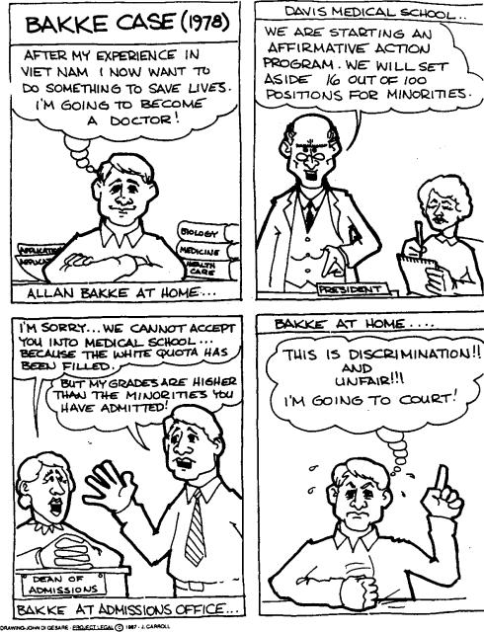
California v. Bakke
School held 16 spots for minorities
Case deals with Affirmative Action
1978
Racial Quotas unconstitutional
However, Race could be used as a factor

Slide 16
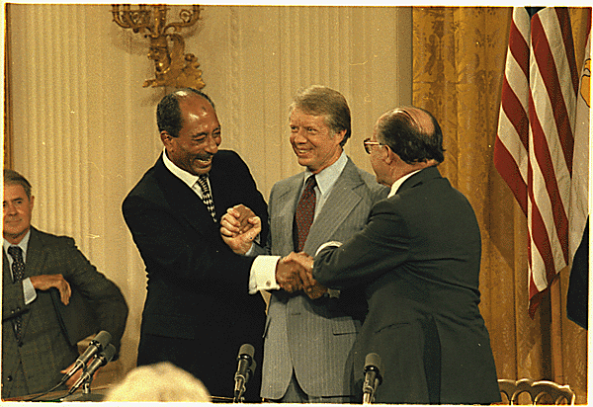
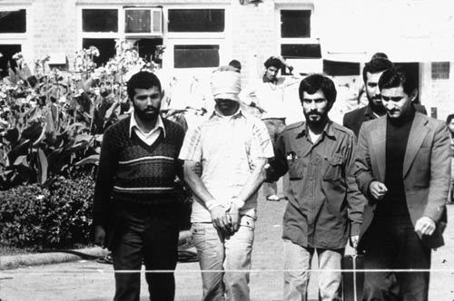
Middle East and Carter
Carter’s high point-
Camp David Accords- Egypt and Israel agree to peace
Hope for Middle East
Carter’s low point-
Iranian Hostage Crisis
U.S. supports Shah
Ayatollah Khomeini
Failed rescue attempt
Hostages released 1st day of Reagan term

Slide 17
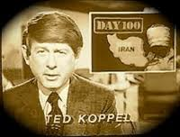

Iranian Hostage Crisis

Slide 18
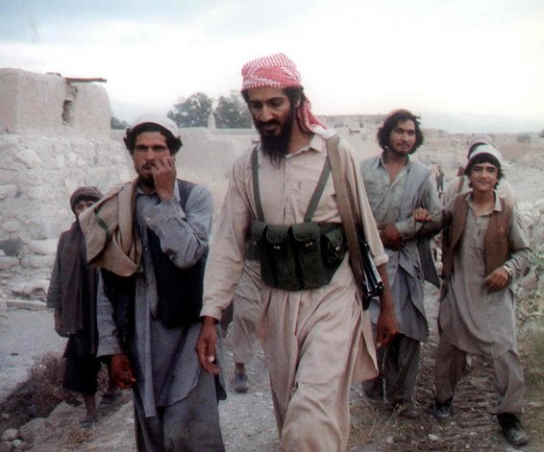
End of Détente
As Carter Presidency ends- Soviets invade Afghanistan
Cold re-heats
Détente ends
U.S. aids Mujahideen
Bin Laden

