Slide 1
UNIT 13: VIETNAM WAR ERA

Slide 2
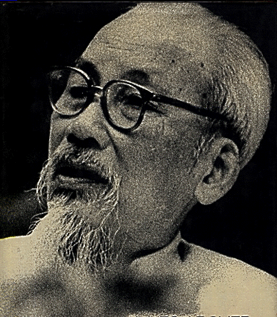
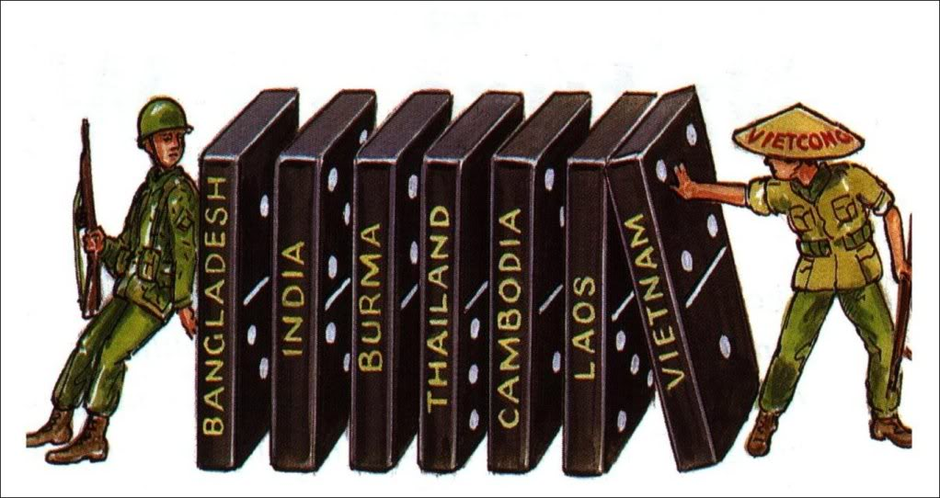
Vietnam War
Remember Truman Doctrine
Domino Theory – one country falls, they all could
Vietnam split in two
North= Communism
Ho Chi Minh
South= Anti-Communist
Ngo Dinh Diem
Supposed to have an election to unite country
Diem cancels elections
Viet-cong begin fighting

Slide 3
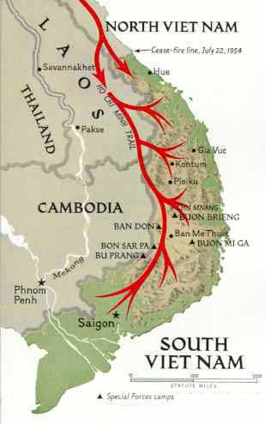
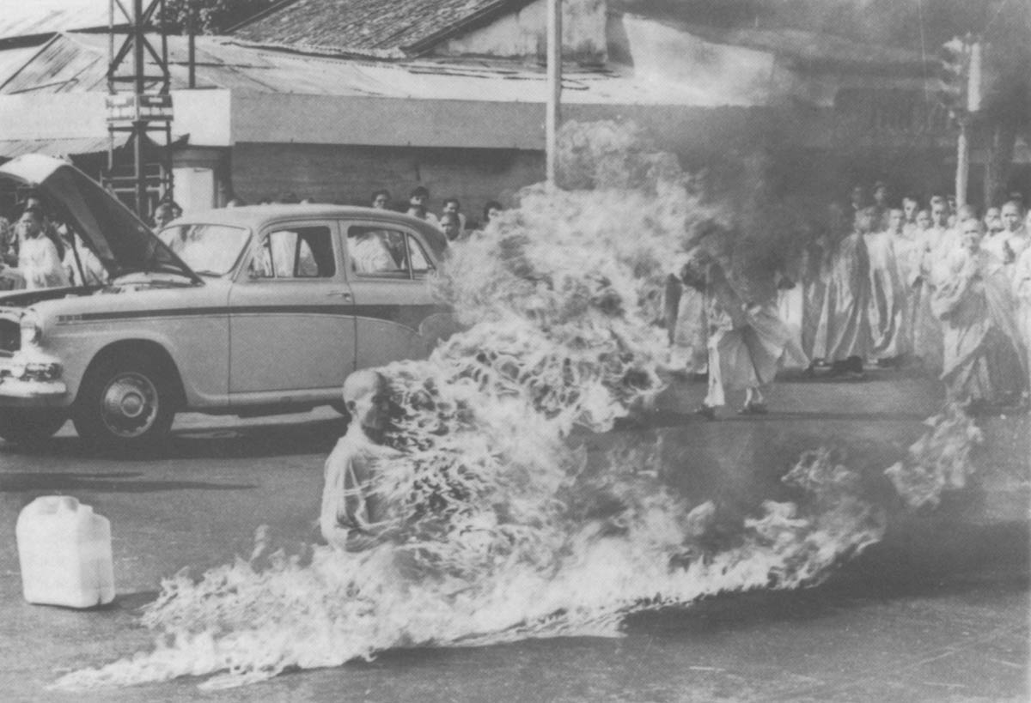
Vietnam

Slide 4
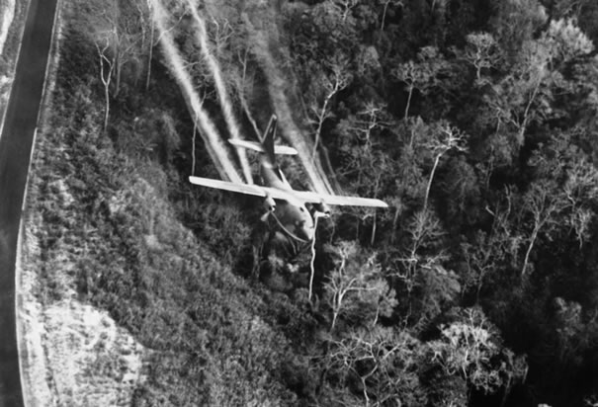
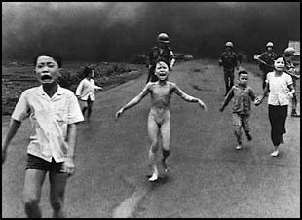
U.S. Involvement
Diem is unpopular and assassinated
Gulf of Tonkin
U.S. ship attacked
LBJ asks for action (war)
Operation Rolling Thunder- bombings begin
Troop buildup
U.S. war led by LBJ, McNamara, Westmoreland
Vietcong- guerilla warfare
Hard to fight- Search and Destroy Missions
Napalm and Agent Orange used

Slide 5
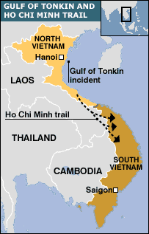
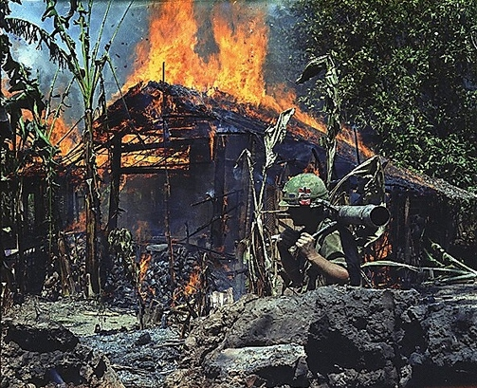
Vietnam

Slide 6
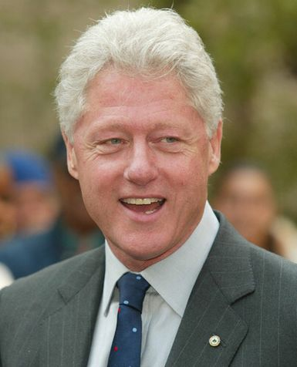
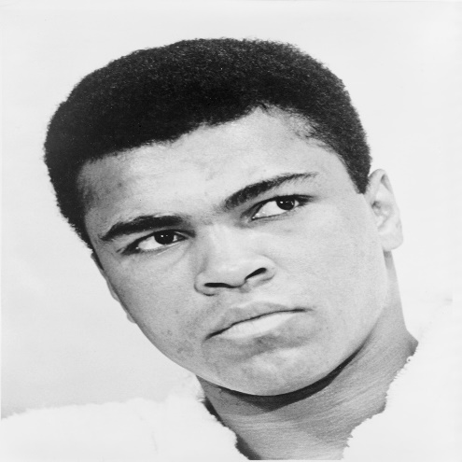
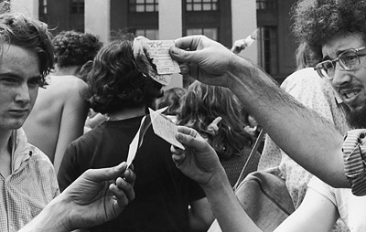
Vietnam
Soldiers have low morale
Great Society gets put on backburner
1st TV war
Credibility Gap with public
Protests begin
Hawks vs. Doves
Long War- why fight?
Unfair Draft practices
Deferments
Dodging
Objectors

Slide 7
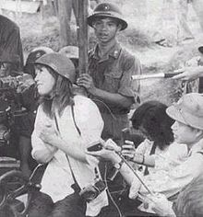
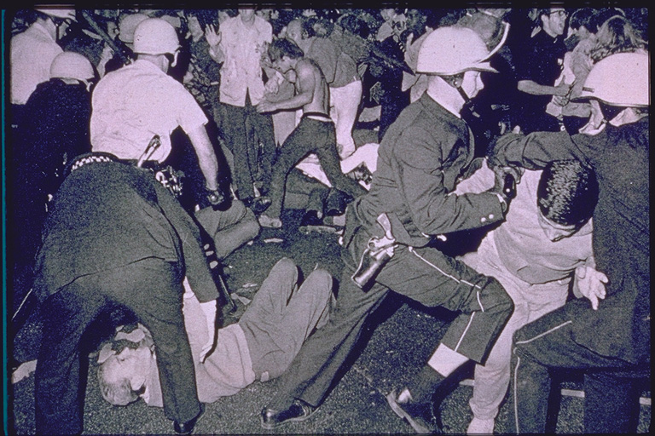
Protests and further escalation
Students for a Democratic Society (SDS)
Anti-War
Teach ins and protests in D.C.
Tet Offensive
  U.S. predicting victory soon
  Jan. of 1968 Vietcong counteroffensive
  Tide turns on LBJ
1968-
  LBJ scales back war
  Does not seek re-election
  MLK, RFK assassinated
  College protests nationwide
  Democratic National Convention- violent protests

Slide 8
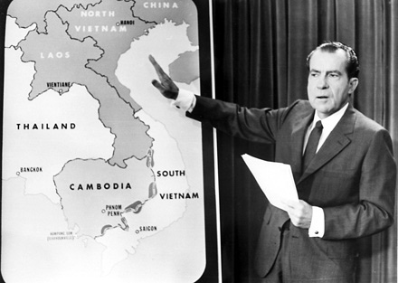
Nixon takes over War
Nixon wins in 1968
Vietnamization- train Vietnamese to fight ground war while continuing air support
Bombs Laos and Cambodia in attempt to break supply lines
Nixon wants to leave without saying U.S. lost

Slide 9
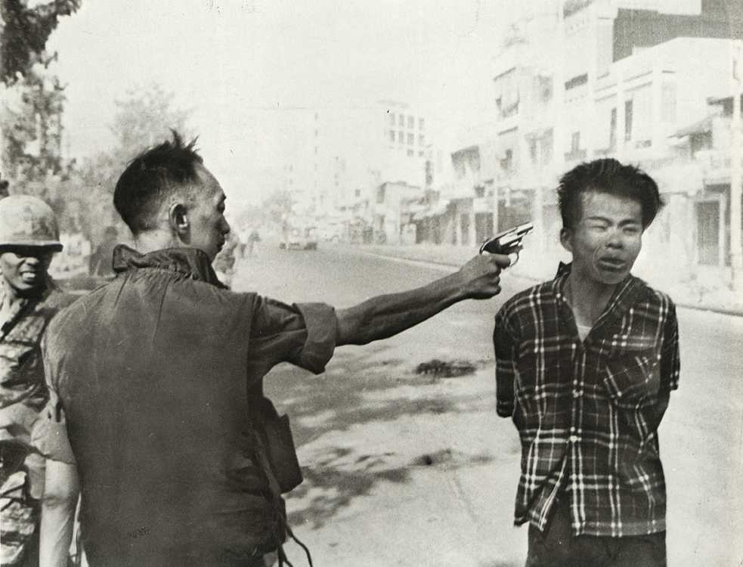
Home front
My Lai Massacre- 1968- killing of civilians
College protests
Kent State- National Guard opens fire on students
Jackson State
Pentagon Papers- documents taken from Pentagon that Presidents were not being truthful
NY Times v. U.S. 1971-

Slide 10
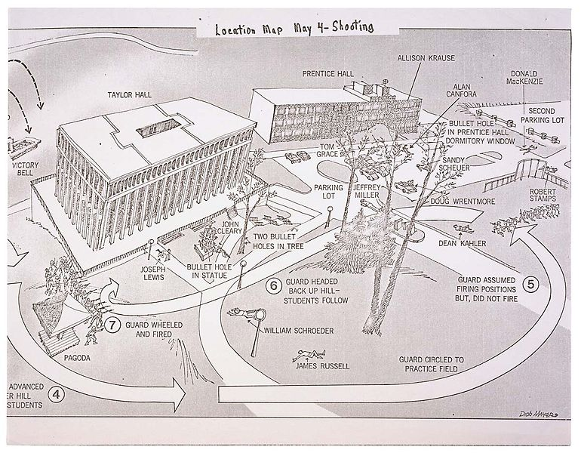
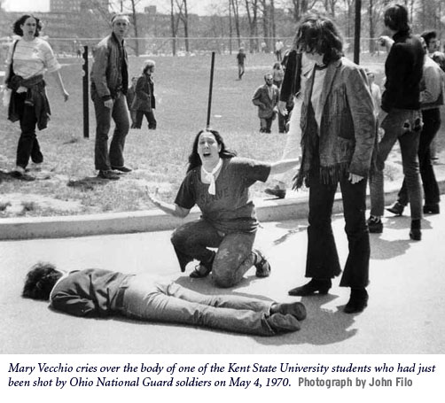
Kent State Shootings

Slide 11
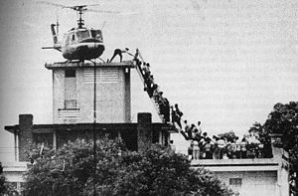
Vietnam Ends
Early 1973- U.S. leaves Nam
Paris Peace Accords
Fall of Saigon 1975
60,000 KIA/ 365,000 WIA
Vets treated unfairly upon return
26th Amendment- voting age 18
War Powers Act- President must tell Congress within 48 hrs of sending troops- has 90 days without Congress approval

Slide 12
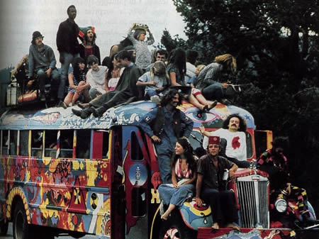
60’s Social Changes
Counterculture- Non Conformists
Hippies
Music, Drugs, Communal living, dress, sex
Turns violent- can’t grasp reality
Pop Art- Andy Warhol
Rock Music
British Invasion- Beatles and Rolling Stones
Protest Music
Woodstock-1969
Conservative Backlash
"Flower Power"

Slide 13
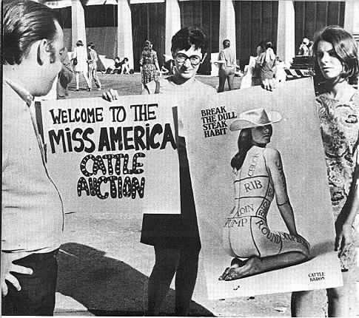
Other Social Change
Women
Freidan- Feminine Mystique
Feminism
NOW established
EEOC- Fairness in jobs
Gloria Steinem- Ms. Magazine
1972 Title IX- act that fights discrimination of women in education/sports
Roe v. Wade- 1973 Abortion case
ERA- Equal Rights Amendment
Phyllis Schlafly- opposed ERA

Slide 14
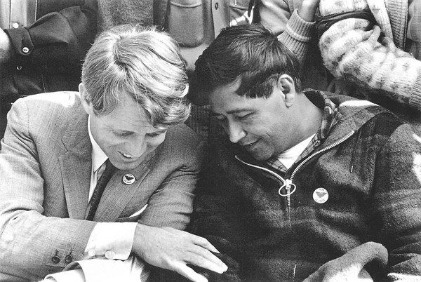
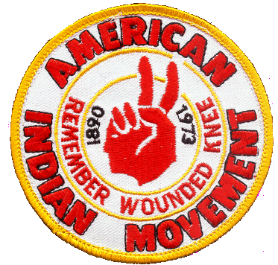
Minorities Culture change
Latinos population increase
Discrimination and poverty
Cesar Chavez- United Farm Workers
Want better education and political power
Native Americans
American Indian Movement
Win back some tribal lands and greater control over Indian affairs

