Slide 1
Unit One: The Civil War

Slide 2
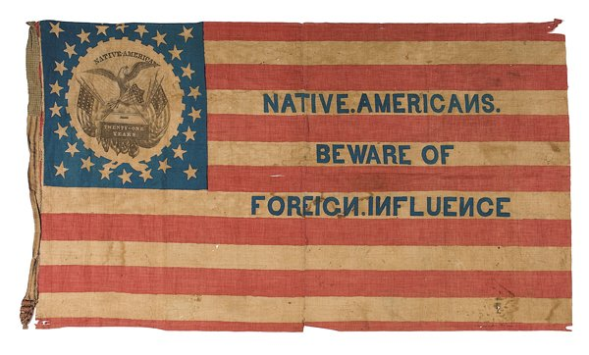
Development of Political Parties
Slavery becomes central issue in parties
Anti-Slavery Whigs, Democrats and Free Soilers form a new party
Republican Party
Oppose the growth of slavery where it did not exist
Know-Nothing Party- Nativists as known as American party

Slide 3
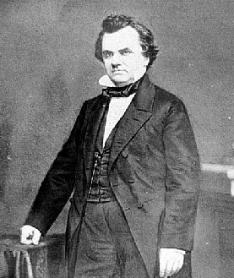
Lincoln-Douglas Debates
Senate race in 1858
Stephen Douglas and Abraham Lincoln debate over slavery issues
neither man wanted slavery to extend, but how to do it?
Douglas issues Freeport Doctrine
Slavery needs certain laws in order to exist. Don’t pass those laws and there will be no slavery
Douglas wins the election, Lincoln gains national fame

Slide 4
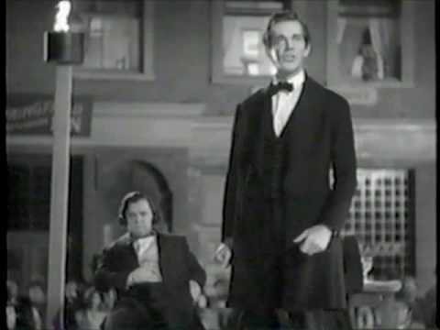
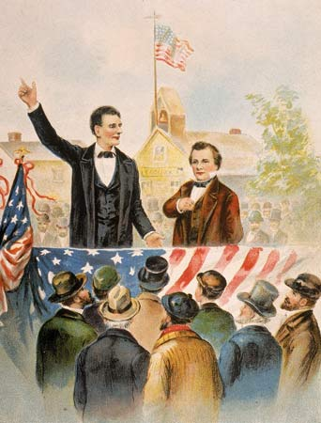
Lincoln gains fame over debates

Slide 5
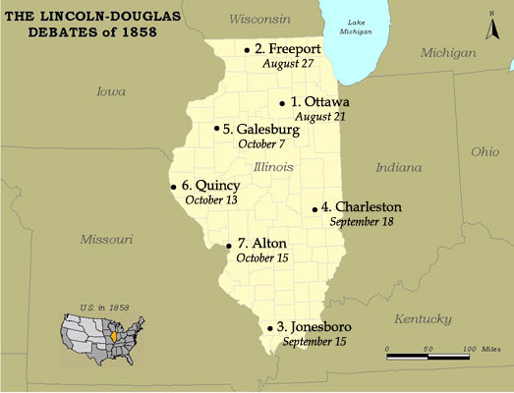
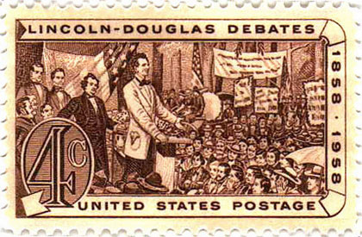
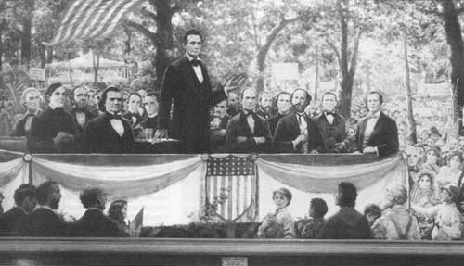
The Lincoln-Douglas (Illinois Senate) Debates, 1858
A House divided against itself, cannot stand.

Slide 6
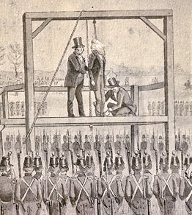
John Brown’s Raid-1859
Brown an extreme abolitionist
Attempted to capture Harpers Ferry arsenal
Forced to surrender after slaves don’t revolt
Found guilty of treason and hanged
Becomes martyr for abolitionists
Brown represented northerners who wanted to control the southern lifestyle

Slide 7
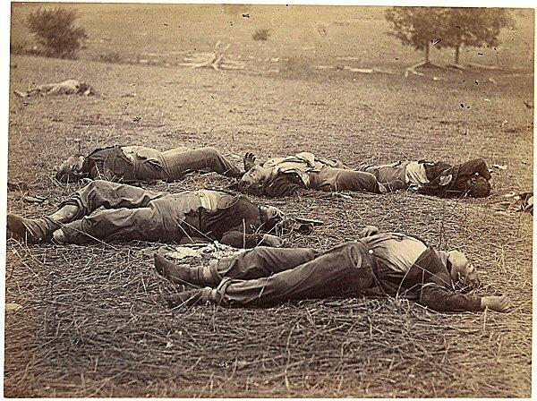
Southern Secession and 1860 Election
1860 election
Stephen Douglas –North Dems
John Breckinridge- Southern Dems
John Bell- Constitutional Union
Abraham Lincoln- Republican
Lincoln wins election with no southern votes
Southern States secede in fear of govt. where they have no voice
*South Carolina secedes first
*Confederate States of America Form before Lincoln takes office
*Jefferson Davis elected Confederate President

Slide 8
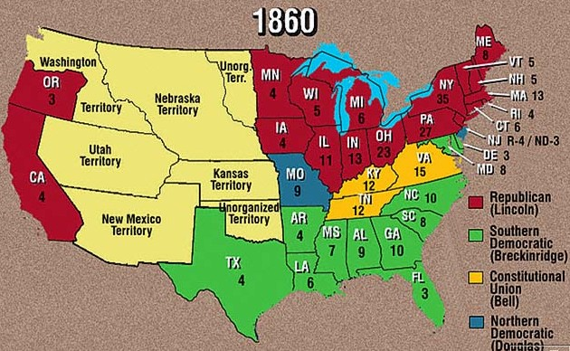
1860 Election

Slide 9
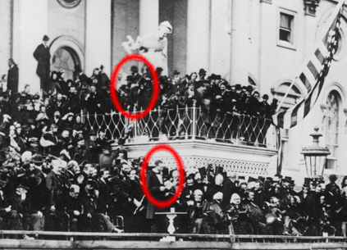
Lincoln’s Inauguration- March 1861 after Secession

Slide 10
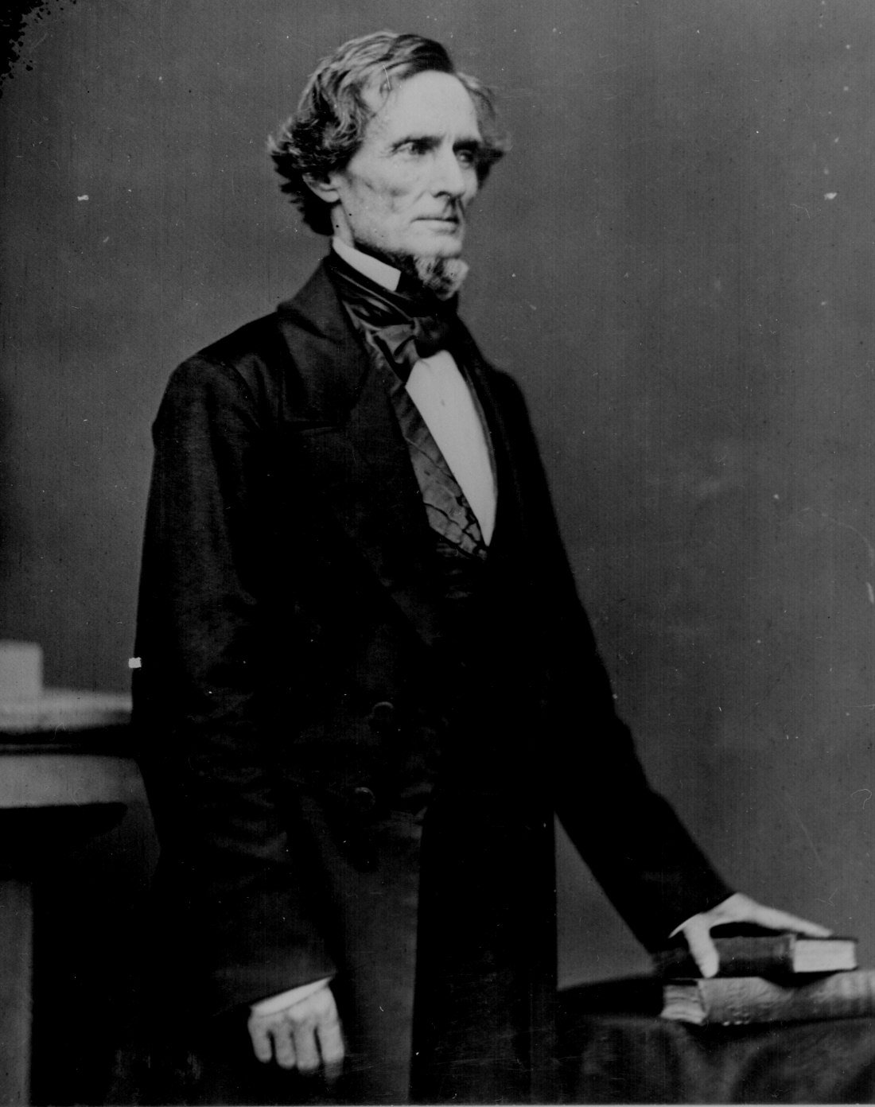
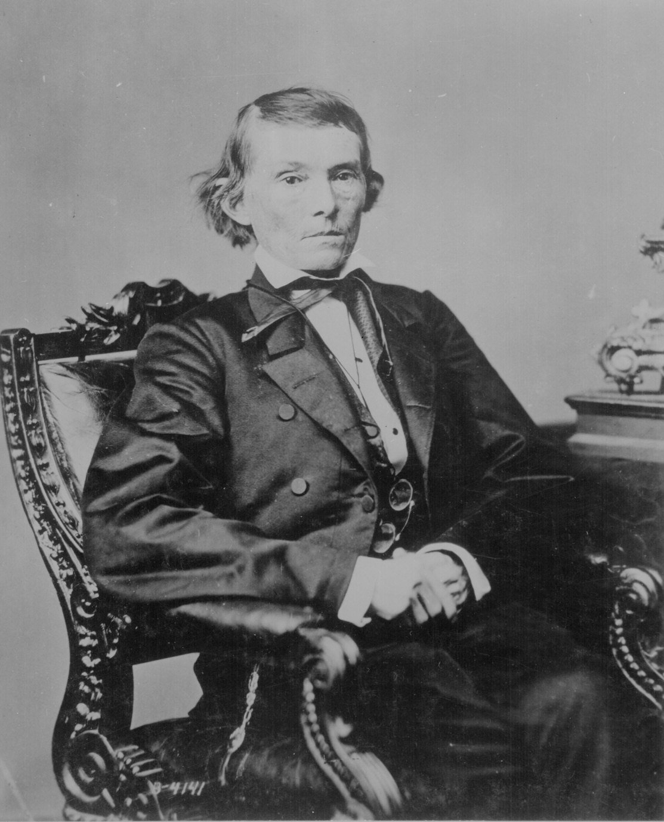
The Leaders of the Confederacy
Jefferson Davis
Alexander Stephens

Slide 11
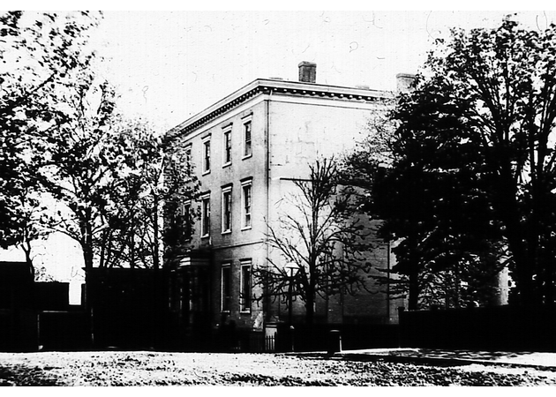
The Confederate “White House”

Slide 12
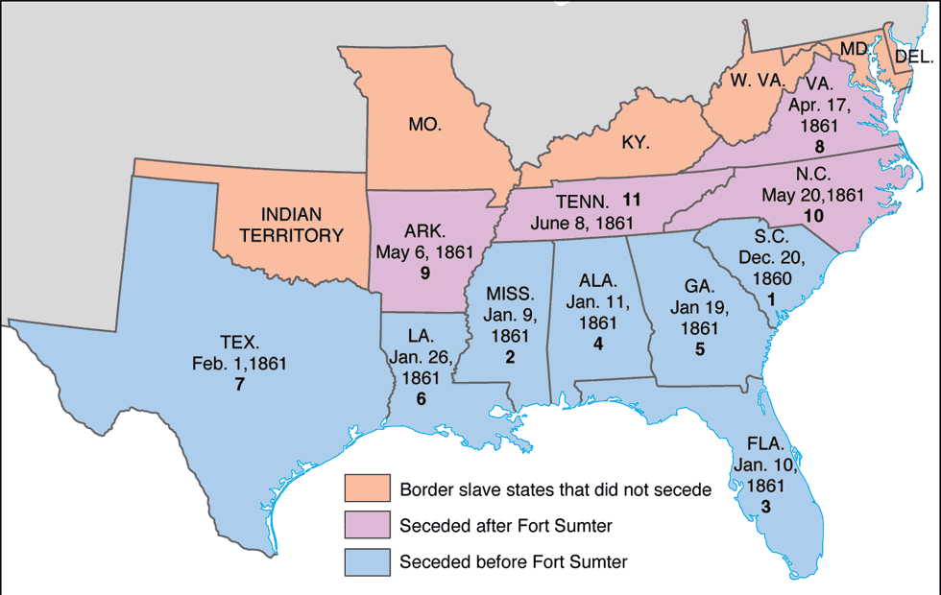
Secession!: SC→ Dec. 20, 1860

Slide 13
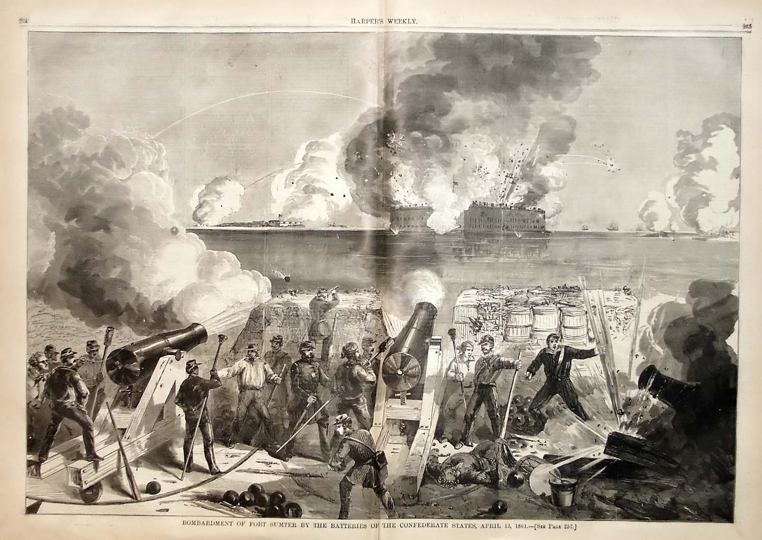
Stars and Bars vs. Stars and Stripes- Civil War Begins
11 states leave the Union
South Carolina fires on Fort Sumter
VA, NC, Ark, and Tenn. All secede after Fort Sumter
Modern War

Slide 14
Advantages and Strategies
Union
Strategy:
Anaconda (Constrictor) Plan-
  1- blockade southern ports so they can’t import or export
  2- take the capital of Richmond
  3- cut the South into 2 parts along the Mississippi
Advantages:
  Larger population
  More industrialized and more resources
  Better transportation
Confederacy
Strategy:
  Defensive battle- with occasional northern attack
  European recognition
Advantages:
  Defending their homes
  Sectional Pride
  Better military tradition and leaders

Slide 15
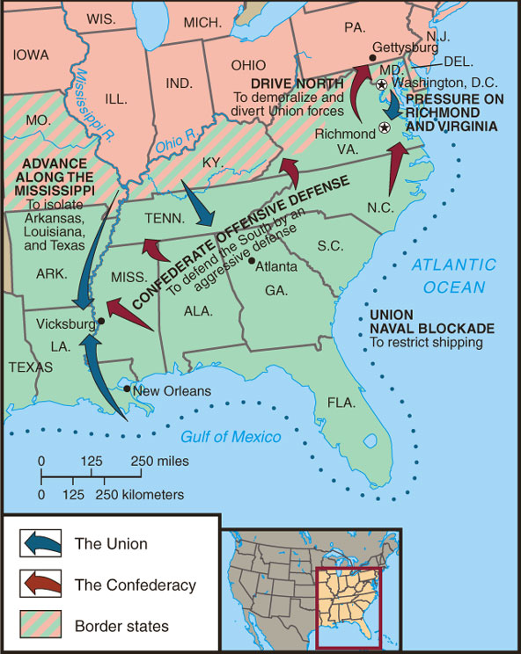
Anaconda Plan

Slide 16
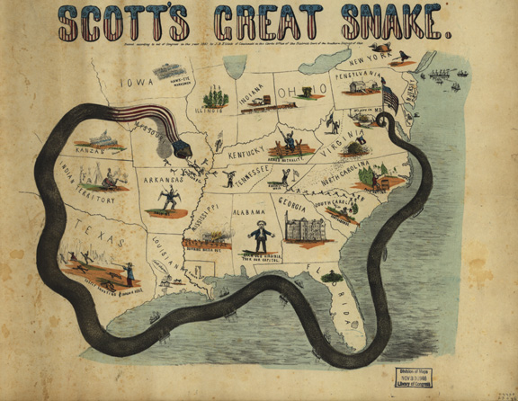
The “Anaconda” Plan

Slide 17
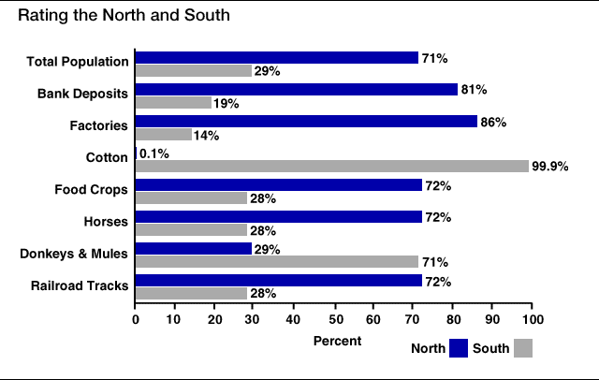
Rating the North & the South

Slide 18
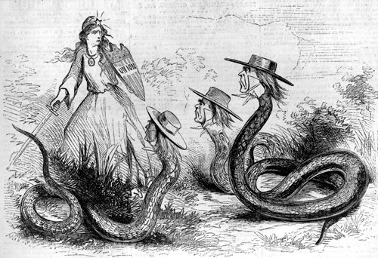
Civil War
Both sides need to raise armies, pay for it, and suppress opposition
Copperheads- northerners who wanted peace with South
North gets volunteers, then the draft
Draft riots
African-Americans fight in segregated forces (54th Massachusetts)
Europe remains neutral
Women serve as nurses
Clara Barton- Union nurse on the front lines

Slide 19
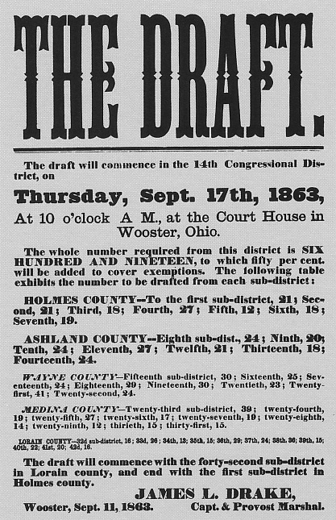
The North Initiates the Draft, 1863

Slide 20
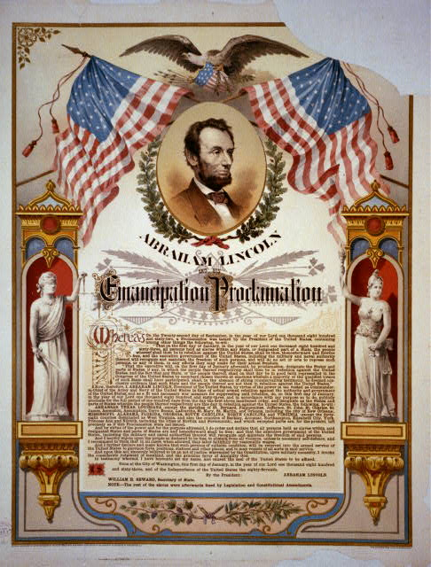
War Politics
Lincoln suspends Habeas Corpus
Emancipation of Proclamation- needed a higher cause
Freed slaves in Confederate States
Not in border States
Jan. 1., 1863

Slide 21
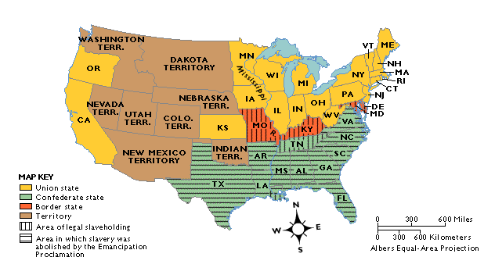
Emancipation in 1863

Slide 22
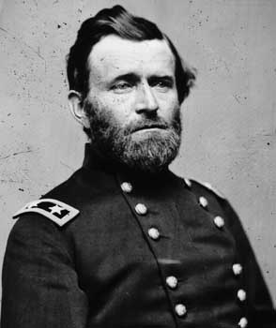
Civil War
Bull Run- 1st Battle( July 1861)
  Also called Manassas
  Confederate Victory
  Citizens watch
  South does not pursue retreating Union
Battle of Shiloh –April 1862
  Costly victory for U.S. Grant
  Showed victory would be costly
  Grant heading for Mississippi

Slide 23
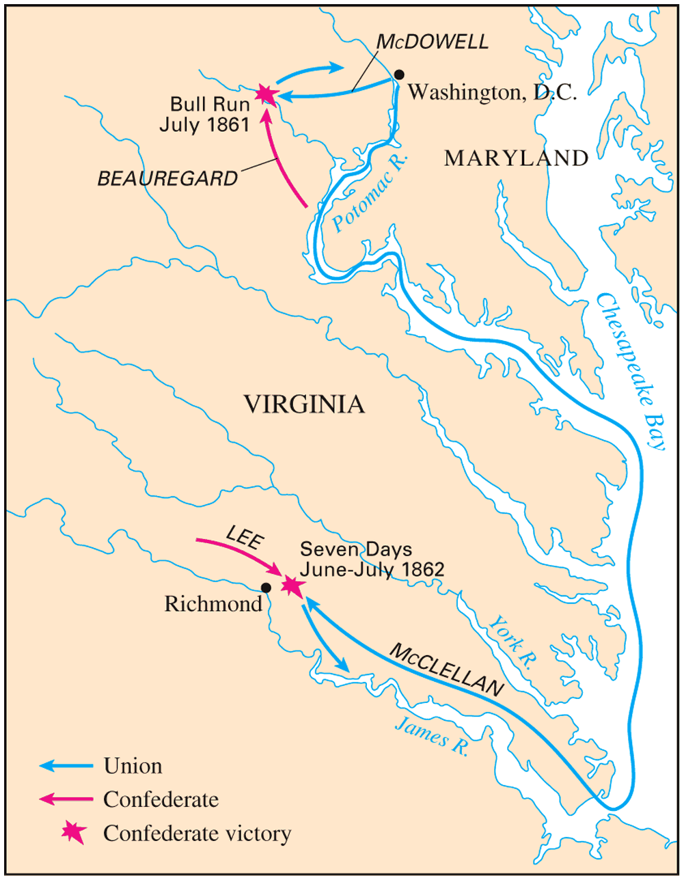
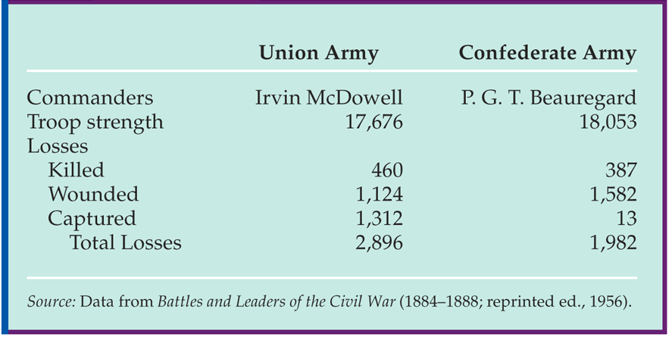
Battle of Bull Run
(1st Manassas)

Slide 24
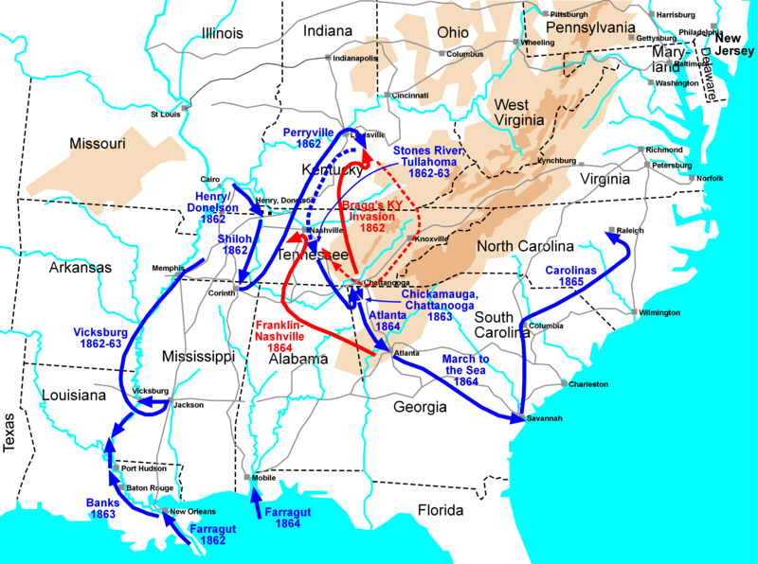

Slide 25
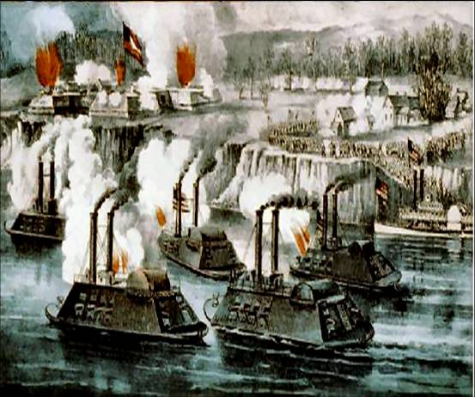
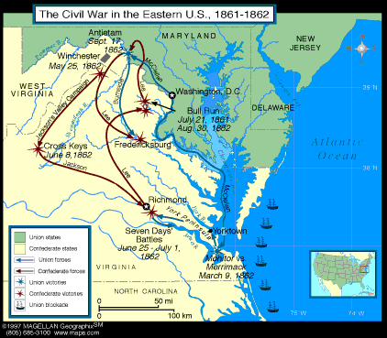
The Battle of the Ironclads,
March, 1862
Iron Ships
Monitor (Union) vs.
Merrimack (Confederate)

Slide 26
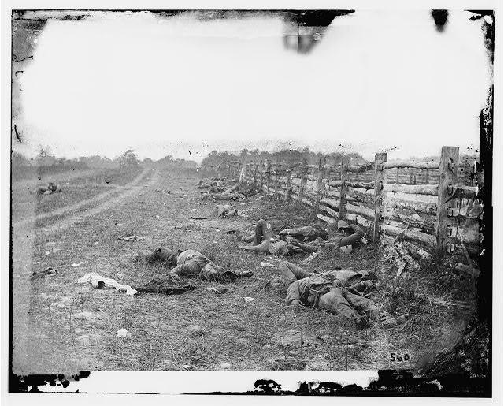
Battle of Antietam
Sept. 1862
Bloodiest single day in the War
Union victory for McClellan
November 1862-Vicksburg
Grant surrounds city on the Mississippi
“Split the South”

Slide 27
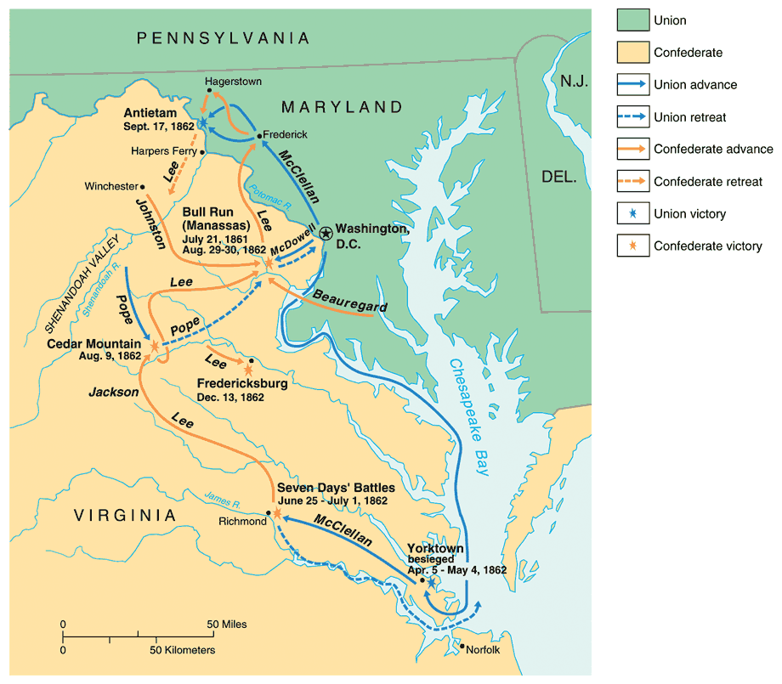
War in the East: 1861-1862

Slide 29

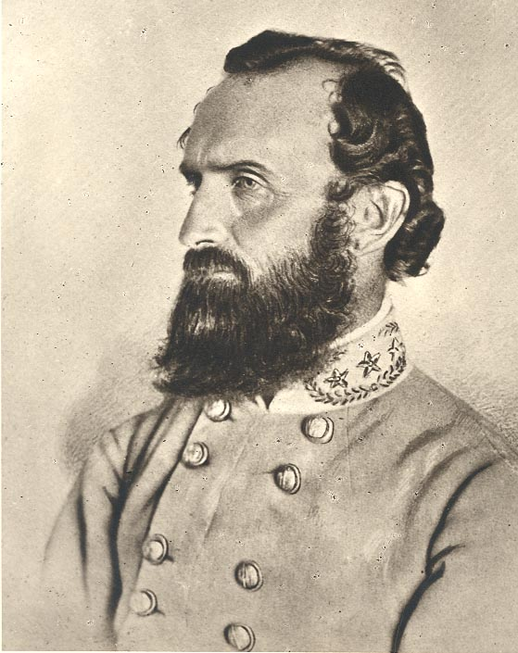
Confederate Victories
Although outnumbered, Confederates still win under Robert E. Lee
Fredericksburg- Dec. 1862
Chancellorsville- May 1863
Stonewall Jackson killed

Slide 30
Chancellorsville

Slide 31
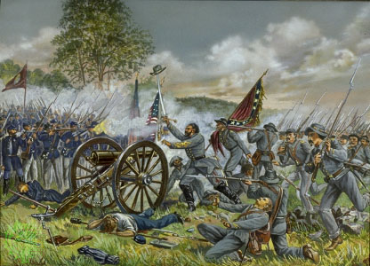
Gettysburg
Turning point of the Civil War
July 1863
Lee invades North
Little Round Top
Cemetery Ridge
Pickett’s Charge
Gettysburg Address- Lincoln dedicates the ground with speech
Vicksburg surrender the very next day to Grant
Grant called to lead entire Union army

Slide 32
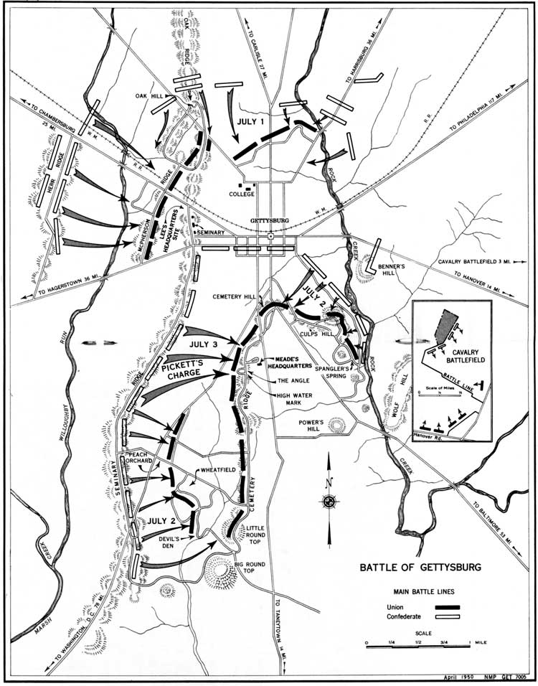

Slide 33
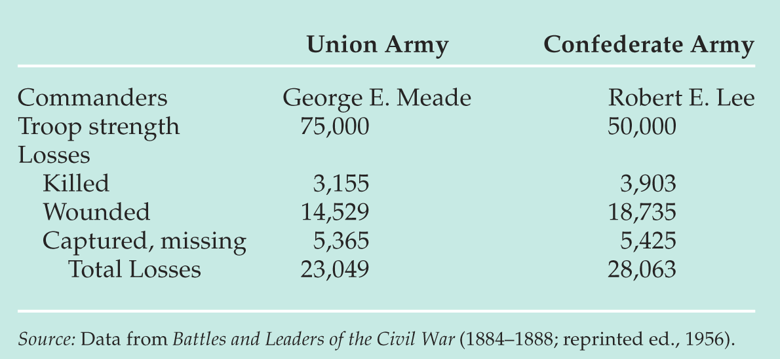
Gettysburg Casualties

Slide 34
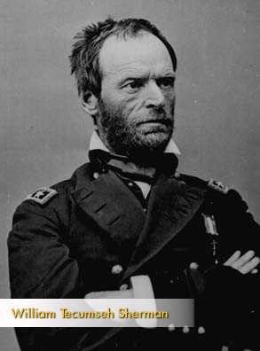
Sherman’s March
1864
William Tecumseh Sherman
Sherman’s “March to the Sea”
Total War- break morale and target civilians who help
“War is hell”
Scorched Earth
Burning of Atlanta
Destroy South’s will to fight
Grant “The Butcher” continues to pursue Lee in VA
Helps Lincoln win re-election

Slide 35
The Gettysburg Address
Four score and seven years ago our fathers brought forth on this continent, a new nation, conceived in Liberty, and dedicated to the proposition that all men are created equal.
Now we are engaged in a great civil war, testing whether that nation, or any nation so conceived and so dedicated, can long endure. We are met on a great battlefield of that war. We have come to dedicate a portion of that field, as a final resting place for those who here gave their lives that that nation might live. It is altogether fitting and proper that we should do this.
But, in a larger sense, we cannot dedicate—we cannot consecrate—we cannot hallow—this ground. The brave men, living and dead, who struggled here, have consecrated it, far above our poor power to add or detract. The world will little note, nor long remember what we say here, but it can never forget what they did here. It is for us the living, rather, to be dedicated here to the unfinished work which they who fought here have thus far so nobly advanced. It is rather for us to be here dedicated to the great task remaining before us—that from these honored dead we take increased devotion to that cause for which they gave the last full measure of devotion—that we here highly resolve that these dead shall not have died in vain—that this nation, under God, shall have a new birth of freedom— and that government of the people, by the people, for the people, shall not perish from the earth.

Slide 36
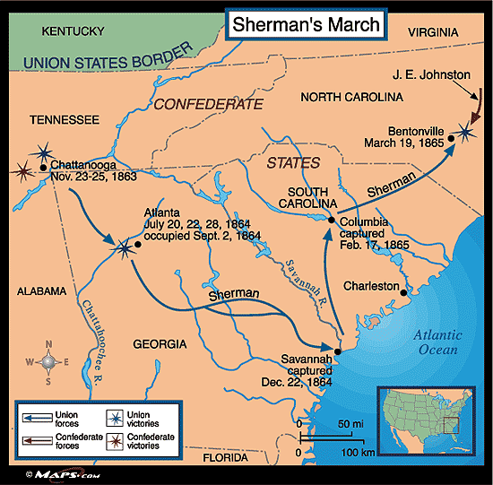

Slide 37
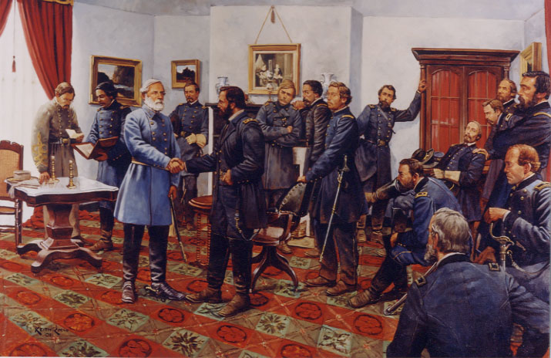
War ends
1864
Lee retreating
Grant always on the attack
Lincoln wants speedy end to war
April 1865
Grant surrounds Lee at Appomattox court House
Just outside Richmond
Lincoln is generous
Will be our brothers again

Slide 38
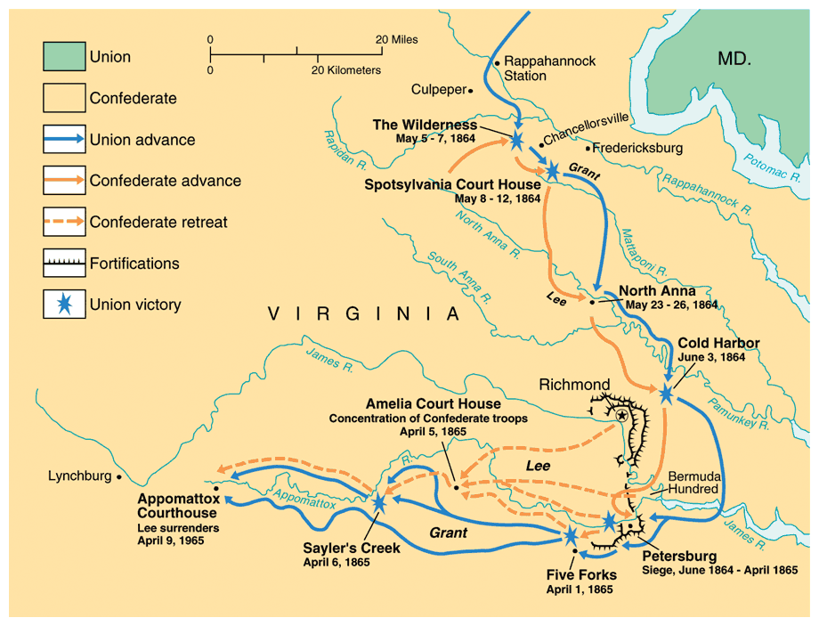

Slide 39
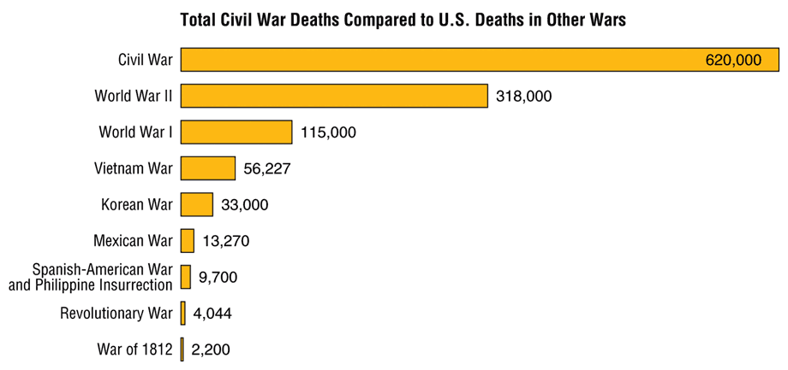
Civil War Casualties
in Comparison to Other Wars

Slide 40
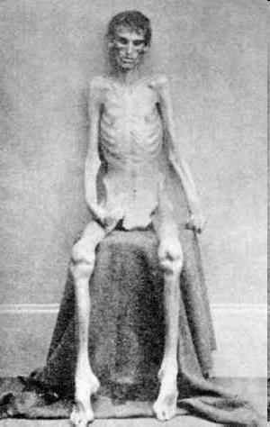
War
Modern warfare
Riffles and mini-balls
Trench warfare
Grenades
Submarines
Iron ships
Andersonville

Slide 41
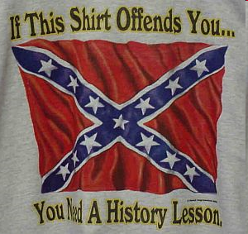
Legacy of War
Federal Government Supremacy
Income taxes
Draft
Civil liberties suppressed during war time
Southern economy wrecked for over fifty years
Must be rebuilt
North gets stronger
600,000 dead
½ million wounded
$20 Billion- 5x that spent in the previous 80 years

Slide 42
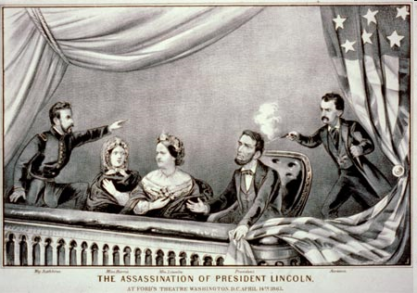
War Politics
13th amendment- bans slavery
Soldiers return home
Urban population growth
Lincoln wanted a forgiving peace to the South to restore Union
Lincoln assassinated at Ford’s Theatre 5 days after war ends
John Wilkes Booth
1st assassination of a President

