Slide 1
UNIT 2: RECONSTRUCTION

Slide 2
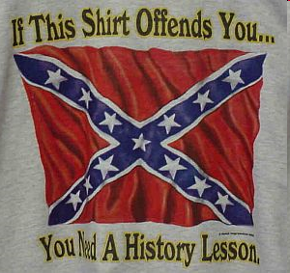
Legacy of War
Federal Government Supremacy
Income taxes
Draft
Civil liberties suppressed during war time
Southern economy wrecked for over fifty years
Must be rebuilt
North gets stronger
600,000 dead
½ million wounded
$20 Billion- 5x that spent in the previous 80 years

Slide 3
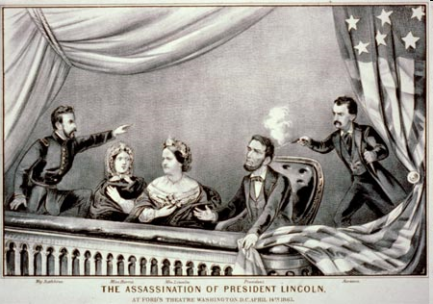
War Politics
13th amendment- bans slavery
Soldiers return home
Urban population growth
Lincoln wanted a forgiving peace to the South to restore Union
Lincoln assassinated at Ford’s Theatre 5 days after war ends
John Wilkes Booth
1st assassination of a President

Slide 4
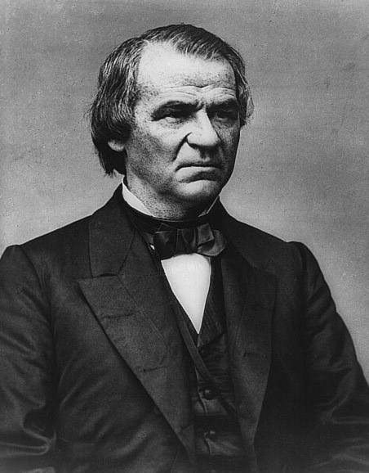
Reconstruction- rebuilding the South and readmitting the southern states
South in shambles
Lincoln’s Plan (10% plan)
  Forgiving peace- fix Union
  Pardons of ex-confederates
  10% take an oath
  Little talk of slavery
Radical Republicans Plan
  Charles Sumner and Thaddeus Stevens
  Wade-Davis Bill- harsher plan that wanted to give Congress control over reconstruction
  Majority take oath
  Martial law
  Bars former confederates from office
  Lincoln Pocket Veto

Slide 5
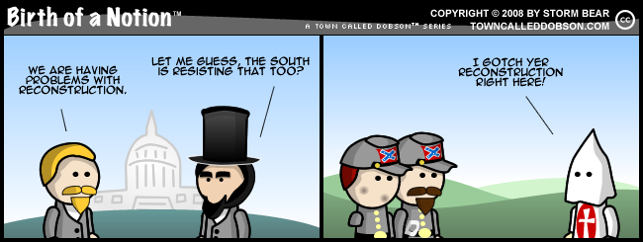
Power struggles
Lincoln assassinated- Andrew Johnson becomes President
Favored Lincoln’s plan with some additions
13th amendment
Congress refuses plan-South tries to reorganize under Lincoln’s plan
South institutes Black Codes; elect same leaders to office, deny blacks rights
Saw little change in the South
Congress refuses to seat southern reps.

Slide 6
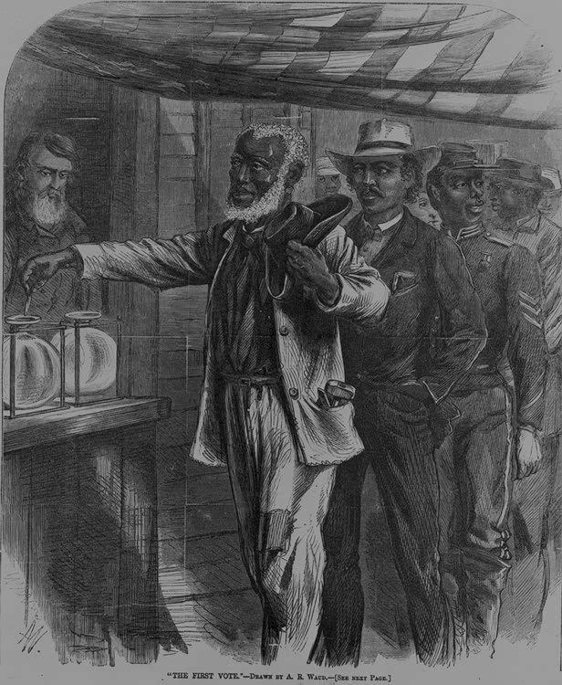
Reconstruction
Congress passes Civil Rights Act of 1866 over a Johnson veto
Eliminate Black Codes
14th amendment passed- made AA’s citizens
Radicals control Congress
Reconstruction Act of 1867
  Overrides President
  Military rule of South
  Protects former slaves
  Bans former leaders
Johnson impeached – Tenure of Office act
Acquitted but not impeached
Grant elected President
15th amendment passed- AA’s males can vote

Slide 7
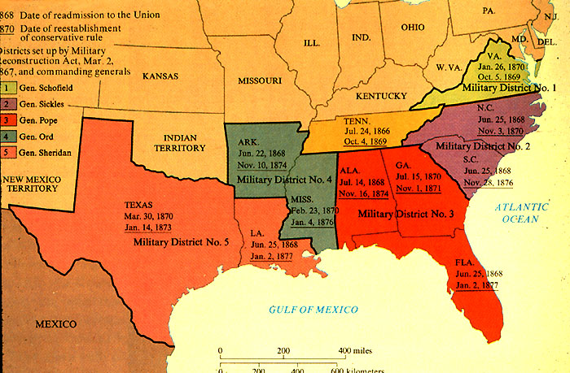
South Military Districts- Reconstruction Act 1867

Slide 8
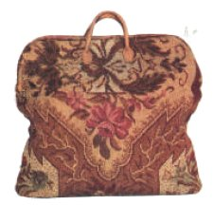
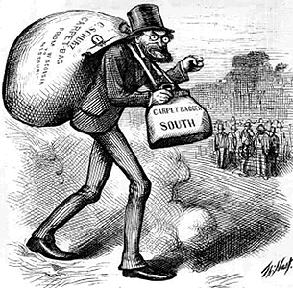
Scalawags vs. Carpetbaggers
Scalawags- White Southerners who joined Republican Party
Carpetbaggers- Northerners who moved South after the war
Make $ off the South
The Carpetbagging Yankees
Reconstruction and the "New South"

Slide 9
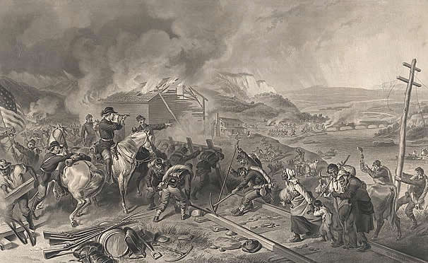
Southern Economy
Economy is destroyed
Cotton is no longer king
Loss of slave labor
Govt. provides services
Plantations hit hard- no slave labor; crops destroyed; homes looted
“40 acres and a mule”
Idea to give slaves land as payment for slavery- never happens
Slaves left plantations to look for family, move to cities; but still too poor to own land

Slide 10
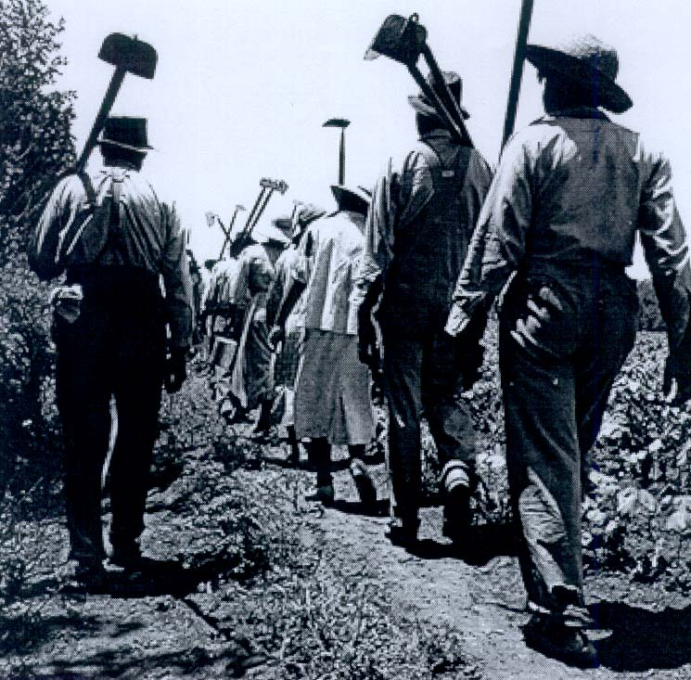
Plantations Restored
Many poor can’t leave South
2 types of Farming Rise:
  Tenant Farming- person pays rent to landowner to farm on it
  Sharecropping- person gives portion of harvest to pay for the land
What happened to slaves owning land?

Slide 11
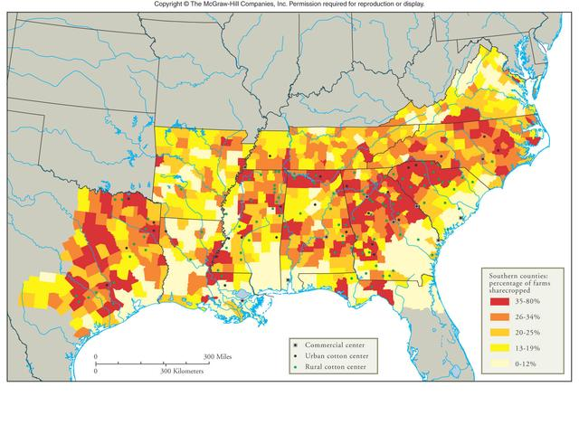
Sharecropping

Slide 12
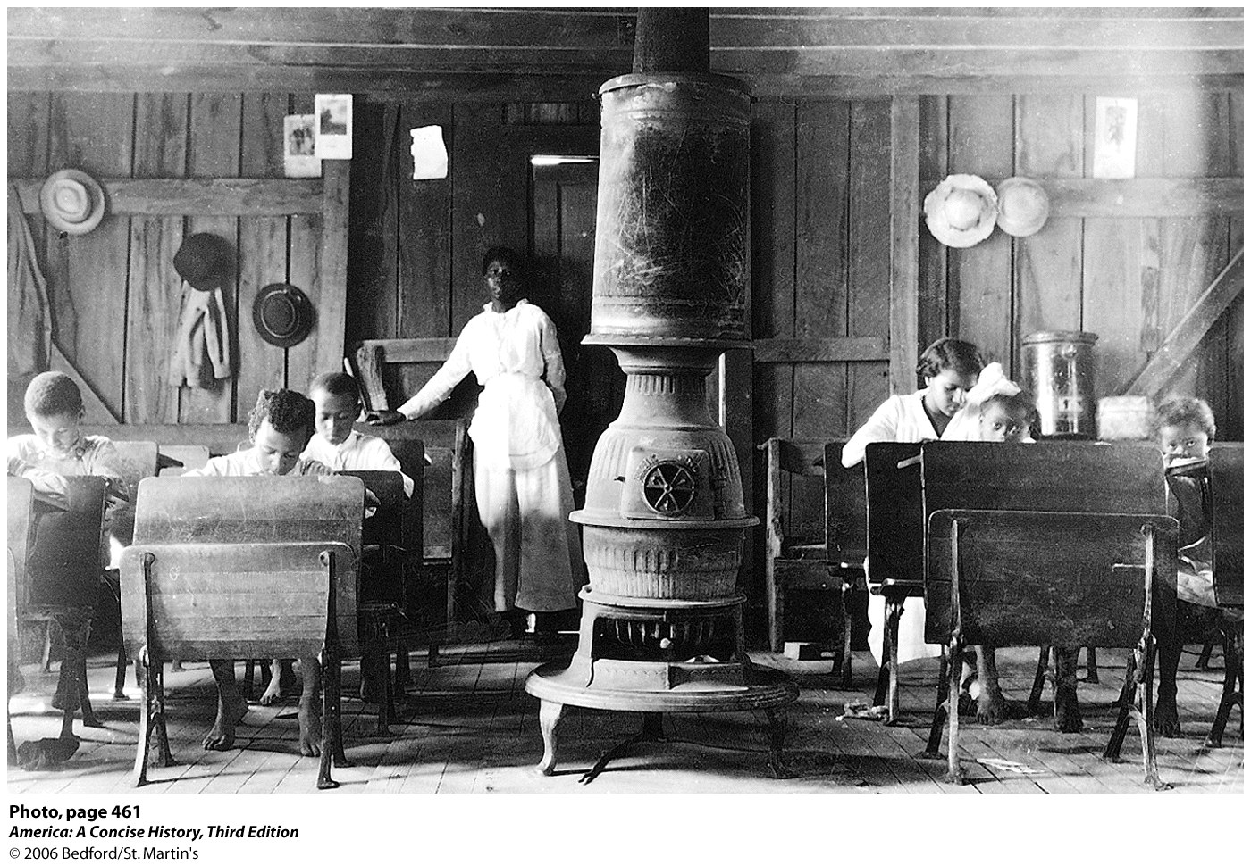
Freedmen’s Bureau
Created to help former slaves adjust
Provides education and schooling
Help slaves find work
Did not help most slaves
Land reform was most basic need
Remember carpetbaggers and scalawags

Slide 13
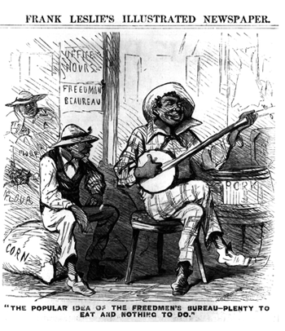
Southern Eyes

Slide 14
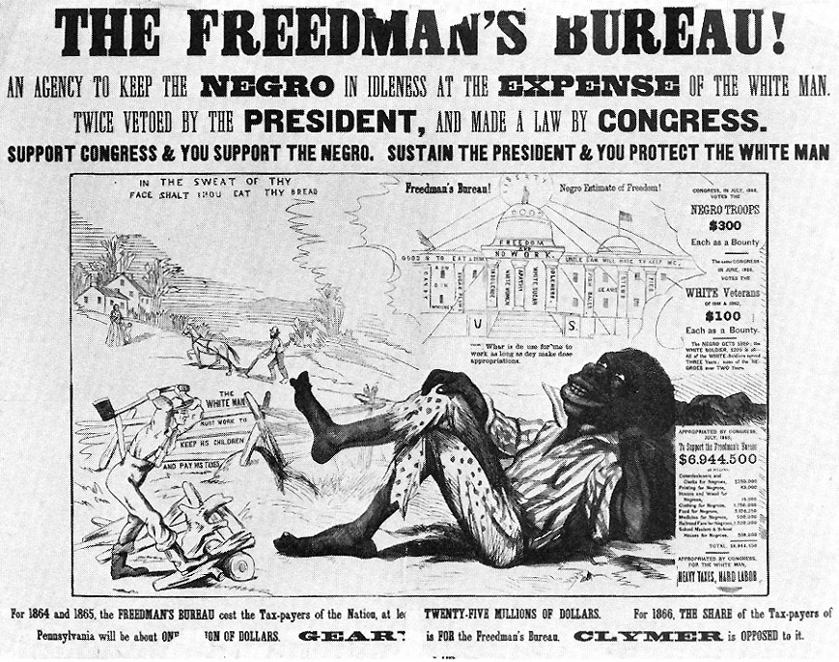

Slide 15
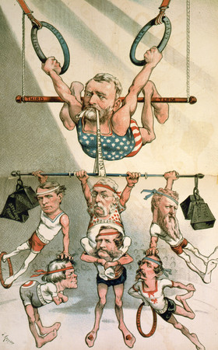
Reconstruction Collapses and Ends
North becomes weary of Reconstruction
Republicans split over President Grant’s Scandals
Credit Mobilier- fraud involving railroads
Whisky Ring- IRS bribery cause loss of U.S. revenue
Panic of 1873- too much borrowing; companies collapse
Economic Depression
Radicals lose their grip on Reconstruction

Slide 16
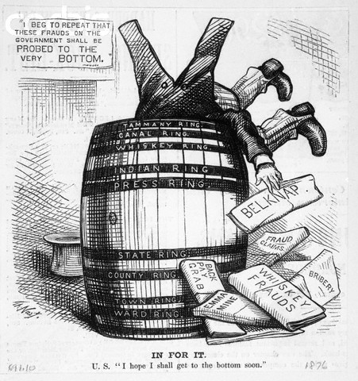
Grant Administration Corruption

Slide 17
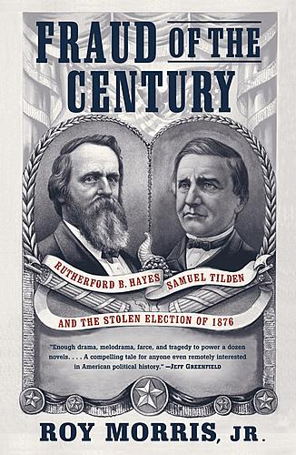
1876 Election
Samuel Tilden (D) vs. Rutherford B. Hayes (R)
No Electoral College winner
Southern votes disputed
Hayes given disputed votes
South threatens secession again

Slide 18
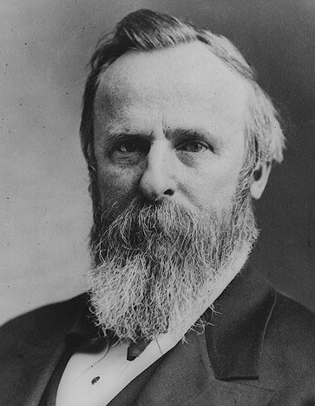
Compromise of 1877
Compromise includes:
  Hayes (R) wins election
  South gets troops removed from the South
  $ for railroads
  Reconstruction Ends
South gets Home Rule
Redeemers- southern democrats who want to return the South to its old ways

Slide 19
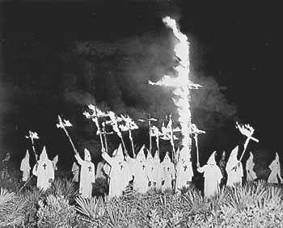
The “New South”
Black Codes
Jim Crow laws
Segregation
KKK- Political, Economic, Social
End of Freedmen’s Bureau
Voting
No money
Ignored Constitution -14th and 15th amendments
Decline in freedoms
Whites in Control
“Solid South”
Economy becomes stronger
Sharecropping over slavery
More industry and transportation

