Slide 1
UNIT FOUR – INDUSTRIALISM,LABOR, and IMMIGRATION

Slide 2
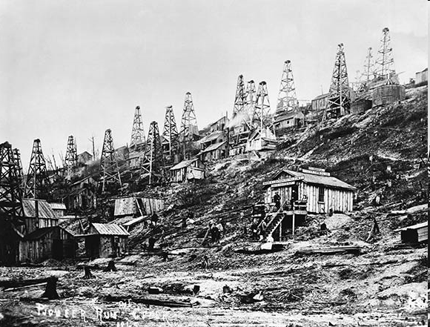
Industrial Development
1880- U.S. industrial world leader in producing goods
Labor force-immigrants
Coal supply
Iron
Edwin Drake- discovers Oil in U.S.
Railroads- Public $
Laissez- Faire Govt.
High tariffs on U.S. goods

Slide 3
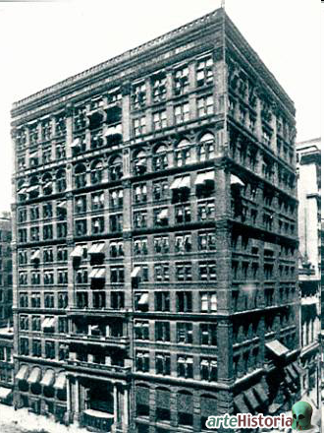
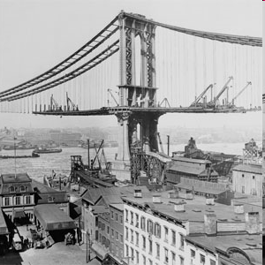
Innovations and Entrepreneurs
Late 1800’s- inventions explode
Telephone- Alexander Graham Bell
Light Bulb/ Phonograph- Thomas Edison
Electric Power- Nikola Tesla (AC power)
Radio
Bessemer Process- Carnegie
Typewriter- Christopher Sholes
Photography
Motion Pictures
Retail
Canned foods
2nd Industrial Revolution

Slide 4
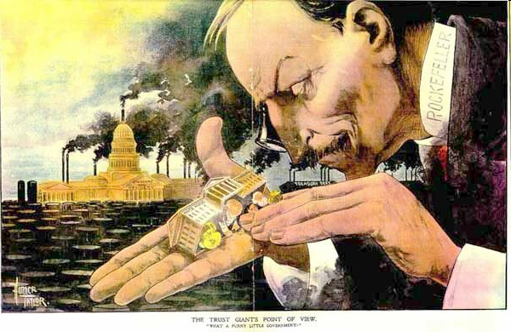
Entrepreneurs
John D. Rockefeller- Standard Oil Company
Andrew Carnegie- Carnegie Steel
J.P. Morgan- U.S. Steel
Cornelius Vanderbilt- Railroads
James Duke- Tobacco-electric power
George Westinghouse- electric power

Slide 5
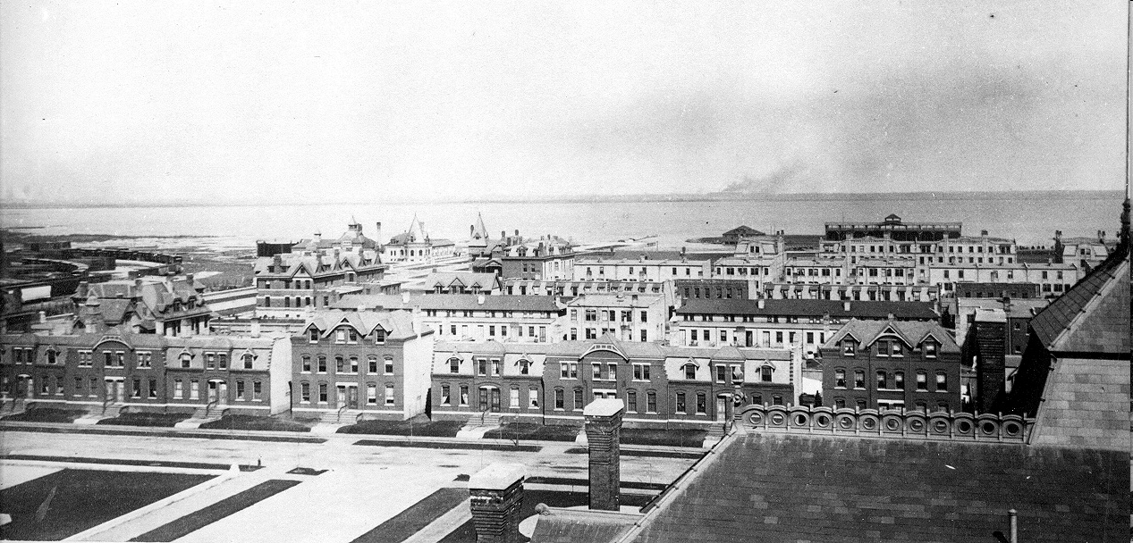
Railroads
Iron Horse
Standardization of time
Transcontinental
Urban areas grow
Company Towns- George Pullman
Makes RR carts in Illinois
Strikes
Scandals- Credit Mobilier
Govt. and fraud
Abuses leads to Granger Laws
Interstate Commerce Act- creates ICC (1887) to regulate business

Slide 6
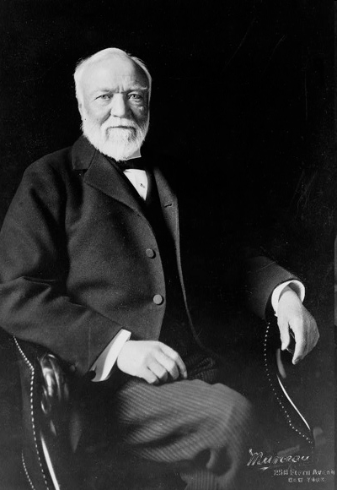
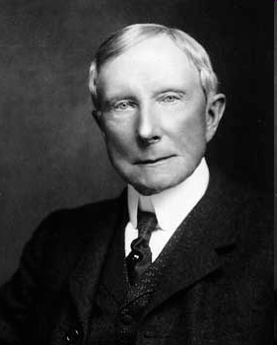

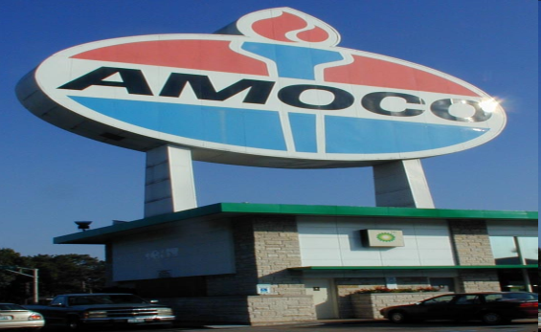
Growth of Big Business
Corporations emerge
Advantages:
  Limited liability- stocks
  Mass production
  More efficient
  Manager-workers
  Productivity- studies
Frederick Taylor-”Taylorism”
Disadvantages:
  Unfair competition
  Corruption and bribery
  Destroy Labor Unions

Slide 7
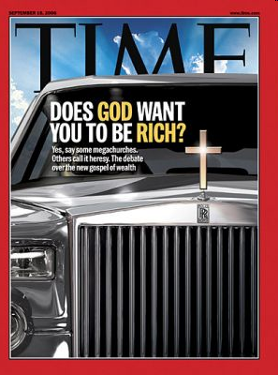
Social Darwinism
New Theory
  Based on Darwin’s Theory of Evolution
  “Survival of the Fittest”
  Apply this business world
  Best business survive
  Justifies wealth
“Gospel of Wealth”- Carnegie writes this
Give to worthy causes-philanthropy
Horatio Alger- Dime Novels
Rags to Riches- “American Dream”

Slide 8
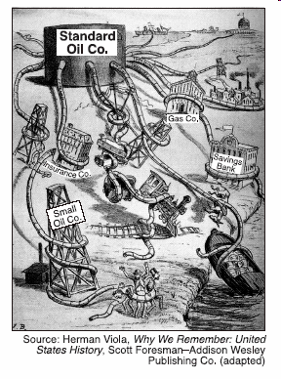
Types of Big Business
Monopoly- one business controls most of the supply of a product
Trust- when several businesses act as one under the control of directors
Merger- businesses come together to become one larger business
Horizontal vs. Vertical Integration
Horizontal- type of monopoly formed by controlling all of the same type of business
Vertical- monopoly by controlling businesses related to the primary business

Slide 9
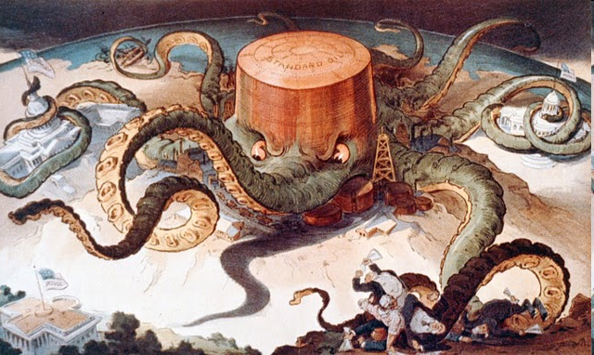
Standard Oil

Slide 10
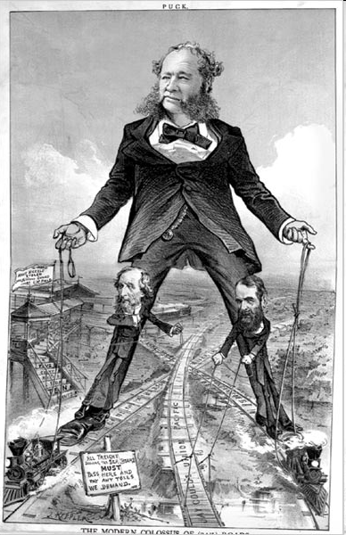
Vanderbilt Railroads

Slide 11
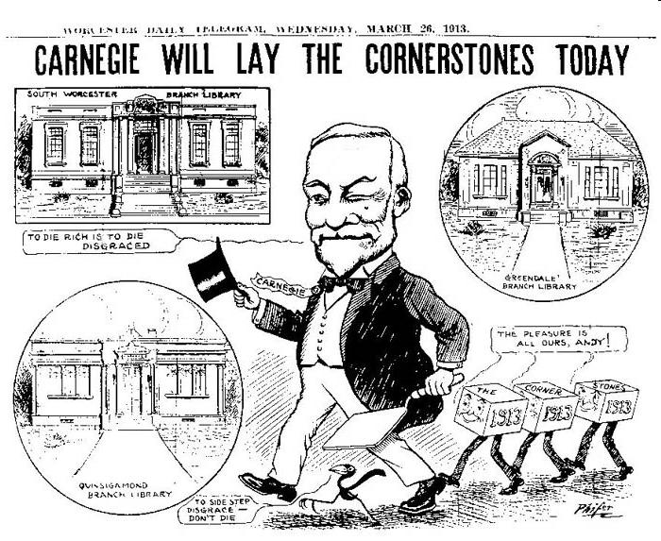
Robber Barons
Term used to negatively describe businessmen
Profits are huge by Businesses
Philanthropy- giving away $ to charity
Helped improve image of robber barons
Business practices start to get exposed
Public starts to call for regulation
Sherman Anti-Trust Act- 1890
Weak law but sets a precedent for future regulation
Illegal to have monopoly or trusts
Too weak to begin with

Slide 12
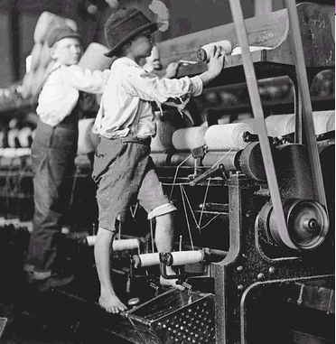
Workers and Growth of Labor Unions
Urban Labor increases 400% by 1890
Unskilled laborers
Assembly line work
Conditions poor:
  Sweatshops
  Low wages
  Long hours
  Dangerous conditions
  Company towns
  Child labor

Slide 13
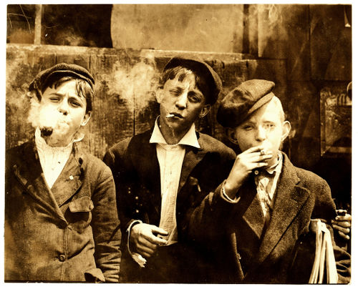
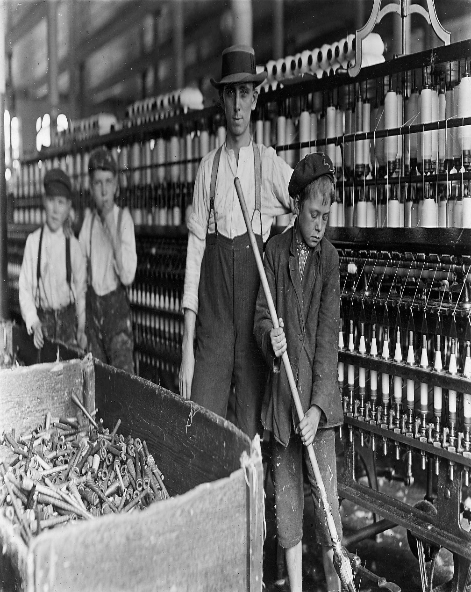
Child Labor

Slide 14
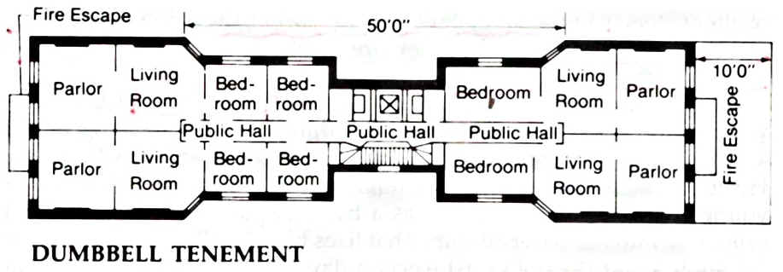
Tenement Housing

Slide 15
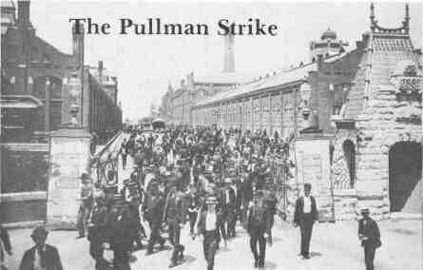
Labor Unions
Workers
  unite for better conditions of workers
  Strikes
  Collective bargaining
  Arbitration
Owners:
  Blacklists
  Lockouts
  Scabs

Slide 16
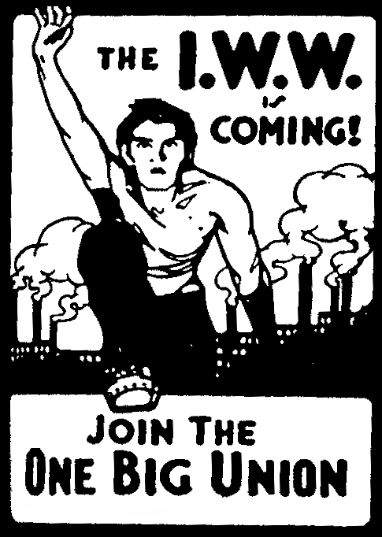
Unions
Knights of Labor- Terence Powderly
  Accepted all labor
  Fails because unskilled labor lacks power
AFL- American Federation of Labor
Samuel Gompers
  Only skilled labor-Craft Union
  Strikes become legitimate
Industrial Unions
  Industrial Workers of the World (IWW)
  Big Bill Haywood
  Eugene Debs- united railroad workers
  socialism?

Slide 17
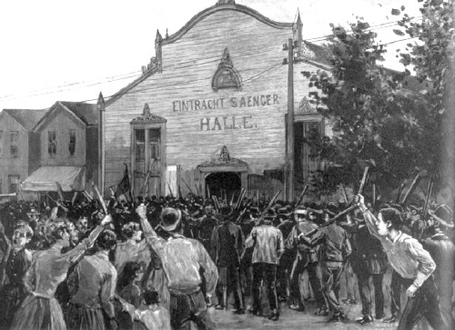
Labor Unrest and Strikes
1- Railroad Strike of 1877
  Violent protest leads govt. troops to restore order
2- Haymarket Square 1886
  McCormick Strike day before
  Bomb is thrown at square- police and workers die
  KOL blamed- several arrested, convicted, hanged
3- Pullman Coach Strike- 1894
  Wages cut but not rent
  Govt. jails Debs- becomes a socialist
4- Homestead Strike- 1892
  Violent strike in a Carnegie Steel Plant
  Strikebreakers brought in- national guard used

Slide 18
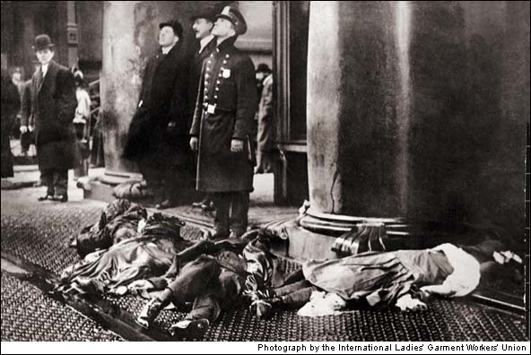
Pressure on Business
Women fight for better working conditions for miners
Helped strike
Mary Harris “Mother” Jones
Fights against Child Labor
Public supports workers problems, but likes cheap products
Triangle Shirtwaist Factory Fire- 146 women dies in NYC fire
Exits blocked

Slide 19
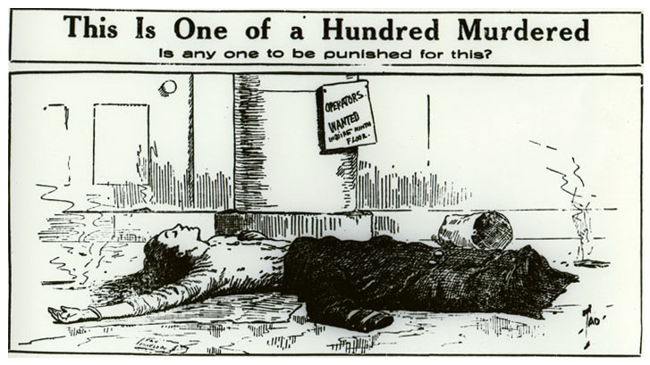
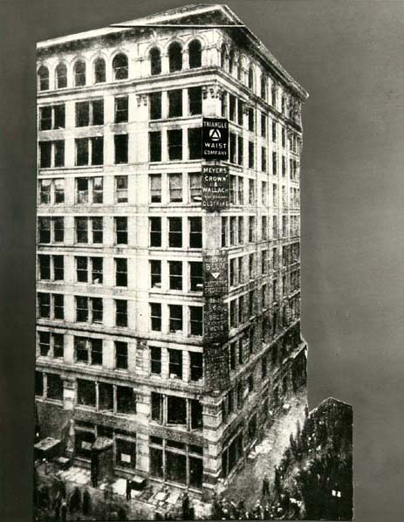
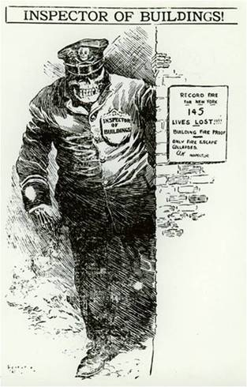
Triangle Shirtwaist Factory

Slide 20
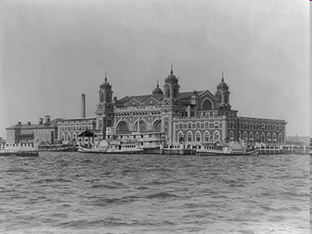
Urbanization
Old Immigration vs. New Immigration (1890)
Eastern Europe and Pacific immigration-New
Western Europe- old
Long journey
Ellis Island- NY immigrant processing
Angel Island- SF immigrant processing
Culture Shock
Melting Pot
Nativism
Chinese Exclusion Act- limited immigration of Chinese

Slide 21
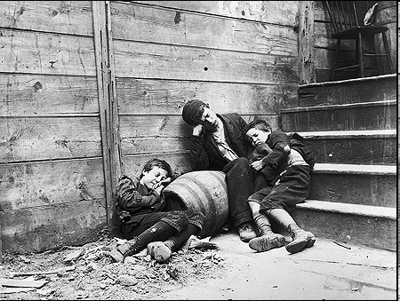
Urbanization
Farming decreases
1/3 by 1900
Poor housing
Tenements
Crime, fire, sanitation, water, pollution, disease
Social Gospel- Christian theme of helping the less fortunate
Salvation army
Jacob Riis- “How the Other Half Lives”
Jane Addams- Hull House- Chicago
Settlement Houses

Slide 22
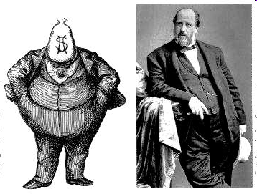
The Gilded Age
Corrupt Govt.
Political Machines- party dominates an area
Led by a city boss
Patronage (spoils), Grafts, jobs, services, kickbacks
Why?
Cities lack services, helped the bottom for votes
Tweed Ring ran NYC- Tammany Hall
Corrupt
Exposed by Political Cartoonist Thomas Nast

Slide 23
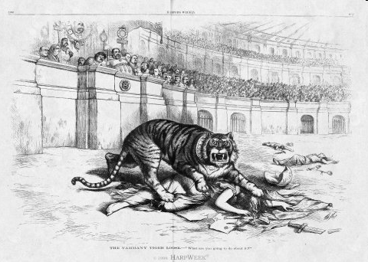
Tammany Hall Tiger

Slide 24
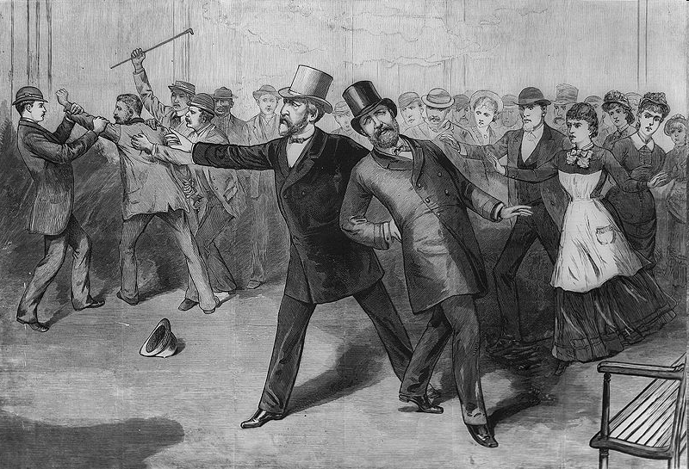
Civil Service Reform
Patronage (Spoils) put unqualified people in positions
Hayes advocates reform
Wants a merit system
Garfield continues Hayes reforms
Garfield assassinated by job seeker replaced by Chester Arthur
Pendelton Act- replaces spoils system
Civil Service System
Republicans dominate (1860-1908)
Cleveland, Harrison, Cleveland 1884-1892
Tariffs become an issue- Big Business likes them
McKinley Tariff the highest yet

Slide 25
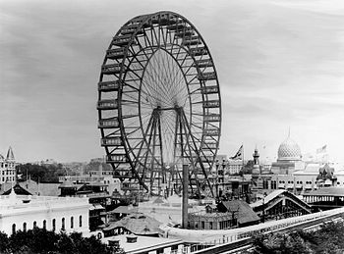
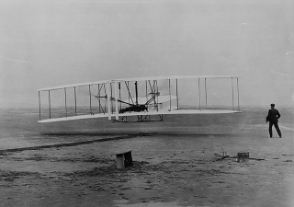
Life at the Turn of the Century
Cities grow up
Daniel Burnham- Architect
Frederick Olmstead- Landscape architect
NY Central Park
Airplanes- Wright Brothers
Photography- George Eastman
Newspapers- Pulitzer vs. Hearst
Mass Culture-
  Baseball
  Bicycles
  Parks
  Department Stores(RFD)
  Chain Stores

