Slide 1
UNIT 7: THE GREAT WAR and THE SHAPING OF THE 20TH CENTURY

Slide 2
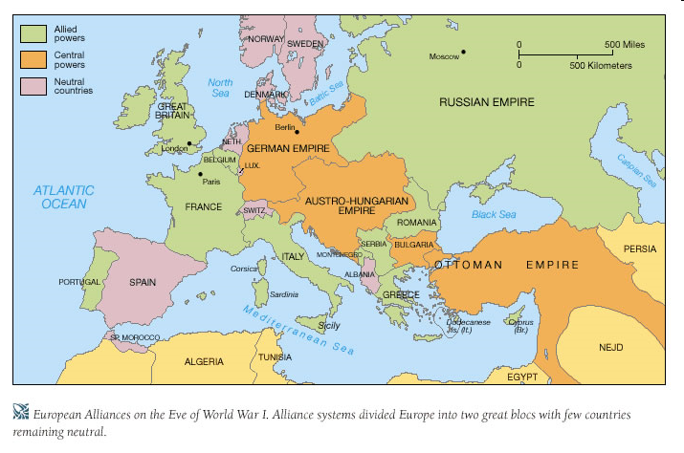
Causes of WW I
Instability
Nationalism- loyalty to one’s country
Imperialism- competition for markets and for control
Militarism- bigger armies and navy’s
*Alliance system- pacts to protect or fight for countries
Central Powers- Germany, Austria-Hungary, Ottoman Empire (Triple Alliance)
Allies- France, Britain, Russia (Triple Entente)

Slide 3
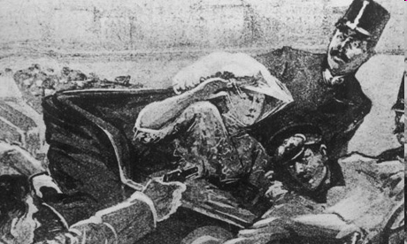
War Starts
Archduke Franz Ferdinand assassinated by Serbian Nationalist
One nation after another joins the war as a result
Germany wants to defeat France quick on Western Front- then fight Russia (Schlieffen Plan)
Allies want 2 fronts and U.S. to enter
U.S. declares neutrality
Sympathetic to Allies- export war materials to Allies

Slide 4
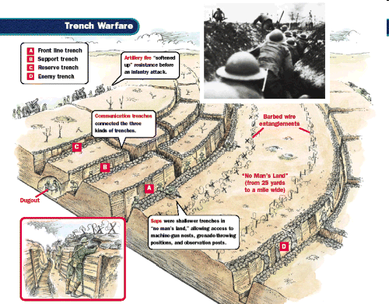
Fighting Stalemate
War becomes a stalemate
Trench Warfare- “going over the top”
“No Man’s Land”
New Technology
Airplanes, Submarine warfare
German U-Boats
Poison gas, mustard gas

Slide 5
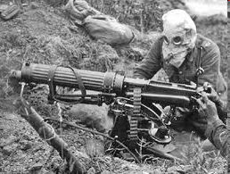
Modern Technology and Warfare

Slide 6
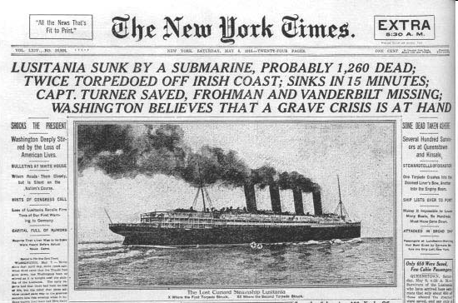
Uncle Sam enters the War
Began by exporting war materials
U- Boats sink any ships on the sea
Lusitania sinks 1915
Sussex Pledge
Wilson wins 1916 election- “He kept us out of war!”
Wants peace
“Peace without victory”
Isolationism
*Zimmerman note/telegraph- attempt to get Mexico to fight a war with the U.S.
Promises to help them regain lost land

Slide 7
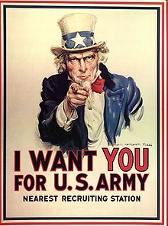
U.S and War
Wilson calls for war
Make the world “safe for Democracy”
Russian Revolution takes them out of war
Selective Service Act- require men to register for draft
About 3 million actually called up
Train for 9 months
American support to send boys “Over There”
Dough Boys
General John Pershing- American Expeditionary Force
Alvin York- American Hero
Former pacifist
Armistice signed- Nov. 1918
No battles fought in Germany

Slide 8
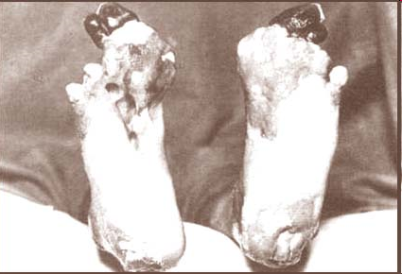
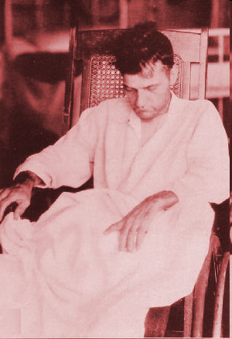
War Effects
Shell Shock AKA Post Traumatic Stress Disorder
Trench Foot

Slide 9
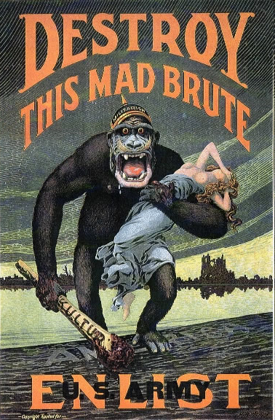
WWI-Home Front
War Industries Board- Regulates American Economy
Rations items (conservation)
Victory Gardens
Daylight Savings Time
Raise taxes
Liberty War Bonds
Committee on Public Information- George Creel
4 minute men/ “I Want You”
Espionage and Sedition Acts- Crime to interfere with war effort or protest
Schenck v. U.S.- “Clear and Present Danger Speech” can be limited
Anti-Immigrant sentiment

Slide 10


Victory Gardens

Slide 11
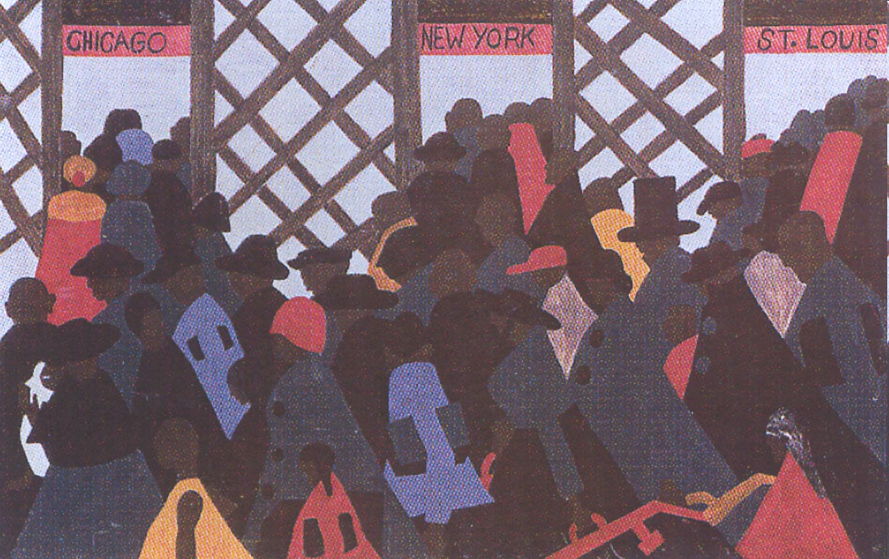
WWI
Women fill jobs as men are gone and have a labor shortage
19th amendment
African Americans move
Great Migration- AA’s move North for jobs, better opportunities
Disease spreads world wide
Influenza (Flu) outbreak in 1918
¼ U.S fell victim and ½ million die
40 million die worldwide

Slide 12
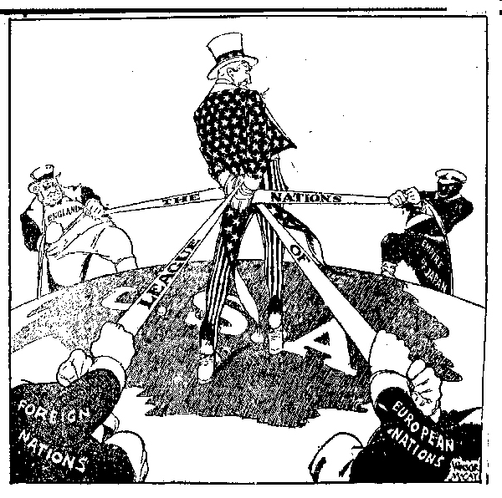
Wilson’s Fourteen Points
Wants to eliminate reasons for future wars
Goals for the world
Democracy
Fourteen Points Speech
  Outlined how to prevent war
  No secret treaties
  Freedom of the seas
  Lower tariffs
  Reduce armaments
  Self-determination
League of Nations- organization of countries to discuss issues

Slide 13
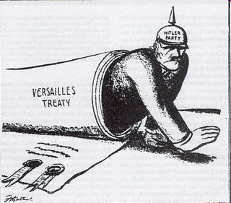
Versailles Peace Conference
Big Four- U.S, Britain, France, Italy
Central Powers and Russia left out
Most of 14 points ignored> Allied leaders wanted to punish Germany
9 new nations created
Germany demilitarized
Germany must pay reparations
War Guilt Clause-Germany
Wilson does get League of Nations
Weakness of Treaty of Versailles will lead to future war

Slide 14
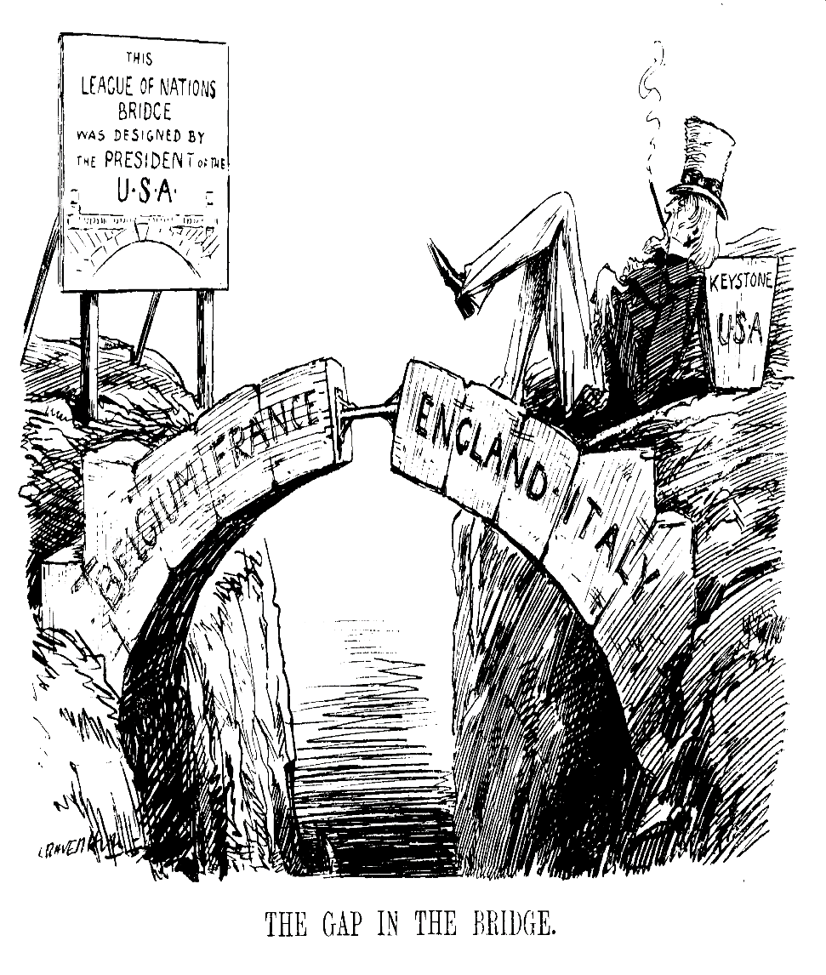
Treaty Reaction
Faces opposition in U.S.
Some thought it was too harsh
Congress dislikes League
Henry Cabot Lodge- said league threatens ability to stay out of foreign affairs
Wilson suffers a stroke while trying to appeal to the people
U.S. Senate never approves treaty
Wilson Legacy
  Progressive
  Women’s suffrage
  Prohibition
  Victory in WWI
  Vision of world organization
  Predicts future war

