Slide 1
UNIT 9 – THE GREAT DEPRESSION AND FRANKLIN ROOSEVELT’S ‘NEW DEAL’

Slide 2
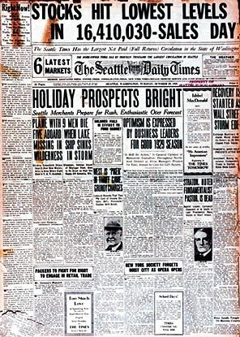
The Great Depression hits
Hoover elected President in 1928
“predicts the end of poverty”
Warning signs of Depression
Buying stock on Speculation
Buying on Margin
Stock prices are inflated
Oct 1929 prices fall
Oct. 29,1929- Black Tuesday- Stock Market crashes

Slide 3
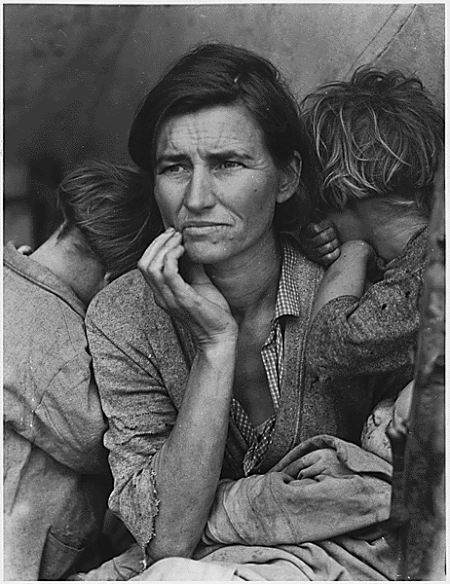
Causes of Depression
Overproduction of goods
too much credit
Less consumption of goods
Farm surplus
High tariffs
No banking regulations
Hawley-Smoot Tariff 1930- passed highest tariff in U.S. history

Slide 4
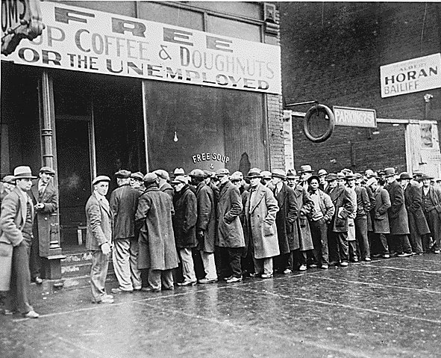
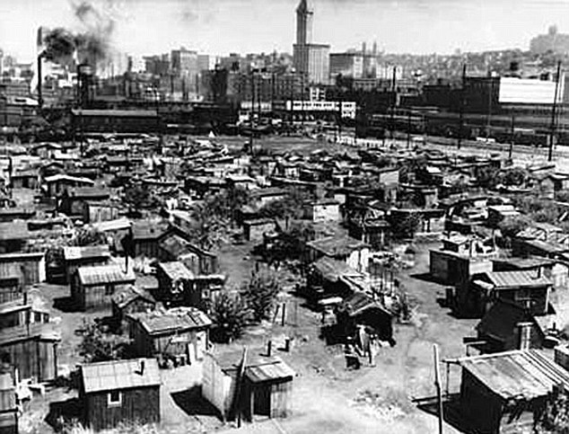
Hard Times
Rural areas
  Farms close
  Food supply
  Dust Bowl- dry conditions in the Great Plains
Cities
  Shantytowns- towns of shacks
  Hoovervilles
  Soup Kitchens and breadlines
Family Life
  Women struggle
  Children’s health
  Suicide rises
  mental illness

Slide 5
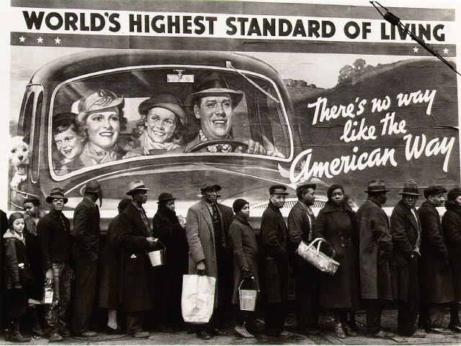
Great Depression- Breadline

Slide 6
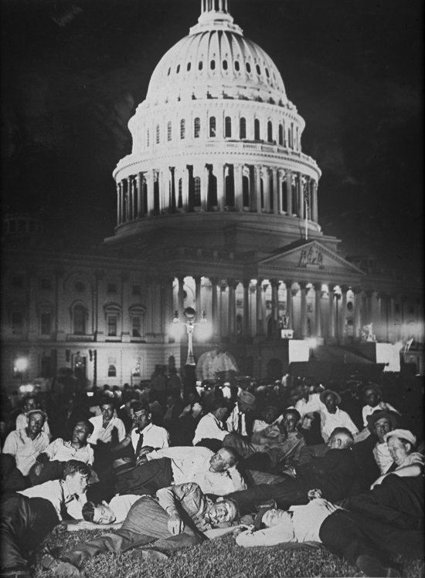
Depression Politics
Hoover calls for “Rugged Individualism”
Does help some businesses with Reconstruction Finance Corporation (RFC)
Voluntary Cooperation
Still does not give Direct Relief to people
Bonus Army March- vets march on Washington
Election of 1932- FDR beats Hoover
Calls for a “New Deal”
Democrats gain most seats
Hoover is a Lame Duck
20th amendment changes inauguration date

Slide 7
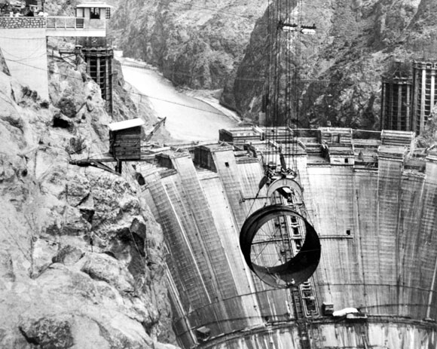
Hoover Dam

Slide 8
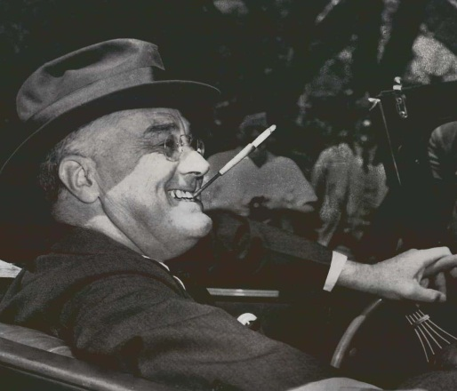
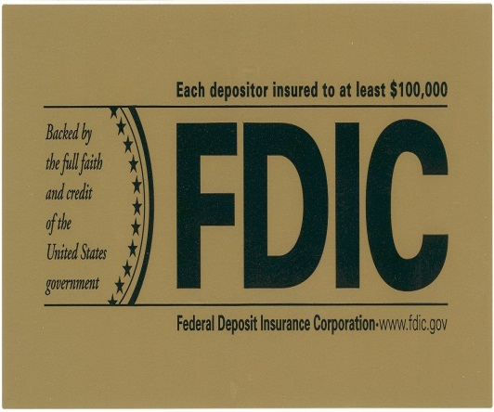
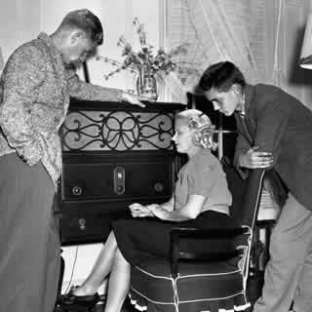
FDR’s New Deal
“The only thing we have to fear, is fear itself”
Fireside Chats- goes straight to the American people
Huge expansion of Govt. involvement
1st 100 days are active
Relief, recovery, reform
Will practice Deficit Spending
Bank Holiday- restore faith in banks
FDIC- Federal Deposit Insurance Corporation
SEC- Securities Exchange Commission

Slide 9
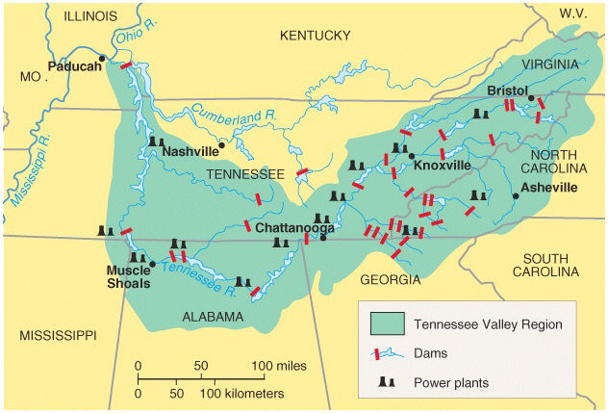

More Relief
Public Works Administration -PWA jobs for govt. projects- part of NIRA
Civil Works Administration -CWA provides federal jobs
Tennessee Valley Authority -TVA provided jobs and developed resources in TV
Civilian Conservation Corps -CCC conservation projects for single males
Agricultural Adjustment Act -AAA aid to farmers and regulates crop prices
National Recovery Administration -NRA set business prices and tried to regulate fair competition

Slide 10
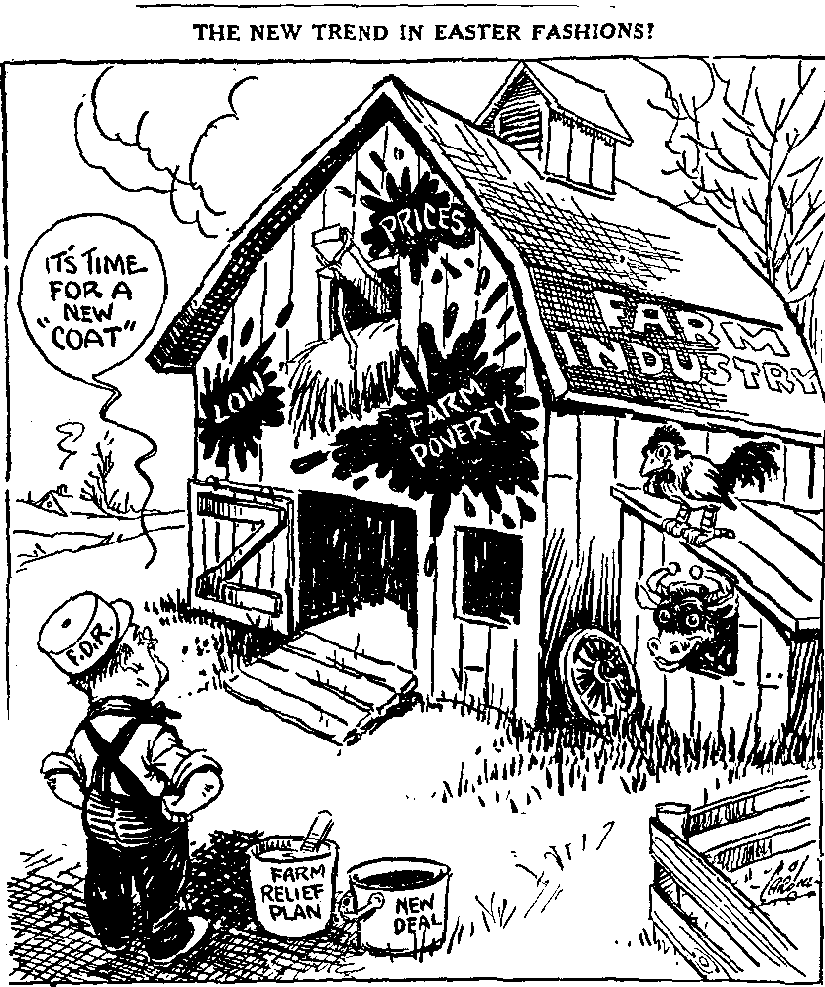
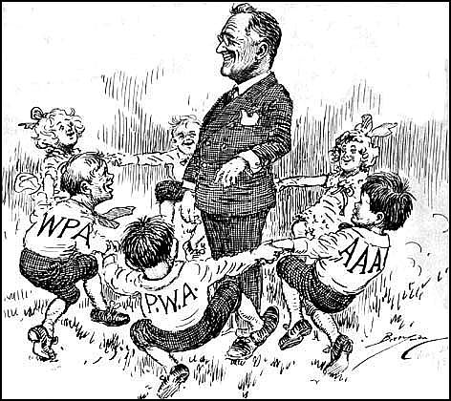
New Deal

Slide 11
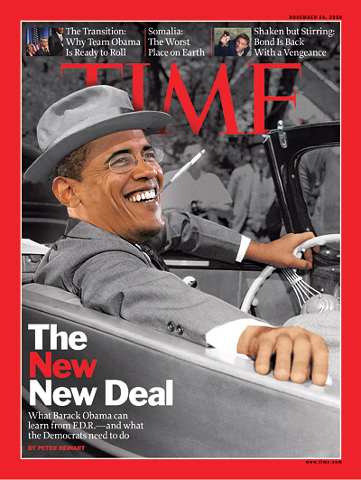
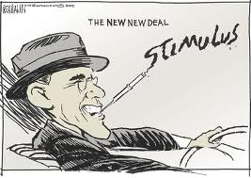
New Deal Reactions?
1935 economy still not recovered
Many people migrate West due to the Dust Bowl
Call them “Okies”
“Grapes of Wrath”- John Steinbeck
Enough direct relief to keep people from starving
Conservative critics
Some call for more action
Father Charles Coughlin- tax rich and provide income for all
Huey Long- level income, home and college for all
“Every man a King”
Francis Townsend- income for elderly

Slide 12
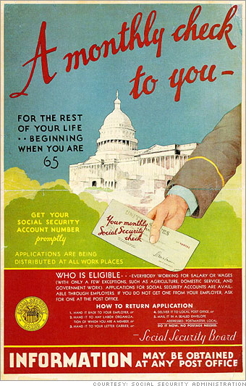
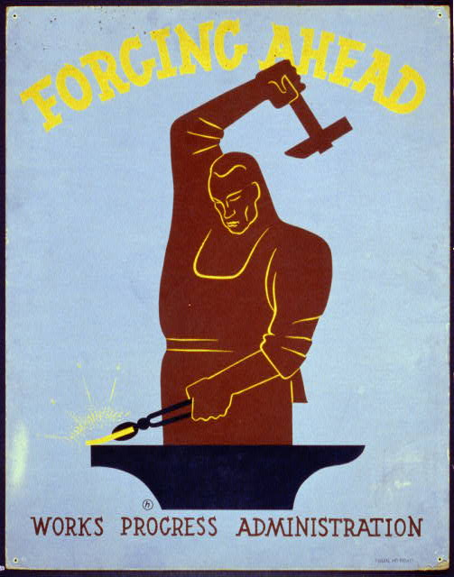
New Deal Continued
2nd New Deal- Programs Continue
FDR elected again in 1936
WPA- Works Progress Administration
Built roads and bridges
Funded large media and arts projects
Social Security Act- provides old age pensions, unemployment checks, aid to families with children
National Labor Relations Act/ Board- workers can unionize and anti-union practices banned
Fair Labor Standards- set minimum wage, 40 hr week

Slide 13
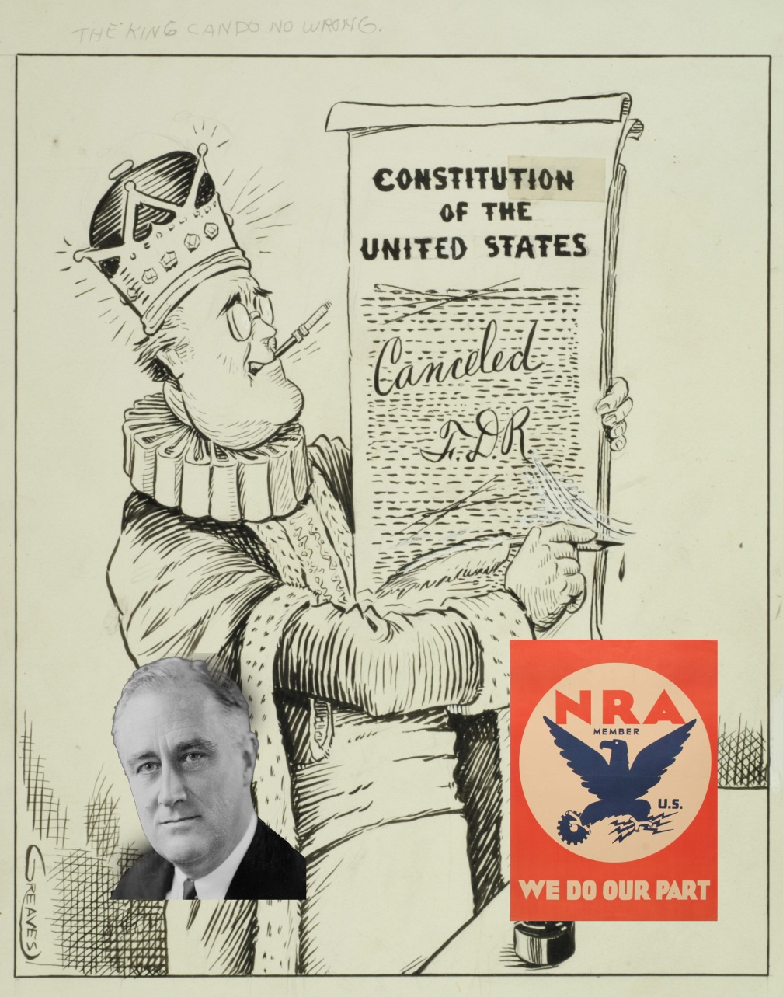
Court Packing Scheme
FDR’s Court Packing Scheme
Several programs ruled Unconstitutional
AAA,NRA
Proposed adding new justice for every justice over 70 yrs old
Seen as threat to checks and balances

Slide 14
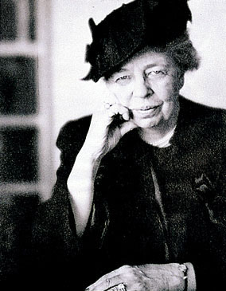
Women and African Americans
Eleanor Roosevelt- strong 1st lady
Women named to govt. positions
Francis Perkins- Sec. of Labor
Still inequality
Depression hits African-Americans hardest
FDR not committed to Civil Rights
African Americans start switching to Democrats

Slide 15
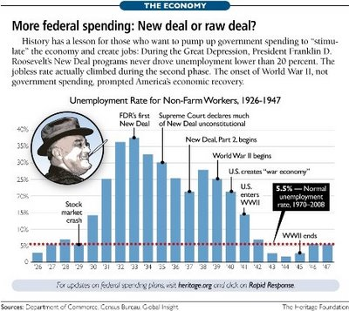
New Deal Culture
Art displays the realities of Depression
Radio has programs for all
Motion pictures become better and more popular
Gangster Films
New Deal Ends, by 1937 recovery has stalled
People want non-government control now
International issues arise
New Deal has a great legacy, but WWII is more responsible for ending the Depression

Slide 16
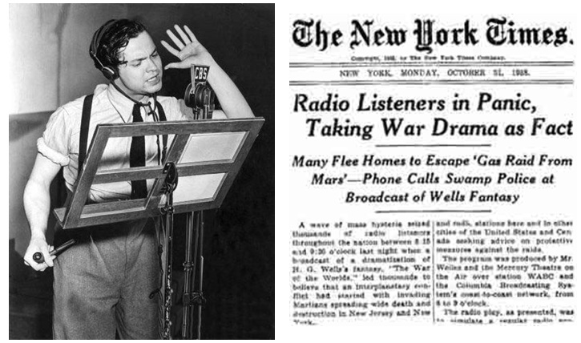
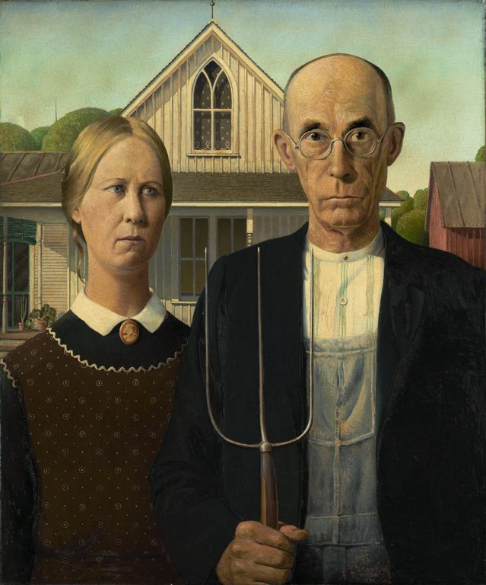
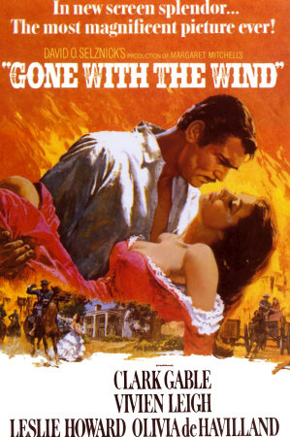
Culture

Slide 17
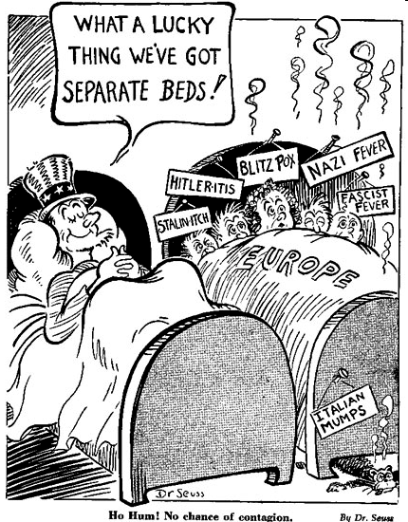
WW II begins
U.S. focused on Depression
Worldwide Depression-leads to rise of dictators
Anti-war feelings-isolationism
Neutrality acts- forbids arms sales to warring nations
1937 FDR gives Quarantine speech

