Slide 1
UNIT 6: THE PROGRESSIVE ERA

Slide 2
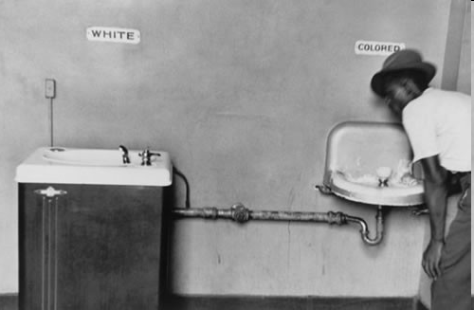
DuBois v. Washington
Booker T. Washington
  Tuskegee Institute
  Gradual improvement
  Vocational training
  Economic equality 1st
  Atlanta Compromise- Could cooperate on economic measures and still be separate in social issues
W.E.B. DuBois-
  1st Harvard grad
  Full rights now-equality
  Education
  Niagara Falls Convention
  Helps found NAACP

Slide 3
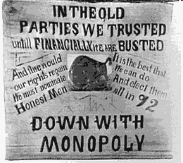
Progressives Emerge
Prior reforms
  Grange/Populists
  Suffragists
  Temperance
  Wealth Gap
Services?
Goals
  Social welfare
  Moral improvements
  Economic reform
  Efficiency

Slide 4

Progressivism
Some fear Socialism
“Ideal society”
Debs- American Socialist Party
I.W.W.
Progressives are middle class mostly
Want “Progress”
Remember “Social Gospel”
Help less fortunate
Religious groups, salvation army
Opposite of Social Darwinism

Slide 5
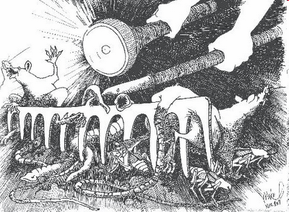
Muckrakers
Journalists who expose corruption in govt. and society
Ida Tarbell- Standard Oil
Upton Sinclair- The Jungle
Lincoln Steffins- business and govt. corruption

Slide 6
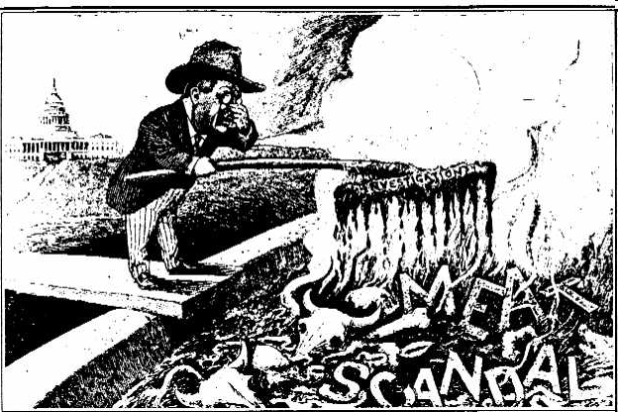
The Jungle- Upton Sinclair

Slide 7
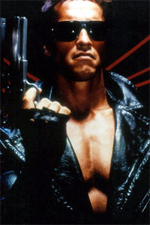

Progressive Reforms
Commission and Manager Governments
Better public interests and utilities
Voting Reforms
Initiative- citizens start own law
Referendum- vote on that law or existing one
Recall-remove an elected official
17th Amendment- Direct Election of Senators
Robert M. La Follete- busted up businesses and regulated railroads

Slide 8
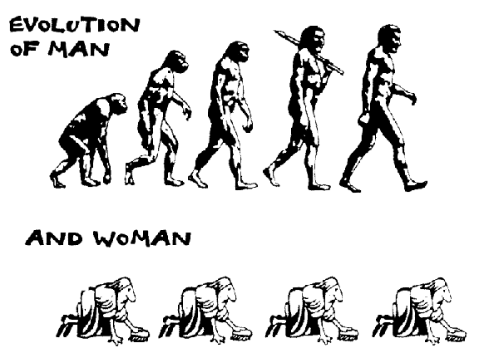
Other Reforms
Women
Some states allowed suffrage
Protests
Susan B. Anthony, Elizabeth Cady Stanton, Lucy Stone
Inequality in economics
Other reforms:
Workers’ comp
Child Labor
Women’s working conditions- Oregon v. Muller
Meat Packing-FDA-Sinclair
Building codes

Slide 9
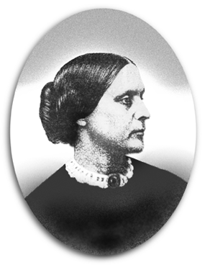
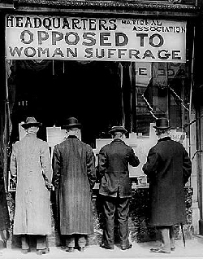

Slide 10
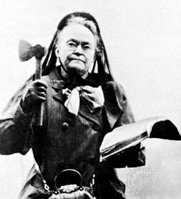
Other Reforms
Income Tax Established- 16th amendment
Prohibition- 18th amendment
Volstead Act
WCTU- Women’s Christian Temperance Movement
Carrie Nation

Slide 11
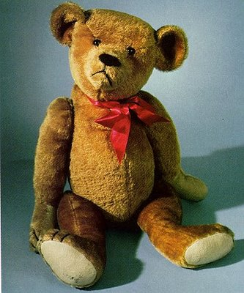
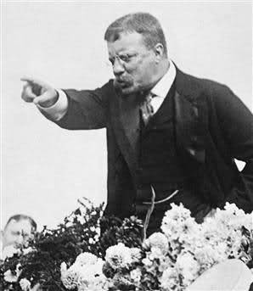
Roosevelt as a Progressive
Rose steadily
Spanish-American War
Gov. of NY
VP for McKinley
President when McKinley assassinated
Square Deal
Fair for all
“Bully Pulpit”- protector of the people
Square deal would fix society

Slide 12
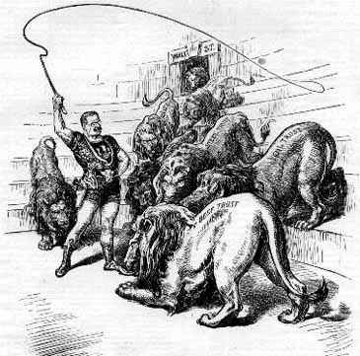
1902 Coal Strike-
Workers refused to work, but strike threatens nation
TR arbitrates- sets example of President mediating conflicts
Trust-busting
TR believes in good and bad trusts
Trusts control 80% of industry
Several trusts broken-
Sherman Anti-Trust law
RR regulation- Northern Securities v. U.S.
Meat Inspection Act 1906- leads to
Pure Food and Drug Act- FDA
“The Jungle”

Slide 13
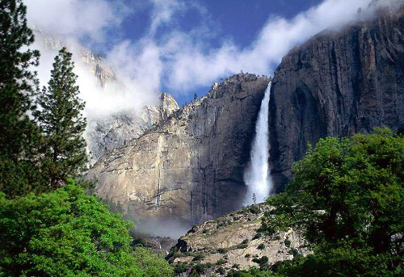
Conservation
Industry sucking resources
Pollution
TR establishes National Parks
Sets aside large portions of land
Gifford Pinchot
Development of land for common good
TR and progressive ignore civil rights
DuBois v. Washington

Slide 14
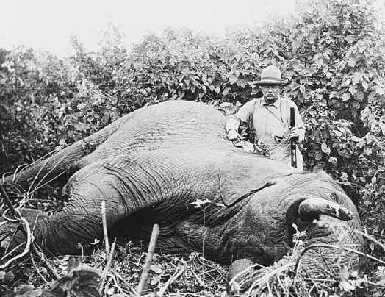

Slide 15
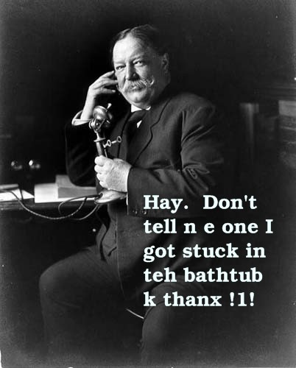
Taft takes over
TR- (R) serves 2 terms
William Howard Taft replaces him
Does not use “bully pulpit”
Dollar Diplomacy
Taft breaks 2x as many trusts as the “Trustbuster” TR
Tries to lower tariffs
*Fires Gifford Pinchot over dispute over Government lands (Conservation)
Progressive and Conservative parts of Party fight
Republicans lose HOR
TR decides to come back run for a 3rd term in 1912 against Taft

Slide 16
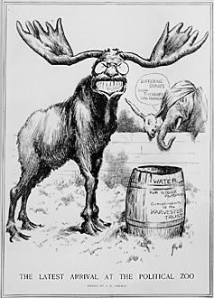
Bull Moose Party
Roosevelt forms own party
Progressive Party/ Bull Moose
Promises a “New Nationalism”
Federal powers to expand and protect the public
Supports progressive reforms
Taft vs. TR vs. Debs vs. Woodrow Wilson
Wilson promises a New Freedom
Fight 4 privileges: wealth, banks, tariffs, trusts,
Small business over monopolies

Slide 17
1912 election
New Nationalism - Roosevelt
New Freedom- Wilson
Conservatism- Taft
Socialism- Debs
TR and Taft split votes
Wilson wins election with only 42% of popular vote

Slide 18
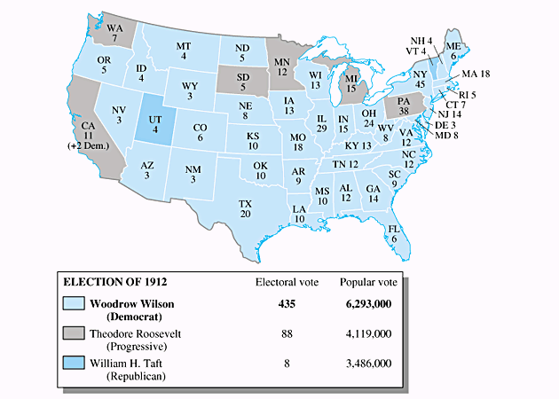
1912 Election

Slide 19
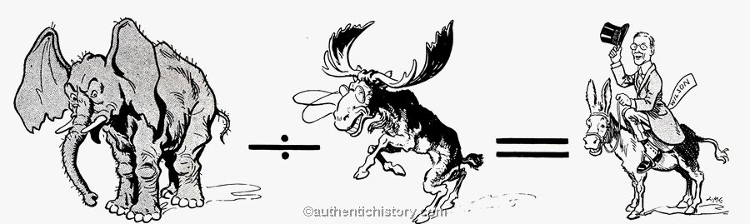
1912 election

Slide 20
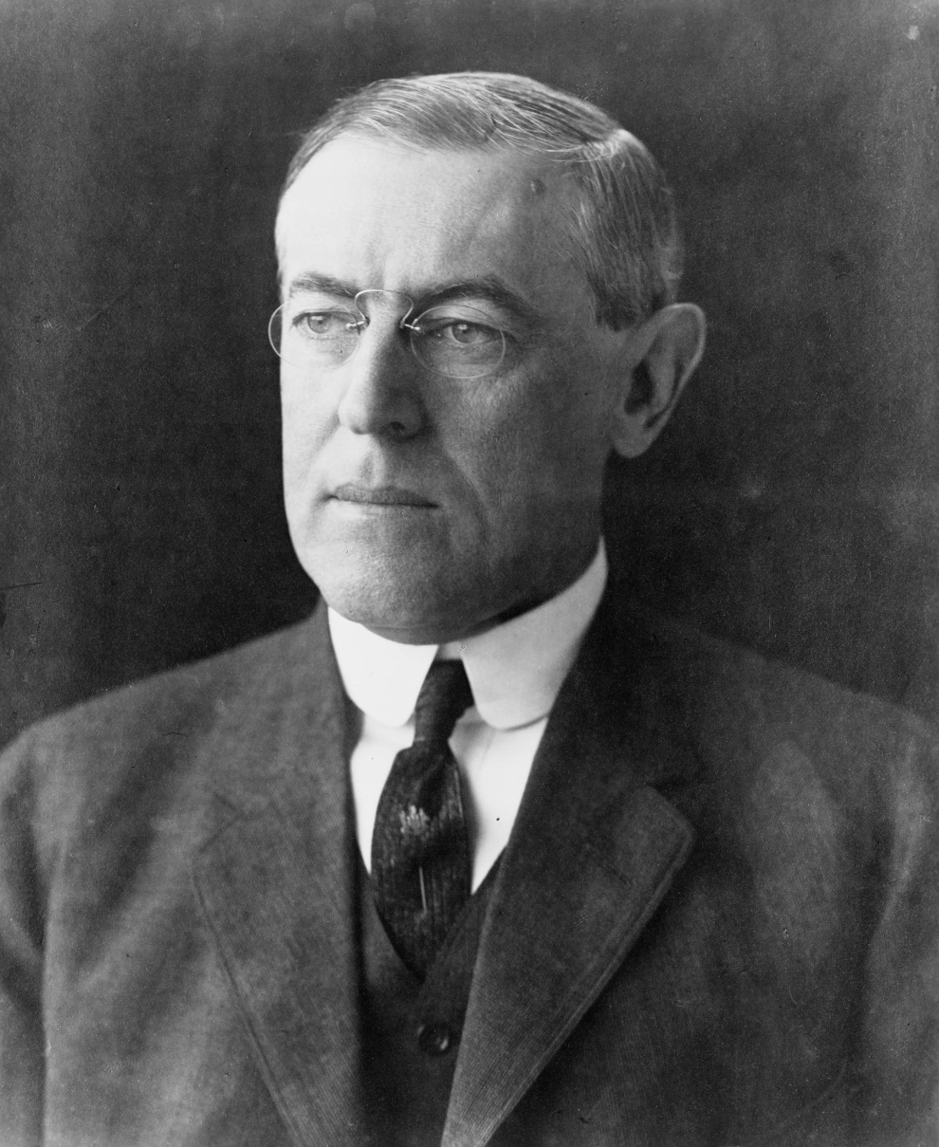
Wilson- New Freedom
Wilson pledges to fight evils
Trusts, poverty, disease, corruption
Will address Congress in person (1st since Madison)
Tariffs and Taxes
Lowers tariffs- 1st time since Civil War
Underwood Tariff
Income Tax added
16th Amendment-Progressive
Main revenue source

Slide 21
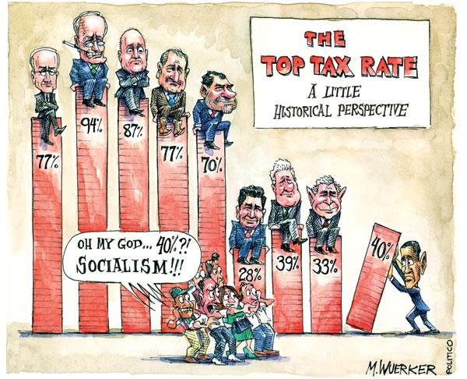

Slide 22
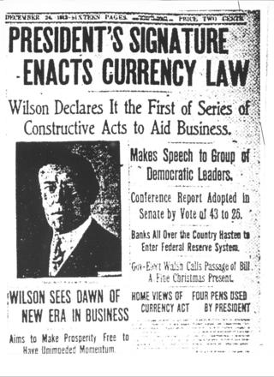
Federal Reserve
Wants Govt. to control $ supply
Reform would remove this from power from banking trusts
Sets up 12 national banks- 1 Main Bank
Still around today
Federal Trade Commission (FTC)
  1914
  created to investigate and regulate unfair business practices
Clayton Anti-Trust Act
1914
Strengthens Sherman Law
Protects Unions

Slide 23
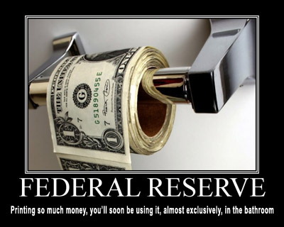
The Fed

Slide 24
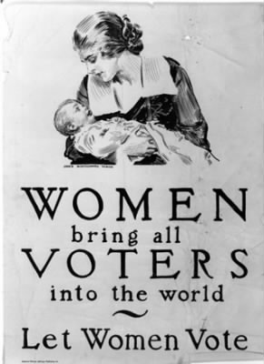
Suffrage
Susan B. Anthony
Carrie Chapman Catt
Presidents of NAWSA
Protests become militant/ persistent
Women’s role in WW I help them
19th amendment passed-
72 yrs after Seneca Falls
Progressivism Ends due to WW I
African-Americans still ignored
Laissez-Fair had faded

Slide 25
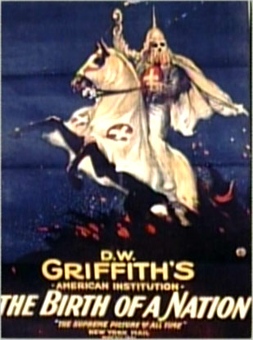
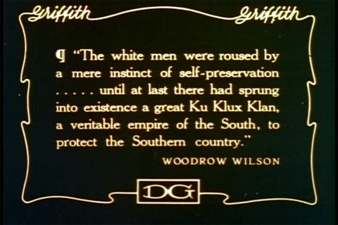
Birth of a Nation/ The Clansman

Slide 26
