Slide 1
UNIT FIVE: IMPERIALISM

Slide 3
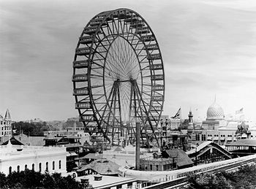
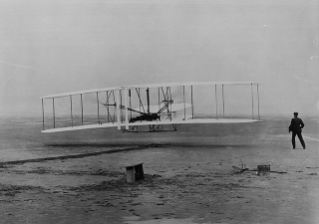
Life at the Turn of the Century
Cities grow up
Daniel Burnham- Architect
Frederick Olmstead- Landscape architect
NY Central Park
Airplanes- Wright Brothers
Photography- George Eastman
Newspapers- Pulitzer vs. Hearst
Mass Culture-
  Baseball
  Bicycles
  Parks
  Department Stores(RFD)
  Chain Stores

Slide 4
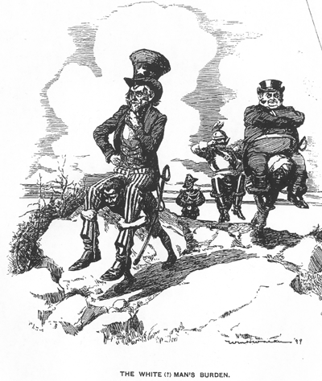
Imperialism
American had been Isolationists
Remember Washington’s advice
Neutrality and No permanent alliances
Imperialism- policy of taking colonies for economic interests
Stronger countries control weaker ones
Jingoism- patriotic aggressiveness
Why Imperialize?
Spheres of Influence-
1- new markets for products
2- military strength
3- cultural superiority- “White Man’s Burden”

Slide 5
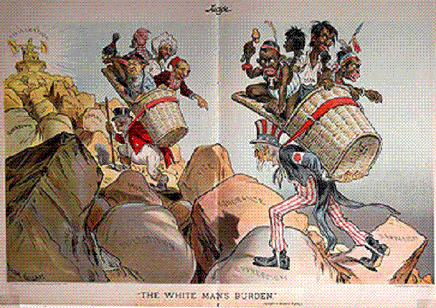
“White Man’s Burden” – Rudyard Kipling

Slide 6
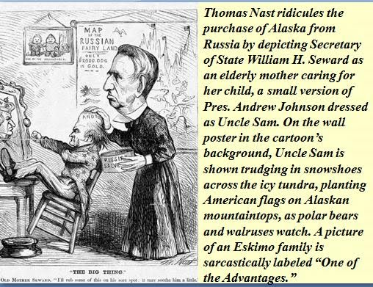
Building an Empire
Create a strong military- Navy
Alfred T. Mahan- “Influence of Sea Power upon History”
The need for a strong Navy- America builds
Alaska (1867)- Seward’s Folly
Purchases from Russia
Hawaii (1898)- Annex and overthrow Queen- becomes a State in 1959

Slide 7
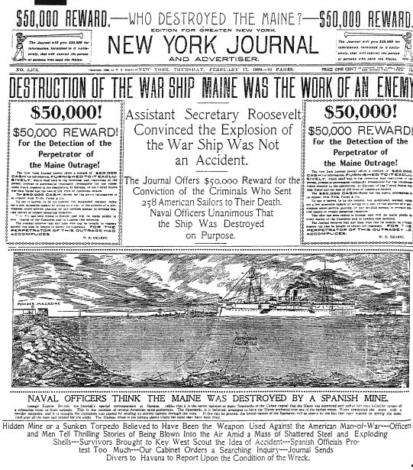
Spanish- American War
Spanish ruled Cuba
Where is Cuba?
Spanish rule harshly
Yellow Journalism- exaggerating news stories to draw readers in
Hearst vs. Pulitzer
De Lome letter- Spanish Minster insults McKinley
U.S. send ships to bring home citizens and observe
USS MAINE explodes in Havana- 260 Killed
“Remember the Maine”
U.S Attacks Spanish Colony- Philippine Islands
George Dewey captures islands
Imperialistic foreign policy

Slide 8
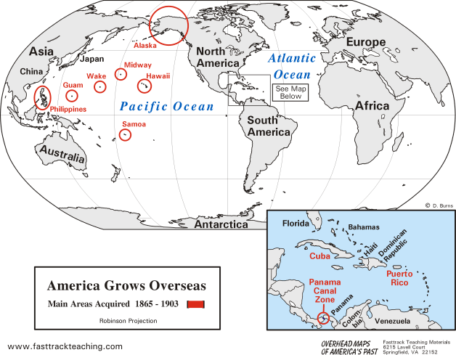
Imperialism

Slide 9
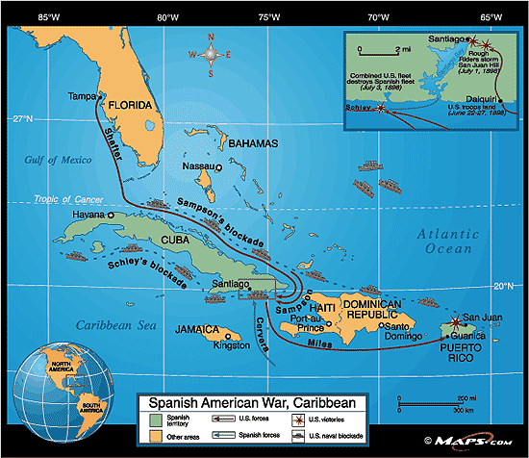
Cuba
Cuba will be Independent
Rough Riders- Theodore Roosevelt
San Juan Hill
“Splendid Little war”
Fighting brief
Cuba is free
Or is it?
Treaty of Paris 1898- Puerto Rico part of U.S.
U.S. buys Philippines
Control Philippines, PR, Cuba*
Anti-Imperialist League-Carnegie vs.
Josiah Strong- Christianize

Slide 10
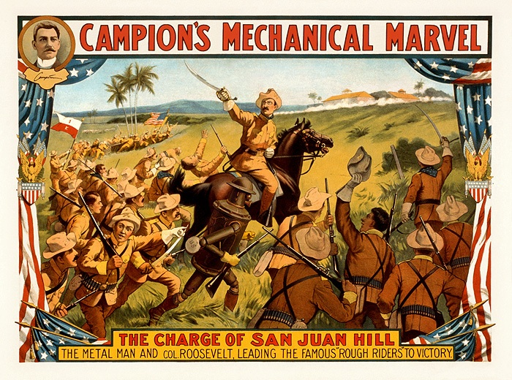
San Juan Hill

Slide 11
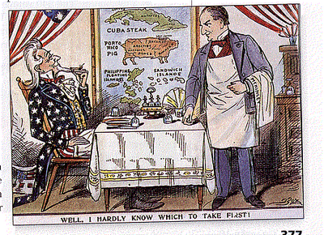
Cartoons

Slide 12
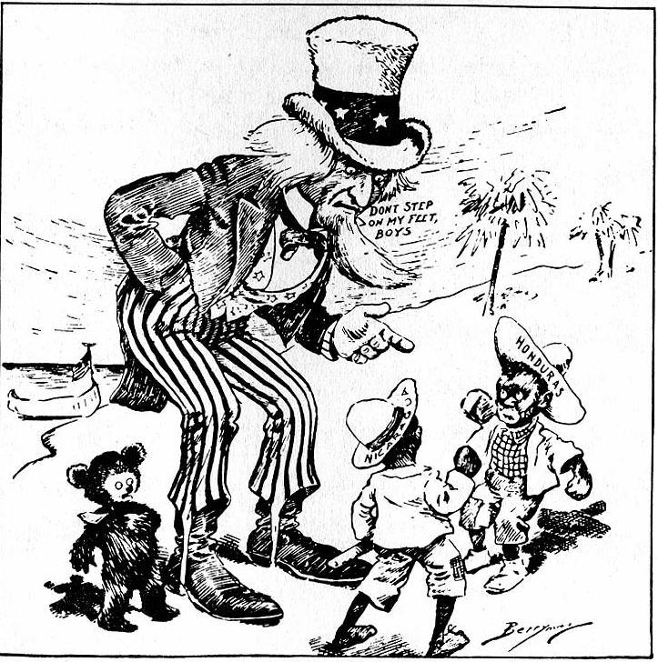

Slide 13
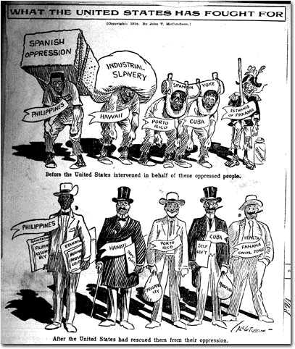

Slide 14
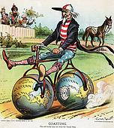

Slide 15
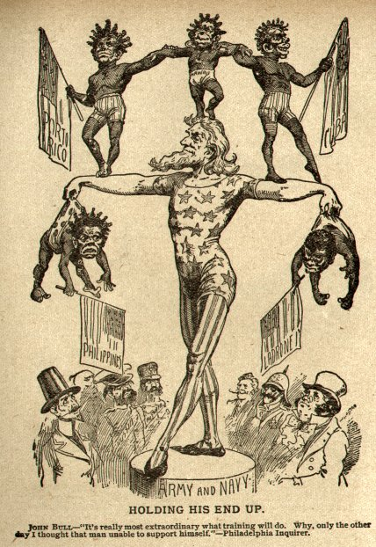
New Territories
Hawaii- Annexed new territory
Philippines- becomes independent after WWII
William H. Taft is Philippines 1st gov.
Puerto Rico- becomes a U.S. territory in 1917
Cuba
Teller Amendment- guaranteed a independent Cuba
Platt Amendment-
  Gives U.S. economic interests in Cuba
  Rights to a Naval Base
  Partial U.S. Control
  Protects business interests

Slide 16
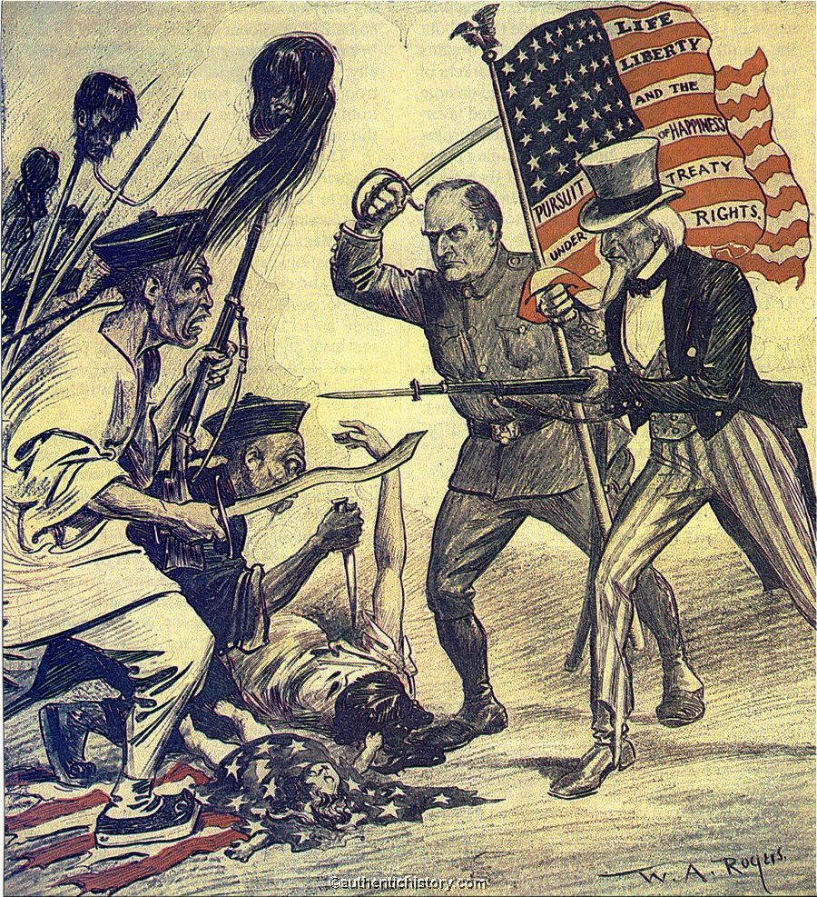
Asian influence
U.S. wanted a Sphere of Influence in China like Europe had
Open Door Note- John Hay want access (Open-Door) to China
The sharing of China by imperialists
Boxer Rebellion- put down by U.S. and others
Chinese protest foreign influence

Slide 17
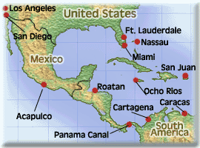
Roosevelt- Foreign Policy
Roosevelt arbitrator for Russian- Japan war
U.S. becomes active in world
Panama becomes part of Colombia
U.S wants a Canal across Central America
Colombia refuses- Panama revolts backed by U.S
10 yrs of Canal follow- Panama Canal built through disease and death
The Panama Canal
The Great White Fleet- sends Navy around World in 1907- Imperialism

Slide 18
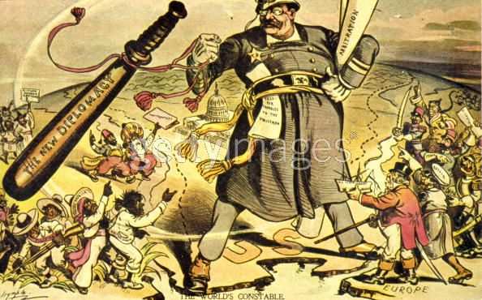
Roosevelt Policy
Monroe Doctrine for years
Now have Roosevelt’s Big Stick Foreign Policy
Roosevelt Corollary- U.S. will be only nation to intervene in Latin America
Taft has “Dollar Diplomacy”- use finances to influence Latin America
Wilson has Missionary Diplomacy- U.S only talk with legal govt’s
Wilson almost goes to war with Mexico- Pancho Villa
U.S. now World Power
Anti- U.S. feelings in world
Imperialism- ethical?

