Slide 1
UNIT 16 – RECENT HISTORY

Slide 2
1989 was such a seminal year in World History: Democracy worked in Germany as East and West United. Democracy did not work in China. Here is a pic of the “Tank Man.”

Slide 3
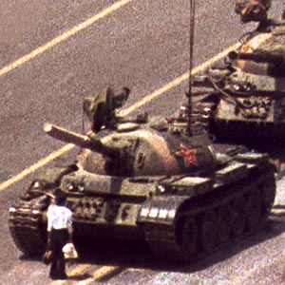
Tiananmen Square

Slide 4
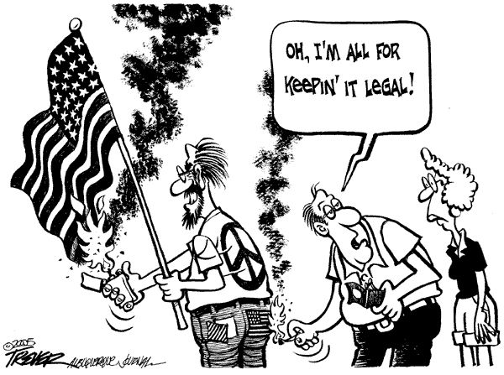

Texas v. Johnson
Ruled Flag Burning was Free speech

Slide 5
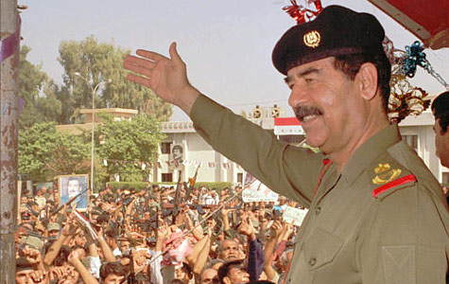
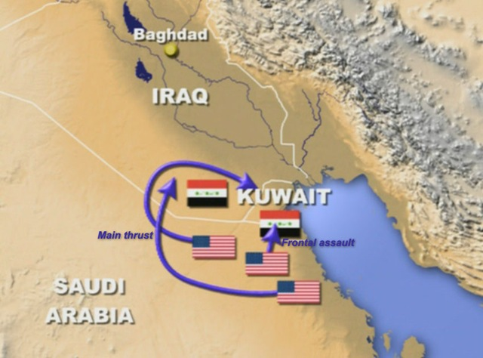
Post Cold-War
Bush 88-92
Promises no new taxes in 88-Read my lips as President
1991
High Point of Presidency is Operation Desert Storm
Iraq invades Kuwait
Saddam Hussein
Colin Powell and Norman Schwarzkopf lead coalition to liberate Kuwait
Operation a success
Bush ratings soar, but failed economy hurts Bush
27th Amendment passed- Congressional pay raises

Slide 6
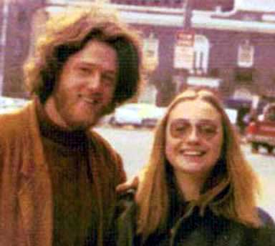
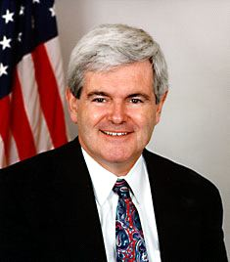
Clinton and the 90’s
Bill Clinton defeats Bush, and Ross Perot
Economy main issue
Clinton raises taxes to reduce deficit spending
NAFTA signed
Brady Bill passed
Family Medical Leave Bill
1994 midterm elections- Republicans take over Congress
Over Universal Healthcare- Hillary
Contract With America
  Led by Newt Gingrich and Bob Dole
  Immigration laws- Proposition 187
  Lower taxes
  Balanced budget
  Welfare reform
Economy does boom in mid to late 1990’s

Slide 7
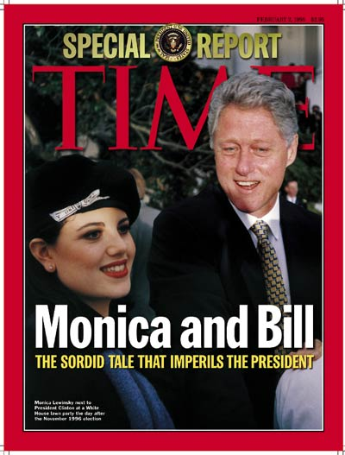
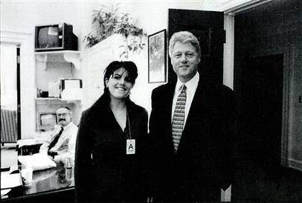
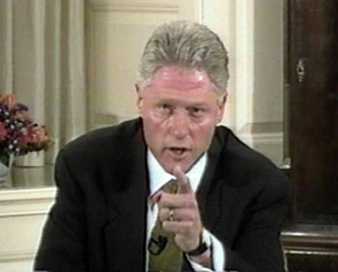
Clinton
Clinton re-elected 96’
Scandals emerge
Whitewater Investment Scandal
Lewinsky Scandal
Clinton commits perjury
Impeached but not removed

Slide 8

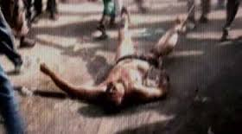
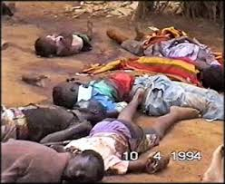
U.S. in 1990’s
1993 WTC bombings
Somalia- try to help starvation
“Black Hawk Down”
Kosovo and Bosnia
Rwanda- do not help
Israel and PLO
Yassar Arafat
Concentrate on Middle East Peace
Modern issues- globalization, healthcare, welfare, budget, technology, computer, environment

Slide 9
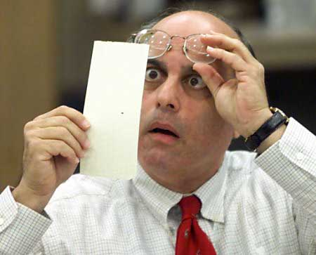
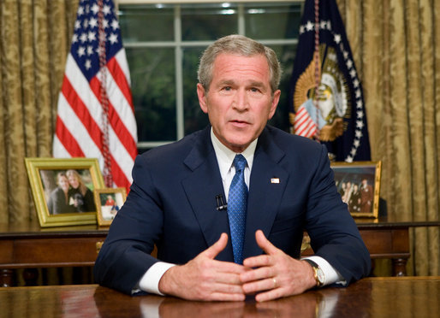
A New Century
George W. Bush elected over Al Gore
Bush v. Gore- case gives bush 2000 election in Florida
Gore wins popular vote
No Child Left Behind Education Act - Bush
September 11 ,2001
Terrorist attack WTC and Pentagon
Osama Bin Laden
Al Qaeda
Bush Goes to War in Afghanistan
Creates Dept. Homeland Security
Patriot Act- constitutional or not
Challenged by the ACLU

Slide 10
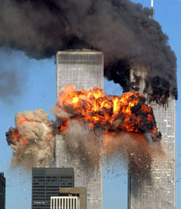
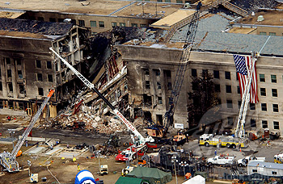
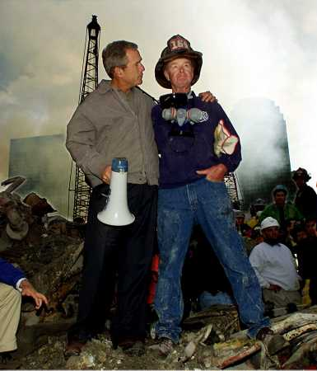
9-11

Slide 11
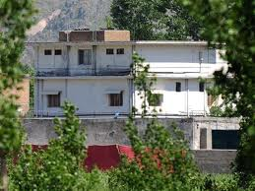
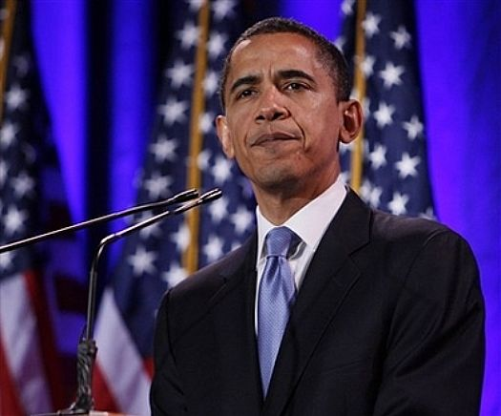
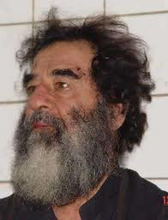
Post 9-11
War on Terror
Iraq War- remove Hussein
Osama Bin Laden killed
Torture
Corporate Scandals
Hurricane Katrina
Budget debates
2008-2016 Barrack Obama elected
1st minority elected

Slide 12
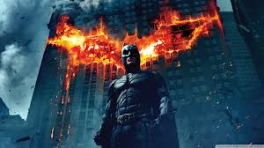
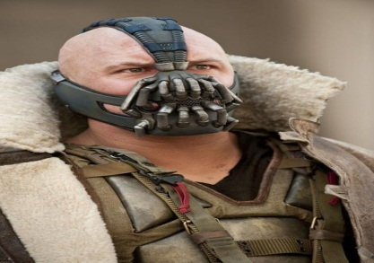
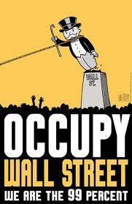
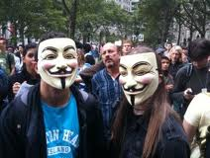
America’s Current Path
Middle East Anarchy
China rising
Huge $ in politics
Stock market breakdowns
Record budget deficits
Healthcare-Obamacare
Gap in Rich and Poor
Occupy Wall St. movement/ Tea Party
The Role of Government
A Storm is Coming
The Oppressed

