Slide 1
UNIT 15: THE 1980S – REAGAN AND GEORGE H.W.BUSH: The End of the Cold War and new threats

Slide 2
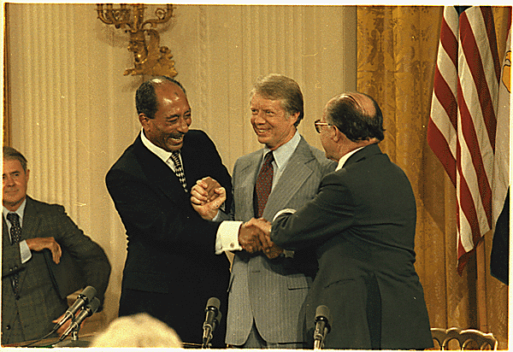
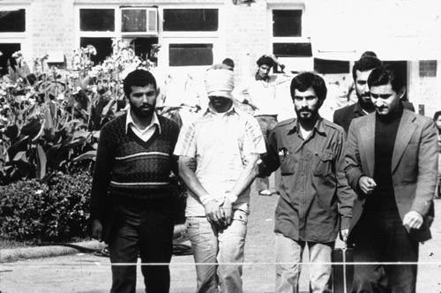
Middle East and Carter
Carter’s high point-
Camp David Accords- Egypt and Israel agree to peace
Hope for Middle East
Carter’s low point-
Iranian Hostage Crisis
U.S. supports Shah
Ayatollah Khomeini
Failed rescue attempt
Hostages released 1st day of Reagan term

Slide 3
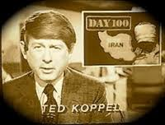

Iranian Hostage Crisis

Slide 4
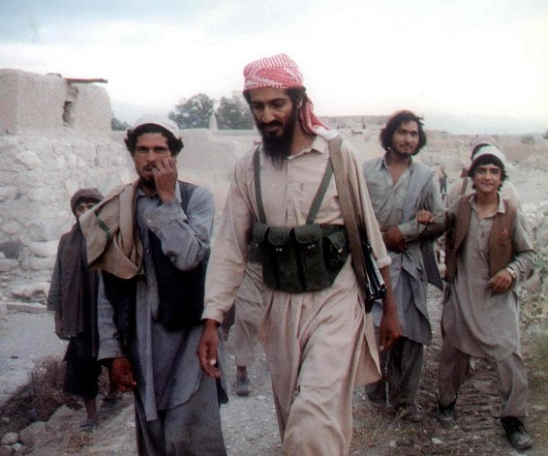
End of Détente
As Carter Presidency ends- Soviets invade Afghanistan
Cold re-heats
Détente ends
U.S. aids Mujahideen
Bin Laden

Slide 5
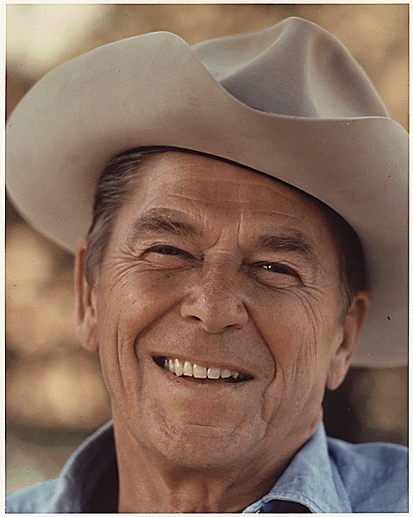
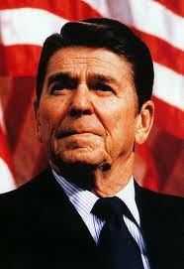
Reagan Revolution
Conservatives rise to counter liberal big govt.
Less federal govt.-more families/ communities
The New Right- Social Issues
Conservative Coalition- Christians, pro-business, and conservative Dem’s
Moral Majority- Christians tired of liberalism
Ronald Reagan – The Great Communicator is the leader of movement

Slide 6
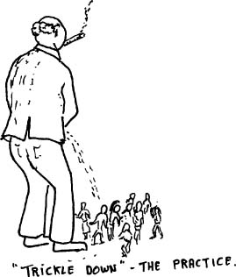
Reaganomics
1980 Election
Reagan beats Carter
Reaganomics aka
Supply Side aka
Trickle Down Economics
Lowering taxes to promote growth
Cut govt. spending
Economy turns around
Debt rises
Savings and Loans bailouts with deregulation as well
Appoints some Conservative justices to S.C

Slide 7
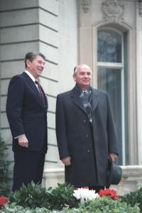
Cold Warrior
Always fought communism
U.S.S.R. is “Evil Empire”
Increases military spending
Outspend Soviets
Star Wars or SDI plan
Soviets begin to crack some-USSR economy in shambles

Slide 8
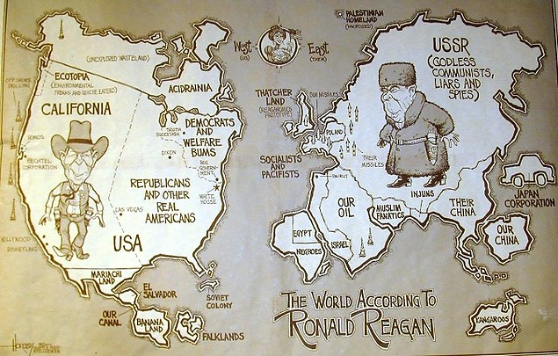

Slide 9
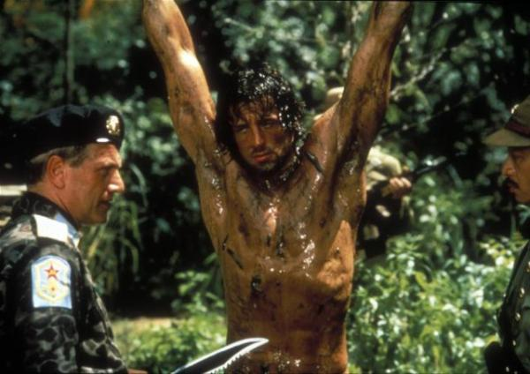
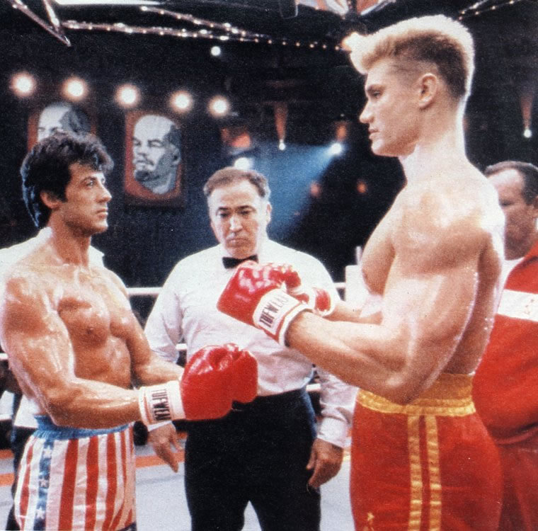
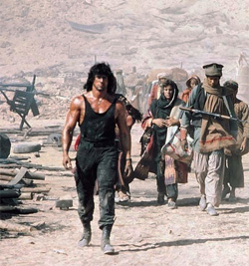
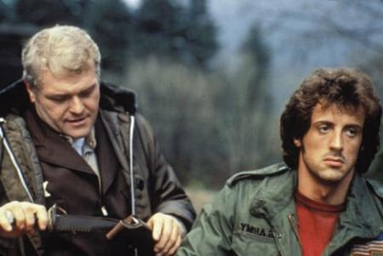
Cold War Movies with Stallone
Rocky IV 1985

Slide 10
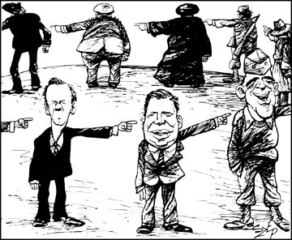
Foreign Affairs 1980’s
Iran Contra Scandal- illegal sale of weapons to Iran to pay for anti- Communist fighters in Nicaragua
Grenada- aid to prevent communism
Panama- arrest General Noriega to stop drug trade

Slide 11

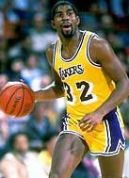
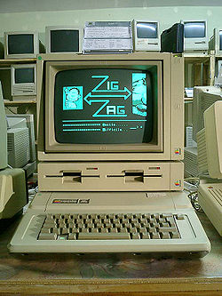
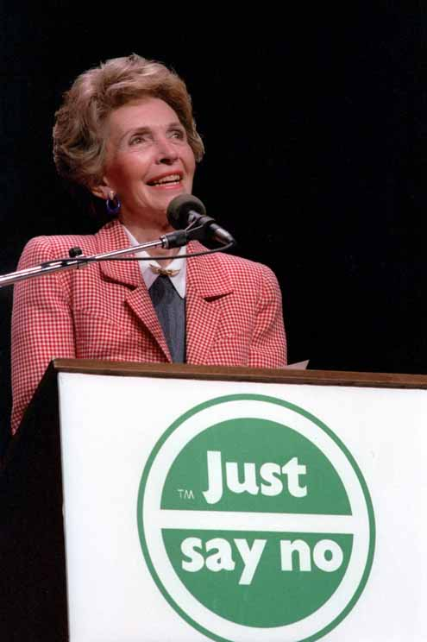
Social Issues
Birth of modern era of technology
Apple and Microsoft
Education debated
MTV, Rap Music
AIDS disease grows
Abortion still an issue
Drugs- “Just Say No”
Graying of America- America gets older
Baby Boomers

Slide 12
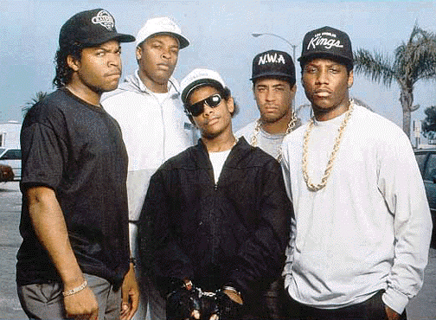
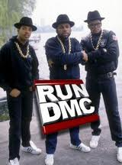
1980’s Rap

Slide 13
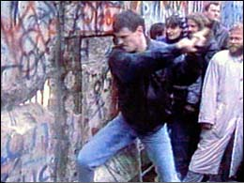
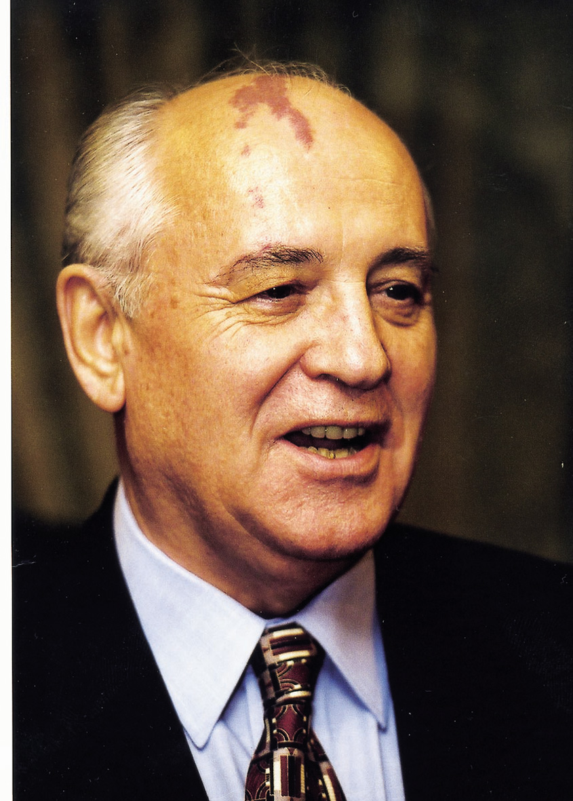
Cold War Ends
Mikhail Gorbachev comes to power in USSR in 1985
Glasnost and Perestroika
Loosen iron grip on East Europe
Democracy movements
1988- George H.W. Bush Elected
1989 Berlin Wall falls
Germany re-united
1991 Boris Yeltsin takes over as USSR breaks apart
Where did the Nukes go?
U.S. Lone Superpower
China- 1989 Tiananmen Square

Slide 14
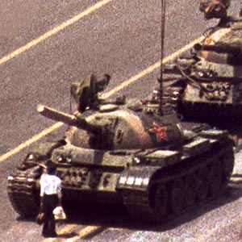
The “Tank Man” at Tiananmen Square

Slide 15

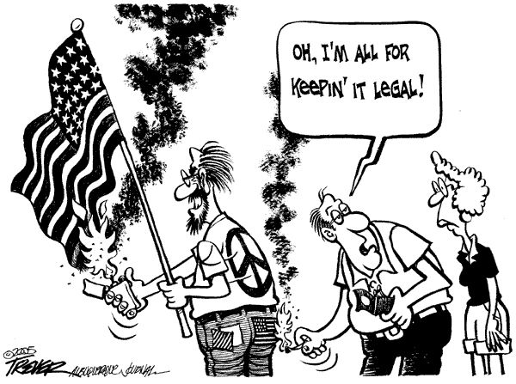
Texas v. Johnson
Ruled Flag Burning was Free speech

Slide 16
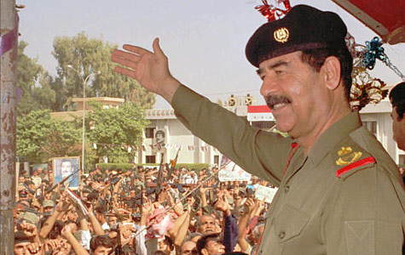
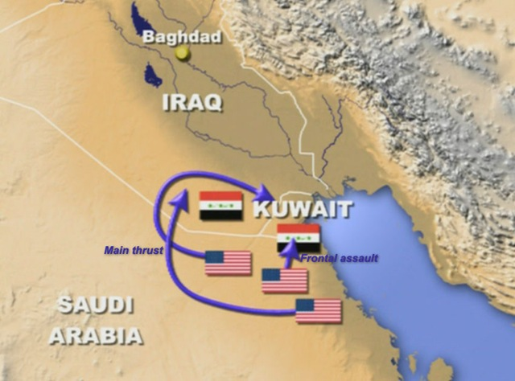
Post Cold-War
Bush 88-92
Promises no new taxes in 88-Read my lips as President
1991
High Point of Presidency is Operation Desert Storm
Iraq invades Kuwait
Saddam Hussein
Colin Powell and Norman Schwarzkopf lead coalition to liberate Kuwait
Operation a success – helps to end so called ‘Vietnam Syndrome’
Bush ratings soar, but failed economy hurts Bush
27th Amendment passed- Congressional pay raises

