Slide 1
UNIT 12: CIVIL RIGHTS MOVEMENT

Slide 2
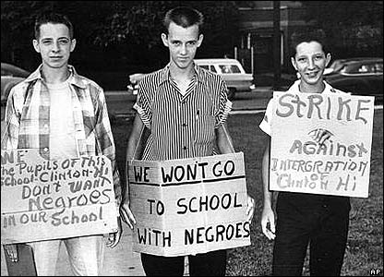
Civil Rights Movement
Old laws being ignored
14-15th Amendments
Racial Etiquette
Jim Crow laws
Plessy v. Ferguson-1896
“Separate but equal”
WW II shows racism-Double V
Truman desegregates Armed forces
Jackie Robinson Dodgers baseball
Brown v. Board-1954 ends school segregation
Resistance begins
NAACP- Dubois
Tuskegee- Booker T. Wash.

Slide 3
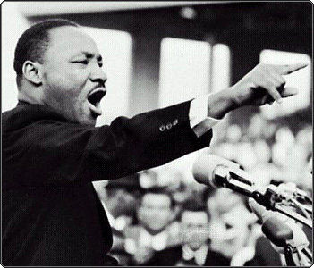
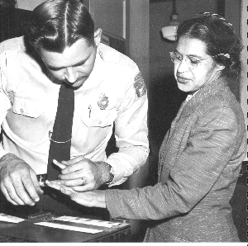
Civil Rights
Rosa Parks- Montgomery Bus Boycott 1955
Emergence of Martin Luther King Jr. (MLK)
Pastor, 26 yrs old
Civil Disobedience- Non Violent
Wants to win Public over
Leader of movement
SCLC- Southern Christian Leadership Conf.
SNCC- Student Nonviolent Coordinating Committee

Slide 4
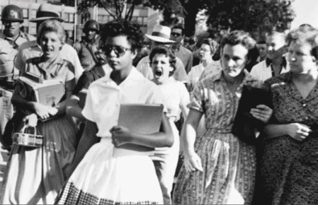
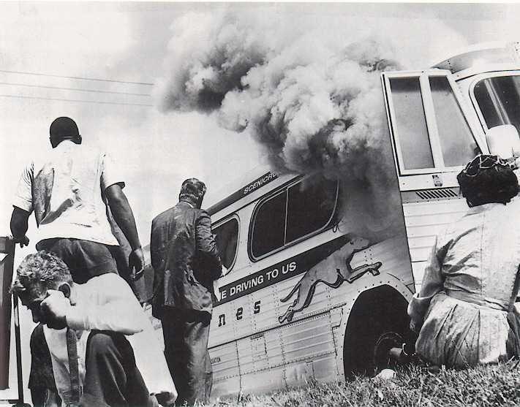
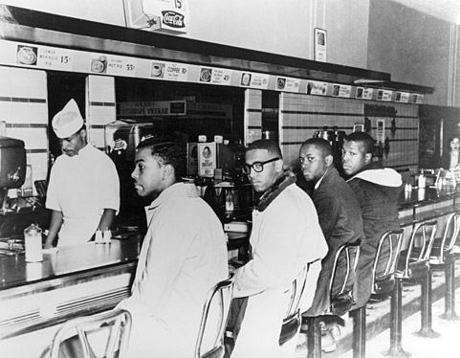
Civil Rights Movement
Resistance to Brown decision-integration
Little Rock Nine- 1957
Gov. orders National Guard to stop black students
Eisenhower uses Federal troops to integrate
Movement grows in protest segregation elsewhere
1960 Greensboro Sit-ins
Freedom Riders- ride through South- met with violence

Slide 5
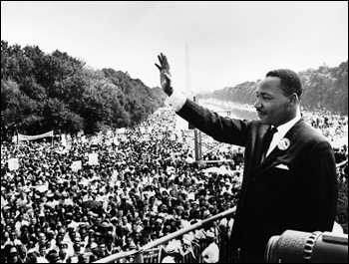
Birmingham
Protests met with violence
April 1963- police use brutality
Looks bad
JFK voice support for blacks
James Meredith- was refused to get in U of Miss.
George Wallace- Gov. of Alabama
Kennedy uses federal force to confront segregationist leaders
March on Washington in August 1963
Promotes Civil rights
“I Have a Dream”- MLK speech
Civil Rights Act 1964- ends segregation in all public places
24th amendment- ends poll tax

Slide 6
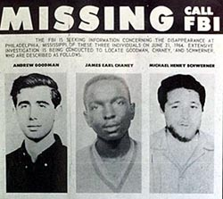
Freedom Summer
1964
Mississippi voting
Several Civil Rights workers die
Selma to Montgomery, Alabama March
Voting Rights Act 1965

Slide 7
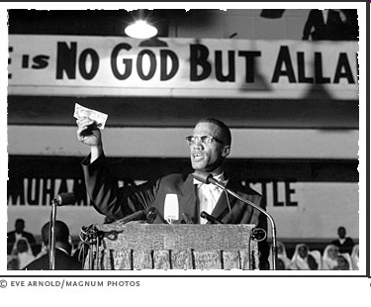
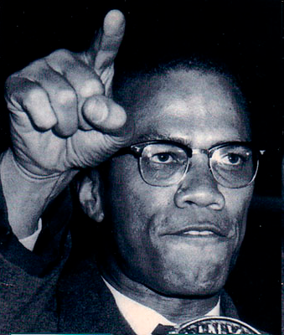
A New Movement
1960’s still have segregation
De Jure Segregation (by law) vs. De-Facto (Custom)
Leaders want a equality now
Is non-violence working?
Medgar Evers assassinated
Armed Resistance- Racial Pride
Malcolm X Emerges
Spokesmen for Nation of Islam
Separatism
Nation of Islam- black nationalism
Led by Elijah Muhammad
Teach self-defense

Slide 8
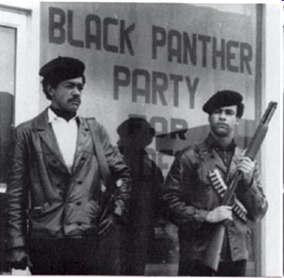
Black Power
Stokely Carmichael- former member of SNCC of now preached force if needed
MLK differs from X and Stokely
Ballots vs. Bullets
By 1964, Malcolm X had flipped & wanted integration
X Assassinated by rivals in Nation of Islam in 1965
1966 Black Panthers formed by Huey Newton and Bobby Seale
Radical-accepted violence
Did create some programs for people
Wanted military exemption

Slide 9
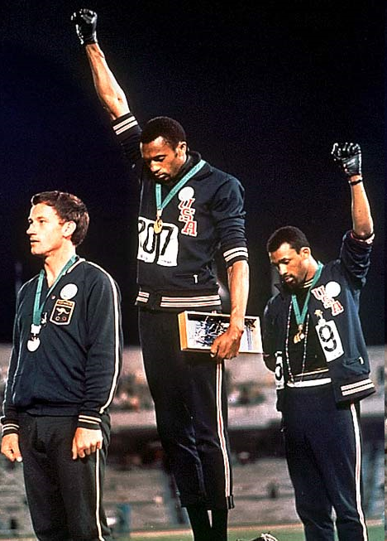
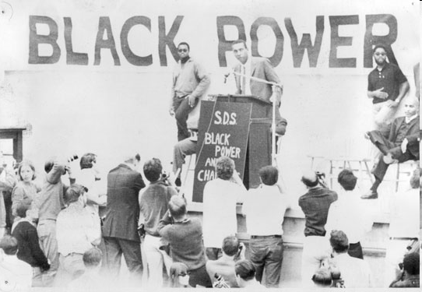
Black Power

Slide 10
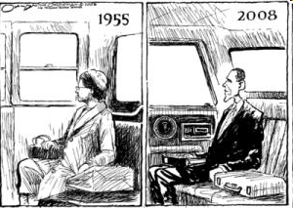
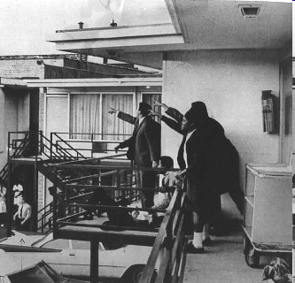
Movement Ends
1968 Memphis Tennessee
MLK assassinated by James Earl Ray
Felt his death was coming
Riots ensue
Robert Kennedy killed in 1968 by Sirhan Sirhan
Another blow to Civil Rights
Nixon wins in 1968
Overall Movement:
Ends de-jure segregation
1964 Civil Rights act
Ends poll taxes and lit tests
Racial pride
More political power
Affirmative Action programs

