Slide 1
UNIT 11: COLD WAR, PART ONE: TRUMAN, IKE, JFK

Slide 2
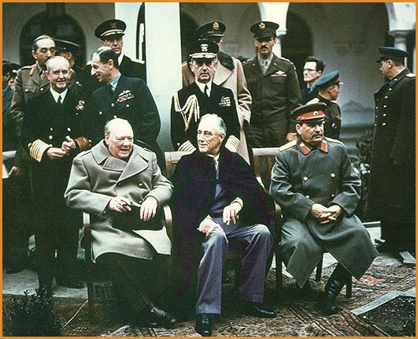
Rebuilding
Yalta Conference-
  Big 3 meet
  FDR, Stalin, Churchill
  Creation of United Nations
  Security Council is most important body
Potsdam Conference
  Division of Germany
Nuremberg Trials
  Put Nazi war criminals on trial
  Many executed
Japan
  MacArthur controls it
  Establish Democracy/ freedoms
  Still have same Constitution today

Slide 3
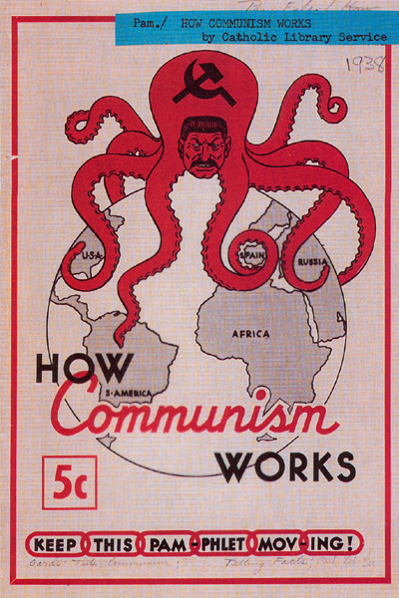
The Cold War
Communism vs. Capitalism/Democracy
War is over- what to do with Europe?
U.S. wants free elections
Churchill says East Europe has fallen under an “Iron Curtain”
Use those countries as Satellite Nations and buffer zones

Slide 4
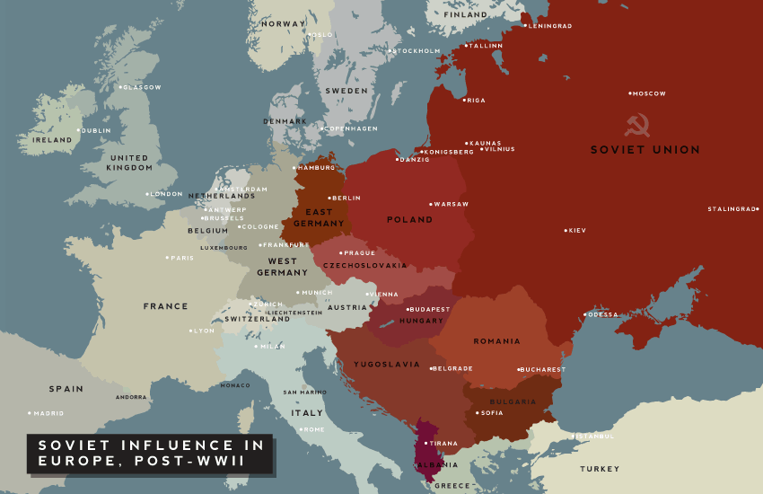
Iron Curtain

Slide 5
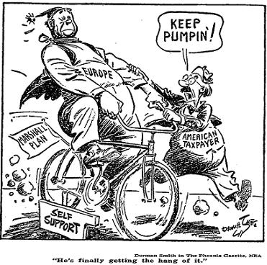
U.S. Cold War Policy
Containment- theory of trying to stop the spread of communism
George F. Kennan- U.S. Diplomat to USSR
Truman Doctrine- give any nation aid that needs it to prevent the spread of communism
Greece and Turkey- 1st countries given aid in 1947
Marshall Plan
  Europe devastated by war
  communism looks appealing
  Marshall offers recovery plan-$
  Offered to all nations
  Very successful

Slide 6
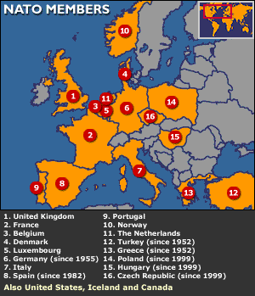
Cold War Politics
Berlin Airlift
  Germany and capital are split
  Soviets blockade Berlin
  U.S. airlifts supplies for over a year
  2 million tons of supplies
National Security Act-1947
  Dept. of Defense created
  CIA and NSC
NATO- North Atlantic Treaty Organization
U.S. part of pact with W. Europe
Isolationism gone
Warsaw Pact created to unite Communist nations
1949- USSR becomes Nuclear Power

Slide 7
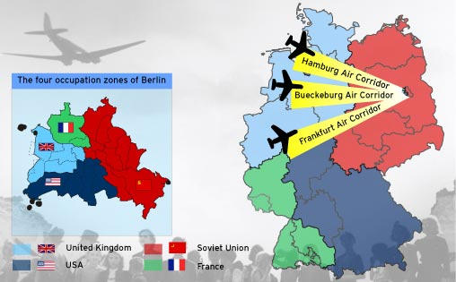
Berlin Airlift

Slide 8
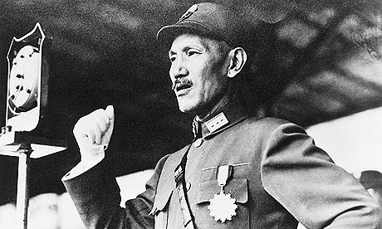
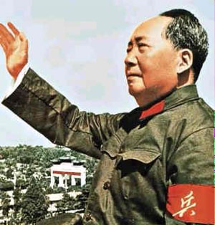
Cold War Heats Up
China falls to Communism
Nationalist Chang Kai-shek is backed by U.S.
Mao Zedong- communist leader of China
Commies beat Nationalists
Nationalist flee to Taiwan
U.S. doesn’t recognize the People’s Republic of China
Does Containment fail?

Slide 9
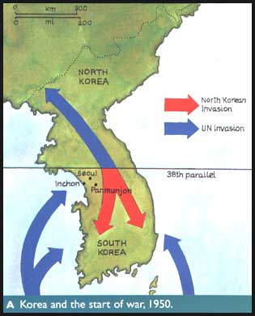
Korean War-1954
Korea split on 38th parallel
North Korea (Communist) invades South Korea (Democratic)
U.S and UN intervene
Macarthur launches counter into NK
China enters on NK side
War drags on-stalemate
Macarthur wants war with China- criticizes Truman
Truman fires Macarthur
War ends @ 38th parallel

Slide 10
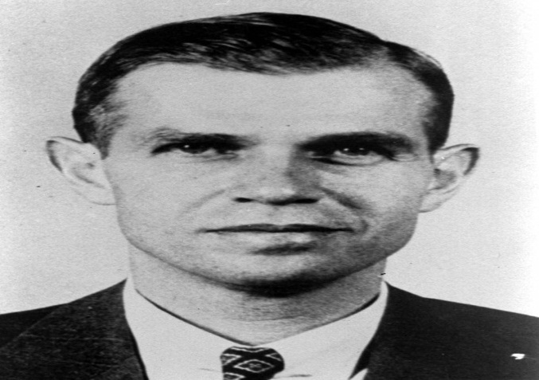
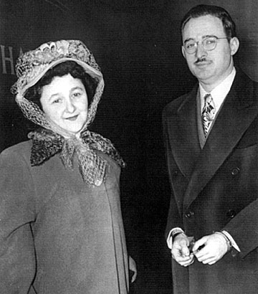
Fear of Communism Grows
Spies discovered
USSR gets A-Bomb
Loyalty boards
HUAC: House Un-American Activities Committee
Investigate Hollywood-”Hollywood ten”
Blacklisting
Alger Hiss- state dept. official imprisoned of spying
Rosenbergs- accused of passing atomic secrets and executed
Joseph McCarthy- Senator who investigated communists
“Witch Hunts”

Slide 11
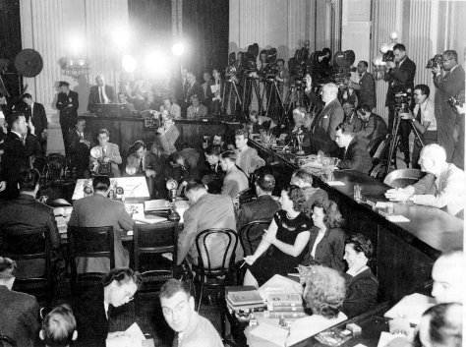
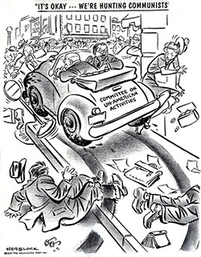
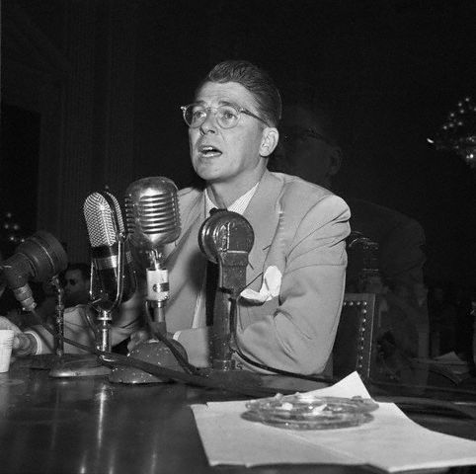
HUAAC – House Un-American Activities Comittee

Slide 12
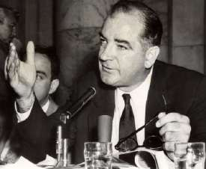
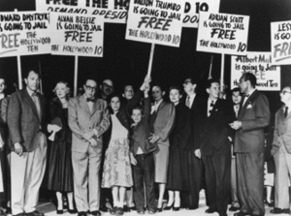
Joe McCarthy and McCarthysim (State Dept)

Slide 13
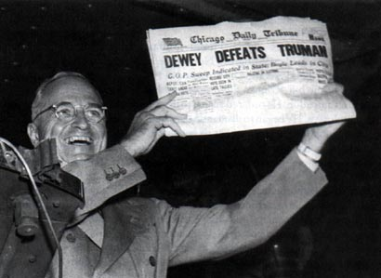
Home Life after War
G.I. Bill- Education and low-interest loans
Suburbs grow- Levittowns
Economy Slumping
Truman takes blame
Taft-Hartley Act- curbs Unions
Truman desegregates armed forces and govt.
Angers Southern Dems
1948 election Truman beats Dewey and Dixiecrats in an upset
Truman offers a “Fair Deal”
SS extended, low income housing pass, others fail

Slide 14
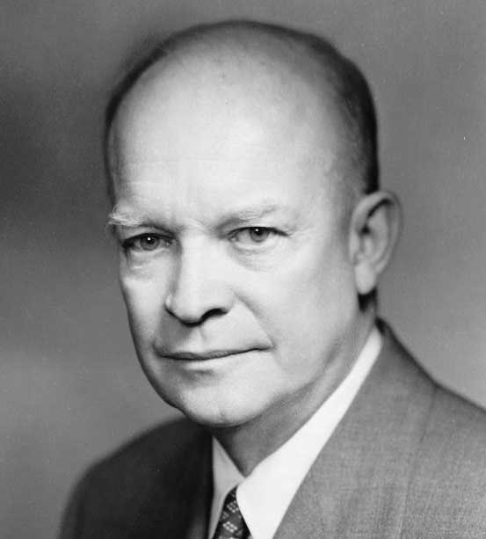
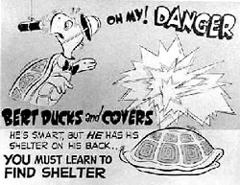
Cold War continues under Eisenhower
1952 Eisenhower elected (IKE)
Nixon is V.P.
“Checkers Speech”
Middle or Straight Road policies- moderate
Eisenhower ends Korean War @ 38 Parallel
War hurt Truman’s popularity
Sec. of State John Foster Dulles proposes:
1- Massive Retaliation
2- Brinkmanship
Begin to build of Nukes and scale down troops
Arms Race begins
1952- H Bomb test in U.S.
1953- USSR tests H Bomb
Citizens build cover shelters

Slide 15
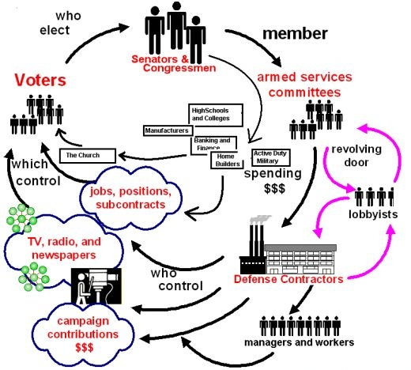
Military Industrial Complex
Eisenhower warns of an Iron Triangle in his farewell address
Involves military, legislators/politicians, and industry
Corruption and Misplaced power

Slide 16
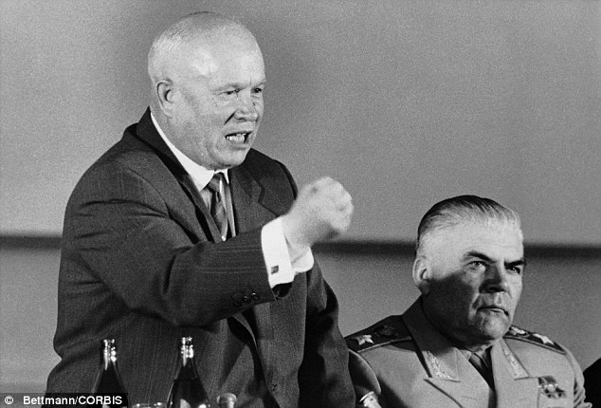
Cold War Spreads
CIA does secret actions in Iran and Guatemala
1953- Stalin dies
Nikita Khrushchev takes over
Hungarian revolt squashed by Soviets
Eisenhower Doctrine copies Truman in U.S. should defend Nations against Communism
Middle East too

Slide 17
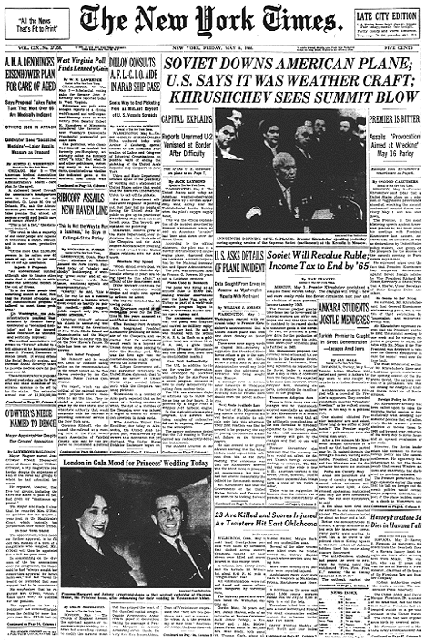
The Space Race
1957- USSR develops ICMB
Long Range attack?
!957- USSR launches SPUTNIK
1st satellite
U.S. embarrasses
Creates NASA
Launches 1st satellite in 1958
Race to Space and Moon has begun
U-2 Incident
  U.S doing secret flights over USSR
  May 1960- Gary Francis Powers U-2 plane shot down
  Tensions escalate

Slide 18
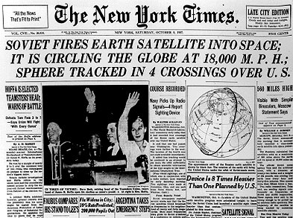
Sputnik

Slide 19
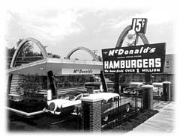
1950’s economy
Business Grows bigger
Franchising and Conglomerates emerge
Mass production and consumption
Planned Obsolescence
Buying on credit
New advertising
Overall more conservative era under Eisenhower

Slide 20
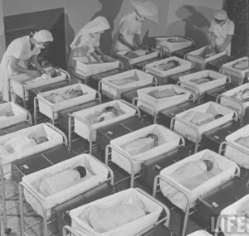

50’s culture
Baby Boom Generation- babies born postwar
People live in suburbs-loss of tax $
White Flight out/ Urban Renewal
Interstate Highway System- Eisenhower okays building 41,000 miles of expressway
TV become widely affordable in 1948
Regulated by the FCC
Quiz shows are popular-scandals
“I Love Lucy”
Sets social norms- Women is housekeeper
Few minorities on TV
Portrays ideal America
Radio turns to news mostly
Movies have to go to 3D and color to draw viewers because TV
Jonas Salk- Creates vaccine for Polio

Slide 21
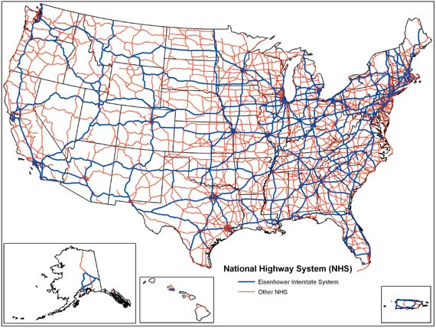
Highway System

Slide 22
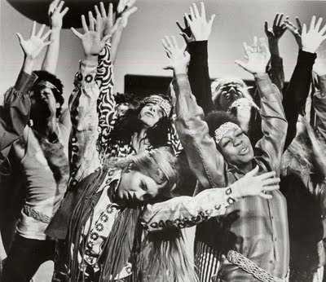
50’s Culture
Beatniks- movement against mainstream
Pre-runner to the Hippies
Non-conformist
Social and literary non-conformity
Teenagers
Rock-n-Roll develops
Elvis Presley, Chuck Berry
¼ of America lives in poverty-Other America
Women still seen as homemakers
Some work same jobs for less $
Betty Freidan- writes “ Feminine Mystique’
Movement in Feminism and women’s liberation
All immigrants face discrimination

Slide 23
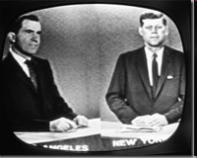
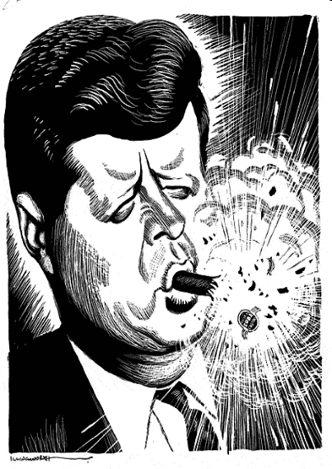
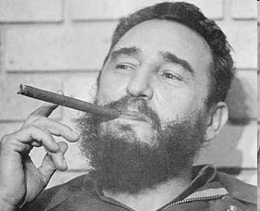
JFK and The Cold War
1960 Election:
JFK- Dem vs. Nixon- Rep.
JFK Catholic?
JFK wins in close election
TV vs. Radio
Hard line on Communism
Cuba taken over by Fidel Castro a communist who welcomes Soviet aide- Cuban Revolution
Seen as threat as he takes over all of Cuban corporations
Bay of Pigs- Cuban exiles with U.S. military support try to overthrow Castro
Massive failure- embarrasses JFK
Cuba looks for more aide from Soviets
Soviets build Berlin Wall splitting East and West Germany
2 nations now- East and West Germany
Becomes symbol of communism

Slide 24
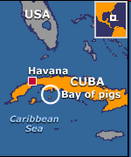
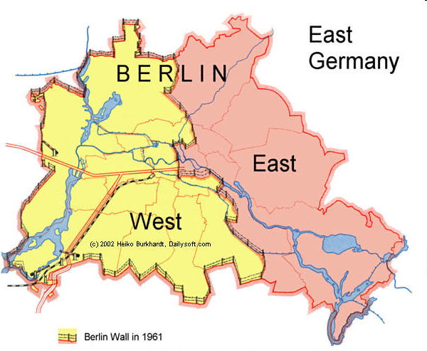
Cold War

Slide 25
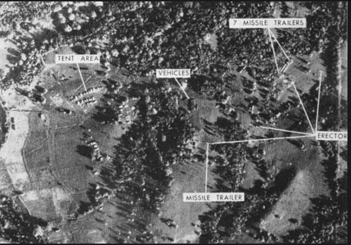
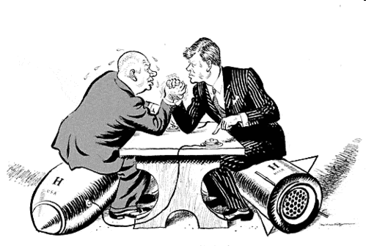
Cold War heats up
Cuban Missile Crisis
Soviets place nuclear missiles in Cuba in 1962
U.S. spy planes get intel
JFK demands removal
Blockade Cuba- USSR ships heading towards Cuba
Soviets back down
After crisis JFK and Khrushchev establish a Hot Line and sing treaty banning above ground nuke testing

Slide 26
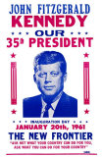
The New Frontier
JFK represents hope
Camelot
New Frontier his legislative package
Lacked voter mandate
Increased deficit spending in military and NASA
Created Peace Corp in 1961
Alliance for Progress- gave aid to Latin America

Slide 27
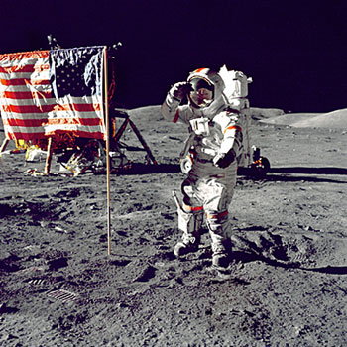
Space Race
Sputnik in 1957
1961 USSR sends man into space
JKF challenges U.S. to win the race
NASA created
Alan Shepard- 1st in space
John Glenn -first to orbit
July of 1969- U.S. lands on Moon
Neil Armstrong- first on the moon

Slide 28
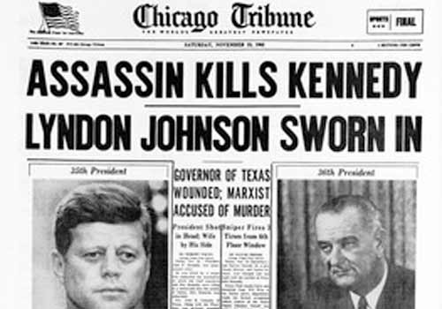
JFK Assassinated
Nov. 22 1963
Dallas, Texas
Texas School Book Depository
LBJ takes over as President
Lee Harvey Oswald arrested
Jack Ruby kills Oswald as he is being moved
Conspiracy theories
Warren Commission- conclude a single or magic bullet theory

Slide 29
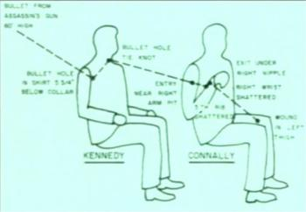
Magic Bullet

