Slide 1
UNIT 10: WORLD WAR II

Slide 2
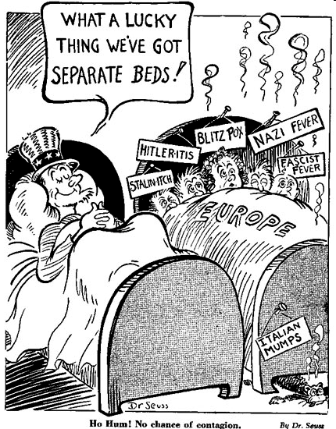
WW II begins
U.S. focused on Depression
Worldwide Depression-leads to rise of dictators
Anti-war feelings-isolationism
Neutrality acts- forbids arms sales to warring nations
1937 FDR gives Quarantine speech

Slide 3
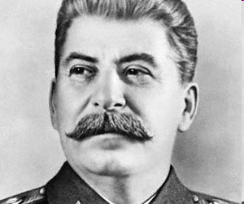
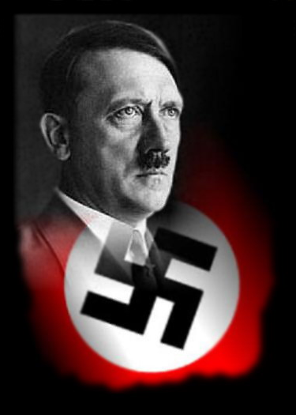
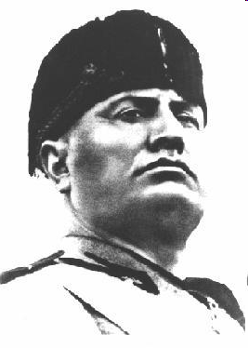
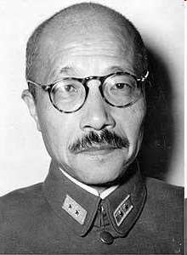
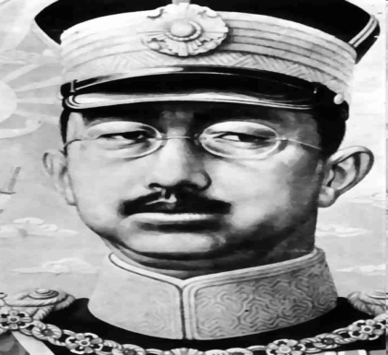
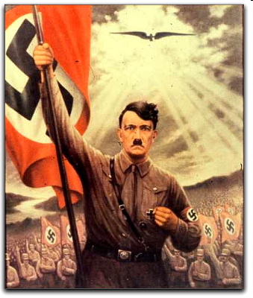
Causes of WWII
Japanese
  Imperialism
  Manchuria/China-1937
  Emperor Hirohito
  Tojo
Italy
Mussolini and Fascism
Germany
Failed Weimar Republic
Adolf Hitler
Third Reich-Nazi
Russia (USSR)
Joseph Stalin
Communism

Slide 4
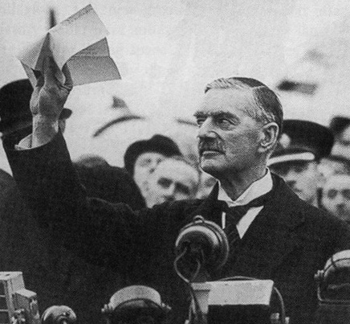
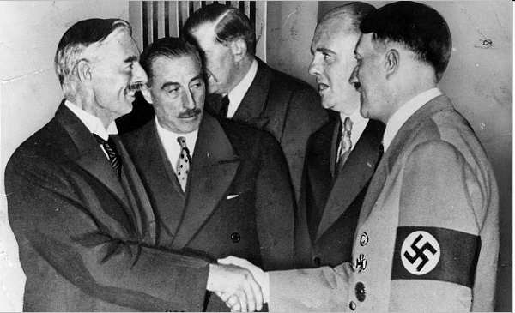
Causes WW II
Kellogg-Briand Pact
Failures of Versailles
Germans Rearm
Take Rhineland
Take Austria
Munich Peace Conference- Hitler declares Sudetenland his last advance
Appeasement Policy
USSR and Germany sign Non-Aggression Pact-1939
Germany invades Poland
Starts WWII- France and GB declare war
American neutral

Slide 5
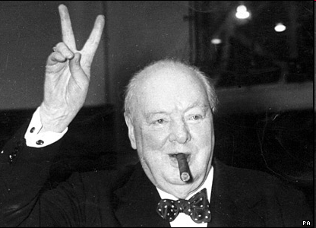
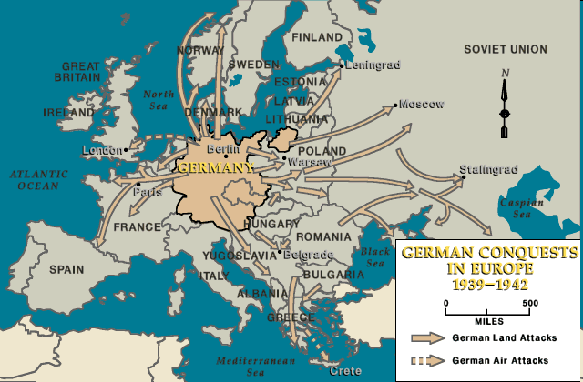
Warfare
Germans use Blitzkrieg
Lighting war-heavy use of machines and aircraft- Luftwaffe
Quick victory in Poland
Phony war with France
Finally Hitler invades France
France surrenders in 1940
Germany controls most of Europe
Battle of Britain
  Massive bombing of GB
  RAF defends Britain-radar
  Winston Churchill
  Germany never invades GB

Slide 6
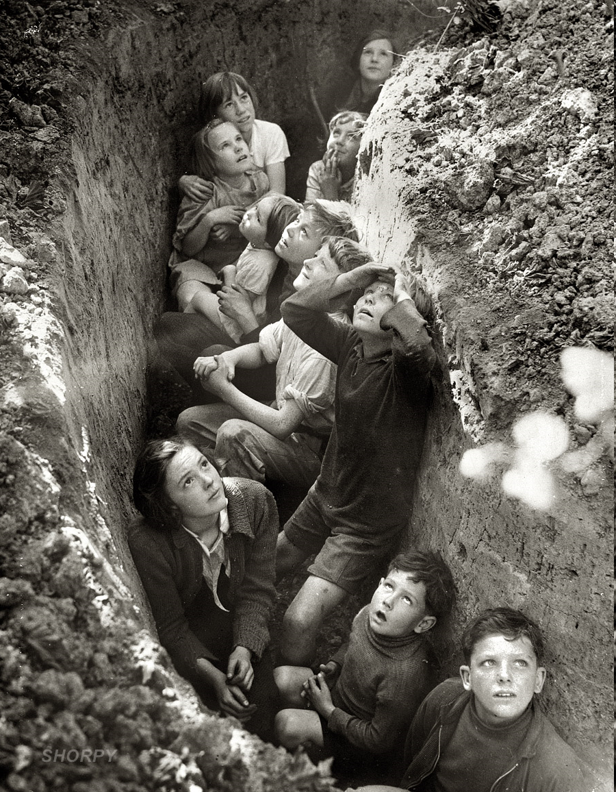
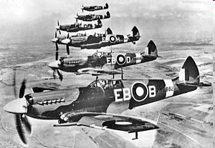
Battle of Britain

Slide 7
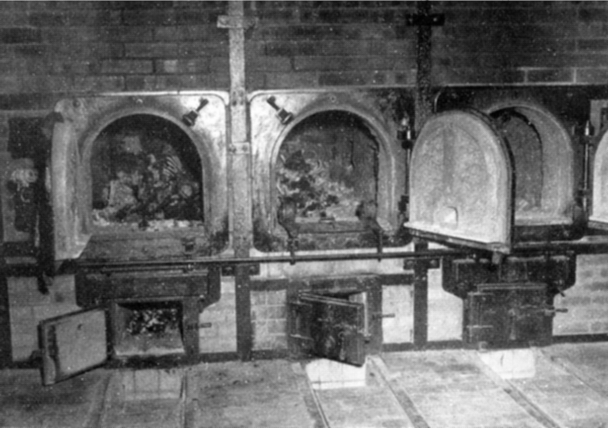
The Holocaust
Nazi’s persecute Jews
Hitler blames them for problems
1939 Final Solution
Concentration camps
Death Camps
6 Million killed-Jews
Camps liberated at the end by allies
The Holocaust

Slide 8
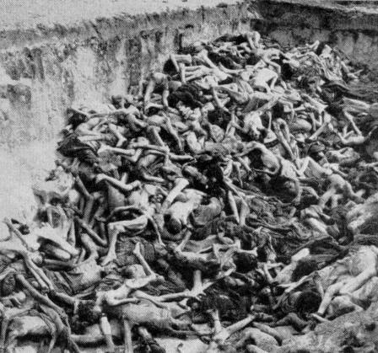
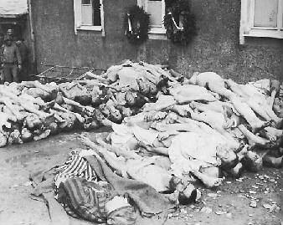
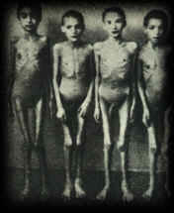
Holocaust

Slide 9
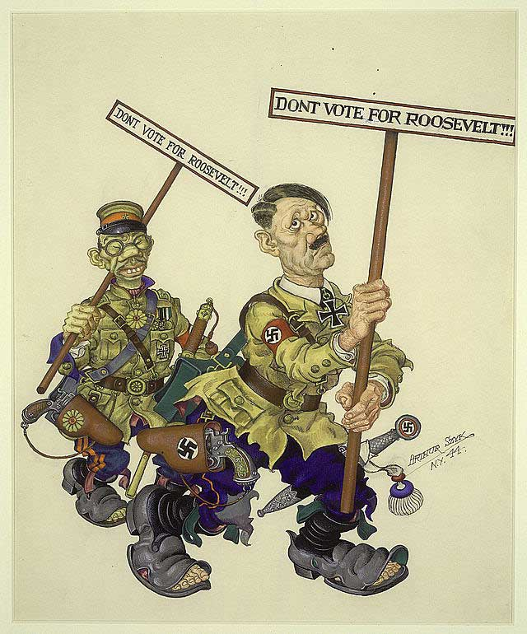
U.S. Prepares for WWII
1939- FDR gets “Cash and Carry Policy”
Axis Powers forms
Germany, Japan, Italy
Selective Service Act- peacetime draft
FDR seeks/wins 3rd term
Lend-Lease Act-begin sending arms to allies-
Arsenal of Democracy
Churchill and FDR sign Atlantic Charter
Same goals as old 14 points

Slide 10
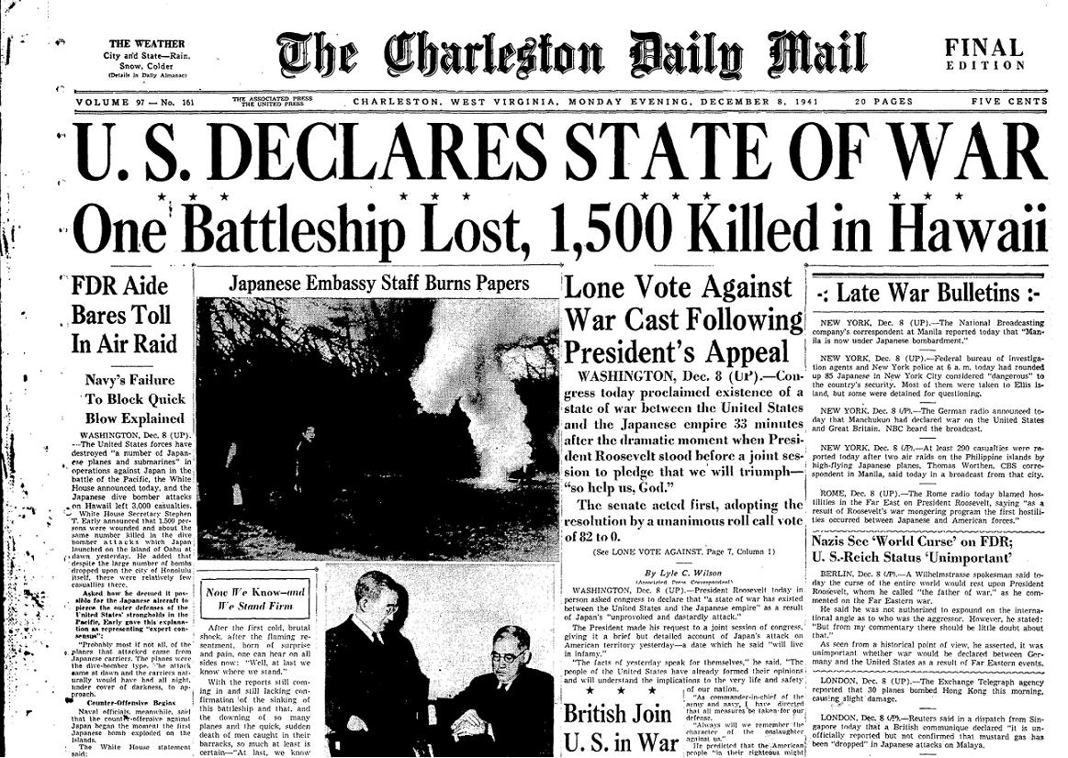
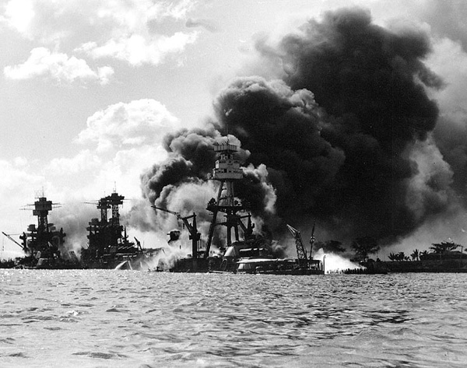
U.S. Enters War
Battle of Britain stalled
June 1941- Germany attacks USSR
2 front war
Hitler has early success, but success stalls with Russian winter
U.S. embargos Japan for aggressive actions in Pacific
U.S. suspects an attack
DEC. 7^{TH,} 1941 Pearl Harbor is attacked
U.S declares war on Japan and Germany

Slide 11
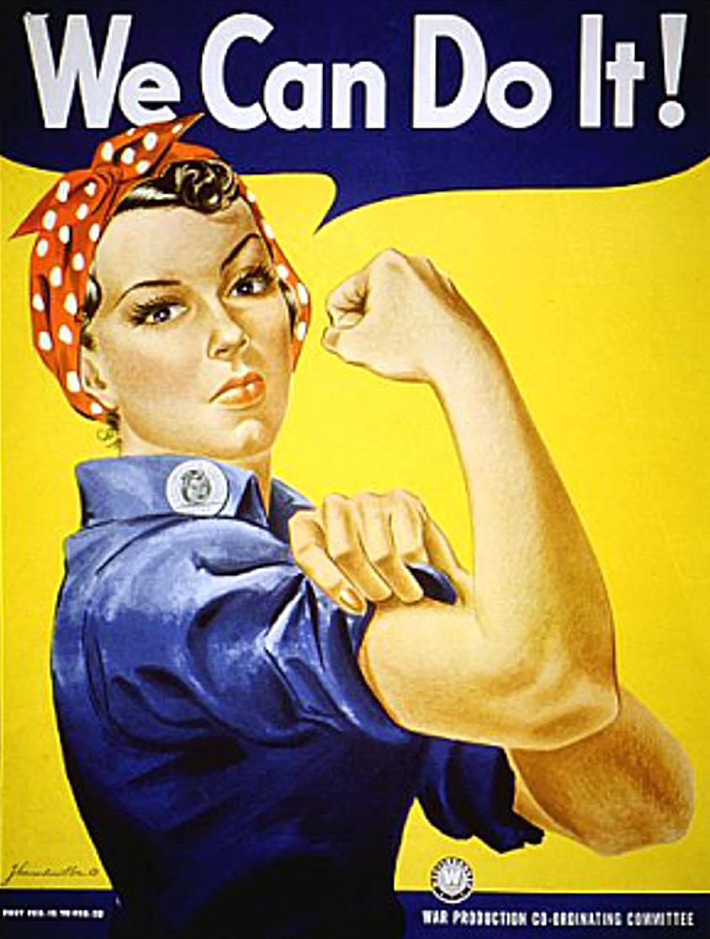
Home Front
Draft and Volunteers
Women’s Auxiliary Corps
Segregated units-Tuskegee Airmen
War Production Board
Govt. rations out resources
Price freezes/ raise taxes
War Bonds sold
Scientists used-Manhattan Project
Women fill jobs in factories
“Rosie the Riveter”
Propaganda
YouTube - Hitler Donald Duck

Slide 12
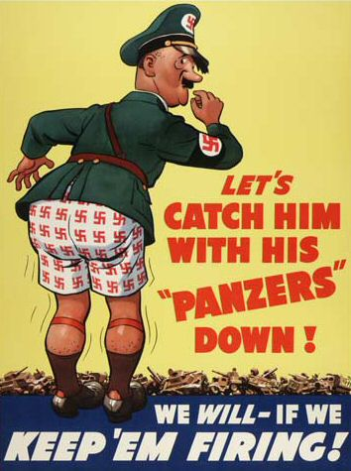
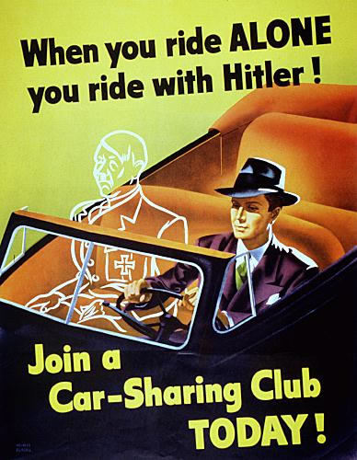
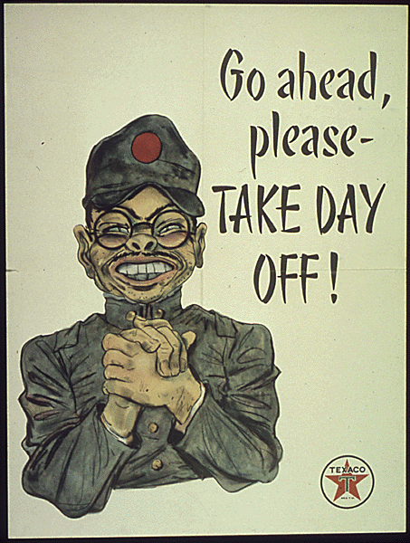
WW II Propaganda

Slide 13
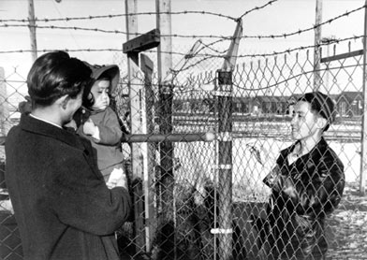
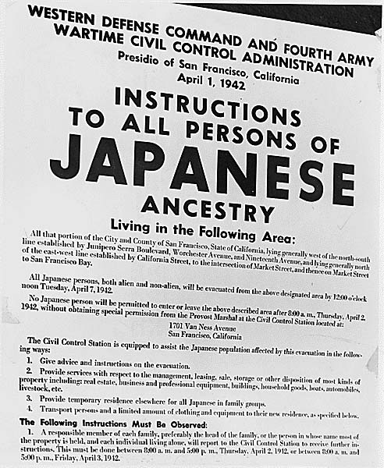
Japanese Internment
FDR issue executive order sending Japanese Americans into Internment camps
Korematsu v. U.S.- Supreme court upholds internment camps/ limits minority rights during wartime

Slide 14
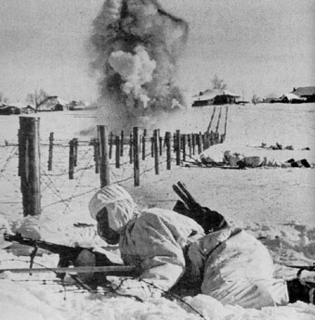
War in Europe-
FDR and Churchill agree Germany top priority
Battle of Atlantic- Allies use convoy system and liberty ships to control sea
Eastern Front
  Germany has initial success
  Winter stops advance
  1942 Stalingrad surrounded
  Germany is defeated at Stalingrad
  Turning Point of European War
  Stalin wants another front- a Western Front

Slide 15
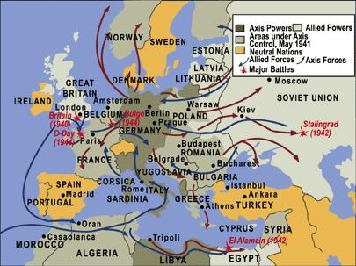
WWII European Theater

Slide 16
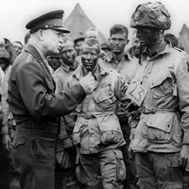
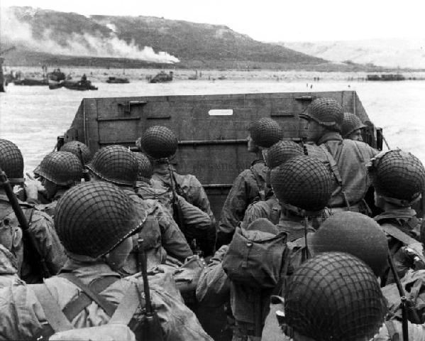
Western Front
U.S. and GB invade North Africa
Defeat Germans and Rommel at El Alamein
Move to take Italy
Germans make it tough-eventually falls
Allies plan an invasion of mainland
Operation Overlord
  Known as D-Day
  June 6, 1944
  Planned by Dwight D. Eisenhower
  Land on Omaha and Utah Beaches in France
  France liberated in weeks
  General George Patton

Slide 17
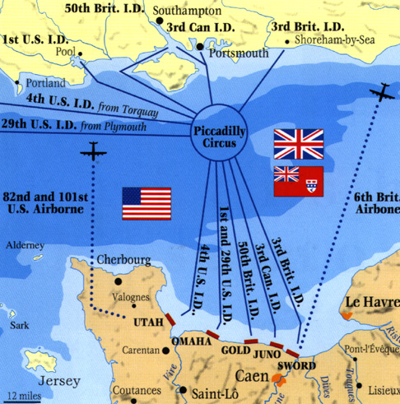
D Day Invasion

Slide 18
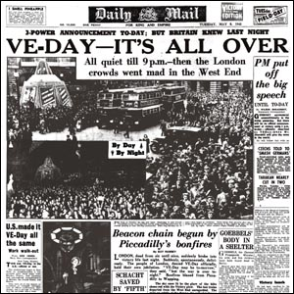
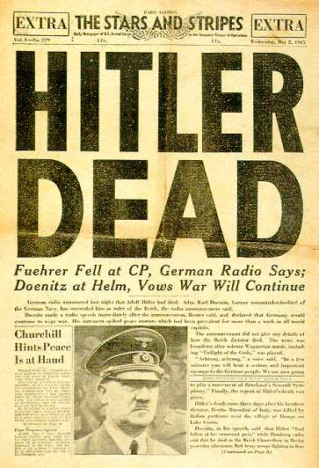
European Theater ends
Dec. 1944- Battle of the Bulge
Last German offensive
Germany then retreats
FDR wins 3rd with Harry Truman as VP
Soviets pushing towards Berlin from the east
Stalin, Churchill, FDR begin to discuss end of war
FDR dies> Truman President
Hitler commits suicide as Russians get to Berlin
Germany surrenders May 8, 1945
V-E Day- Victory in Europe Day

Slide 19
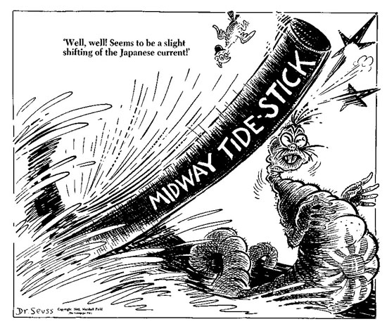
War in the Pacific
Japan has empire much bigger than Nazis
Japan advance into Philippines- General MacArthur has to leave
“I shall return”
“Bataan Death March”
America recovers
Bombs Tokyo April 1942
Battle of Midway- 1942
  Turning Point of Pacific War
  Admiral Chester Nimitz
  Japan never recovers naval power

Slide 20
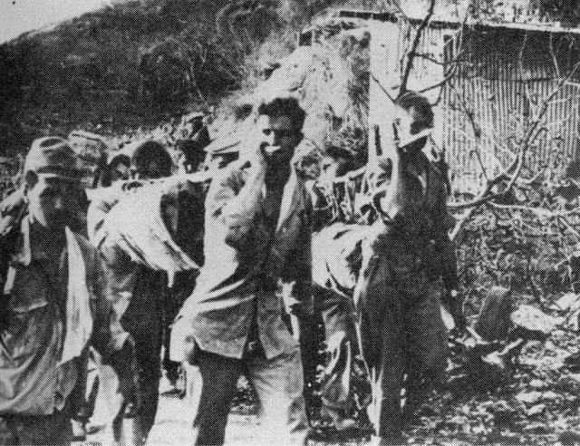
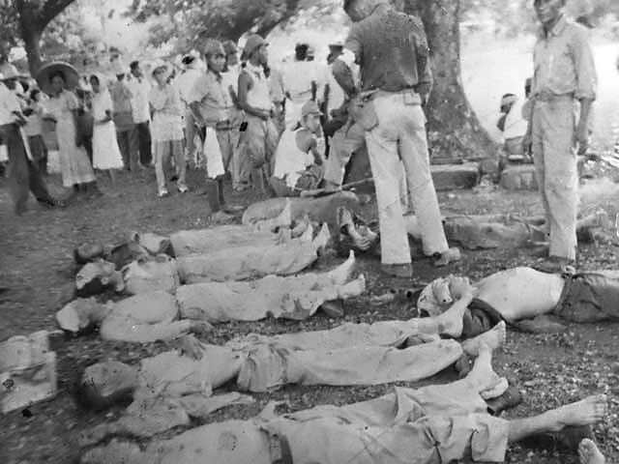
Bataan Death March

Slide 21
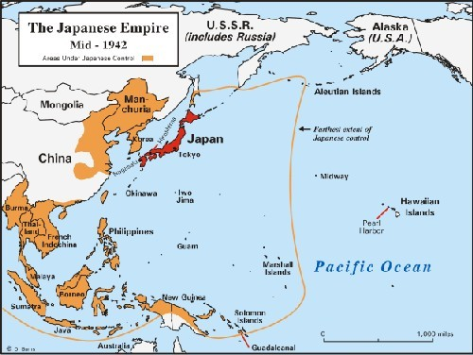
Midway Islands and Japanese Empire

Slide 22
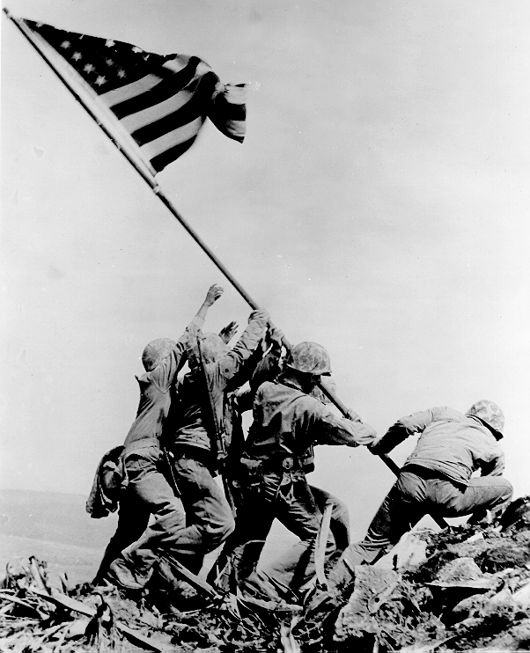
Island Hopping
U.S. builds Navy
Japan hangs on tight to islands
Guadalcanal- 1942
Philippines- 1944- MacArthur returns
Kamikaze attacks
Iwo Jima -1945
6,000 Marines die
Okinawa 1945
Even more deadly
What would an invasion cost?

Slide 23
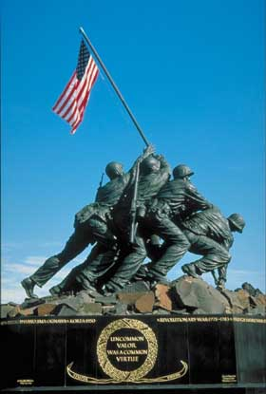
Iwo Jima Memorial

Slide 24
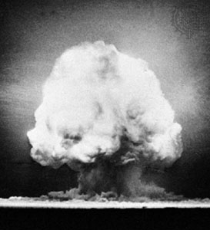
Manhattan Project
J. Robert Oppenheimer leads project to create atomic bomb
Tested and works in NM desert
Truman makes decision to drop bomb despite some resistance
Drop leaflets urging surrender
Japan refuses
August 6, 1945 Enola gay drops bomb on Hiroshima
Nagasaki- 3 days later
Japanese surrender
V-J day- Victory in Japan

Slide 25
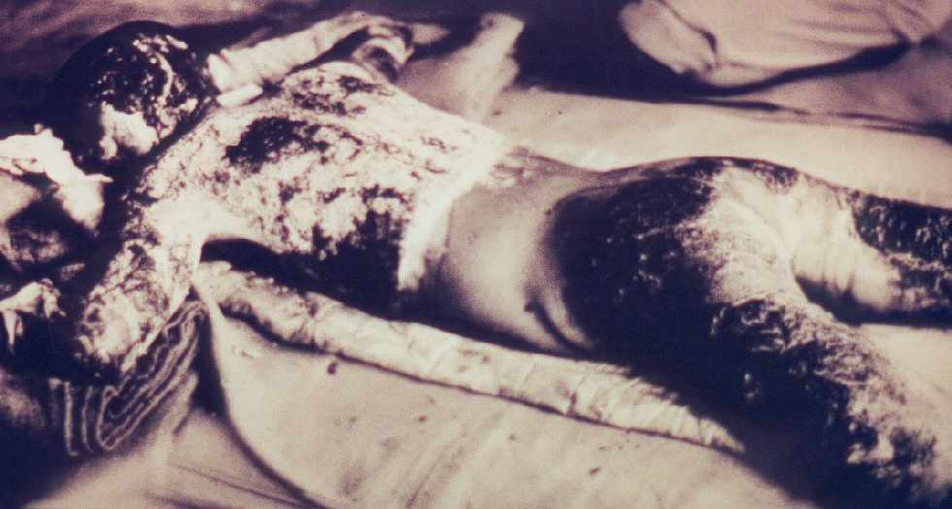
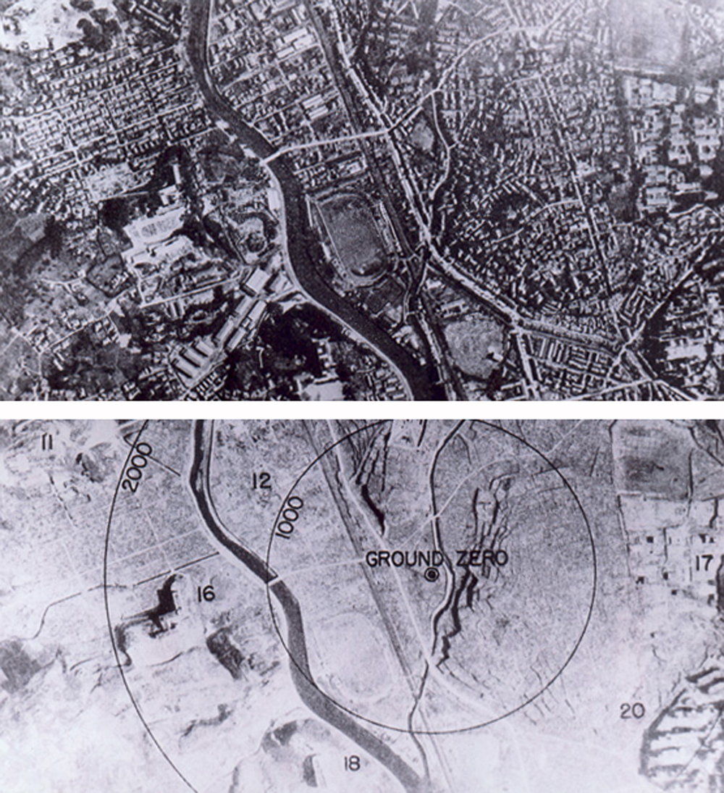
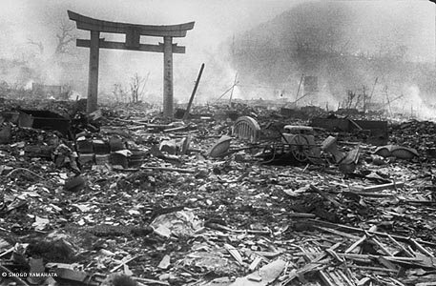
Hiroshima and Nagasaki

Slide 26
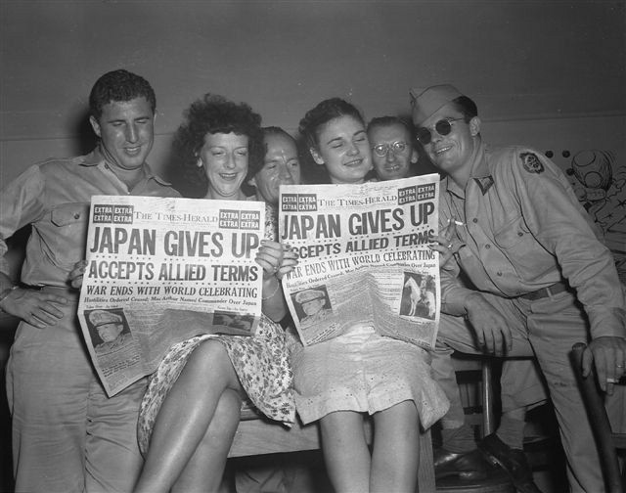
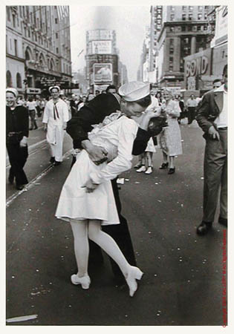
V-J Day 1945

Slide 27
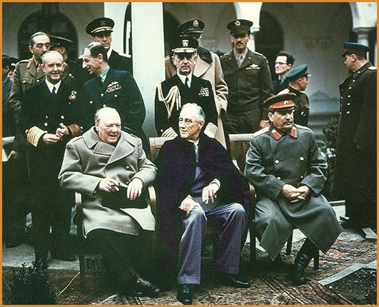
Rebuilding
Yalta Conference-
  Big 3 meet
  FDR, Stalin, Churchill
  Creation of United Nations
  Security Council is most important body
Potsdam Conference
  Division of Germany
Nuremberg Trials
  Put Nazi war criminals on trial
  Many executed
Japan
  MacArthur controls it
  Establish Democracy/ freedoms
  Still have same Constitution today

