Slide 1

Communication Skills
Honors
Course Information

Slide 2
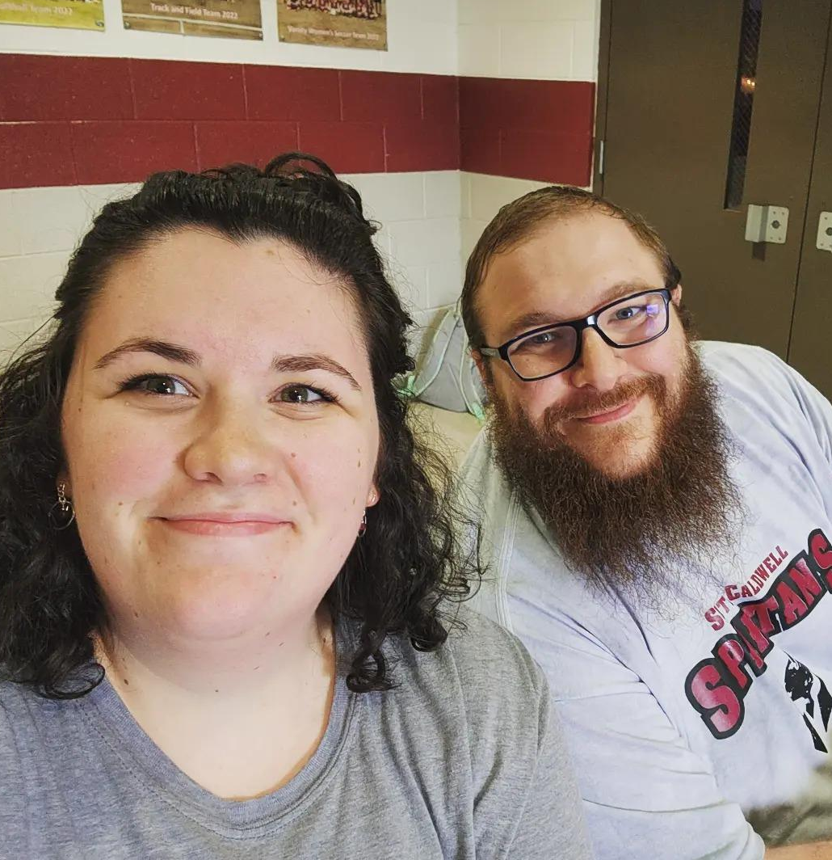
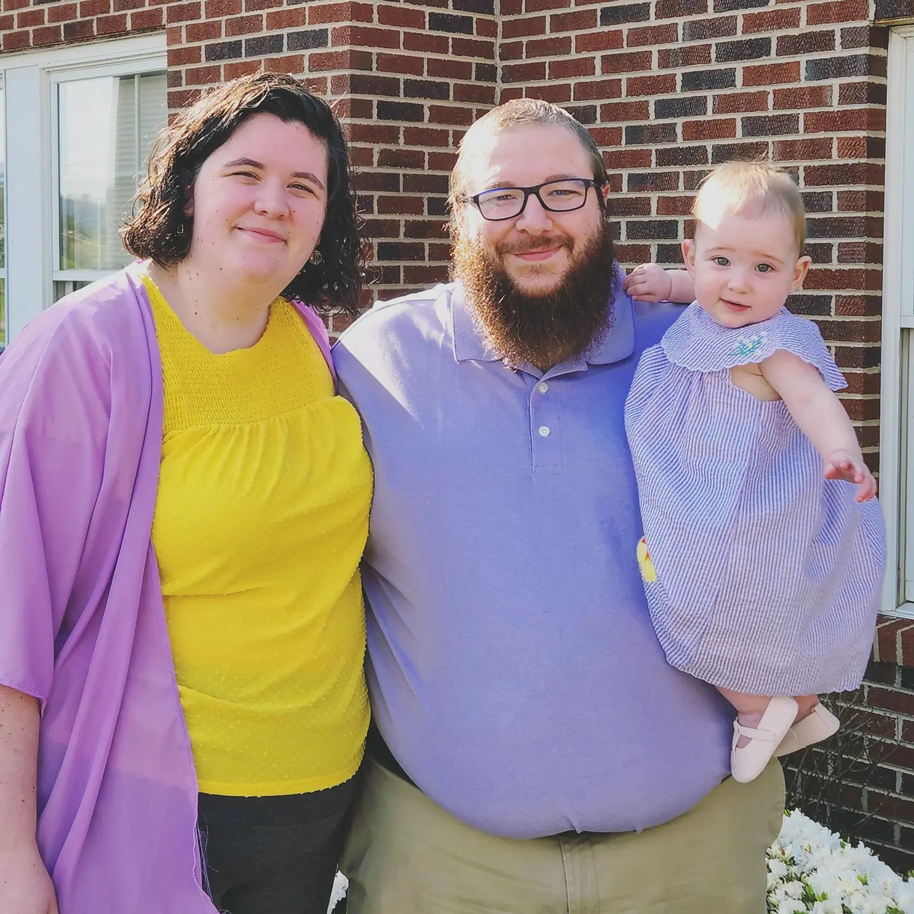
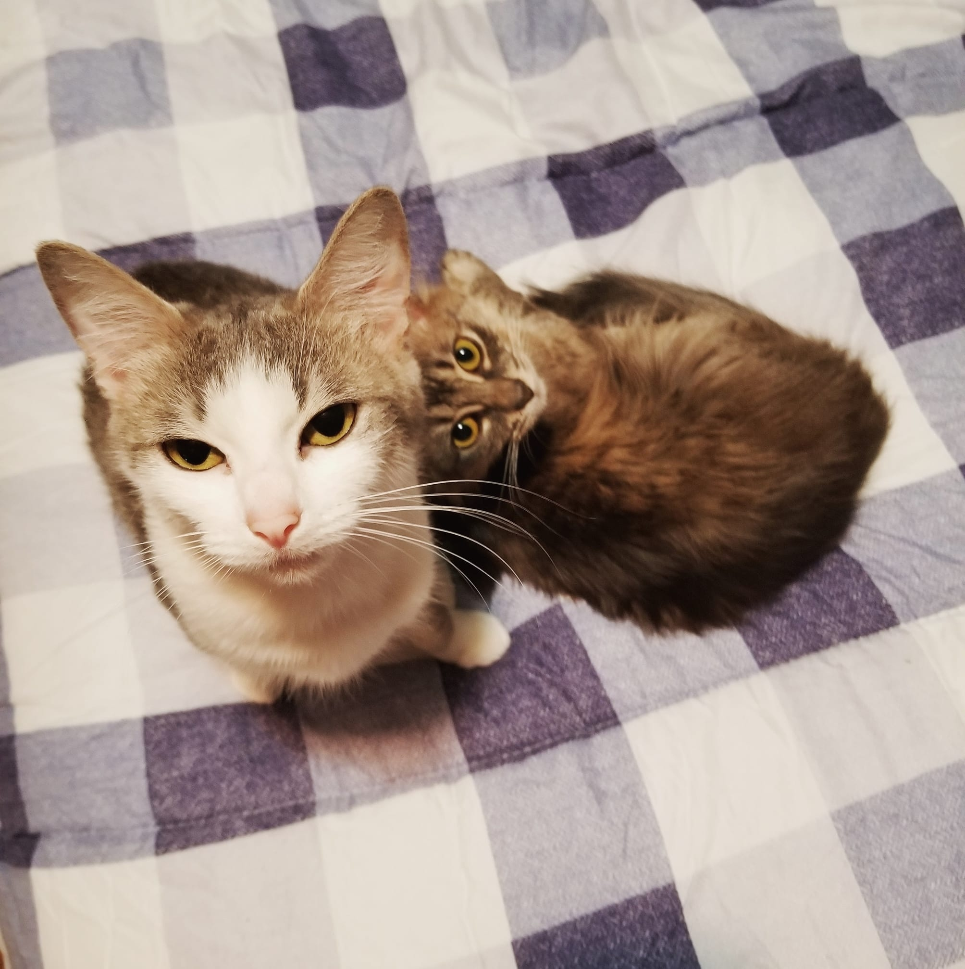
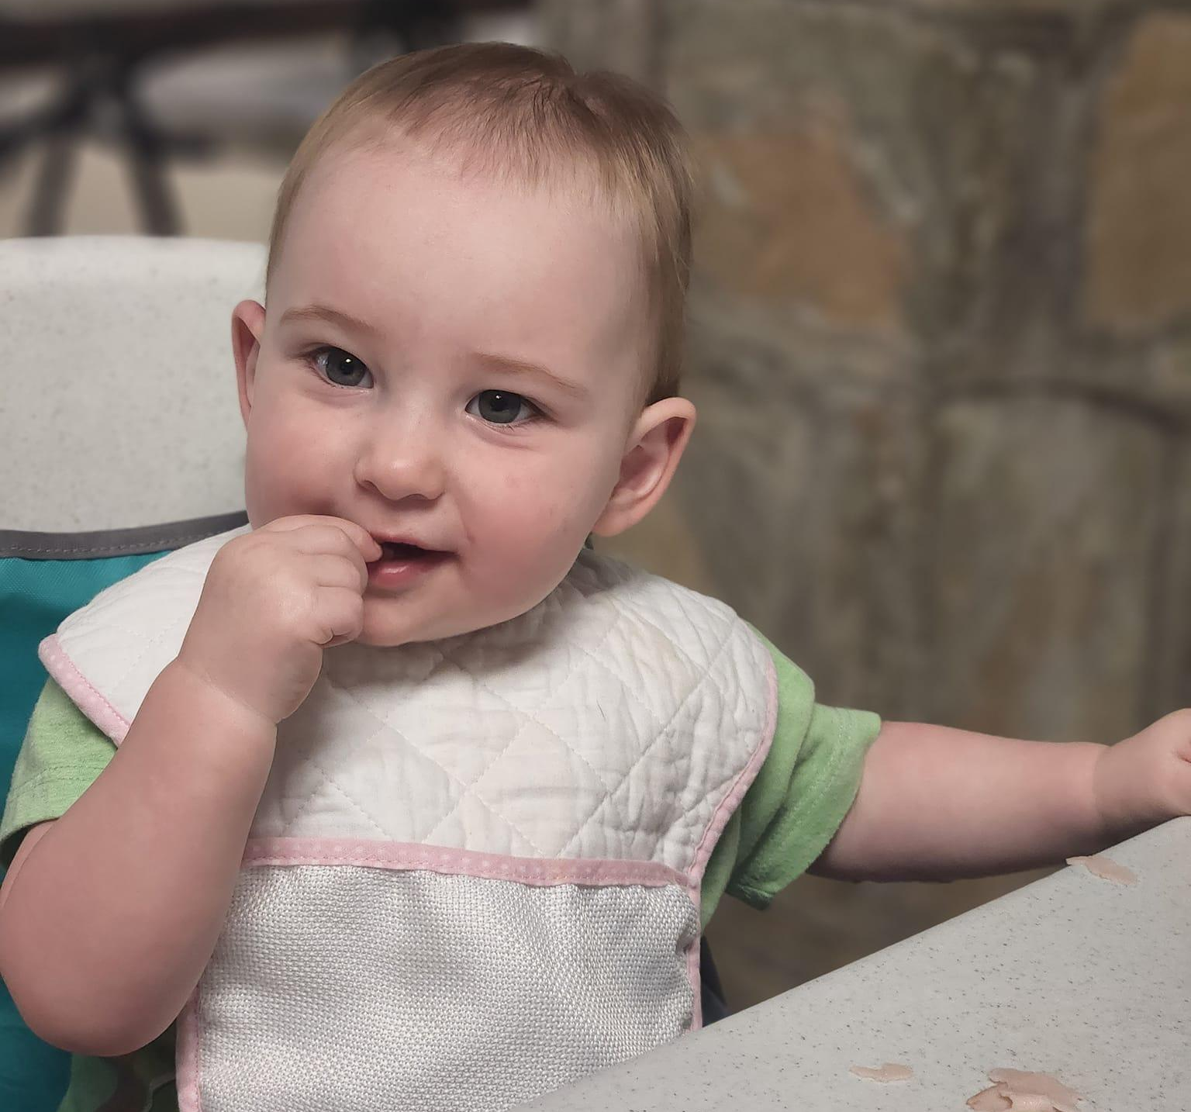
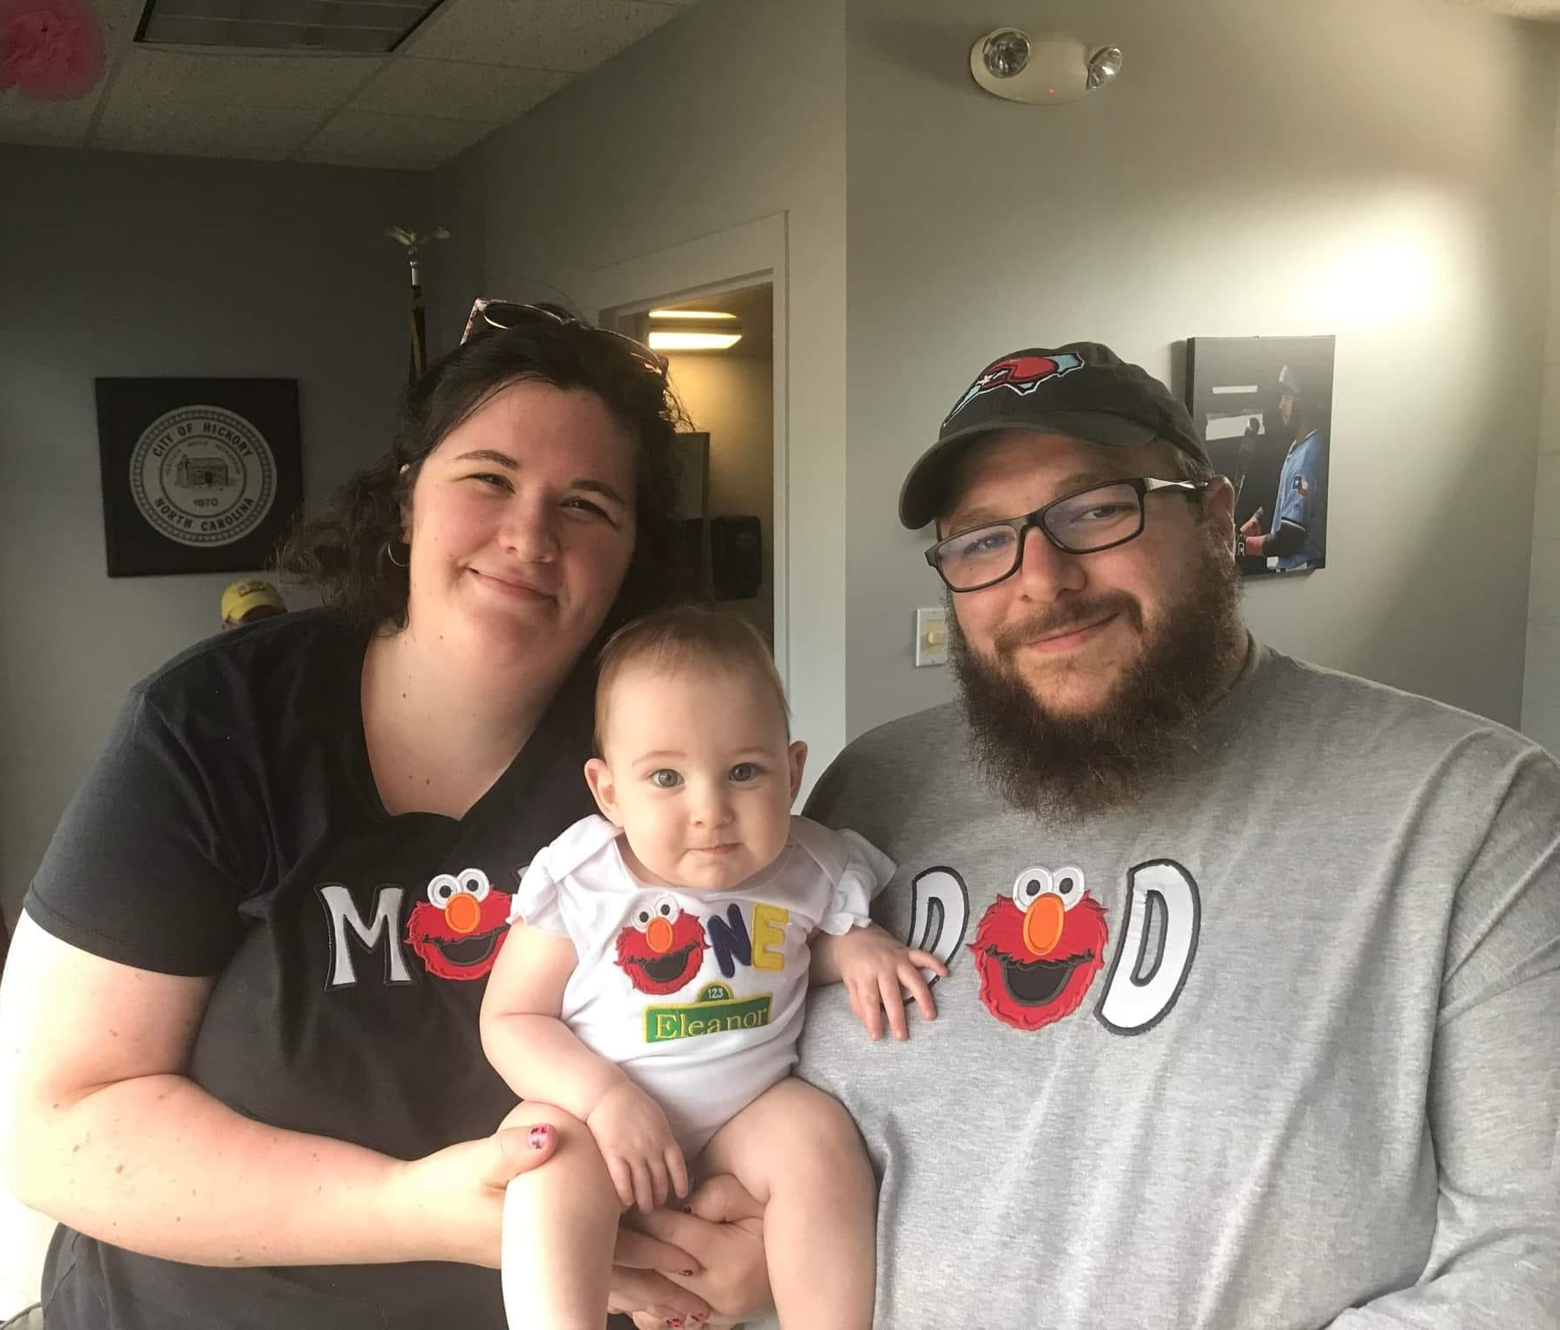
About Your Teacher
Favorites
TV Show: New Girl & Parks and Recreation
Music: 2000s pop
Drink: Sundrop
Books: The Bell Jar, Sylvia Plath / Where the Crawdads Sing, Delia Owens / Harry Potter Series
Animal: cat

Slide 3
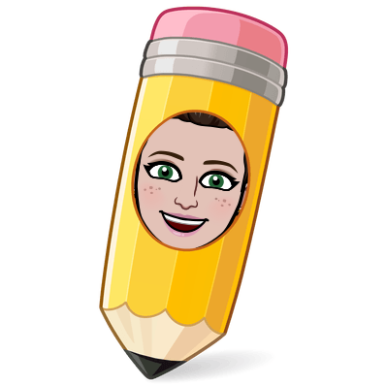
Course Information
Honors Communication Skills is an class for incoming freshmen that develops strong writing skills focusing on grammar, mechanics, and vocabulary as well as teaching the writing process – prewriting, drafting/writing, and revising/editing. The class also develops proper research and presentation skills, including an emphasis on technology. Students will focus on publishing work. Students will complete assignments in which they will be writing in standard English.

Slide 4

Class Structure
In this class, students will be expected to read, write, and speak every day. I am not a lecturer, but I am a facilitator of learning in this classroom. With that being said, class discussions are essential and students should plan on participating.

Slide 5
Independent Reading
In this class, you will be expected to be reading novels for enjoyment. You will be able to pick a novel of your choice and read it. Any “down” time during class will be spent reading, and we will have 30 minutes of dedicated reading time each Friday.

Slide 6
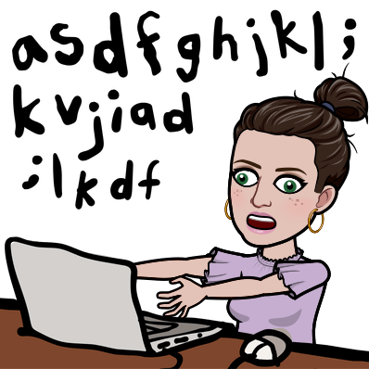
How to Contact Your Teacher
Email- ehewitt@caldwellschools.com
School Phone #: 828-396-2188
In-Office Hours: 7:30AM-3:30PM, M-F

Slide 7

Email Tips
Do:
Say what class you are in
State your problem or question very clearly
Check your email from a reply
Type the email in the body box

Slide 8

Email Tips
Don’t:
Say “did I miss anything”
Ask “how can I bring my grade up”
Type your entire email in the subject line
Be rude

Slide 9
Materials
1 composition notebook
Notebook Paper
Pens
Pencils
Highlighters
Scissors
Glue Sticks

Slide 10
Final Exam: Teacher Made
For any high school class that does NOT have an associated state-mandated test required as the final exam, students may be exempt from the teacher-made final exams if they meet the following attendance criteria:
1. Course average of A and class absences not exceeding two absences (excused and unexcused combined);
2. Course average of B and class absence not exceeding one absence (excused or unexcused); or
3. Course average of C and no class absences of any kind
A student’s course average shall be determined by equal weighting of the two nine-week grading periods.

Slide 11
Final Exam: Teacher Made
Additionally, for teacher-made exam exemption purposes only, three tardies to class count as one class absence.
Absences due to disability or for religious observance or school sponsored field trips will not be included in determining the cumulative days absent in a course for purposes of exam exemption.

Slide 12

The easy version: How to be Exempt
Your Grade is… | Your Absences…
90-100 | 0, 1, or 2 | EXEMPT
80-89 | 0 or 1 | EXEMPT
70-79 | 0 | EXEMPT

Slide 13
Examples
Your Grade is… | Your Absences…
92 | 2+4 tardies | NOT EXEMPT
64 | 0 + 2 tardies | NOT EXEMPT
80 | 2 | NOT EXEMPT
75 | 0 | EXEMPT
85 | 1 | EXEMPT
95 | 2 | EXEMPT

Slide 14

Tardies
You are tardy to class if you are not physically present when the bell rings. Setting your belongings down and going elsewhere does not mean you are present.

Slide 15
Late Work Policy
Late work will be accepted. I will deduct 10 points per school day that an assignment is not turned in. After 5 days, the maximum grade is 50. After 30 days, teacher discretion may be used. Some assignments may not be accepted after 30 days because the academic value has been lost.

Slide 16
Make-Up Work
Any work missed in this class is expected to be completed promptly. It is the student’s responsibility to contact the teacher to find out what assignments and/or tests need to be made up the day the student returns. DO NOT ASK “Did I miss anything?” If you miss a day, you are missing 95 minutes of valuable time. Make-up work is to be completed during Spartan Flex time, not during class time.

Slide 17
Re-Dos and Corrections
Redos and corrections are not permitted. Since you are in an honors class, we are preparing you for college where redos and corrections will not be allowed. Study and work hard the first time.

Slide 18

Electronic Device Policy
Phones, tablets, and AirPods will not be permitted in this class under any circumstances. You have a school Chromebook to use.
If you choose to use a phone, tablet, or headphones of any kind during class, it will be confiscated and you will be written up each time.

Slide 19
Plagiarism & Cheating
Plagiarism means using words, ideas, or arguments from another person or source without citation. Cite all sources consulted to any extent. Cheating is defined as the giving or receiving of illegal help on anything that has been determined by the teacher to be an individual effort. Any form of cheating will immediately earn you a ZERO for that assignment, and your parents will be contacted.

Slide 20

Class Norms
Be respectful
Be a learner, not a finisher

