Slide 1
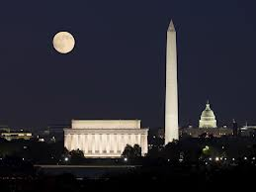
8th grade DC trip 2019

Slide 2
Expectations of Students
All school rules will be in effect on this trip.
Students should treat all teachers and chaperones with respect and follow their directions.
Students must remain with their tour groups at all times.
Students will respect and pay attention to all tour guides and presenters.
Students will behave respectfully at all sites, especially those honoring the dead.
NO GUM on buses or in buildings.
Boys and girls will sit separately on the buses.

Slide 3
Expectations of Students
Boys and girls will NOT be allowed to visit each other’s hotel rooms for ANY reason.
Buses are to be kept clean. Drivers and guides must be treated with respect.
After curfew, students must remain QUIETLY in their rooms.
Students will report to the bus ON TIME each morning and after each activity.
Hotel rooms should be left clean.
Students will NOT be allowed to order room service.
*Our tour company provides 2 security guards to monitor the halls at our hotel room each night.

Slide 4
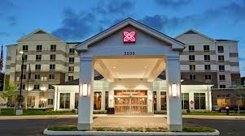
Money and Hotel information
How much money do I need?
  3 lunches (about $10 each)
  Souvenirs (about $25)
Where are we staying?
  Please note that this information is subject to change and will be finalized by the tour company 1 week prior to our trip.
HILTON GARDEN INN
2500 Neabsco Common Pl
Woodbridge, VA 22191

Slide 5

Day 1
Arrive at Belk parking lot around 6:30
Busses will leave promptly at 7:00
Don’t be late!!

Slide 6
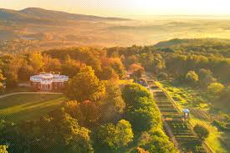
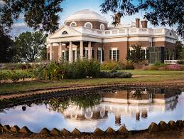
Day 1
Thomas Jefferson’s Monticello Home

Slide 7
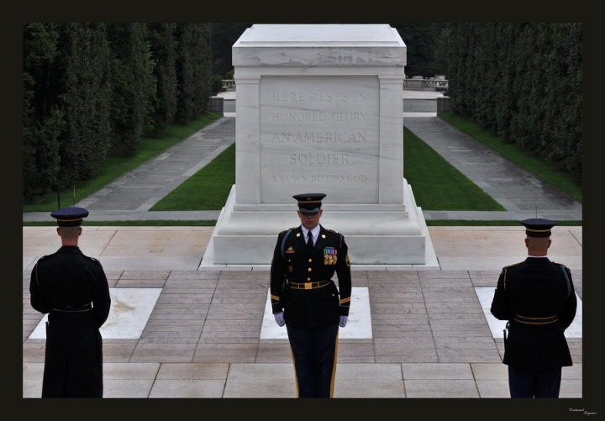
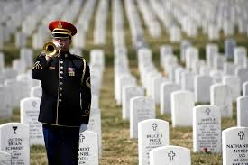
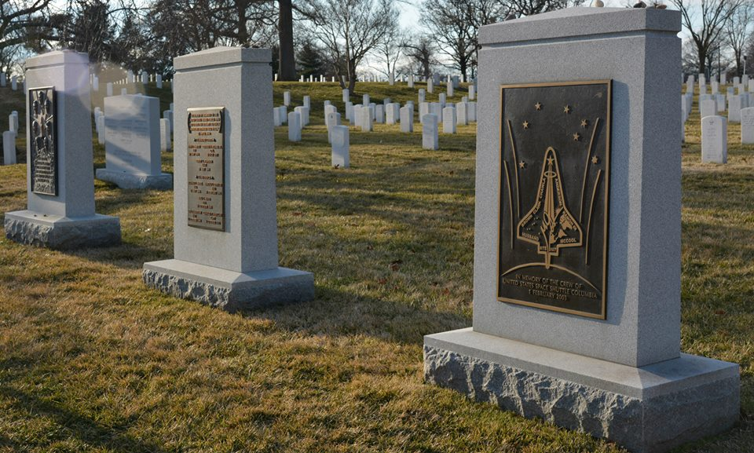
Day 2
Arlington National Cemetery

Slide 8
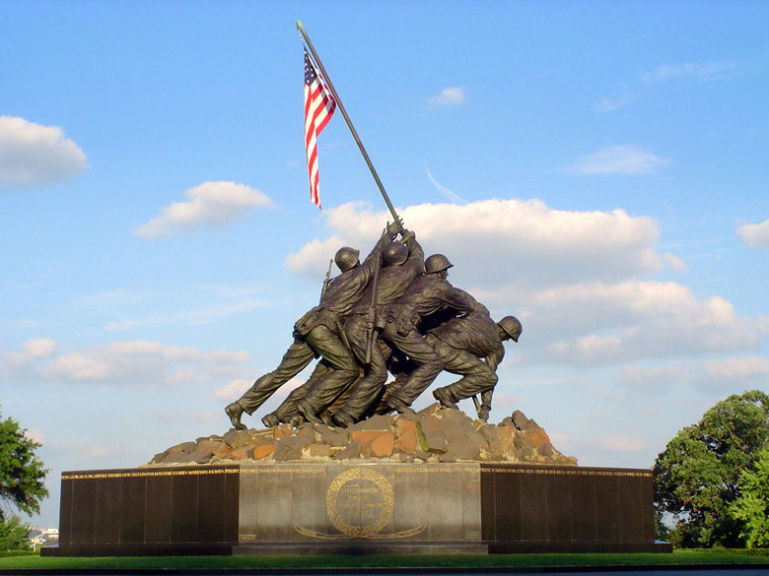
Day 2
Marine Corp Memorial Iwo Jima

Slide 9
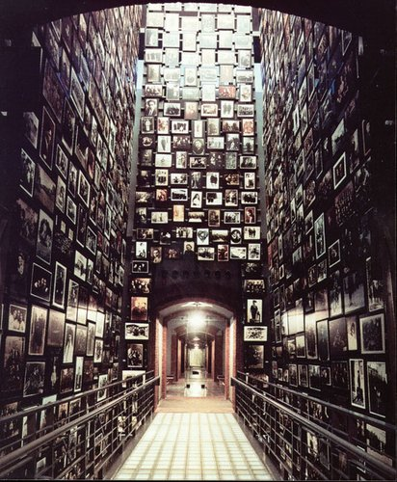
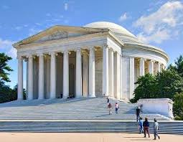
Day 2
Holocaust Museum
Thomas Jefferson Memorial

Slide 10
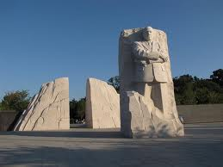
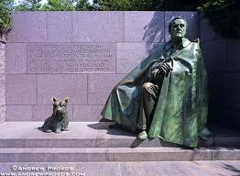
Day 2
Martin Luther King, Jr. and Franklin Delano Roosevelt Memorials

Slide 11
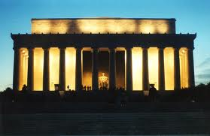
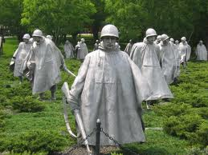
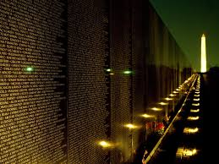
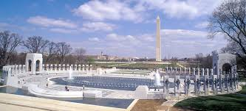
Day 2
Lincoln, Vietnam, WWII, & Korean War Memorials

Slide 12
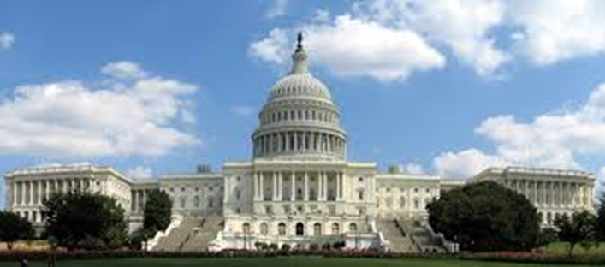
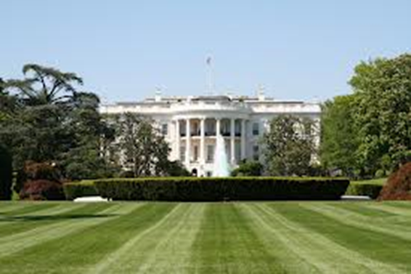
Day 3
Capitol Building
White House photo stop

Slide 13

Momma, I’m Coming Home…
Depart for home
Dinner en route (Buffet)
Arrive around 10:30 pm

Slide 14
Official Permission Form and Medical Release Form
We will be handing out a permission and medical release form in just a moment. You will need to complete the form here if possible and have it notarized by one of our notary publics present here also this evening
Form will have medical release information as well as any medications and dosage information needed for your student
We must have this form in our possession before your student can board the buses.
All medication will be logged in with our attending nurse on the morning of the trip.
Nurse Questions/Comments?

Slide 15
Questions
?

