Slide 1
Superhero Success!
Presented by:
Mrs. Rex

Slide 2

Today’s Learning Targets
I can describe my strengths that will help me be successful at school.
I can describe my weaknesses and how I will overcome them.

Slide 3
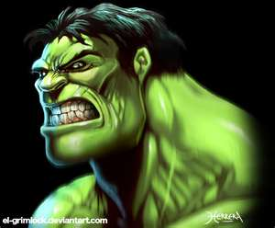
The Hulk
Strength:
  Super strength
  Alter ego: Super smart
Weakness:
  Gets angry and frustrated easily. When angry, he transforms. He gets very strong, but can’t control his strength.
  He loses his super smarts

Slide 4
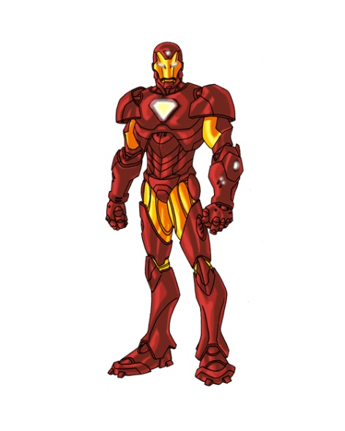
Iron Man
Strength:
  Very smart
  Loyal to those who help him
Weakness:
  Doesn’t think about other people’s feelings
  Doesn’t always try his hardest

Slide 5
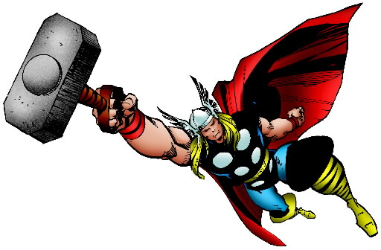
Thor
Strength:
  Super strong
  Good leader
Weakness:
  Likes to start fights, thinks it will make him more special or a better leader
  Doesn’t always think before he acts

Slide 6
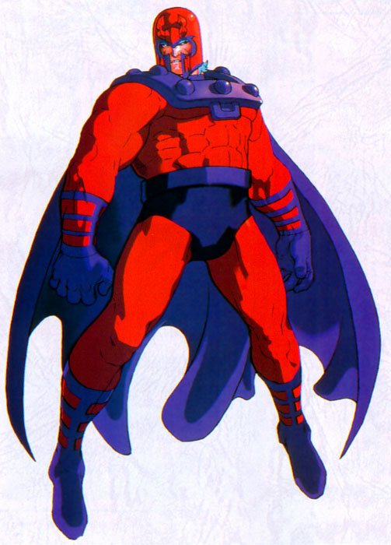
Magneto
Strength:
  Can control metal objects
  Can create force fields
Weakness:
  Doesn’t let people get to know him
  Doesn’t like people who are different from him

Slide 7
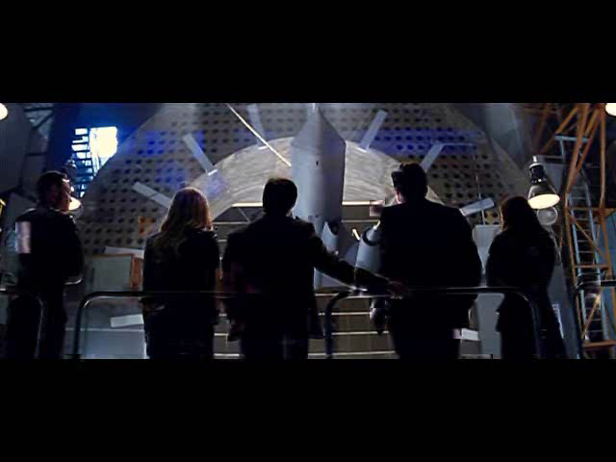
Example: Video

