Slide 1

Student Services in a
Tiered System of Support
Notes:
Add pretty pictures or logos

Slide 2
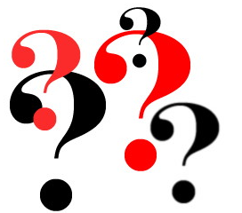
What is Tiered System of Support?
Do you really mean RtI?
Notes:
Not just RtI for elementary schools, but tiered system of support is for all.

Slide 3
Tier III
Intensive Support
Tier II
Supplemental
Support
Resources
Tier I
Foundational Core
Student Needs
Notes:
Explain relationship of increased needs = increased resources

Slide 4
Total School Improvement Model
Notes:
If thinking about previous slide, then notice that if MTSS/RTI is not embraced as Total School Improvement model, both within schools and at district level, then all are separate initiatives.

Slide 5
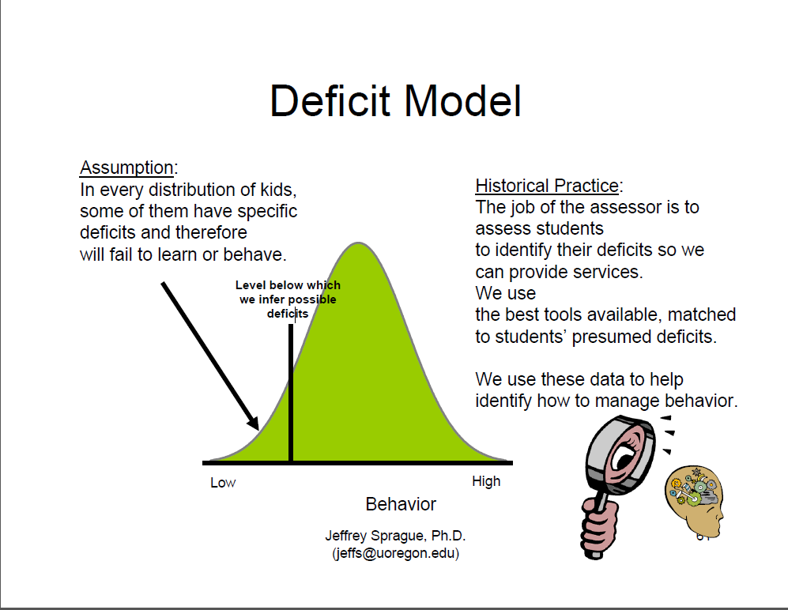

Slide 6
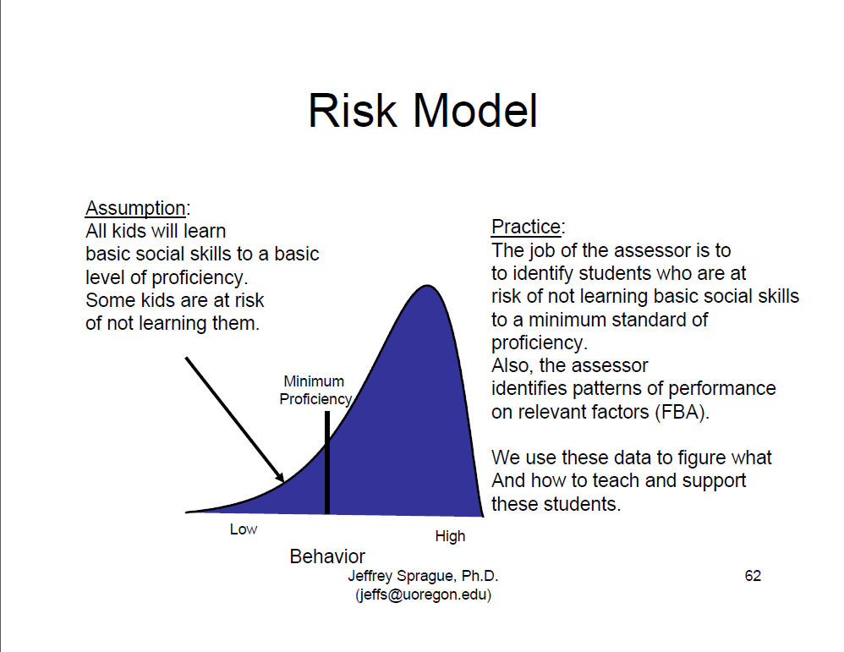

Slide 7

Notes:
Play video – laugh – sharing about how relates to education

Slide 8
Layering of Support
Notes:
Blanket analogy

Slide 9
Foundational Core: Tier 1
Who: All students are in Tier 1 (Foundational Core)
What: Evidence-based programs and practices demonstrated to produce good outcomes for the majority of students
Effectiveness: If at least 80% of all students are meeting benchmarks in Foundational Core alone.
What about subgroups?
Notes:
Tier 1 = Core

Slide 10
Analyzing Foundational Core
Notes:
Note difference between ratios of triangles

Slide 11
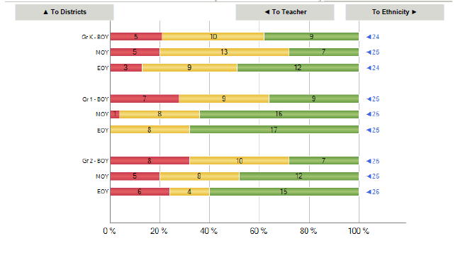
Early Warning System
Fall- 72% of 2nd graders not
on target…
Foundational Core issue?
Notes:
FC plan or multitude of individual plans?

Slide 12
Analyzing the Foundational Core
More efficient to problem-solve the core than individual students
Trends in data
Consider adjustments in:
  Instruction
  Environment

Slide 13
Framing Issues and Key
Concepts
Academic Engaged Time (AET) is the best predictor of student achievement
  330 minutes in a day, 1650 in a week and 56,700 in a year
  This is the “currency” of instruction/intervention
  It’s what we have to spend on students
  How we use it determines student outcomes
MOST students who are behind will respond positively to additional CORE instruction
  Schools have more staff qualified to deliver core instruction than specialized instruction
  Issue is how to schedule in such a way as to provide more exposure to core
Slide created by G. Batsche

Slide 14
Master Schedule
Details core academic instruction time
Resource for all staff members
Tool to maximize student learning
Tool to maximize staff support
Flexible
Notes:
How do we fit in? How do we protect?

Slide 15
Supplemental Instruction: Tier II
Who: Students needing supplemental support in addition to Foundational Core instruction
(approx. 20% of students)
What: Evidence-based programs and practices demonstrated to improve performance in Foundational Core
Effectiveness: If at least 70-80% of students improve performance (toward Foundational Core standards)
Slide adapted from G. Batsche
Notes:
Tier 2 = Supplemental

Slide 16
Tier II –
Supplemental + Foundational Core
Instruction is connected to core content
Supplemental instruction does not supplant core
Documentation is established for a group of students
Analysis of effectiveness of Tier II instruction for all students (towards Core Standards)
Notes:
Refer back to master schedule importance

Slide 17
Intensive Instruction: Tier III
Who: Students needing Intensive support in addition to Supplemental and Foundational Core instruction
(approx. 5% of students)
What: Evidence-based programs and practices demonstrated to improve performance
Effectiveness: If there is progress toward performance in Foundational Core standards
Slide adapted from G. Batsche
Notes:
Tier 3 = Intensive

Slide 18
Tier III – Intensive + Supplemental
+ Foundational Core
Instruction is most intensive in the building
Increase intensity and frequency
(time, duration, or digging deeper in specific skill)
Documentation is established for individual student
Analysis of effectiveness of Tier III instruction for all students (toward Foundational Core standards)
Notes:
Notice there are various ways that intensity can increase

Slide 19
Transitioning between tiers
Are students making progress?
  Progress monitoring data
    National norms (Benchmark standard)
    Local norms
    Gains expected per week (rate of improvement)
  And other data!
    Progress toward Core Standards
    Student grades/work samples
    Observational data/Daily behavior report cards
Notes:
A student can be initially placed in a tier (2 or 3) or move through tiers

Slide 20
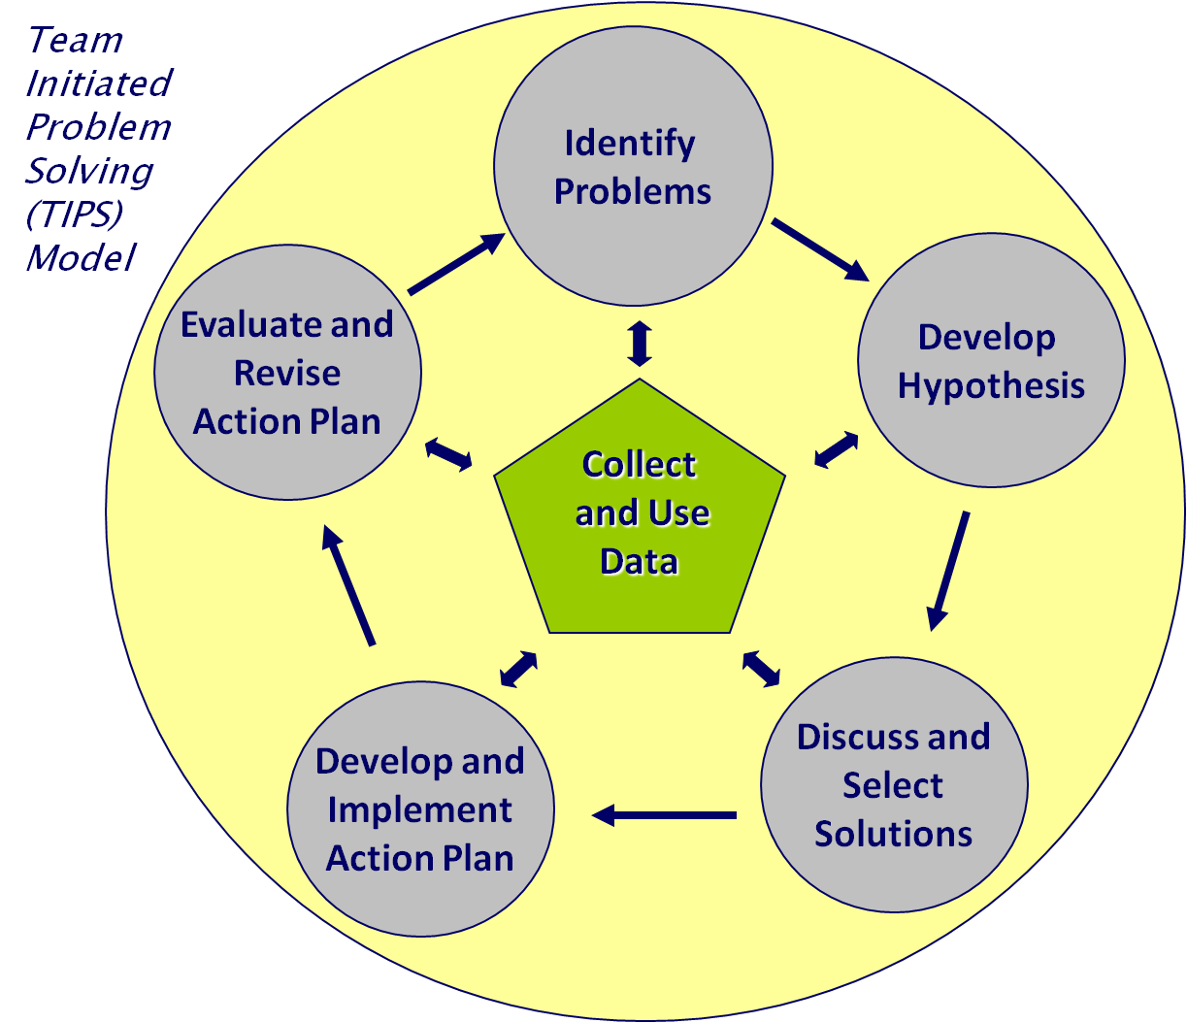
Notes:
PS model

Slide 21
Develop Hypothesis
Instruction
Review
Curriculum
Environment
Review
Learner
Interview
Observe
Test
Review
Interview
Observe
Test
Interview
Observe
Test
Review
Interview
Observe
Test
Notes:
ICEL RIOT

Slide 22
Comprehensive Assessment
System
Comprehensive Assessment System
Formative Assessments
Summative Assessments
Notes:
School level

Slide 23
Formative Assessment
Assessment FOR learning
Classroom/curriculum measures of student progress; monitors progress made toward achieving learning outcomes; informs instructional decision making. -RtI Action Network
Can be formal or informal
Notes:
FOR

Slide 24
Summative Assessment
Assessment OF learning
Comprehensive in nature, provides accountability, and is used to check the level of learning at the end of a unit of study- RtI Action Network
  The autopsy but also a way to triangulate data
Notes:
OF

Slide 25
Summative Assessment:
Outcomes Assessment
Outcomes Assessment
Examples: EOG, EOC
Assessments that measure level of achievement of content area curriculum, standards, and instruction
Used to triangulate data within a multi-tiered system of support
Used to determine student achievement and instructional effectiveness of Foundational Core for all student groups
  Kellough and Kellough (1999); McMillan (2000)
Notes:
Historically summative has been the most common and high profile of our assessment system. Measure of foundational core with respect to both student achievement and instructional effectiveness. Too late?

Slide 26
Formative Assessment
Formative
Universal Screening
Progress-Monitoring
Diagnostic
“First Alert”
“Dip Stick”
“In-depth View”
Notes:
US First Alert = Who is Struggling?
PM Dip Stick = Is the instruction effective?
Diag In Depth View = Why?

Slide 27
Formative Assessment:
Universal Screening
Universal Screening
A quick check of all students’ current levels of performance in a content or skill area. This is administered at least three times per year.
Purpose(s):
Assess the effectiveness of instruction
Determine need for intervention/enrichment
Used as a “Temperature check”
Notes:
Universal Screening
- helps to determine if the core is working for all students
- helps identify students who are struggling
- Academic and behavioral

Slide 28
Formative Assessment:
Universal Screening
Universal Screening
Conducted at least three times a year:
fall, winter, spring
Critical for Foundational Core problem-solving
Allows problem-solving of whole school/sub-group/grade level skill gaps
Allows school-wide norms
Notes:
Traditionally, all students in an RtI model are screened three times per year- fall, winter and spring. This allows for early identification of students needing more help and also comparison of your school to the your district, state and nation. Also allows you to problem solve the effectiveness of your core for your whole school, grade levels, subgroups. Academic and behavioral

Slide 29
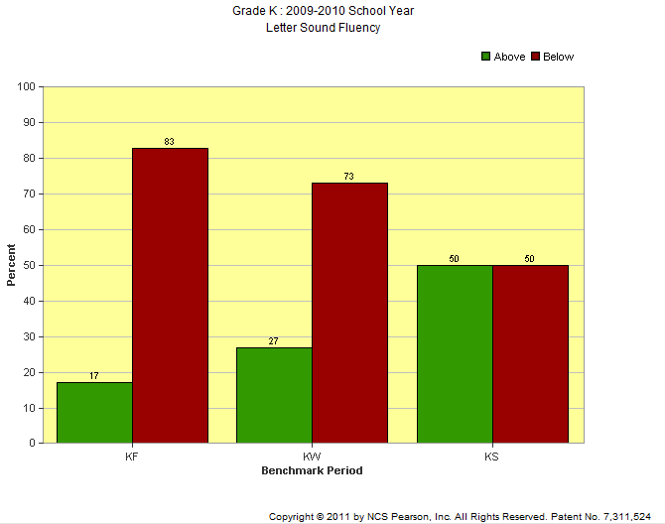
Options:
Hope (and pray)
Individual interventions for 83%
Foundational Core problem-solving
Notes:
discuss

Slide 30
Formative Assessment
Formative
Universal Screening
Progress-Monitoring
Diagnostic
“First Alert”
“Dip Stick”
“In-depth View”
Notes:
Next is PM

Slide 31
Progress Monitoring
Progress Monitoring
Purpose: helping teachers to know whether students have learned the concepts and skills taught
Instruction may be adjusted to re-teach concepts or to provide additional practice on skills not yet mastered
  “How do we know our students are responding?”
Notes:
Really good at collecting PM data – need to ensure that it is being used effectively to adjust instructional practices

Slide 32
Types of Assessments for
Progress-Monitoring
Progress Monitoring
Informal Formative Assessments
Common Formative Assessments
Benchmark Assessments
Curriculum-Based Measures

Slide 33
Benchmark Assessments
Benchmark assessments: assessments used to set benchmarks (e.g., according to local norms) and/or to determine whether students are achieving grade level standard
(RtI Action Network)
Benchmark Assessments

Slide 34
Curriculum-Based Measures
(CBM)
Uses:
Monitor Foundational Core changes
Individual student progress monitoring
Curriculum-Based Measures

Slide 35
Informal Formative Assessment
Examples:
  Exit Slips
  Student Checklists
  Misconception Checks
  Observations
  Student assessments/responses
Informal Formative Assessments

Slide 36
Common Formative Assessments
A common assessment is any assessment given by two or more (‘more’ is entire team) instructors to collaboratively examine the results for:
  Shared learning
  Instructional planning for individual students
  Curriculum, instruction, and/or assessment modifications(Erkens, 2007)
May be same as benchmark or universal
Common Formative Assessments

Slide 37
Formative Assessment
Formative
Universal Screening
Progress-Monitoring
Diagnostic
“First Alert”
“Dip Stick”
“In-depth View”
Notes:
Next is Diagnostic

Slide 38
Formative Assessments:
Diagnostic
Diagnostic
Error Analysis = analysis of error patterns in order to address learner needs more efficiently
“Digging Deeper”

Slide 39
Valid and Reliable Assessments
Validity : An indication that an assessment instrument consistently measures what it is designed to measure, excluding extraneous features from such measurement
(RtI Action Network)
Reliability: refers to the consistency of a measure; its degree of stability, consistency and repeatability.
Sattler (1996)

Slide 40
Valid and Reliable Assessments
Reliability = measures what we intended to measure
Validity = we can believe in the score
Must be both

Slide 41
Standards of Education
Academic Standards
Knowledge and skills students should possess at critical points in their educational career
Goals to provide focus for academic learning
Provides a means for alignment of resources
Behavior Standards
Skills students should demonstrate in certain environments
Goals to provide focus for behavioral learning
Clearly and positively stated
Notes:
Notice academic and behavioral. DPI state training included both for the first time in my recollection of trainings.

Slide 42
Evidence Based Practices and Strategies
Evidence-based interventions (EBI) are treatments that have been proven effective (to some degree) through outcome evaluations
EBI are treatments that are likely to be effective in changing target behavior if implemented with integrity
Notes:
http://ebi.missouri.edu/?page_id=52

Slide 43
Treatment Integrity
EBI are validated for a specific purpose with a specific population.
  A hammer is an effective tool, but not with a screw.
EBI assumes that the treatment is used in the manner that it was researched.
  Amount of time
  Materials/Resources
  Group size and attendance
  Strategies/Practices
Notes:
As such, changing parts of an intervention, while typical, can invalidate the EBI. There are many ways to change an intervention (frequency, materials, target, and on and on), which can alter the effectiveness of the EBI.

Slide 44
Big Ideas of Tiered Systems of Support
Universal, proactive screening – systematic process to detect subset of students who are struggling/at risk for experiencing a range of negative short and long term outcomes
Progress monitoring – practice to assess students’ performance and evaluate the effectiveness of instruction (intervention)
Data-based decision making – using student response data to make decisions about supports
Evidence based/scientifically validated interventions – interventions are supported by scientific research
Treatment integrity – supports should be implemented as intended
Multiple tiers of support – providing graduated sequence of intensifying interventions to match services to student need
Problem solving – dynamic and systematic process of identifying and analyzing problem in order to develop, implement and evaluate plan
Notes:
Review of all that has been covered thus far
ACTIVITY: discuss how each discipline can contribute to each of the big ideas of RtI and share

Slide 45
Something is “wrong” with this student…
Problem- Solving for all students

Slide 46
A different way of thinking
Tiered System of Support | Traditional
External Characteristics | Internal Characteristics
Prevention | Provide Services After Identification
Student Needing Alternative Programming | Learning Disability
Instructional Support Team | Pre-Referral Team
Instructional Planning Monitoring Progress | Screening Classification

Slide 47
Educating Collaboratively
Special Education
AIG
Title I
ESL
Slide adapted from Dale Cusumano, Ph.D.
Notes:
; RtI provides an opportunity to provide another pathway to services other than special education that occurs sooner & includes more students
Working together to assist all students

Slide 48
School Nurse
*Included in problem solving process to determine the level of health services necessary for the student to have adequate access to education.
Tier One: Universal –High Quality Health Promotion and Prevention
General screening/assessment for health problems
Hearing (audiologist) and vision screening of students as indicated
Optional screening: Dental (through DPH dental program), BMI
Promote immunizations and monitor for communicable disease
Acute health problems
Tier Two: Targeted ‐ Early Identification and Intervention
Participation in Student Problem Solving Team, as appropriate
Monitoring health issues
Participation on the Section 504 team, as appropriate
Individualized Healthcare Plan for students with mild to moderate chronic health problems
Provide consultation and education for administration of medication and treatments
Identify community resources for families
Tier Three: Intensive Intervention For Severe and Chronic Health Problems
Individualized Healthcare Plans for Students with severe chronic health problems
Consultation for daily intervention health needs, i.e. diabetes monitoring, asthma, special procedures
Participation on the Special Education multi‐disciplinary teams as necessary to appropriately identify child related service needs
Screenings and referrals to outside agencies related to vision and health
Notes:
Revised, but needs final approval

Slide 49
School Social Worker
Tier One:
Participates in school wide process of identifying and developing mechanisms for universal screening to obtain data regarding behavioral/emotional and attendance risk factors
Assist in analyzing universal screening data using an ecological perspective for identifying groups or individuals at risk
Identifying and implementing school wide interventions to address areas of concern
Tier Two:
Assist in the development of Tier 2 behavioral interventions
Stay current on and help implement proven and promising practices to address students needs individually and/or in small groups.
Monitor or assist in monitoring effectiveness of interventions on student outcomes.
Provides documentation of Social History
Assist with assessing how a student’s culture and background may influence development, personality, and school performance
Serves as liaison between schools, families, community agencies and other stakeholders
Tier Three:
Conducts observations to assist in intervention development
Works collaboratively with families, significant adults, and other community partners involved to meet identified needs of students
Assists with development, implementation and documentation of Functional Behavioral Assessment and Behavior Intervention Plan
Monitor or assist in monitoring effectiveness of interventions on student outcomes
Serves as liaison between school, families, community agencies, and stakeholders
Conducts observations to assist in intervention development
Helps families gain access to community resources
Provides documentation of Social History
Consults with teacher and school counselors regarding any critical response needs of student or students (Suicide, self-harm, family crisis, homeless, etc.)
Notes:
Not yet revised and tiered

Slide 50
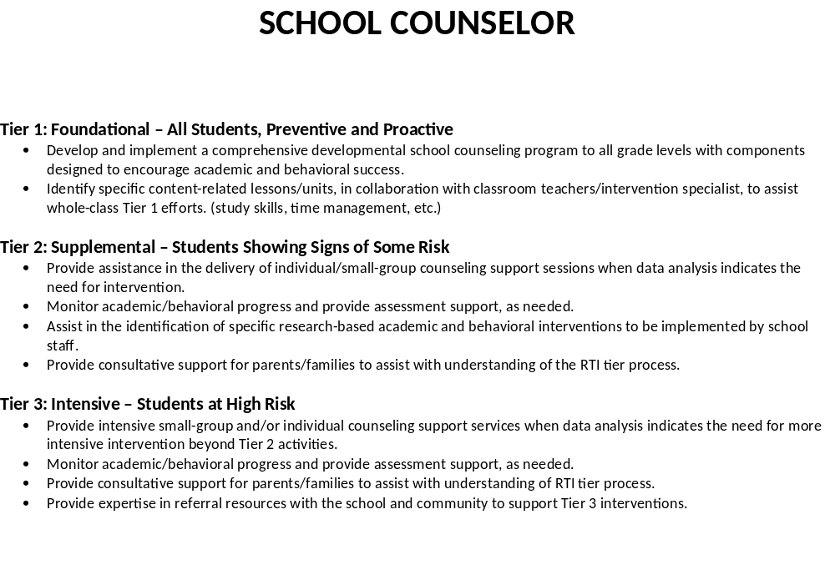
Notes:
Not yet revised and tiered

Slide 51
School Psychologist
*Included in the problem solving process to provide psychological perspective to social/emotional, behavioral, adaptive and academic needs of students
Tier 1
Collection, display and analysis of Universal Screening data (academic and behavioral/emotional)
PBIS or other school wide behavioral system
Tier 2
Collection, display and analysis of Progress Monitoring group data (academic and behavioral/emotional)
Provide direct intervention to groups
Observational data collection
Plan and develop effective interventions/strategies to use to address identified skills weaknesses through use of a strengths based approach (academic and behavioral)
Assistance with scheduling and resource allocations for instructional support delivery
Tier 3
Collection, display and analysis of Progress Monitoring individual student data (academic and behavioral/emotional)
Provide direct intervention to individual students
Observational data collection
FBA/BIP
Crisis response
Evaluations of cognitive, adaptive, educational, behavioral, emotional, visual motor, executive functioning, etc.
Analysis and Interpretation of evaluation data with teachers and parents for use it in educational/behavioral planning
Notes:
Most recent version; End morning session

Slide 52
Lunch
Notes:
Lunch break now or keep going to leave more time at end of day for Extras

Slide 53
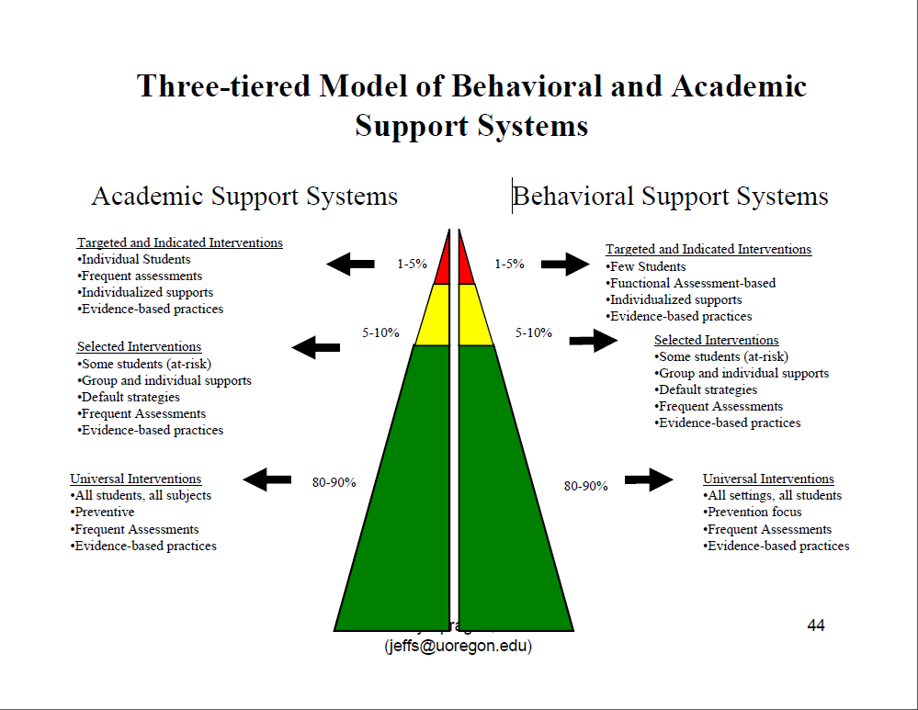

Slide 54
Traditional School Behavior Plans
Common Approaches
  Restrictions
  After-School Detention
  In-School Suspension
  Out of School Suspension
  Alternative Placements
Research indicates these practices alone leads to increases in:
  Truancy
  Tardiness
  Aggression
  Vandalism
  Mental Health Problems
Notes:
What do all of these have in common? → they have been shown to be the least effective responses to problem behavior

Slide 55
Most Effective Approaches to Curb Problem Behaviors
Programs that Clarify & Communicate Behavior Norms
  Establishing school rules
  Improving consistency of enforcement via positive reinforcement
Instructional & Curricular Adaptations (e.g., Direct Instruction)
Social Skills Instruction
Behaviorally Based Interventions (e.g., Functional Assessment)
Notes:
Comprehensive programs that include:
Self-control & -management
Responsible decision making
Social problem solving
Communication skills

Slide 56
Behavioral Support Levels
Tier 1
What: school wide behavior plans differentiated within classrooms
By Whom: all staff
For Whom: all students
Purpose: general expectations and overall modification of behavior
Evidence: school and classroom behavior plans
Data: classroom behavior logs, office referrals, suspensions, detentions, etc.
Tier 2
What: specific individual or group plans
By Whom: teachers or grade level teams with assistance from Student Services team member (most likely school counselor, but could also include school psychologist or school social worker or behavior support personnel)
For Whom: individual or groups of students not maintaining behavioral expectations of Tier 1
Purpose: processing and modification of behaviors
Evidence: behavioral plans and contracts
Data: progress monitoring specified on behavioral contract
Tier 3
What: specific individual plans
By Whom: teachers or grade level teams with assistance from Student Services team member (most likely school psychologist and behavior support personnel, but could also include school counselor or school social worker)
For Whom: individuals not maintaining behavioral expectations of Tier 2
Purpose: processing of behaviors with direct instruction on replacement behaviors
Evidence: FBA/BIP
Data: progress monitoring specified on behavioral contract

Slide 57
Tier 1 Behavior
Component | Content
Student Focus | All students in general education
Program | PBIS or other school wide positive support system combined with classroom management and reinforcements
Time | All day, every day
Assessment | Universal screening 3-4 times per year
Interventionist | Administration and all school staff
Setting | All school settings

Slide 58
Universal Screening Behavior
Office Discipline Referrals
Attendance
Grades
Teacher nominations: Externalizing/Internalizing behaviors (see handout)
Specific rating scales: Walker Survey Instrument, BASC, Behavioral and Emotional Rating Scale, etc.

Slide 59
Direct Review and Instruction of Expected Behavior
School Rule Lesson Plan Example
The Topic/Rule: Use appropriate language in conversation
What do we expect the student to do?
1. Speak appropriately in all school settings
2. Give up use of profanity
3. Express anger or frustration with appropriate words
How will we teach the expected behavior?
Tell why following the rule is important:
Profanity is offensive to other people and spreads negative attitudes. Using appropriate language is an important social skill for behaving in future employment and community settings.
List examples and non examples of the expected behaviors (two to three each):
Ask students to identify examples and not-examples of each part of the rule. Ask them to identify both and tell why is a good or bad example of expected behavior.
A. positive example:
When John's locker was stuck he said "I'm going to be late!" and walked to class.
Mary saw an excellent car in the parking lot at the local store. She said, "I saw this really cool car today!"
B. non example:
John's locker won't open and class is about to start. He says" ******" and slams the locker with his fist. Other people in the area feel uncomfortable and afraid.
Mary wanted to tell about a car she saw at the local store. She said, "I saw this ***** cool car at the Safeway parking lot." Her friends were embarrassed.
Provide opportunities to practice and build fluency:
1. Brainstorm a list of alternative words or terms.
2. Engage students in a frustrating activity and prompt them to use appropriate language.
3. Discuss/identify positive things about our school or other students.
4. Generate a list of words that are not acceptable/appropriate.
Notes:
Make handouts

Slide 60
Tier 2 Behavior
Component | Content
Student Focus | 10-20% of students unresponsive to Tier 1 universal supports or identified at risk based on universal screening
Program | Self management strategies, behavioral contracting, school-home note system, Check In/Check Out, basic classroom alterations, behavior specific praise, environmental rearrangement
Time | On going for brief specified implementation phases
Assessment | Group or individual goals, observational data, self management data
Interventionist | General education classroom teacher and support staff
Setting | All school settings (primarily general ed classroom)

Slide 61
Features of Tier 2 Targeted Interventions
Major Features
Strategies for groups of students identified at-risk
  Class-wide or Small Group
Low effort by teachers & school professionals
Consistent with School Wide expectations
Flexible
Continuous Monitoring
Why Do They Work?
Improved structure
Set up for success
Increase feedback
Elevated rewards
School-home link
Increase self-management

Slide 62
Operational Definition of Behavior
Activity
General Description:
  Jan is hyperactive.
Concrete (Operational) Definition:
  Jan leaves her assigned area without permission.
  Jan blurts out answers without raising her hand.
  Jan completes only small portions of her independent work.
General Description:
  John is noncompliant.
Concrete (Operational) Definition:
Notes:
They do operational definition for john

Slide 63
Tier 2 Strategies and Practices
Direct Instruction of Behavior
Differential Reinforcement
Response Cost
Check In/Check Out
Goal Setting + Reinforcement

Slide 64
Direct Instruction of Behavior
Socially acceptable & learned behaviors that enable someone to function appropriately in the educational environment and interact appropriately with others
Competencies that help:
  Meet behavioral expectations in the school setting
  Initiate and maintain social relationships
  Adapt behaviors to generalize in various settings and interactions
Contextual training may lead to better outcomes
  Teach behaviors in settings students need to use them
  Teachable moments
  Structured opportunities to practice skills in other settings (generalization)
Notes:
Share out- Melissa and/or others who have done T2 things

Slide 65
Differential Reinforcement
  Reinforcement is given for alternative appropriate behaviors
    Out of seat = Staying in seat
    Blurting out = Raising hand
    Running = Walking
    Off-task = Engaged
  Reinforcement provided at specified intervals in the absence of the problem behavior
    Every 5 minutes that passes where no problem behavior occurs, student is reinforced

Slide 66
Response Cost
  Select target behaviors based on data
  Teach the students the expectations
  Provide specified number of representative items to student
    Items can include colored slips, straws, pom-poms, etc.
    Items should be accessible to students (on desk, bulletin board, public space, etc.)
  When student engages in disruptive behavior:
    Teacher states specific misbehavior
    One item is removed
  Rewards and consequences given based on specified goals
Notes:
ADHD students

Slide 67
Check-In/Check-Out
A group-based, standardized intervention
Critical Features
  Increased positive adult contact
  Embedded social skills training
  Direct link to school-wide behavioral goals and expectations
  Frequent feedback
  Daily home-school communication
  Positive reinforcement contingent on meeting behavioral goals
Daily Activities
  Check in with a CICO coordinator (or their homeroom teacher) in the morning
  Carry a point card that is based on school-wide expectations
  Receive frequent and regular feedback on their behavior from adults throughout the day
  Review their goals with the coordinator (or their homeroom teacher) at the end of the day
  Take their point card home for parent signature and positive feedback
Notes:
Emphasize positive- morning and afternoon meetings should not be negative or blaming- stick to facts and be encouraging
Taken from PBIS workbook for CICO http://www.pbis.org/common/pbisresources/presentations/8APBS_Tier2_GettingStartedWorkbook.pdf

Slide 68
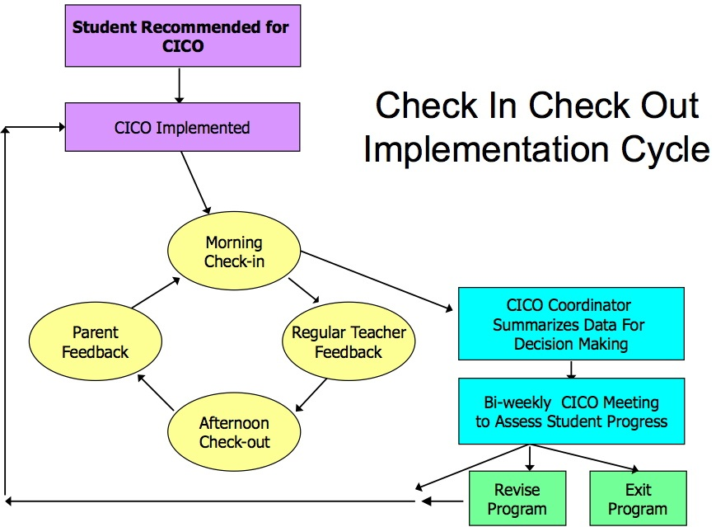

Slide 69
Goal Setting + Reinforcement
Operational Definition of Problem Behavior
  Specifically defining the behavior to include what it looks like
  Passes stranger test
Identification of Replacement Behavior
  Specifically defines what we want them to do
  Incompatible with problem behavior
Goal Setting
  Goals should be limited
  Improvement over baseline
  Set small successive steps
  Initial goal easily attainable for student
  Change the criteria as students are successful
  Specify student responsibilities
Reinforcements
  Obtain student input
  Rewards can be home & school based
  Consistent reinforcement schedule based on behavior and developmental level of student
  Weight of reinforcement should be proportionate to goal
Consequences
  Allow natural consequences
  Consequences should be in balance with reinforcement and targeted behavior
Notes:
Talk about daily report cards, behavior contract/basic BIP

Slide 70
Tier 3 Behavior
Component | Content
Student Focus | 3-5 % of students not responsive to Tier 1 and 2 supports
Program | Behavior intervention plan combined with replacement behavior or social skills training
Time | Daily, On going for brief specified implementation phases
Assessment | Functional Behavioral Assessment, behavior report cards, observational data
Interventionist | Behavior support team
Setting | All school settings with direct behavioral training sessions

Slide 71
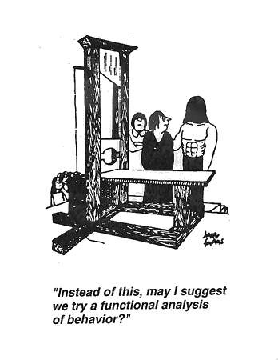
Notes:
Points for Discussion

Slide 72
Functional Behavior Assessment (FBA)
Primary Components
Identification of specific problem behavior
Systematic data collection through observation, records review and interviews
Identification of Antecedent – Behavior – Consequence (ABC)
Identification of function or purpose of behavior
Development of hypothesis about behavior

Slide 73
FBA: Identification of specific problem behavior
Identify the behavior that most impacts the student’s ability to be successful in the setting
Operational Definition
May be a continuation of targeted behavior that was non-responsive to Tier 2 interventions
Behavior will be confirmed and examined more closely through systematic data collection
Notes:
*remember operational definition (from goal setting slide)

Slide 74
FBA: Systematic data collection
Can be collected through:
  Observations
  Interviews
  Records Reviews
Collect appropriate data based on the problem behavior
  Frequency count: Calling out
  Time of day and duration: Tantrums
  Timed sampling: Time on-task
Notes:
Talk about different forms, strategies to collect data. *Make handout

Slide 75
ABC’s of Understanding Chronic Behavior Patterns
What happens before (A or antecedent) the behavior occurs?
What is the behavior (B)?
What happens after (C or consequence) the behavior occurs?
    A ➔ B ➔ C

Slide 76
FBA Terminology
Antecedents
Behavior
Consequences
B
(Outcome/Function)
A
C
Reinforcement
Punishment
Setting Events
Problem Behavior
Appropriate Behavior
Access
Avoid/Escape
Immediate
or
Attention
Internal Feelings
Tangible
Power/control
Attention
Internal Feeling
Task
Setting
or
Goal:
Decrease
Goal:
Acquire skill & Increase
Fast Triggers
Slow Triggers
Occur immediately before a behavior
Environmental factors that influence behavior, not immediate
Notes:
An FBA essentially fills in this formula for the student being assessed. These are the components you are trying to reveal.

Slide 77
Antecedents
What triggers the behavior?
What happens immediately preceding the problem/target behavior?
What triggers the behavior, be specific...
  What activity?
  What peers?
  What tasks?
  Other setting events versus immediate triggers

Slide 78
Consequence
What’s the response to the behavior?
What happens immediately following the behavior?
  How do peers respond?
  How do the adults respond?
  What are the consequences for the student?
  Are these responses typical?
What is the student gaining as a result of engaging in the behavior?
  How is it paying off for the student?

Slide 79
Learning
A ➔ B ➔ C
Student Learns through repeated experience,
that under these specific Antecedent
triggers, if I engage in this Behavior, I
can expect this Consequence

Slide 80
FBA: Identify Function or Purpose
GAIN/OBTAIN something
  Attention (Peer or Teacher)
  Tangible (Object, Activity, Food, Event)
  Internal Feeling (Approval, Acceptance)
  Power
AVOID/ESCAPE something
  Attention (Peer or Teacher)
  Demands, Tasks, or Assignments
  Internal Feeling (Pain, Embarrassment, Failure )
  Setting

Slide 81
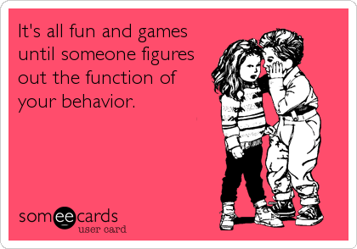
Notes:
Another cartoon to use?

Slide 82
FBA: Hypothesis Development
Summary Statements
Setting Event Antecedent Behavior Consequence
Difficult AM @
Home or on bus
Lg group setting;
expected to
share
Tattles,
pushes,
Cries,
whines
Teacher talks to child
about app.beh.; Gets
materials from peers
1:1 Aide absent
Structured time
occurring before
recess; Peer
makes comment
Refuses to work,
shouts,
slams books
bothers others
Teacher & peer
attention
History of
Academic failure
Difficult/disliked
independent,
unstructured
academic task
Refuse to do
classwork,
homework,
Head on desk
Gets out of
Doing work

Slide 83
Summary Statement:
Diagram to Text
Difficult AM @
Home or on bus
Difficult AM @
Home or on bus
Lg group setting;
expected to
share
Lg group setting;
expected to
share
Tattles,
pushes,
Cries,
whines
Tattles,
pushes,
Cries,
whines
Teacher talks to child
about app.beh.; Gets
materials from peers
When/During _____________ (insert antecedent behavior),
Student will _______________(insert operational definition of behavior),
in order to________ (insert maintaining consequence/function of behavior)
This is more likely to occur when _______________(insert setting event)
“When she is in a large group setting and expected to share, Felicity will tattle, push, cry and whine to obtain desired materials from peers or to obtain attention from her teacher. This is more likely to occur when Felicity has had a difficult morning at home or on the bus ride to school”
Notes:
83

Slide 84
Linking FBAs to BIPs:
Competing Pathways Model
Desired Behavior
Desired
Maintaining
Consequences
Difficult AM @
Home or on bus
Lg group setting;
expected to
share
Tattles,
pushes,
Cries,
whines
Teacher talks to child
about app.beh.; Gets
materials from peers
Alternative/
Replacement
Behavior
Notes:
84
Middle row = what is happening right now
Top is what the teacher or parent ideally would like to happen;given the setting and antecedent events have occurred what is the appropriate behavior you would like the person to perform in that situation
The bottom row is what alternative behaviors that the client could perform in the meantime instead of the problem behavior; the article you read describes not only generating this but using this as a consultation tool so that teachers can generate replacement behaviors. Given that the setting and antecedent events have occurred what would be a socially appropriate equivalent behavior that procedures the same consequences as the problem behavior? What is the appropriate behavior you would like to see the child perform? What would typically happen if the student engaged in the appropriate behavior?
Given that the setting and antecedent events have occurred - What is a socially appropriate equivalent behavior that would produce the same consequences as the problem behavior?
What you are able to illustrate here is that the problem behavior is performed instead of the desired behavior b/c the former behaviors compete with the desired behavior (are more reliable, efficient)

Slide 85
Practice
Shares with others
Age appropriately
Positive attention
from peers/teacher/
access to preferred
items faster
Difficult AM @
Home or on bus
Lg group setting;
expected to
share
Tattles,
pushes,
Cries,
whines
Teacher talks to child
about app.beh.; Gets
materials from peers
Asking for toy/item
appropriately
Notes:
85
Middle row = what is happening right now
Top is what the teacher or parent ideally would like to happen;given the setting and antecedent events have occurred what is the appropriate behavior you would like the person to perform in that situation
The bottom row is what alternative behaviors that the client could perform in the meantime instead of the problem behavior; the article you read describes not only generating this but using this as a consultation tool so that teachers can generate replacement behaviors. Given that the setting and antecedent events have occurred what would be a socially appropriate equivalent behavior that procedures the same consequences as the problem behavior? What is the appropriate behavior you would like to see the child perform? What would typically happen if the student engaged in the appropriate behavior?
Given that the setting and antecedent events have occurred - What is a socially appropriate equivalent behavior that would produce the same consequences as the problem behavior?
What you are able to illustrate here is that the problem behavior is performed instead of the desired behavior b/c the former behaviors compete with the desired behavior (are more reliable, efficient)

Slide 86
Practice on your own
Desired Behavior
Desired
Maintaining
Consequences
History of academic
failure
Difficult/disliked
independent,
unstructured
academic task
Refuse to do
classwork,
homework,
Head on desk
Gets out of
Doing work
Alternative/
Replacement
Behavior
Notes:
86

Slide 87

The best way to address undesirable behavior…
…is to prevent it from
happening in the first place!
Notes:
Discussion slide
The goal is to prevent the behavior from occurring by adjusting the antecedents of the behavior, the consequences, or both. Consider modifying the environment: instructional methods and strategies, curriculum and materials, physical classroom arrangement, testing and evaluation, increased opportunities for students to make choice, predictable classroom routines, foreshadowing change, cueing students, having consistent expectations and consequences, reinforcement methods and schedules (both for the target student and for other students if they ignore the inappropriate behaviors).
Discuss other strategies for preventing behavior from occurring.

Slide 88
Behavior Intervention Plan (BIP)
Primary Components
Designed to address the function of the problem behavior
Recognition and modification of behavioral triggers through adaptations in the environment
Teaching of alternative behaviors, coping strategies and self management skills
Includes both Reinforcers and Consequences

Slide 89
Selecting Intervention Procedures
Purpose of BIP:
  IS: To organize a cluster of changes in
  the setting that will reduce the likelihood
  that the problem behavior will occur
  IS NOT: A single technique
  (e.g., time-out; home-school note)
Notes:
Emphasis on all pieces of ABC rather than just C

Slide 90
Focus of Control
Acknowledge and consider factors we cannot change
  Mental Health diagnoses and decision for treatment
  Medical conditions and decision for treatment
  Socioeconomic status
  Parental cooperation and skills
  Previous experiences of student and family
  System practices and regulations
  All problem behaviors
Focus on what we can change
  Create a plan that is sensitive toward above factors
  Offer suggestions and support for factors that student and family are willing to be addressed
  Always advocate for best interest of student
  Prioritize behaviors to target those that cause harm to student/others, interfere with learning, or are socially unacceptable

Slide 91
WARNING: Stick with it!
Inappropriate behaviors may initially increase when changes are made in the environment
    Ex: When a student typically calls out to get attention in class and that behavior is now ignored, he may become more persistent with disruptions
Reduction versus Interruption
  Research shows that over time, the behavior steadily becomes less severe and the individual initiates the behavior less frequently
  An intervention causes the behavior to temporarily stop. Lack of generalization or maintenance may cause the behavior to return in the future and potentially be more intense then before

Slide 92
Important Factors
The Behavior Support Plan Should…
Appropriate arrangement of environmental factors for prevention
Be DIRECTLY based on function of behavior (FBA)
Be technically sound by promoting replacement (incompatible) behaviors
Be a good fit with values, resources, & skills of people responsible for implementation
Notes:
92
*this discussion about classroom/school. There are home factors that we can encourage change/be a part of BIP– social workers!

Slide 93
Intervention Planning: 1st Important Factor:
1. Appropriate arrangement of environmental factors for prevention
  Problem Behaviors are often impacted by the environment
  By changing aspects of the environment (ex: setting, demands, teacher actions, reinforcements, etc.) we can prevent behavior of the student
  BIP should include detailed descriptions of environmental changes
Notes:
93

Slide 94
Intervention Planning: 2nd Important Factor:
2. Be DIRECTLY based on function of behavior (FBA)
  We should be able to identify specific changes in classroom from assessment data
  How do we ensure this?
    List summary statements in BIP – consider the function!
      Do NOT use an intervention that provides the student with his desired consequence when problem behavior is displayed
      DO employ an intervention that offers provides the student with his desired consequence when replacement behavior is displayed
    Competing pathways model
      Appropriate behaviors will be included to COMPETE with problem behaviors
      Plans should indicate what students SHOULD DO, not only what students should not do
Notes:
94
We should be able to ID specific changes in the classroom, home, or workplace from assessment data.
How do we ensure this—use the summary statements or the completing pathways model.
Summary statement (these are listed in the FBA and should be repeated in the BSP)
if the function is attention than we need to avoid or miminize attention (good or bad) following the problem behaivor
Competing Pathways Model – recall IEP and BSP teams tended NOT to match functions with treatments, and often failed to offer alternative appropriate behaviors or skill building but rather focused on punishment procedures

Slide 95
Intervention Planning: 3rd Important Factor
3. Be technically sound by promoting replacement (incompatible) behaviors
  Human behavior generally responds similarly to certain principles (e.g. reinforcement, punishment, generalization)
  Behavior management is NOT set of techniques…
    E.g., time-out, response cost, overcorrection
  …Behavior management IS a set of principles that can be applied in different ways & are the foundation of a BIP
Notes:
95
Distinction between set of techniques (behavior management is not) but a set of principles that can be applied in different ways. Such as reinforcement, punishment, generalization and stimulus control that are the technical foundation; will be if make problem behaviors irrelevant, inefficient, and ineffective.

Slide 96
Technologically Sound:
Make the problem Behavior IRRELEVANT
PREVENTION
GOAL: Minimize factors that “trigger” the behavior and maximize factors that support appropriate behavior
What are the antecedents & setting events that SET THE OCCASION for problem behaviors?
  Change physical settings
  Increase engagement of environment and/or activities
  Vary complexity or expectation of assignments
  Increase predictability and choice
Examples
  Jason lacks skill to do math work and therefore avoids it → change complexity of task or the amount of work
  Nicole screams and yells to get attention in a boring environment → create a more interesting active schedule of daily events
Notes:
96

Slide 97
Technologically Sound:
Make Problem Behavior INEFFECICENT
TEACHING
GOAL: Identify more efficient socially appropriate way for student to receive desired consequences
  What skill deficits will be addressed?
  What replacement behaviors will be taught?
Efficiency refers to…
  Physical effort required to perform behavior
  Number of times student needs to perform behavior before he is reinforced
  Immediate reinforcement changing to delayed reinforcement
Example
  Kara talks out and makes noises during independent work (because she doesn’t understand the task) → Teach her to use a help signal when she doesn’t understand the task (more efficient)
Notes:
97

Slide 98
Technologically Sound:
Make Problem Behavior Ineffective
REINFORCEMENT/CONSEQUENCE
GOAL: Provide desired consequences for displaying targeted replacement behaviors & reducing problem behaviors
Students will engage in problem behavior as long as it is effective: They will go back to what has always worked to get what they want!
Strategically reinforcing only the targeted replacement behavior
  Caution to not reinforce problem behavior
Examples:
  John is reinforced by escape from task demands→ allow break from task after specified amount; do not allow John to escape demands
  Sarah receives social attention for calling out→ provide immediate acknowledgement when she raises her hand; do not provide attention for calling out (ignore)
Notes:
98
Even if the individual is taught alterative behaviors that are more efficient and make other behaviors less relevant, b/c the student knows the behavior worked and and used it a long time they will continue to unless they cannot get what it is they want

Slide 99
Intervention Planning: 4th Important Factor
4. Be a good fit with values, resources, & skills of personnel responsible for implementation
  Fits the natural routines of the setting
    Goal is not to build the perfect plan but to build a plan that can be carried out in the environment
  Be efficient with time, money, & resources
    Shared responsbility
  Discover and utilize professional skills of personnel responsible for implementation
    Include training & feedback as part of BIP
  Concise plan with allowance for personnel input
    Personnel buy in and ease of implementation increases fidelity
  Produce reinforcing results in short-term
    Students and personnel need to see plan as effective
Notes:
99
Can see its effective when regular data is collected and changes are made or form the results do not punish the treatment agent.
Contextual fit:Goal is not to build the perfect plan but to build a plan that can be carried out in the enviornment; that’s why there is an emphasis on parsimonius interventions b/c the fewer steps the intervention employs the more likely it will be the tteacher carries it out; benefit of intervention teams—share the burden. And training…teachers will require training and feedback on the implementation of the BSP.

Slide 100
Problem Behaviors
Maintained by Avoid/Escape
Reduce Aversion
Embed Demands (preferred following non-preferred)
Fade Demands
Reduce Task Difficulty (find instructional match)
Provide Assistance 5. Ensure success on task through scaffolding
Increase Predictability
Transition Warnings
Clear Schedules (visual)
Specify Task Requirements (checklist, first-then)
Consistent class routines
Increase Control
Student input (defining expectations, choosing reinforcements)
Choice (order of assignment, method of response)
Student initiates certain aspects of plan (break card)
Notes:
Imbedding demands (preferred following non-preferred)
Fading demands
Reduce task difficulty→ find instructional match
Change level of prompting or assistance needed
Errorless learning procedures
100

Slide 101
Problem Behaviors
Maintained by Gain/Obtain
Enriched
Environment
Increase active learning activities
Allow appropriate interactions (students work in groups, teacher acknowledgement)
Student input
Satiation
Before difficult times of the day…
Provide access to toys/activities
Provide access to teachers/peers
Check in with students at the start & end of the day
Reinforcement
Provide attention contingent on appropriate behavior
Behavior contracts
Lottery system
Mystery motivators
Notes:
Imbedding demands (preferred following non-preferred)
Fading demands
Reduce task difficulty→ find instructional match
Change level of prompting or assistance needed
Errorless learning procedures
101

Slide 102
Competing Behavior Model
More work completed
Good grades
Positive peer/teacher attention
Do assignment
No peer contact in the past 30 minutes
Independent work assignment
Talk out
Out of seat
Obtain peer attention
Request peer attention
Strategies that Make the Problem Behavior Irrelevant, Inefficient, and Ineffective
Setting Event Strategies
Schedule independent work after lunch or recess instead of just before lunch or recess
Antecedent Strategies
Shorten independent assignment length
Have her bring her finished work to the teacher every 10 minutes
Work in pairs or small groups
Teaching Strategies
Teach her to request a peer helper
Consequence Strategies
If she talks out or leaves her seat, she is moved to an isolated part of the classroom
If she completes a small amount of work she can have a peer check it
Prevention
(Irrelevant)
Teaching
(Inefficient)
Consequence
(Ineffective)
Notes:
Slide 101

Slide 103
Curtis Data
?
?
# of days without
access to desired
items
Peer with
Desired Item
Pinch/Scratch
Obtain Item
?
Notes:
103

Slide 104
Activity
Identify a desired behavior and consequence
Identify a replacement/alternative behavior
Notes:
Each group

Slide 105
Curtis Data
Wait his turn to get
Desired item or share
Delayed access
Positive attention
From teacher/peers
# of days without
Access to desired
items
Peer with
Desired Item
Pinch/Scratch
Obtain Item
Ask peer to share
Waiting
Notes:
105

Slide 106
Activity
List at least one setting event strategy
List at least one antecedent strategy
List at least one teaching strategy
List at least one consequence strategy
Notes:
Each group does all

Slide 107
Curtis Data
Setting Strategies
Antecedent Strategies
Teaching
Strategies
Consequence
Strategies
Provide ongoing access to item | Preview expectations of sharing using social stories Arrange seating so Curtis can not easily pinch/scratch peers | Teach Curtis to ask a peer to share an item via multiple training trials Teach Curtis to ask an adult for a preferred item via multiple training trials Develop “waiting” program | If Curtis pinches/scratches make sure he does NOT get access Teach peers to provide immediate access to item when Curtis asks and increase wait time systematically If Curtis asks teacher appropriately provide item

Slide 108
Review and Revise
Assess fidelity of implementation
  Were environmental changes, reinforcers, and direct teaching implemented as specified?
  Be honest! Identify missteps and/or barriers to address for improvement
Although BIP states timeline and method of data collection, ongoing review is occurring throughout implementation
  Review date can be changed
Decisions should consider direction, trend, and variability of data
Consider revision to plan when:
  Immediate action if harm to self or others
  Student has reached short-term goal (increase goal, promote generalization, change target behavior, develop maintenance plan)
  Change in setting (review appropriateness of current plan to new setting)
  The original intervention plan is not producing positive changes
Notes:
Each group does all

Slide 109

IMPLEMENTATION
Impl. Team
NO Impl. Team
80%, 3 Yrs
14%, 17 Yrs
Effective
Making It Happen
Letting it Happen
Helping it Happen
Fixsen, Blasé, Timbers, & Wolf, 2001
Balas & Boren, 2000

Slide 110
Bonus Materials/Q&A Time
CCS MTSS: Meeting structure, expectations, G/Y/R
DIBELS/Mclass/Rd 3D/TRC
1st Steps flowchart
CCS Guidelines
Tech training
Activities packet
FBA/BIP resources
Q&A

