Slide 1
Child Abuse and Neglect
Caldwell County Department of
Social Services
Children have the right to be safe! Adults have the responsibility to ensure this basic right for children.

Slide 2
To report child abuse and neglect you need to know:
What is abuse/neglect?
How to identify it.
Why, when and how to make a report.
What happens next?

Slide 3
An Abused Juvenile, as defined in General Statute 7B-101(1), is a child whose parent, guardian, custodian or caretaker does any of the following:
Inflicts or allows to be inflicted on the juvenile a serious physical injury by other than accidental means; or
Creates or allows to be created by other than accidental means a substantial risk of serious physical injury to the juvenile; or
Uses or allows to be used upon the juvenile cruel or grossly inappropriate procedures or cruel or grossly inappropriate devices to modify behavior; or

Slide 4
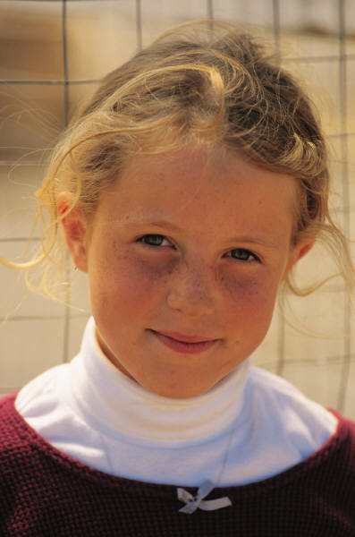
Identifying Child Abuse and Neglect
Signs of possible Physical Abuse:
unexplained bruises in various stages of healing
welts, human bite marks
unexplained burns, especially cigarette burns
unexplained fractures, injuries or abrasions
nervous, hyperactive, aggressive, disruptive,
destructive behaviors
unusually wary of physical contact
unduly frightened of parent or caretaker
expresses little or no emotion when hurt
unduly shy, withdrawn and passive
injuries inconsistent with the child’s age and the explanation

Slide 5
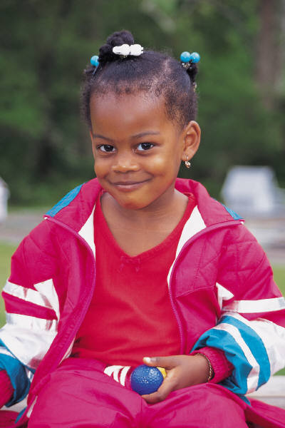
Signs of possible Sexual Abuse:
Engages in ongoing sexual activity that is not appropriate for the child’s age
has detailed and sophisticated understanding of sexual behaviors
regress to such behaviors as bed-wetting, speech loss, etc.
suffers sleep disturbances or nightmares
pain, itching, bruising or bleeding in genitalia
venereal disease
frequent urinary tract or yeast infections

Slide 6
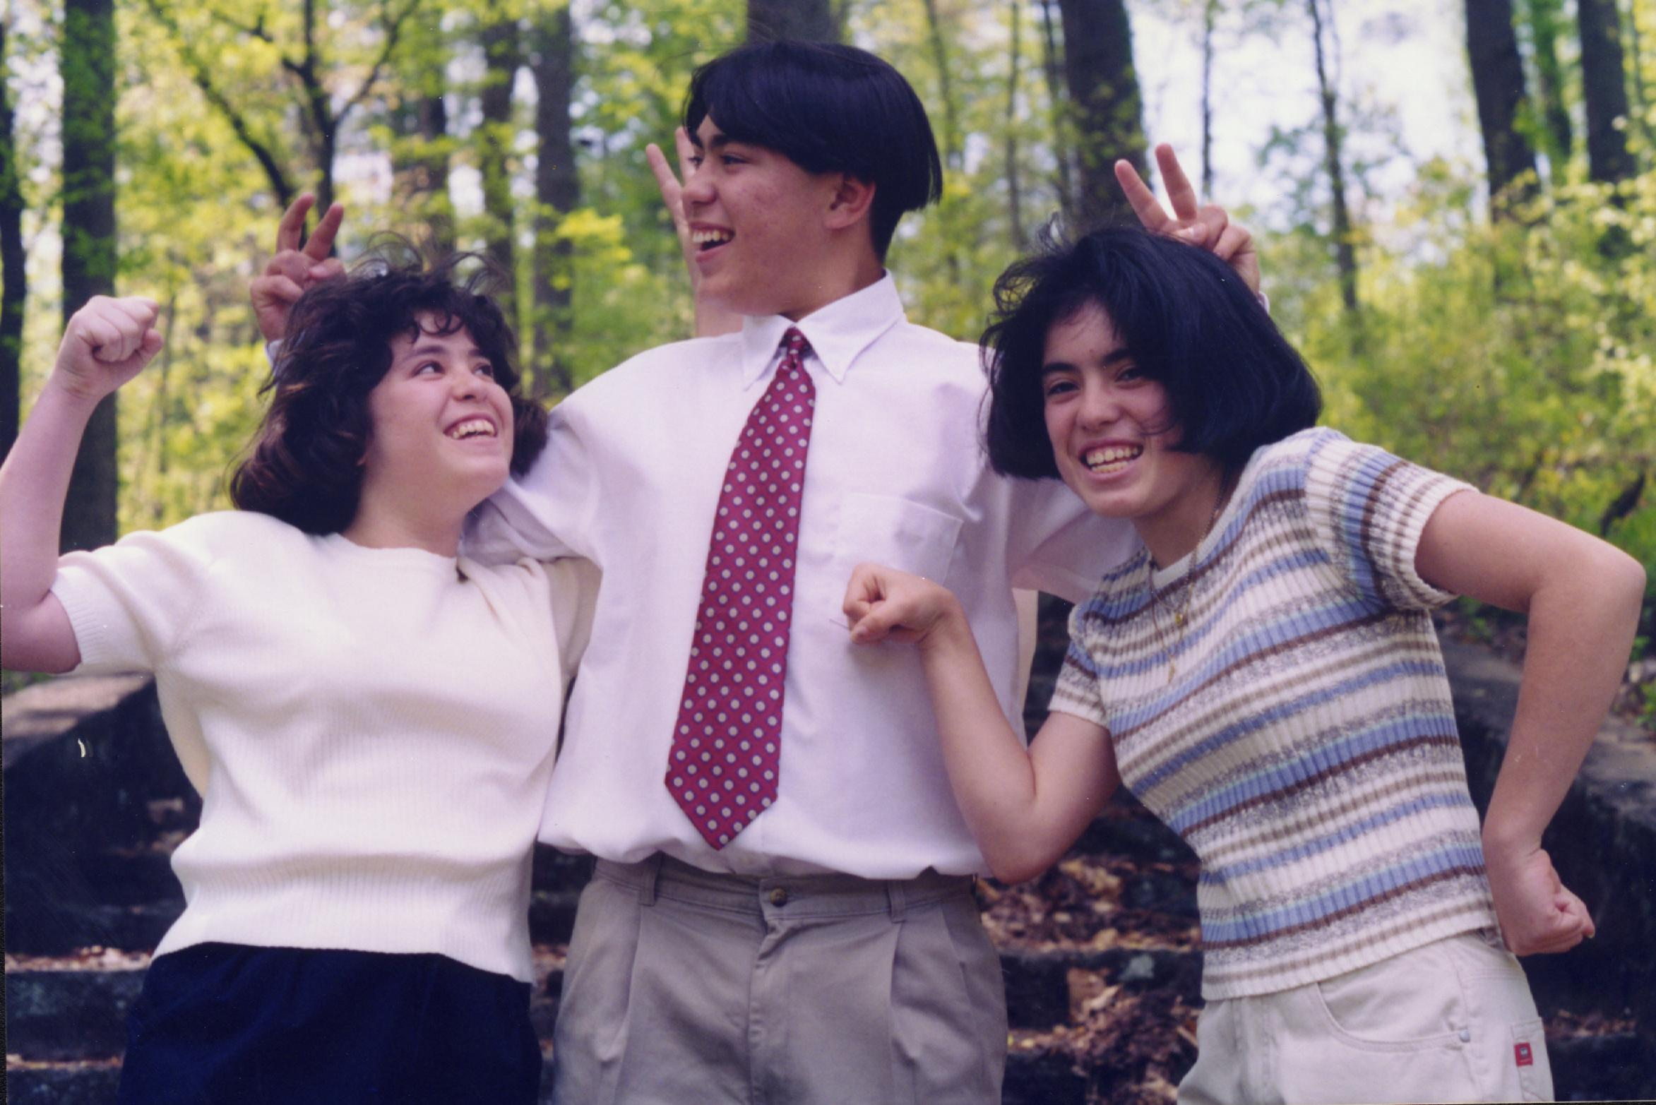
A Neglected Juvenile, as defined in General Statute 7B-101(15), is one who:
Does not receive proper care, supervision or discipline from his parent, guardian, custodian or caretaker.
Has been abandoned
Is not provided necessary medical or remedial care.
Lives in an environment injurious to his welfare, or
Has been placed for care or adoption in violation of the law

Slide 7
A Dependent Juvenile, as defined by General Statute 7B-101(9), is a juvenile in need of assistance or placement because:
He has no parent, guardian or custodian responsible for his care or supervision; or
His parent, guardian or custodian is unable to provide for his care or supervision due to physical or mental incapacity and the absence of an appropriate alternative care arrangement.

Slide 8

Signs of Possible Neglect:
Abandonment by parent or caretaker
unattended medical needs
consistent lack of supervision
consistent hunger, inappropriate dress,
poor hygiene
indiscriminate with his or her affection
pale, listless, begs or steal food
falls asleep in class, regularly displays fatigue
self- destructive

Slide 9

How to make a report.
426-8257 or 426-8200
(it takes MORE than 5 minutes)
Name, address and age of the child
Name of the child’s parent, guardian or caretaker
Child’s condition, including the nature and extent of the injury
Any information regarding the presence of weapons in the home, alcohol/drug abuse or other factors affecting a social workers safety
After hours, weekends and holidays, you may call the Caldwell County Sheriffs Department 758-2324.
A social worker is always on call 24 hours a day 365 days a year

Slide 10
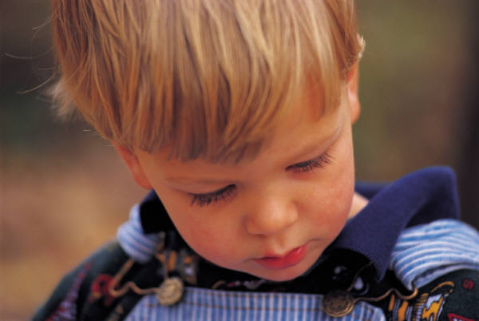
Who should report suspected child abuse and neglect?
Any person or institution who has cause to suspect that a child is being abused or neglected is required by law to report. GS 7B-301

Slide 11

You can help by:
Listening carefully to what the child is saying
Telling the child you believe them
Telling the child the abuse was not their fault
Letting the child know you will make a report to help stop abuse

Slide 12
Discipline or Abuse?
Discipline- Helps the child learn a lesson that will carry over and positively affect future behavior.
Abuse- Affects the child’s behavior in ways that become increasingly less desirable to the parents.

Slide 13
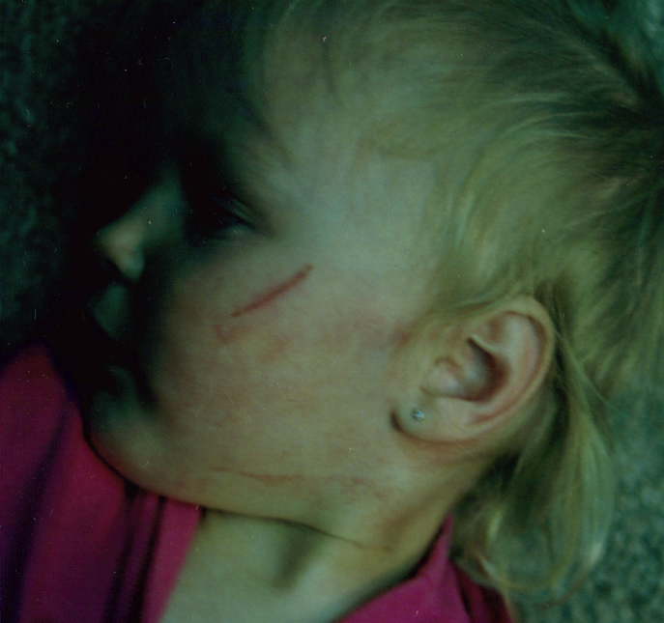
Handprint on Face

Slide 14
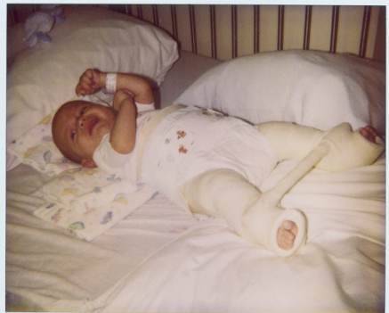
Spiral Fracture Leg

Slide 15
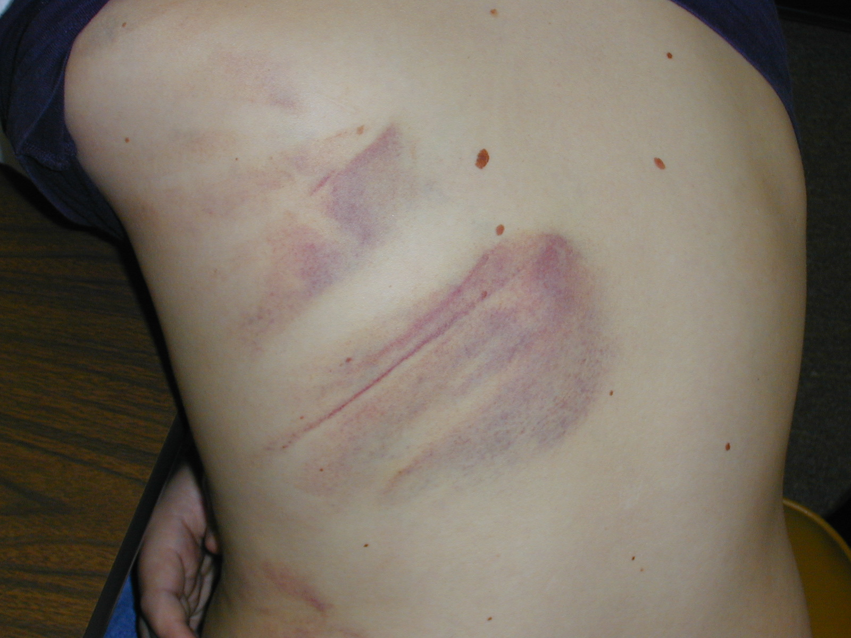
Improper Discipline with a Belt

Slide 16
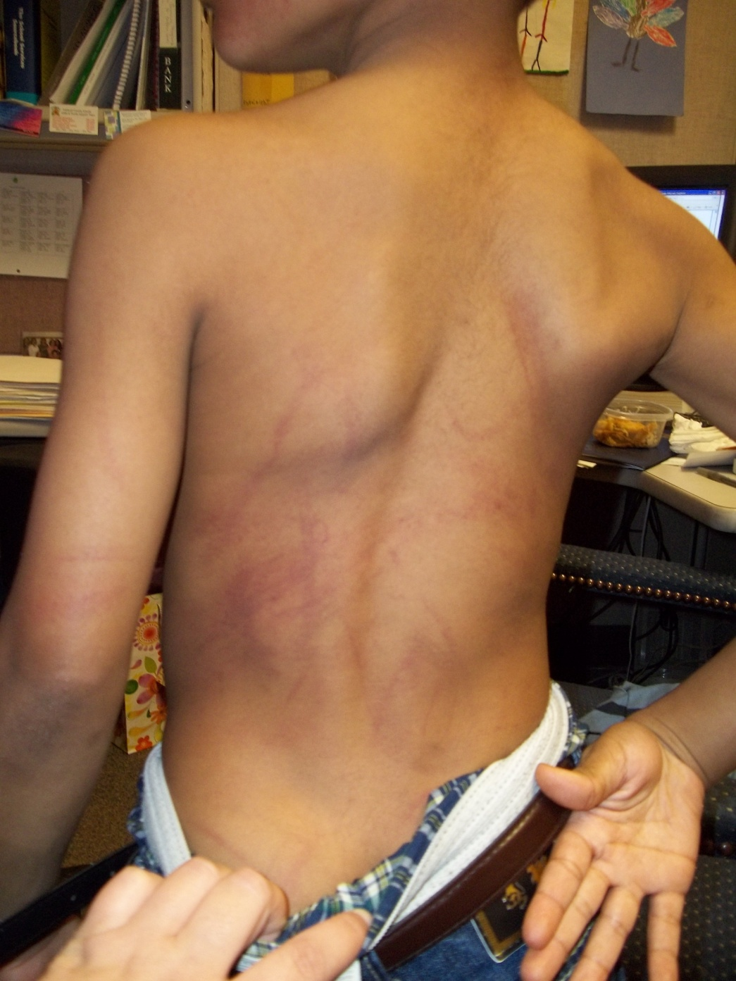
Improper Discipline

Slide 17
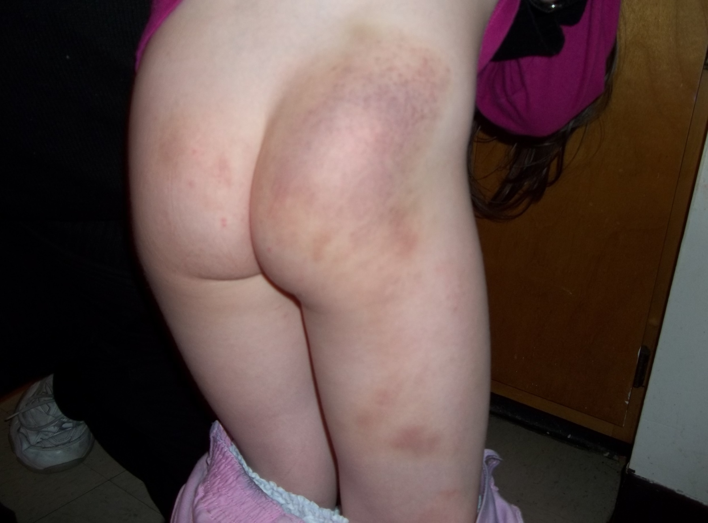
Improper Discipline

Slide 18
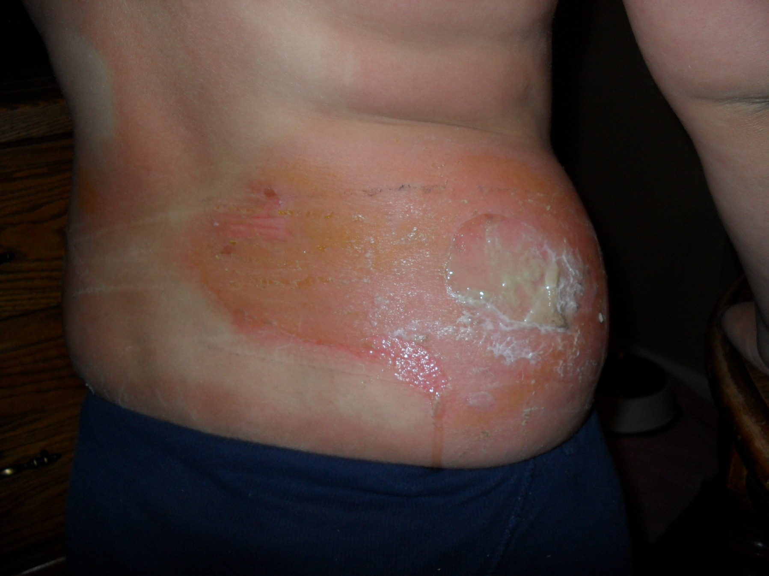
Severe Sunburn

Slide 19
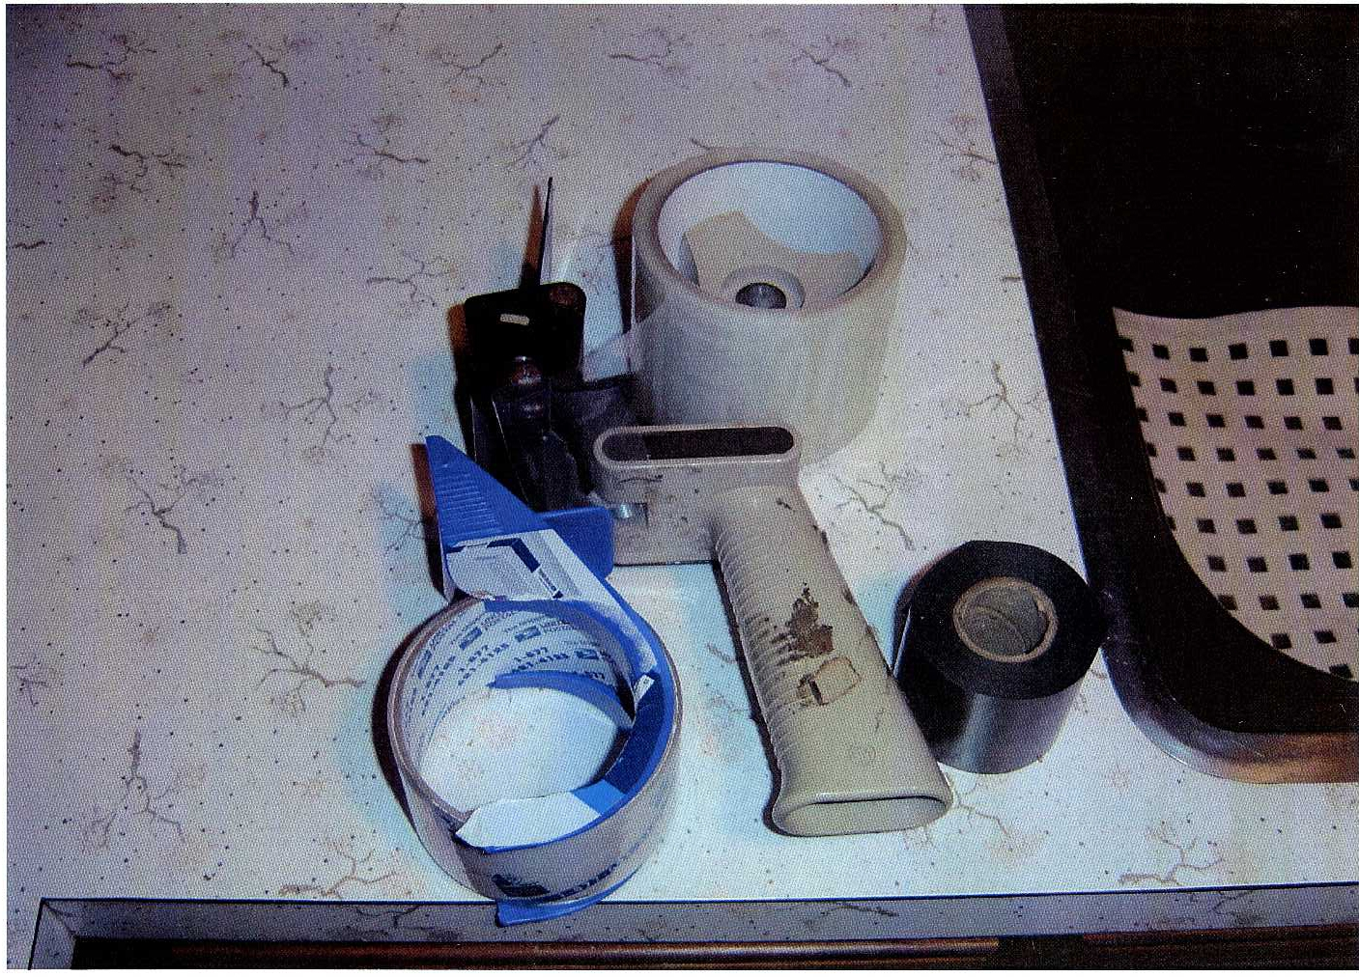
Tape Used in Abuse Case

Slide 20
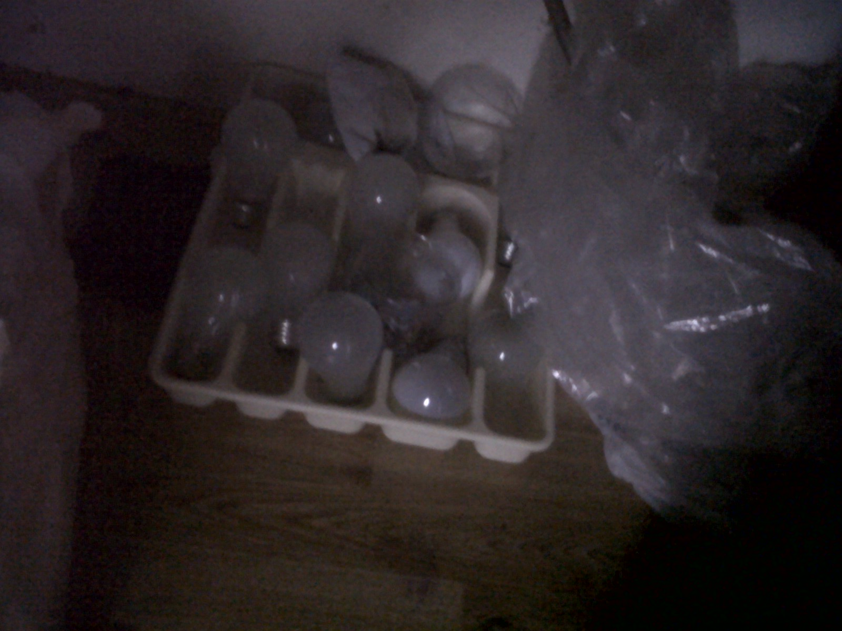
Items used in Meth Lab

Slide 21
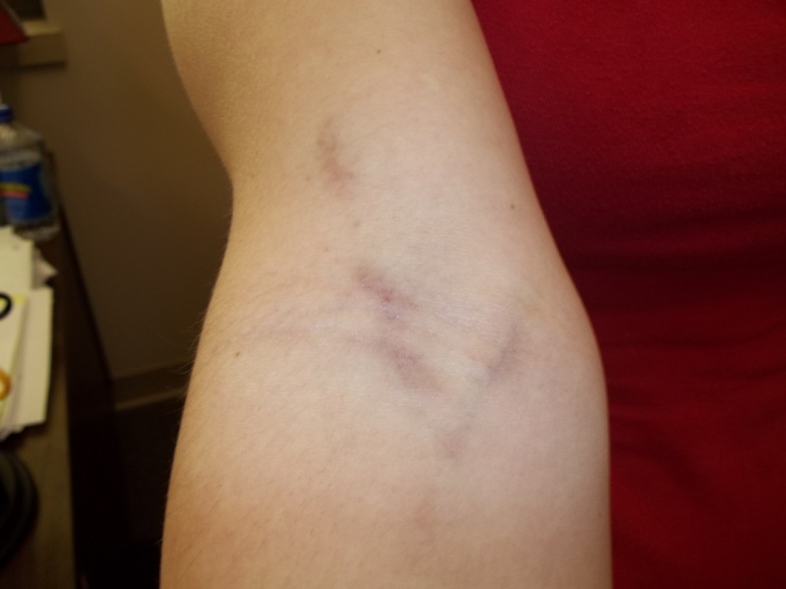
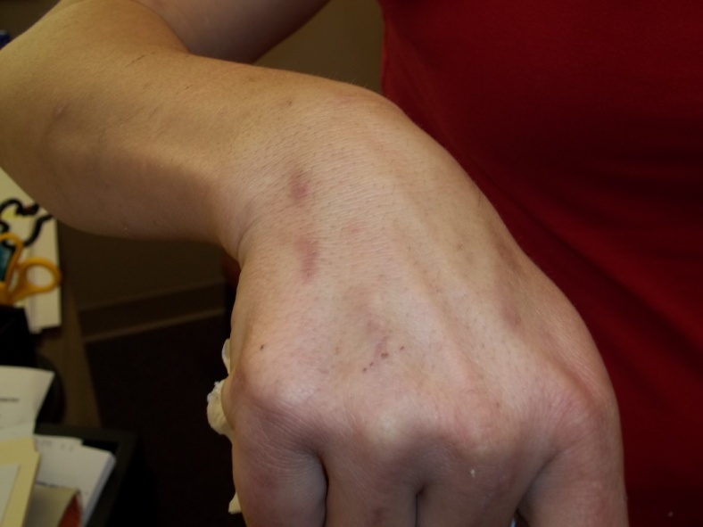
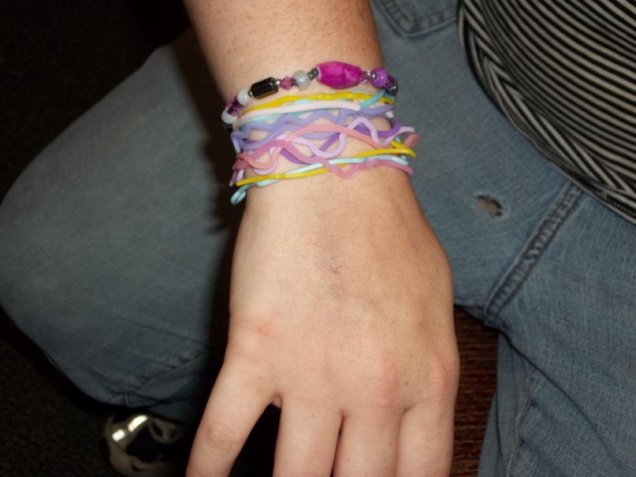
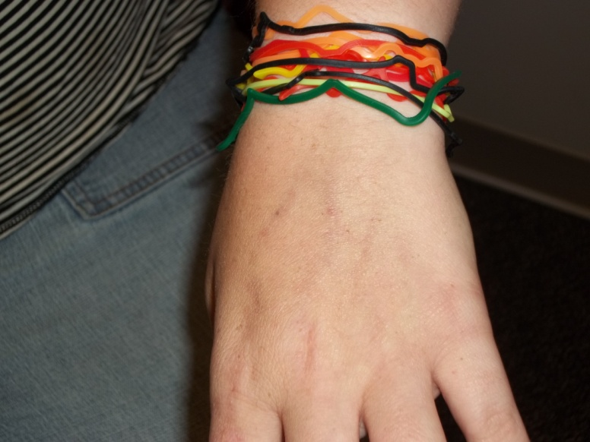
Needle Marks from Methamphetamines

Slide 22
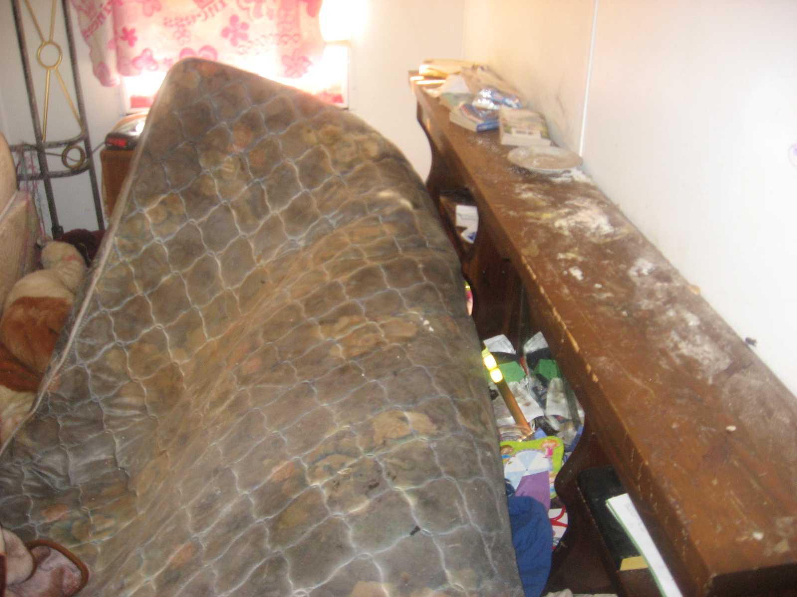
Unsanitary Living Conditions

Slide 23
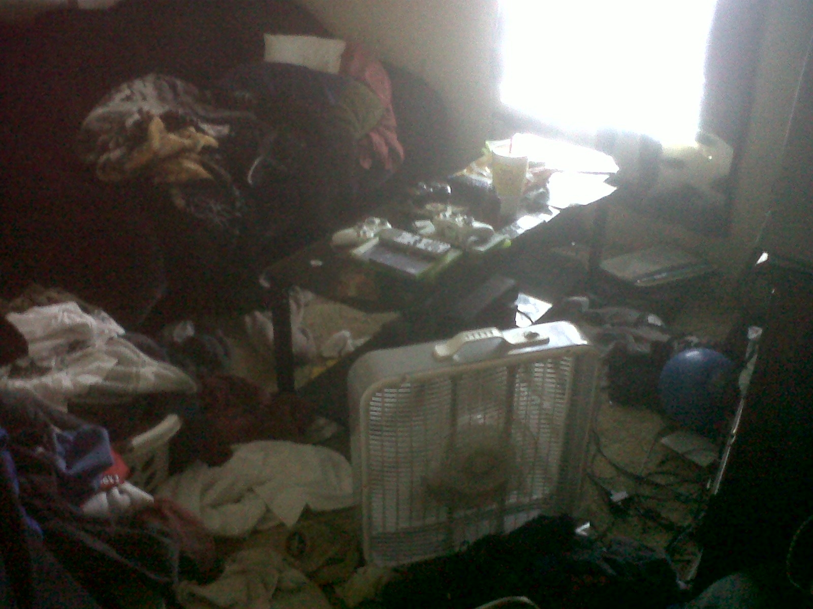
Unsanitary Living Conditions

Slide 24
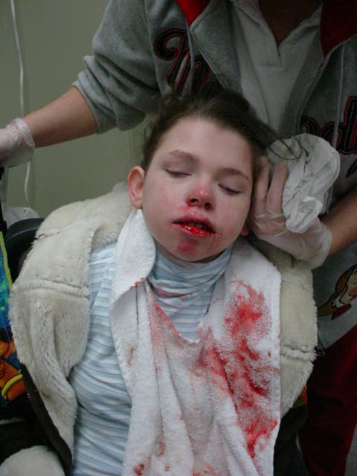
Physical Abuse

Slide 25
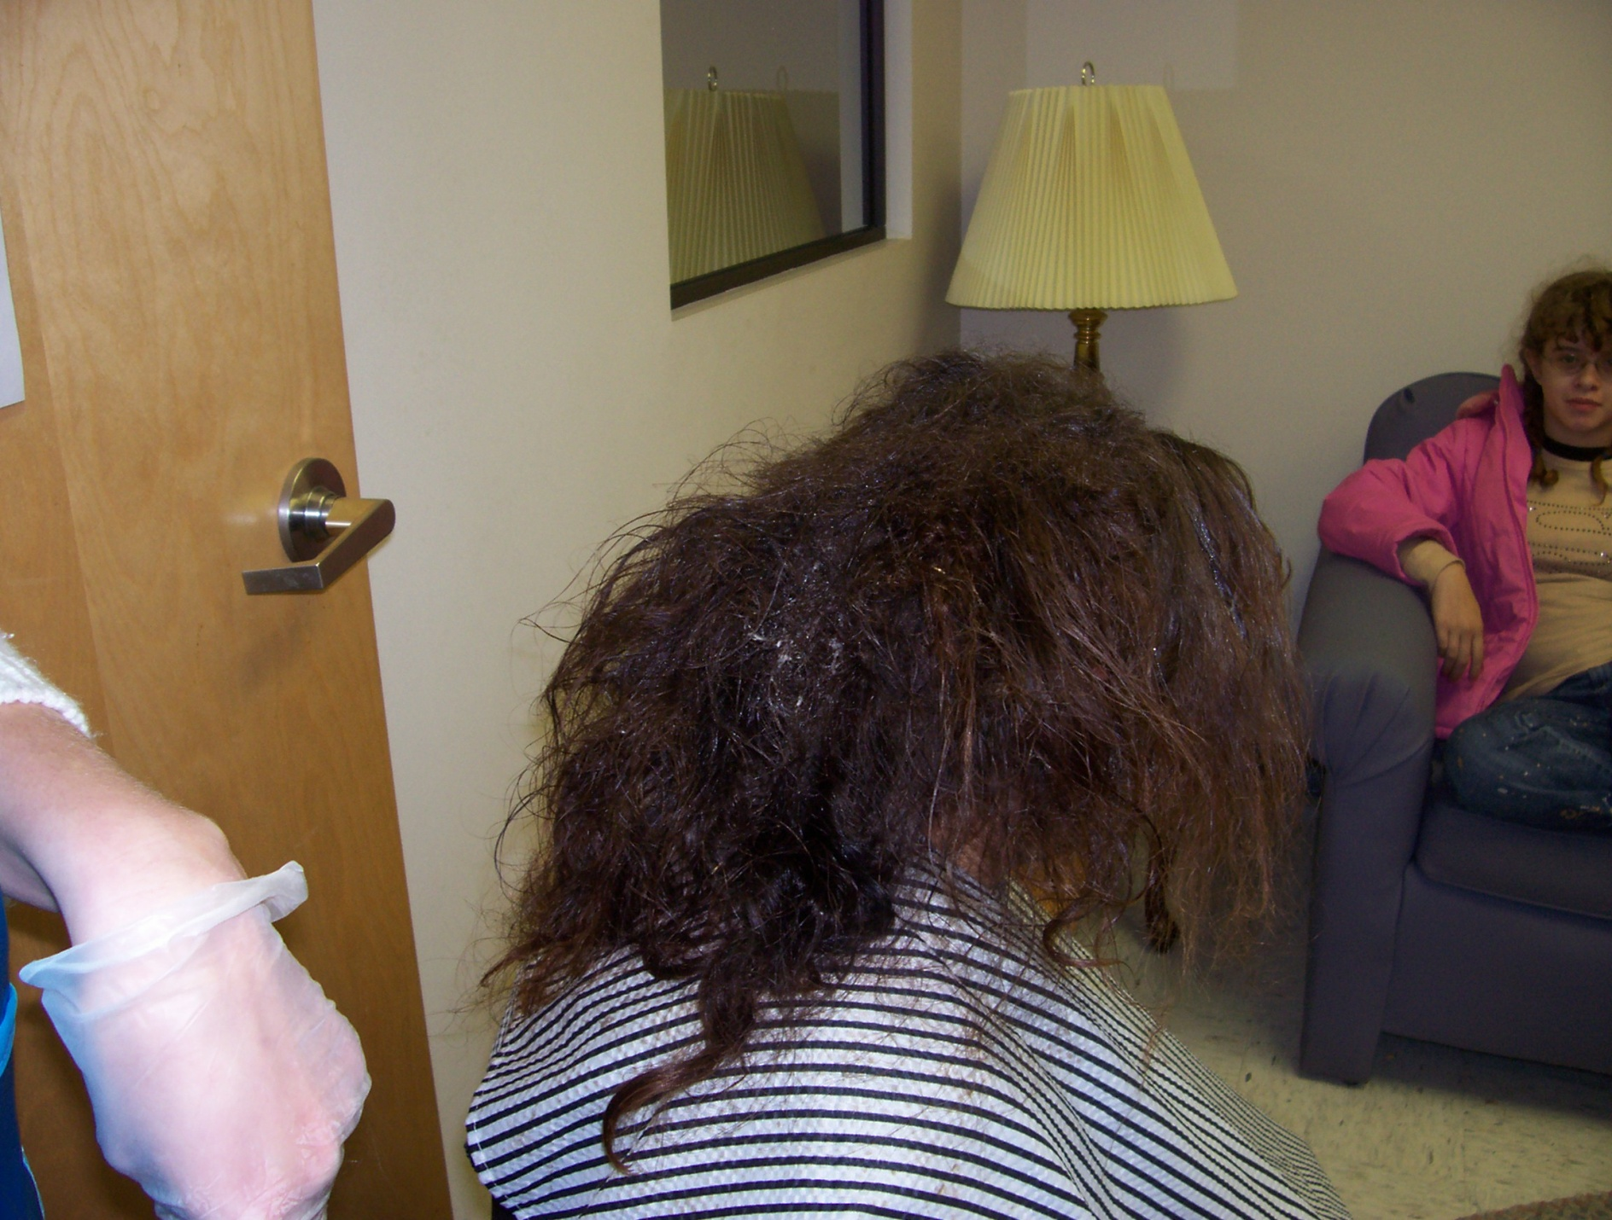
Mold Growing in Hair

Slide 26
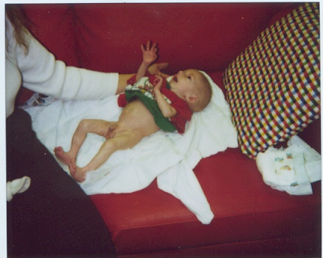
Failure to Thrive Infant

Slide 27
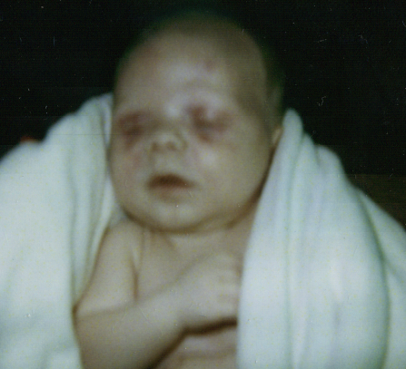
Infant Hit in the Eyes With a Bottle

Slide 28
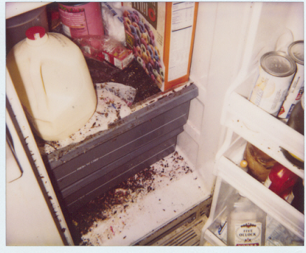
Roaches in Refrigerator

