Slide 1
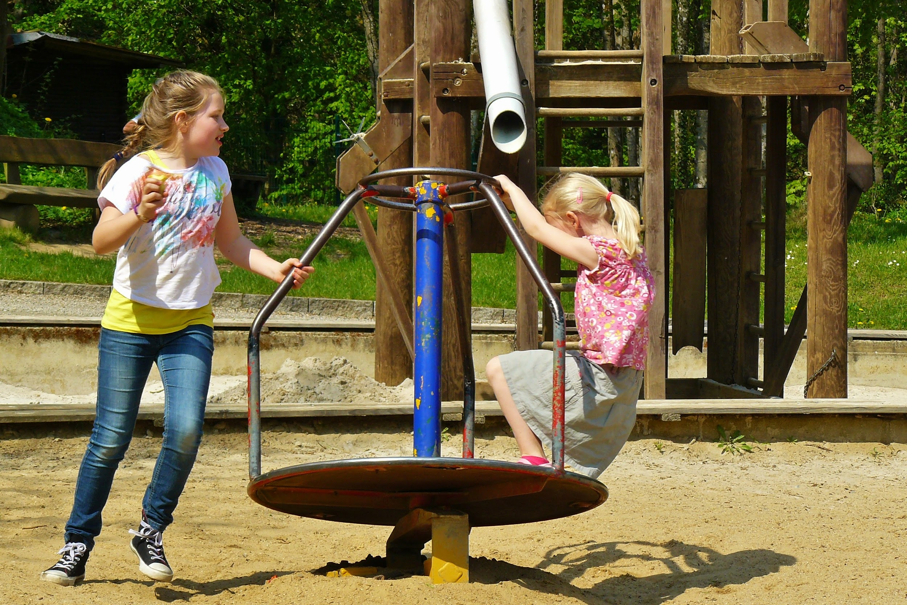
GRANITE FALLS ELEMENTARY
TITLE I PARENT INFORMATION
2023 - 2024
WHAT IS THIS FUND AND HOW DO WE USE IT TO HELP OUR STUDENTS?

Slide 2

WHAT IS TITLE I?
TITLE I IS A FEDERAL PROGRAM THAT PROVIDES ADDITIONAL SERVICES TO DISADVANTAGED STUDENTS.
SCHOOLS WITH STUDENTS AT 35% OR HIGHER LOW INCOME QUALIFY FOR FUNDING.

Slide 3

PARENT INVOLVEMENT
1% OF TITLE I MONEY GIVEN TO OUR SCHOOL MUST BE SPENT ON PARENT INVOLVEMENT.
OUR SCHOOL HAS AN UPDATED PARENT AND FAMILY ENGAGEMENT POLICY (on website under Title 1 tab).
OUR SCHOOL ALSO HAS AN UPDATED PARENT-STUDENT-TEACHER COMPACT .
READING AND MATH NIGHTS ARE FUNDED BY THIS 1% OF OUR PARENT INVOLVEMENT BUDGET. *BUDGETS HAVE NOT BEEN GIVEN TO SCHOOLS YET.
PARENTS HAVE A RIGHT TO BE INVOLVED IN THEIR CHILD’S EDUCATION.

Slide 4
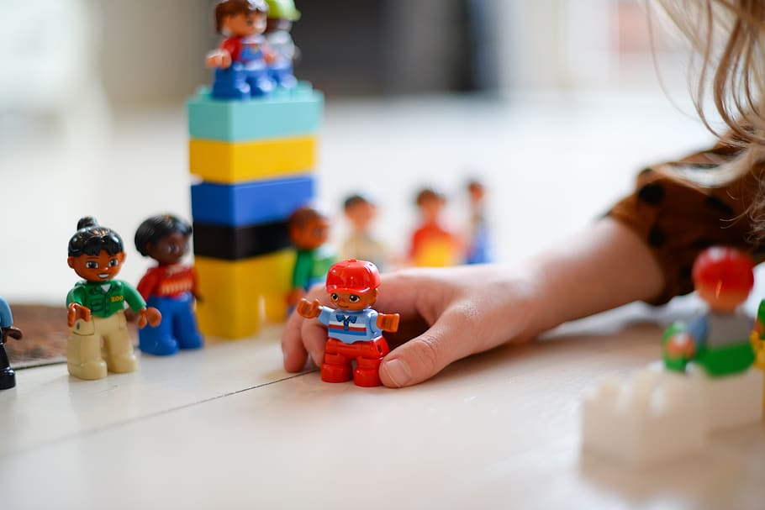
WHAT DO WE USE OUR FUNDING FOR EACH YEAR?
OUR GFES TITLE I BUDGET SPENDING HAS STAYED CONSISTENT OVER THE YEARS WITH VERY LITTLE CHANGE. HOWEVER, FUNDING CHANGES EACH YEAR FOR EACH SCHOOL. OUR COUNTY HAS NOT GIVEN US A SET AMOUNT OF MONEY AT THIS TIME.
INCLUDED IN THE SPENDING OF OUR TITLE I FUNDS (SUBJECT TO CHANGE):
ONE TEACHER POSITION
ONE TEACHER ASSISTANT POSITION
TWO ACADEMIC COACHES
EDUCATIONAL PROGRAMS
READING/MATH ACTIVITIES FOR OUR STUDENTS AND PARENTS
STAFF DEVELOPMENT WORKSHOPS

