Slide 1
PowerTeacher Pro
Caldwell County Schools
2017-2018

Slide 2
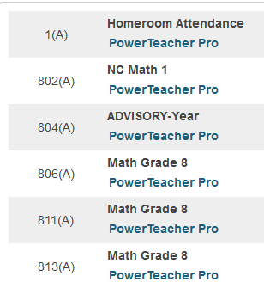
Accessing PowerTeacher Pro:
URL- https://caldwellschools.powerschool.com/teachers
From my.ncedcloud.org: Click PowerTeacher icon. This will take you straight to the teacher side.
From there, you only click the PowerTeacher Pro blue link under the headings of any of your classes.

Slide 3
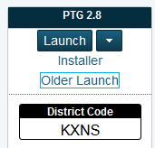
FYI
You still have the option of launching (as long as Java is available) your old gradebook via the “Older Launch” link as shown below:
This is READ ONLY. This allows you to look back on past assignments, etc. , but you will not be able to copy them over to the new gradebook.

Slide 4
FYI
From the Help Menu, you have the following options which will provide answers to most of your questions.
Help
Tips and Tricks
Getting Started
What’s New?
Videos

Slide 5
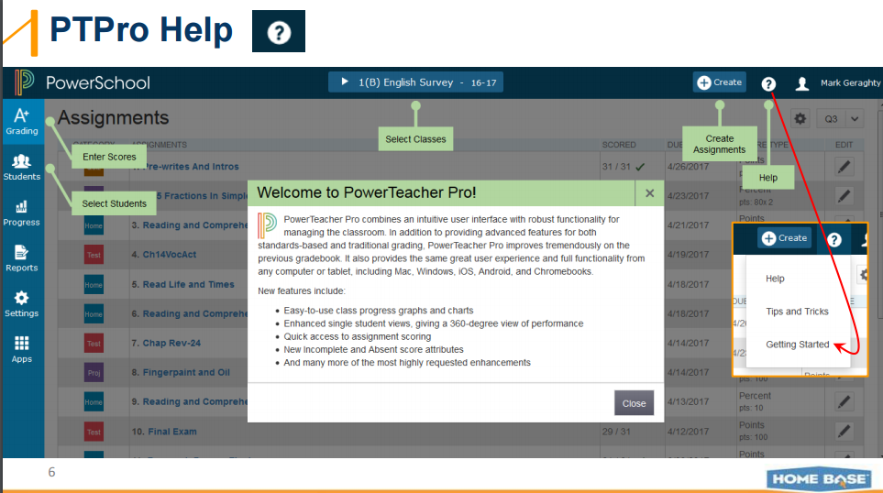
Getting Started presents this screen:

Slide 6
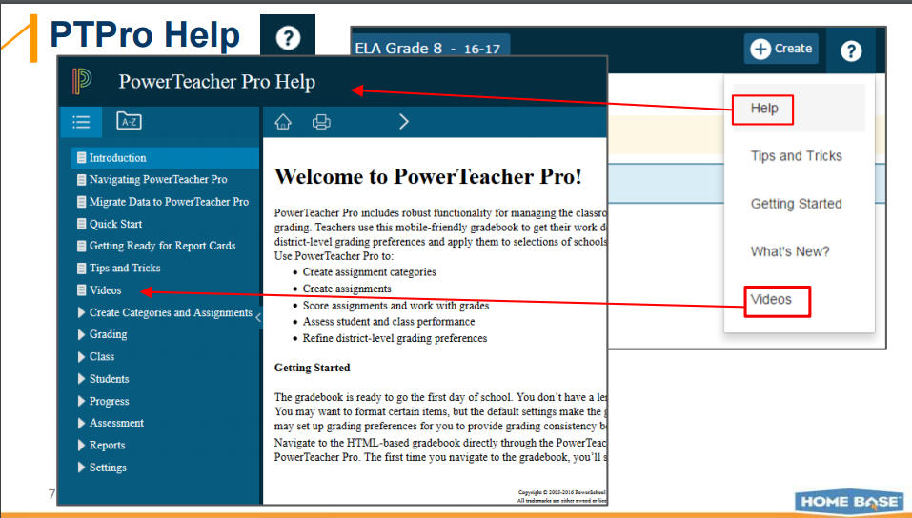

Slide 7
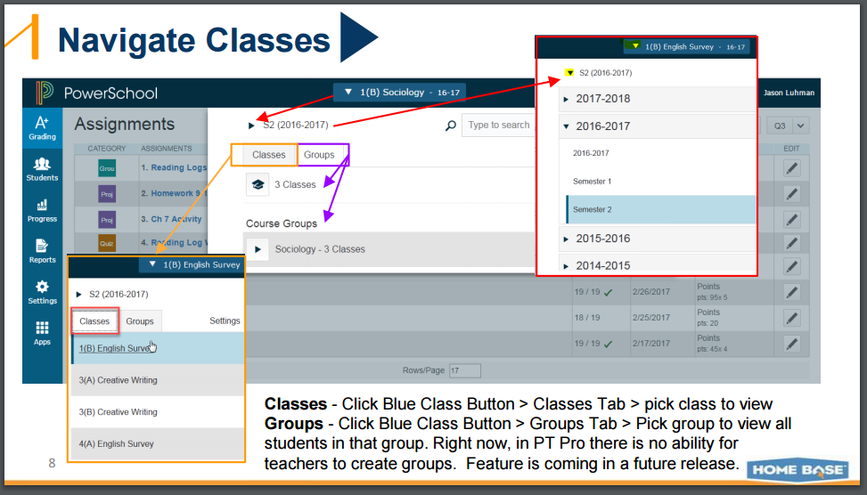

Slide 8
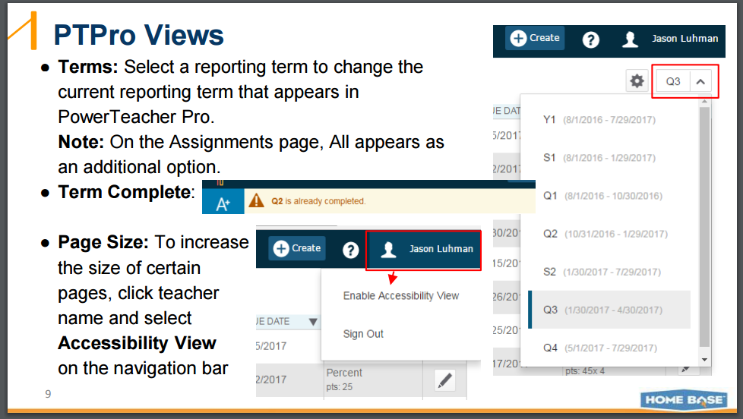

Slide 9
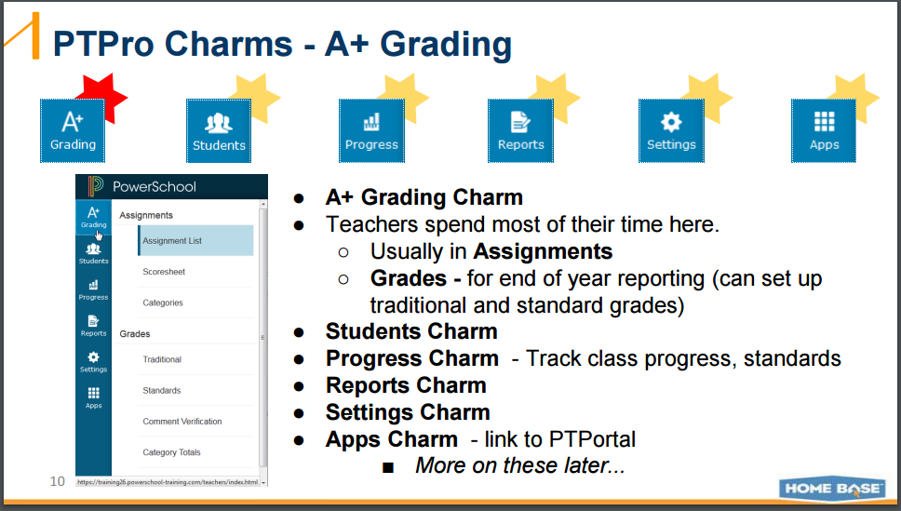

Slide 10
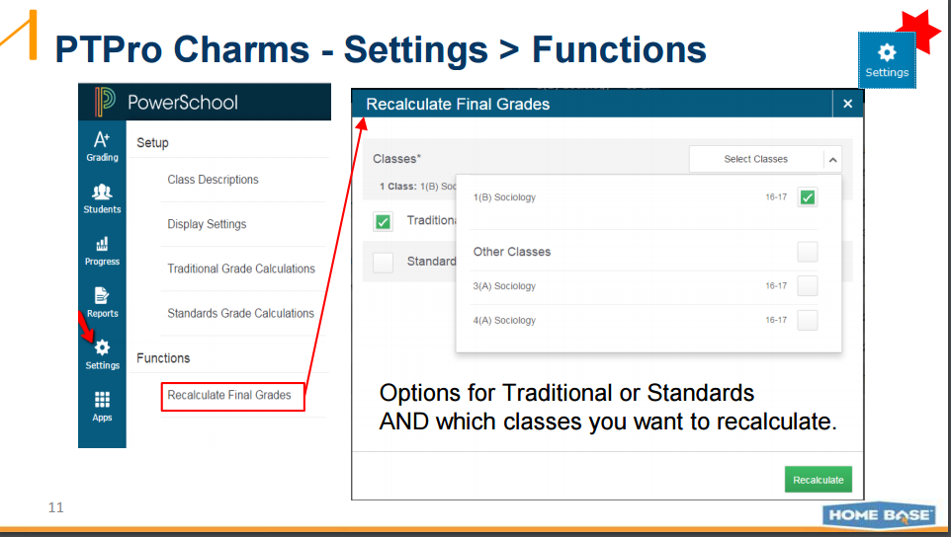

Slide 11
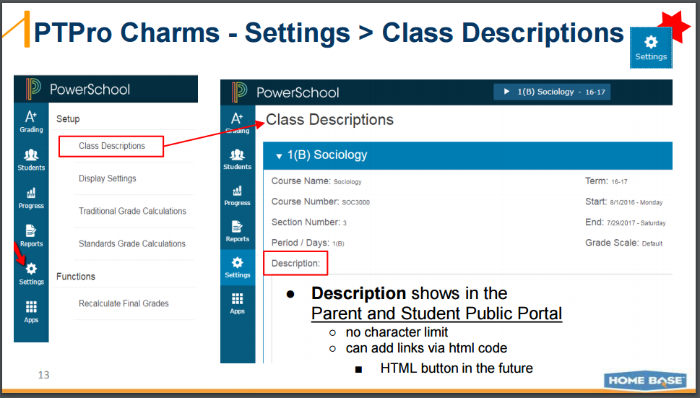

Slide 12
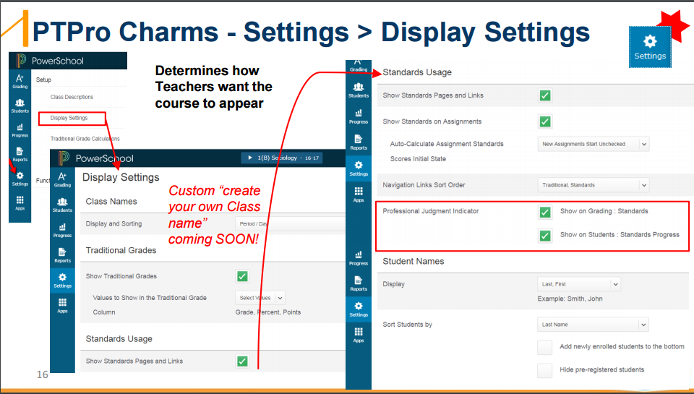

Slide 13
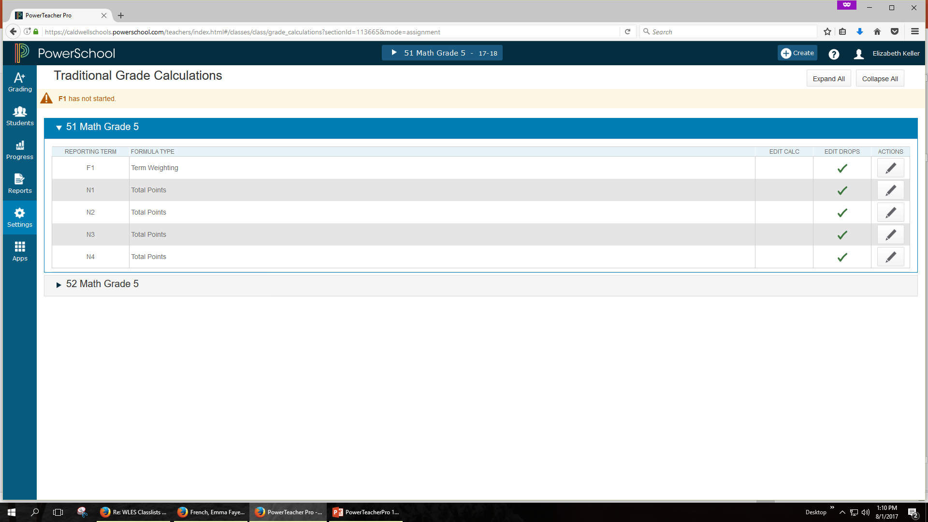
Click on “Traditional Grade Calculations” to bring up your sections. Click on “Actions” to view the screen that allows you to drop the lowest grade.

Slide 14
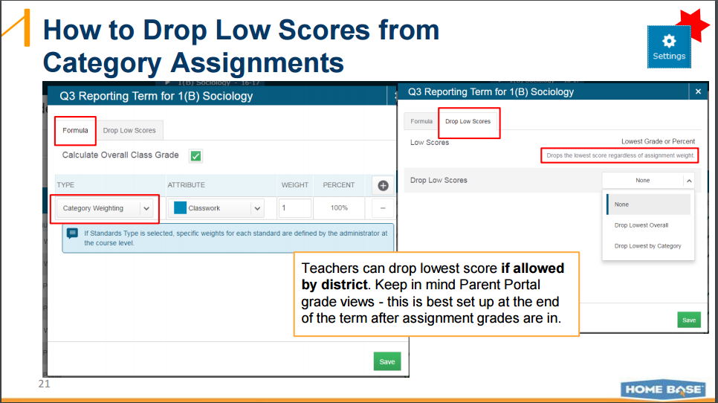

Slide 15
Category or Assignment????
Daily Work
Quiz
Caught Ya!
Journal
Pass Offs
Test
Bonus
4th 9 Weeks
N3
PE/Health Grade
Lab Work
Optional
Homework
Ela/Grammar Test
Azi’s Grades
Books, Titles, and Where They Want to Live
Project
3 Chapter Test
What If Essay
Tickets-Out-The-Door
Elements of Fiction and Poetry

Slide 16
Category or Assignment????
Daily Work
Quiz
Caught Ya!
Journal
Pass Offs
Test
Bonus
4th 9 Weeks
N3
PE/Health Grade
Lab Work
Optional
Homework
Ela/Grammar Test
Azi’s Grades
Books, Titles, and Where They Want to Live
Project
3 Chapter Test
What If Essay
Tickets-Out-The-Door
Elements of Fiction and Poetry

Slide 17
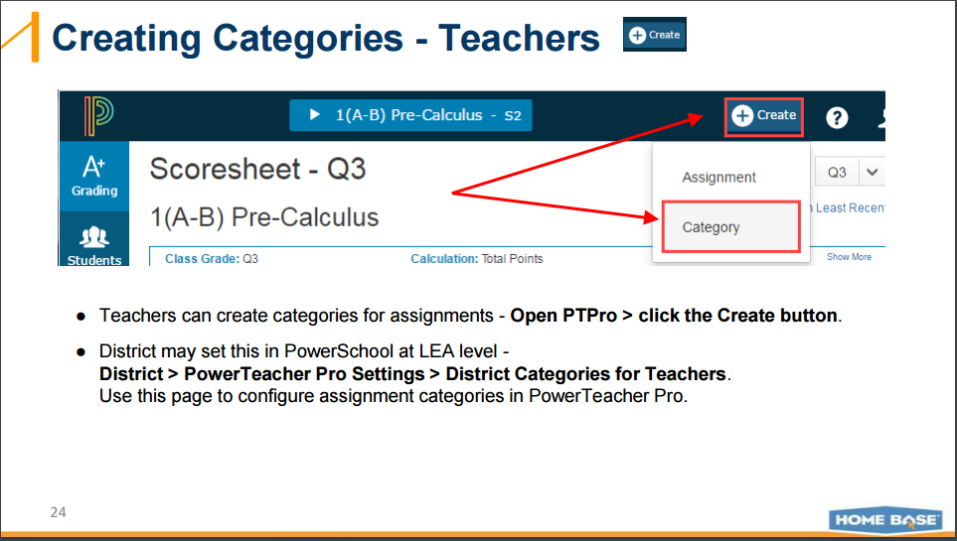

Slide 18
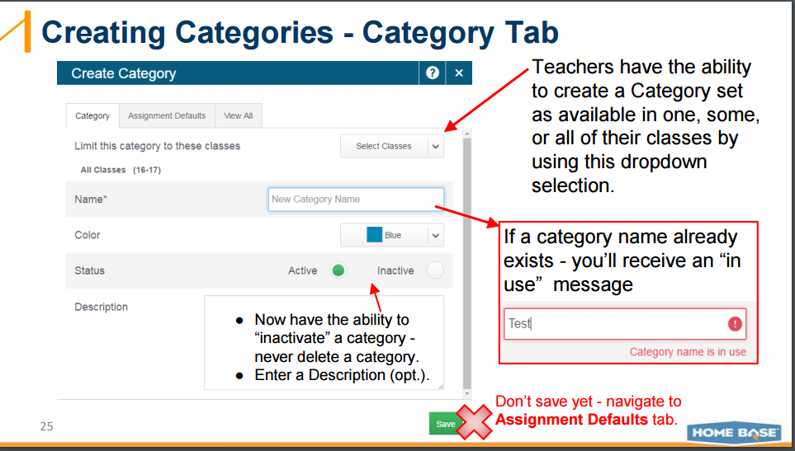

Slide 19
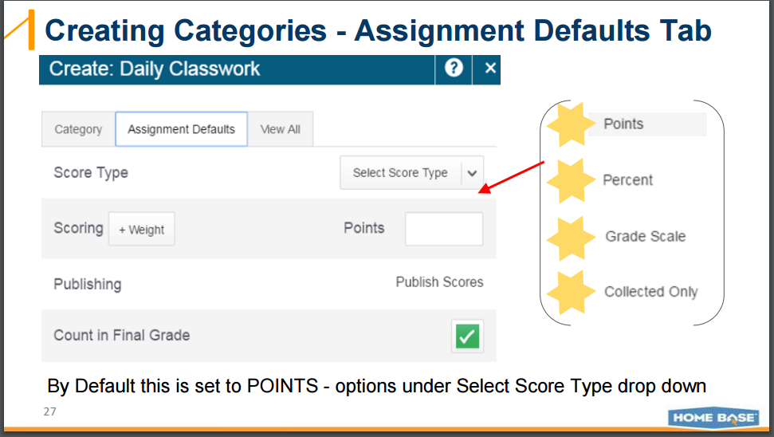

Slide 20
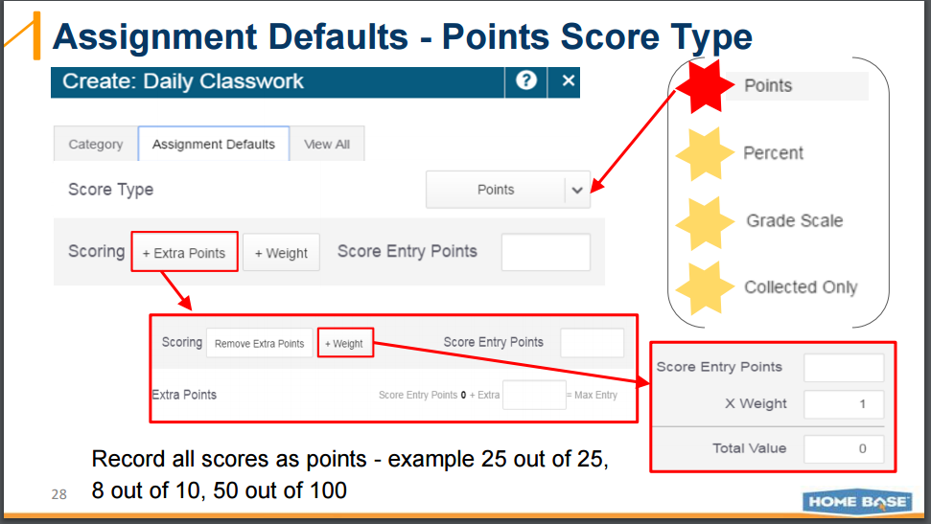

Slide 21
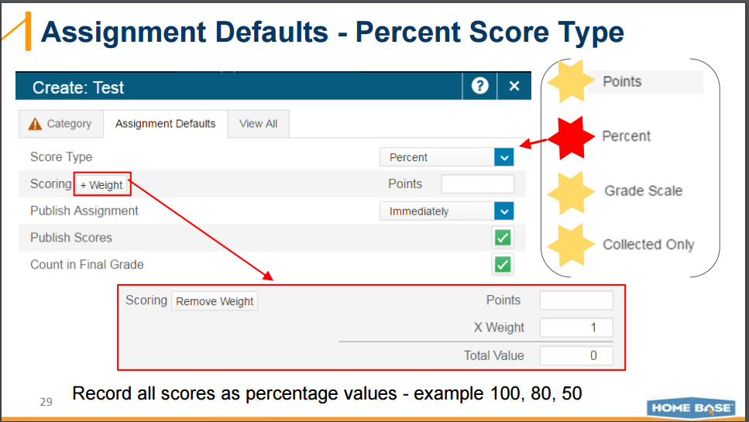

Slide 22
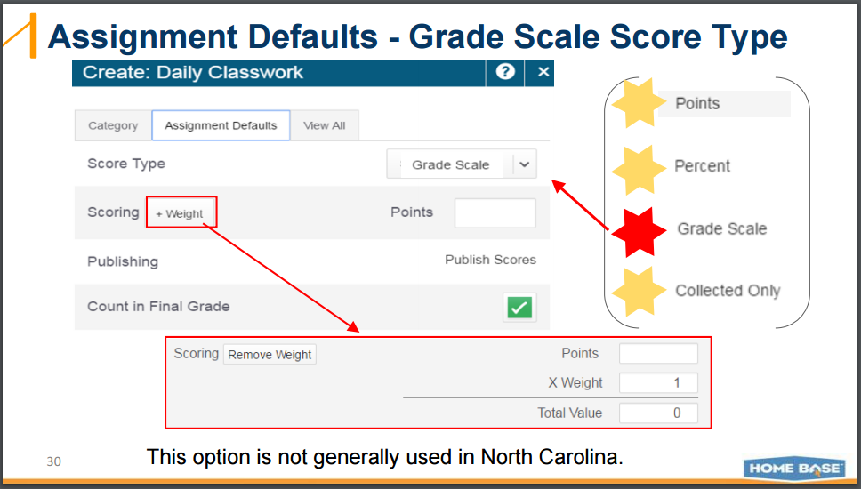

Slide 23
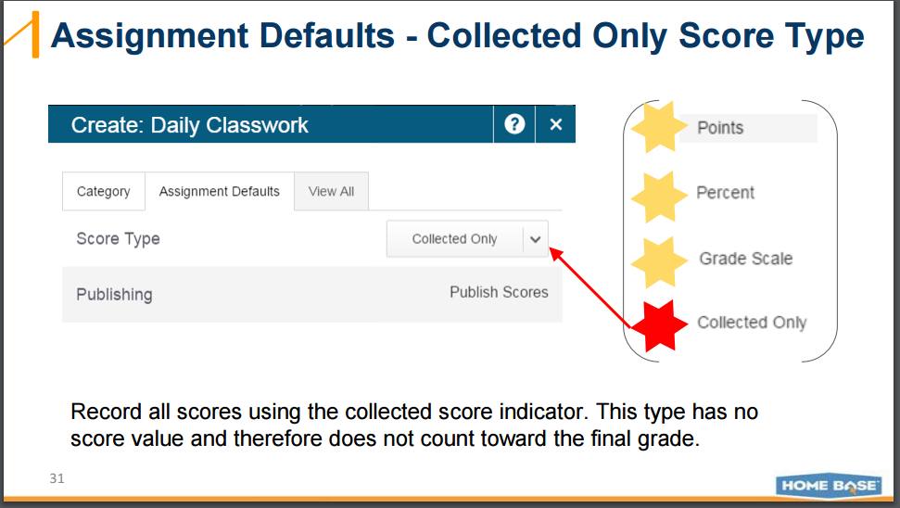

Slide 24
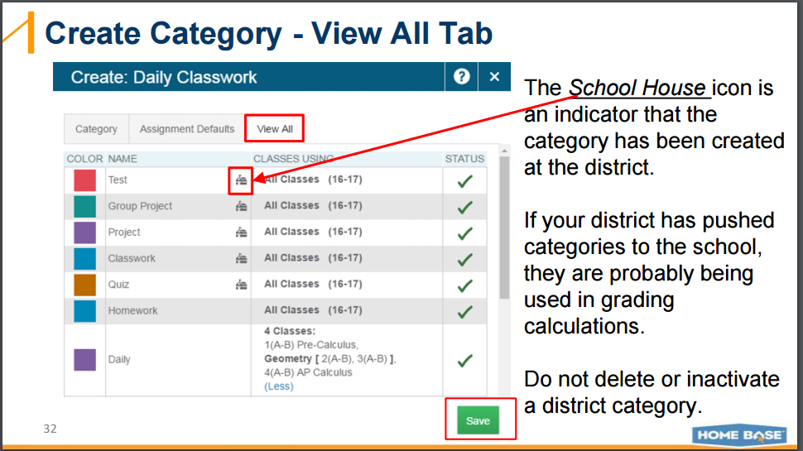

Slide 25
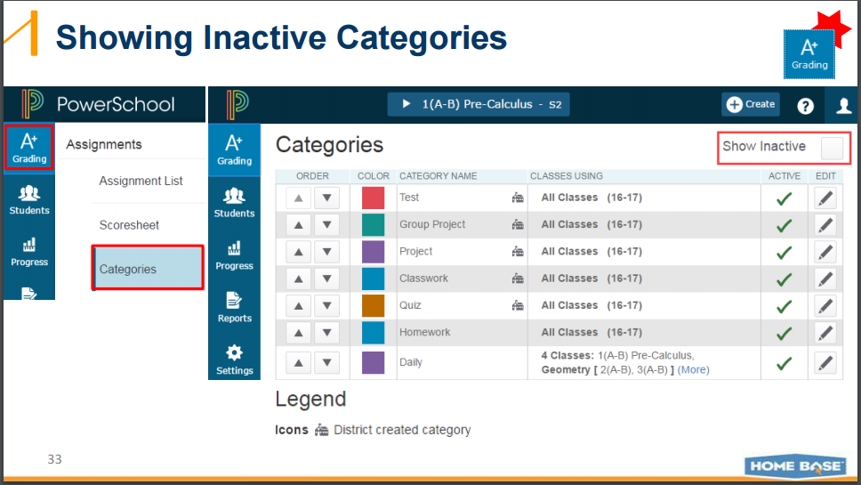

Slide 26
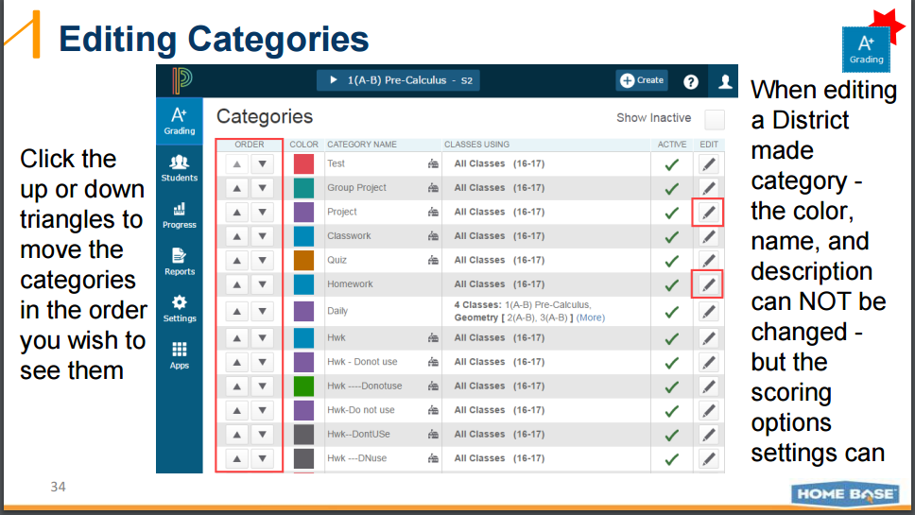

Slide 27
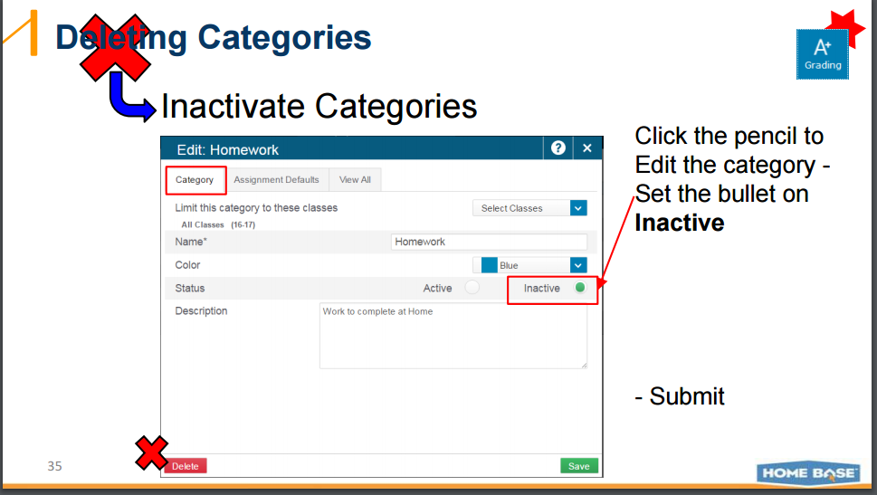

Slide 28
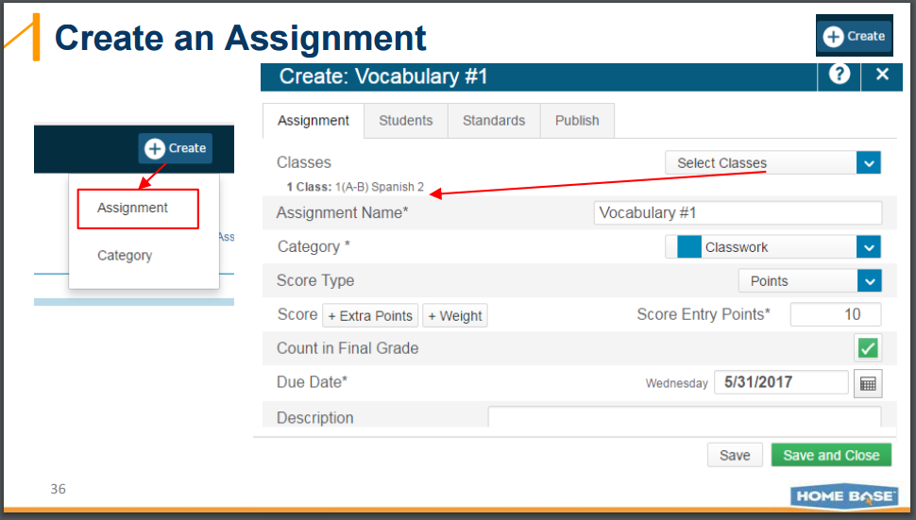

Slide 29
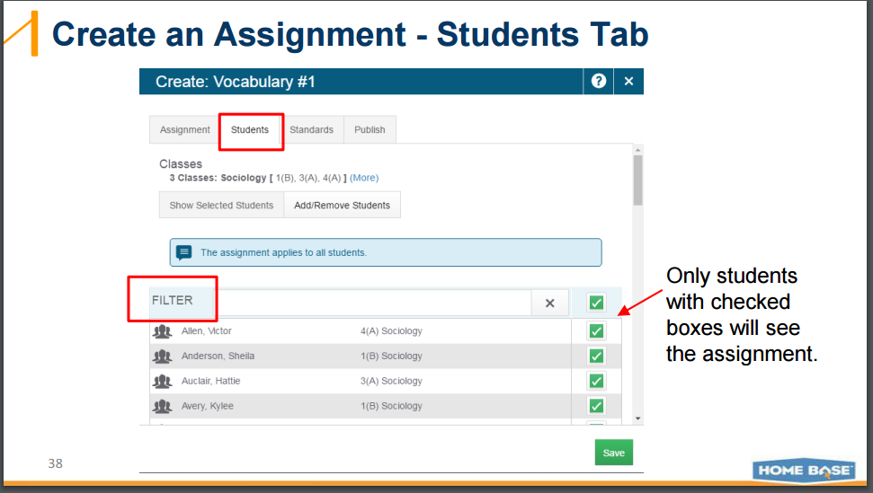

Slide 30
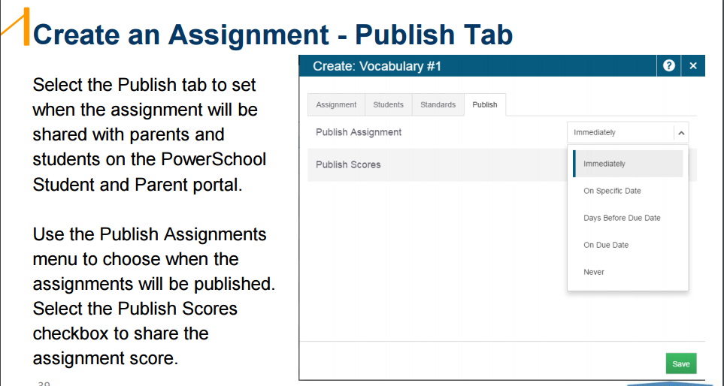

Slide 31
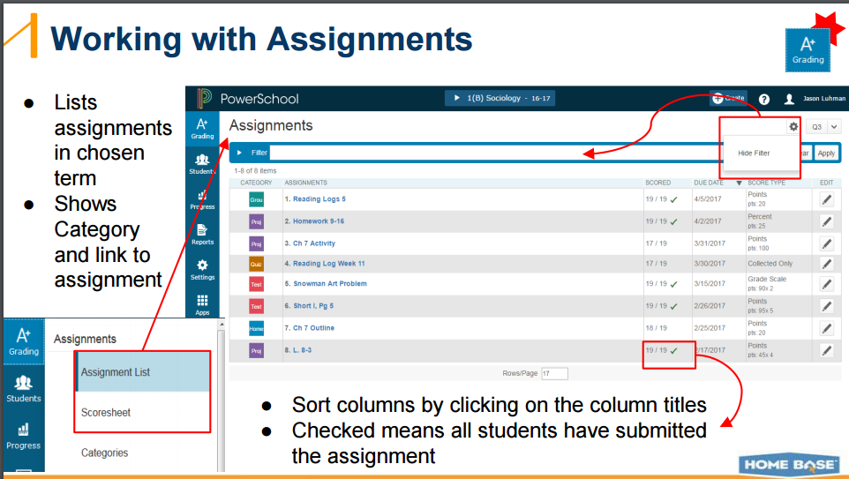

Slide 32
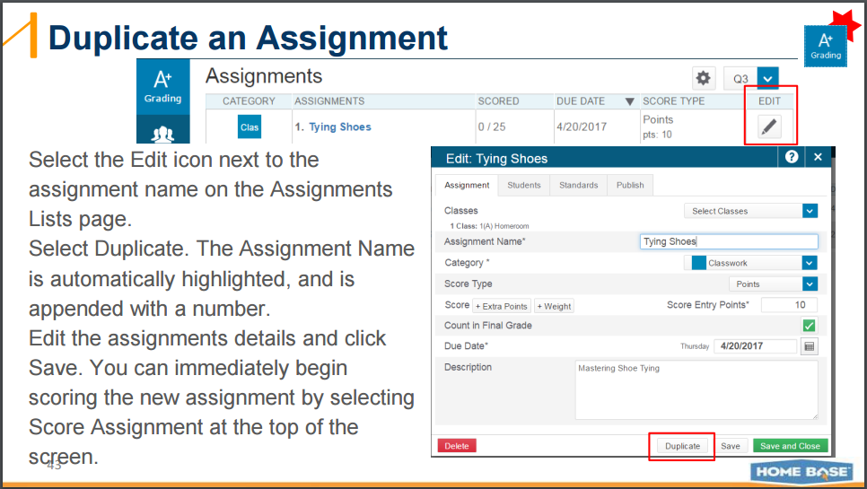

Slide 33
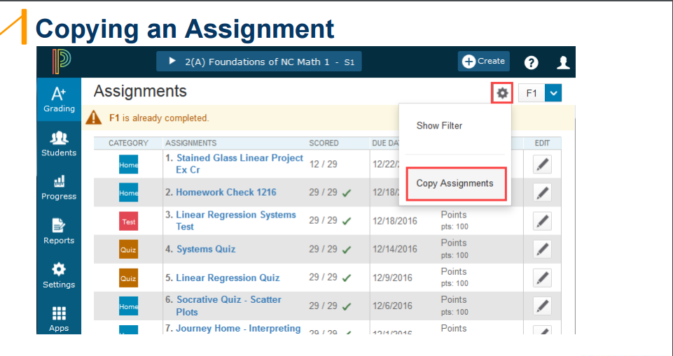

Slide 34
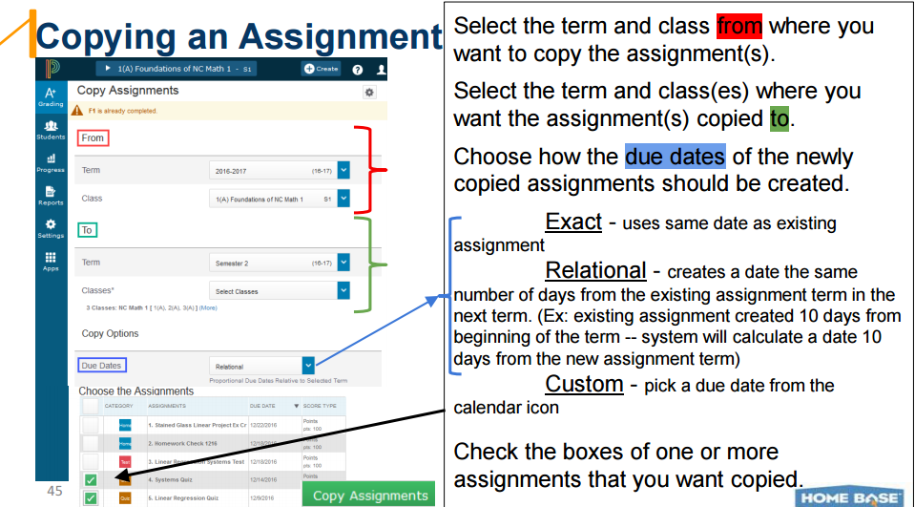

Slide 35
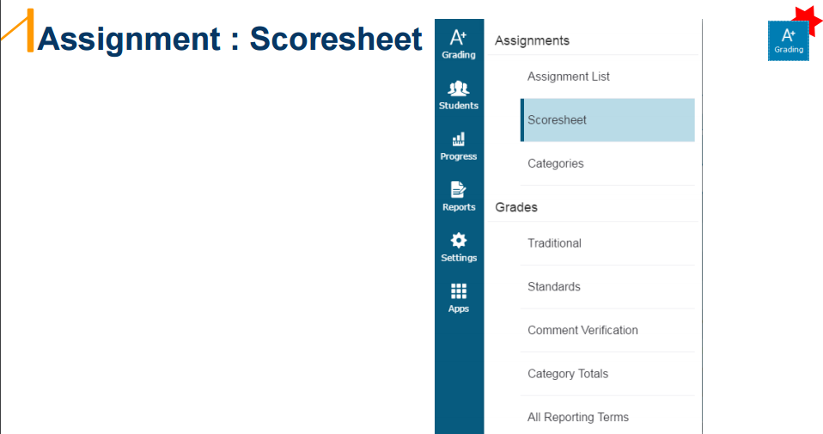

Slide 36
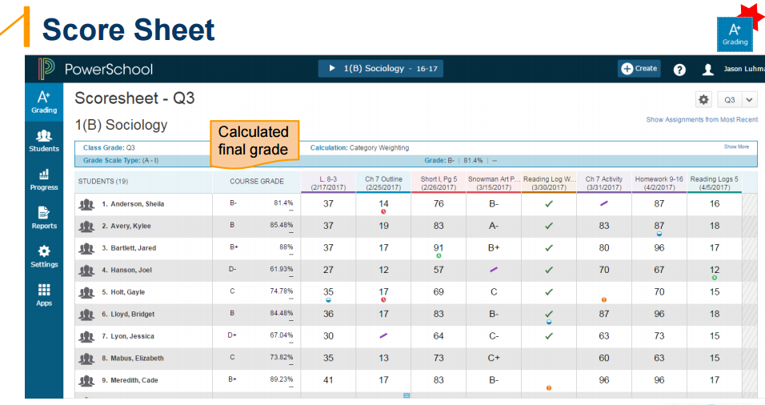

Slide 37
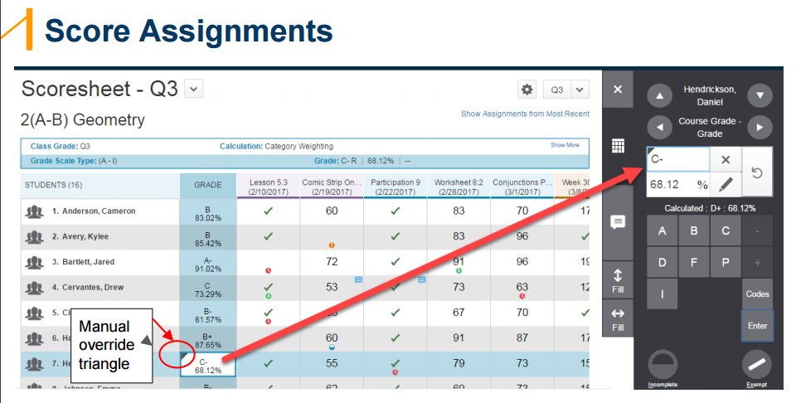
FYI-Manual Override should not be used to give grades for an entire class. A Manual Override was designed to express a judgement call, or extenuating circumstances. Non “core” teachers have been using the Manual Override exclusively to give grades in the past. This must stop. Teachers have been instructed to create 1 assignment to give grades. This is not only quicker, but it allows PowerSchool to accurately calculate Honor Roll.

Slide 38
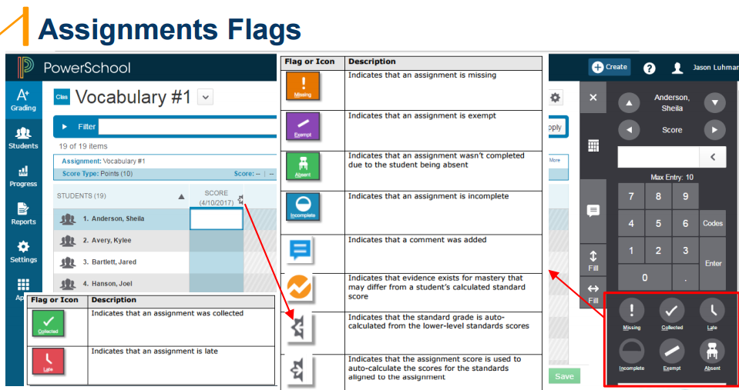

Slide 39
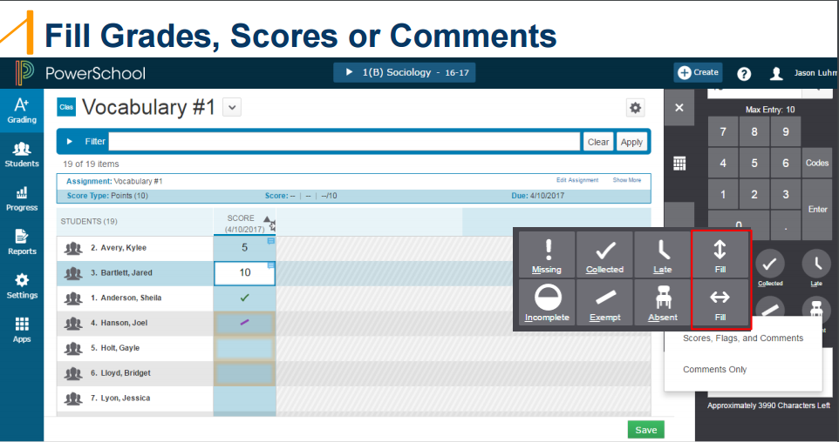

Slide 40
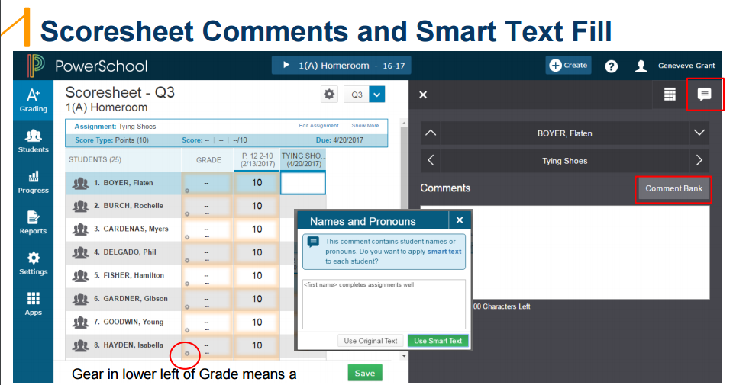
To use Smart Text, which substitutes the first name of the student into a generic comment, write the first comment using the first student’s name. Click on “Fill”. A box appears titled “Names and Pronouns”. When you click on “Smart Text”, it replaces the first student’s name with the names of each of the subsequent students on the list to personalize.

Slide 41
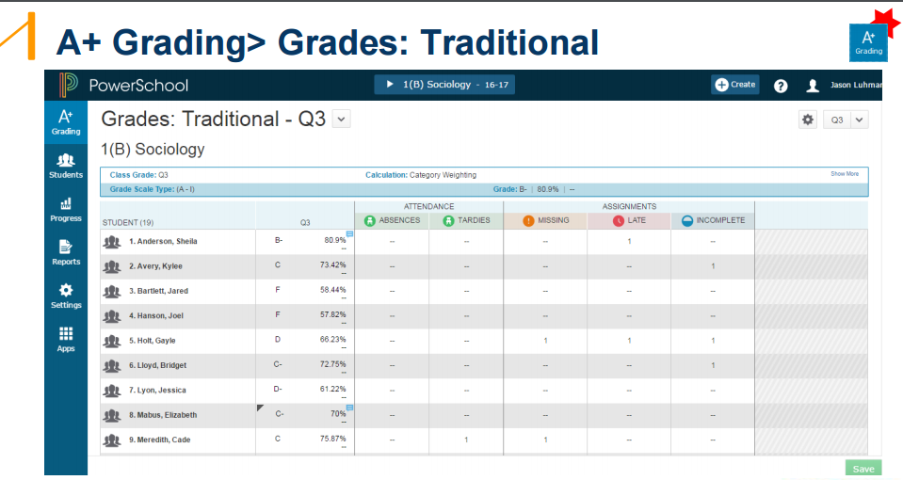

Slide 42
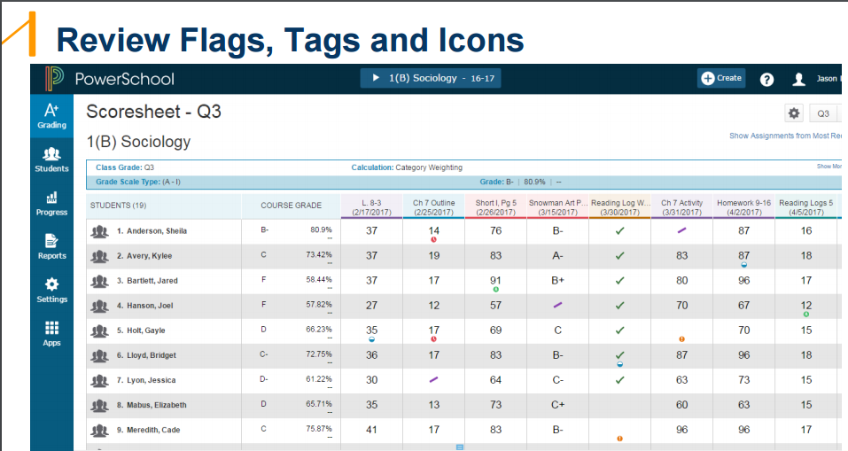

Slide 43
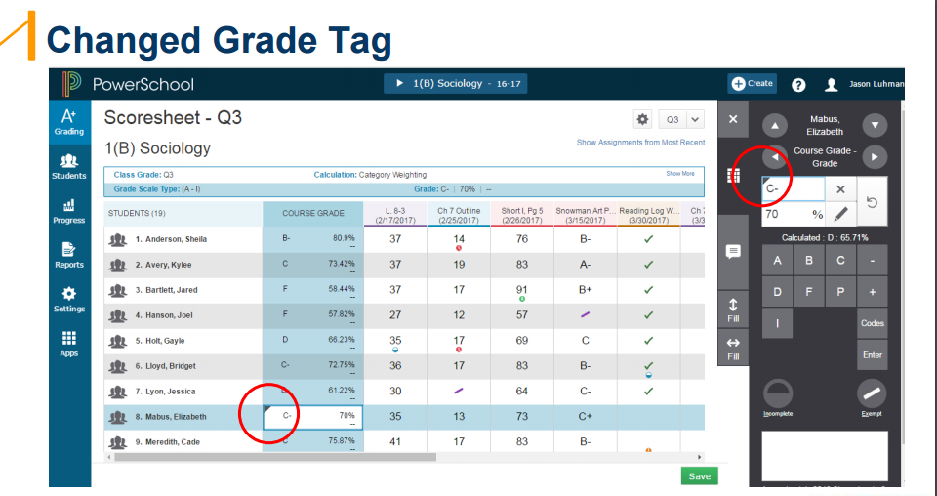

Slide 44
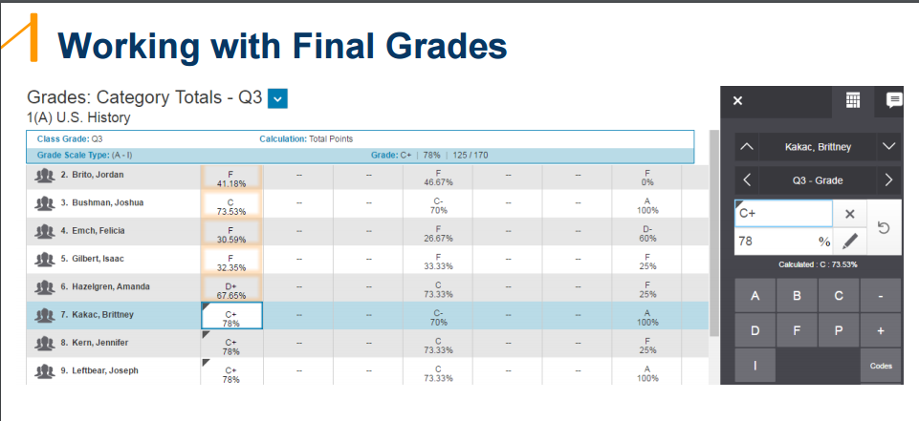

Slide 45
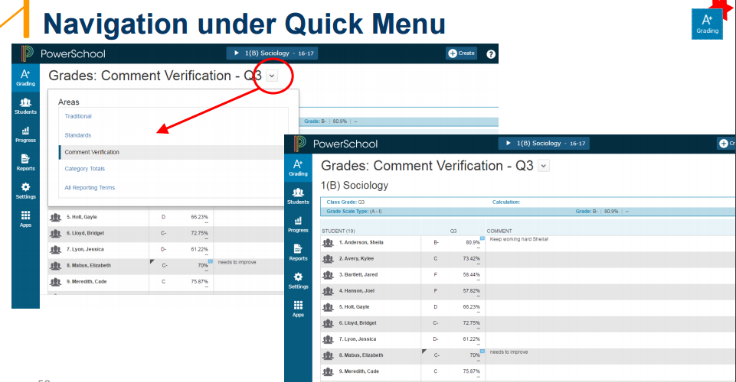

Slide 46
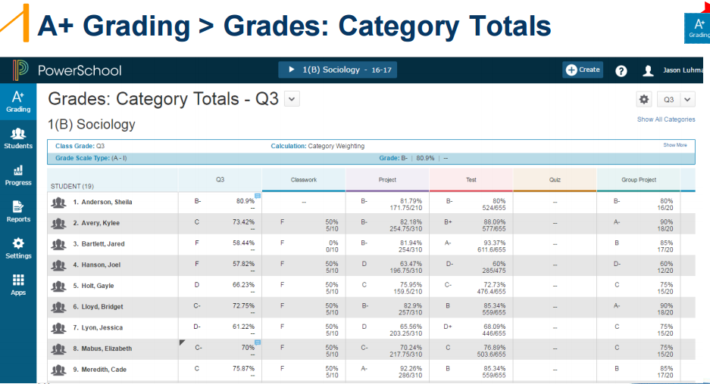

Slide 47
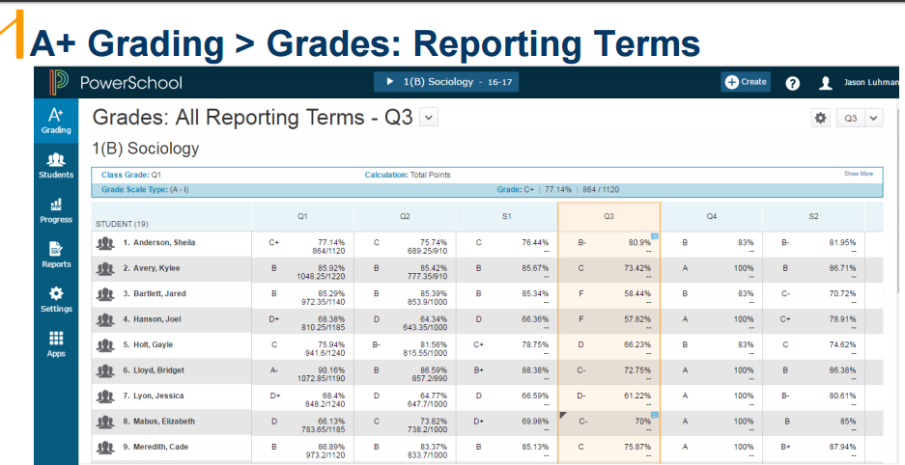
Grades should never be entered into F1. F1 is auto calculated from all the other terms. The only time a grade is entered into F1 is with a Manual Override following a judgement call or extenuating circumstances.

Slide 48
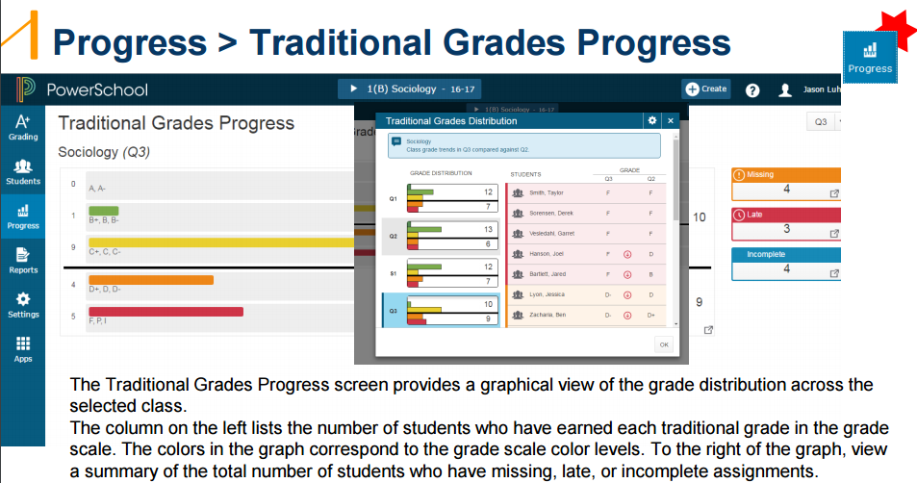

Slide 49
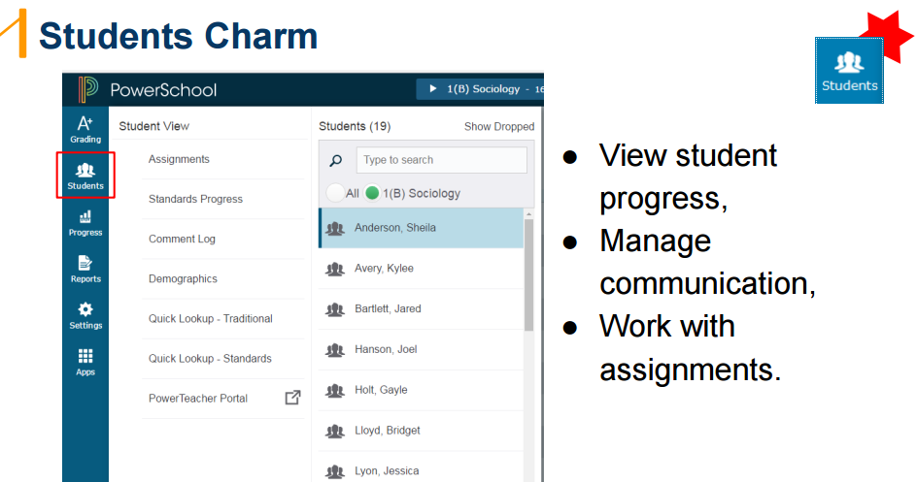

Slide 50
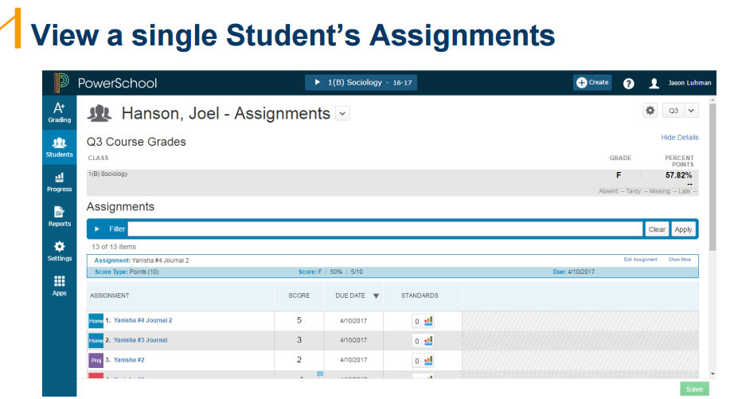

Slide 51
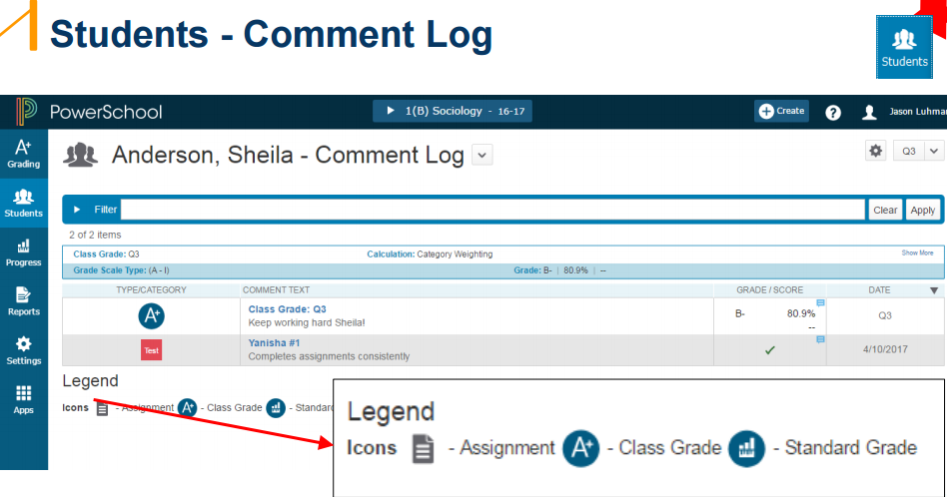

Slide 52
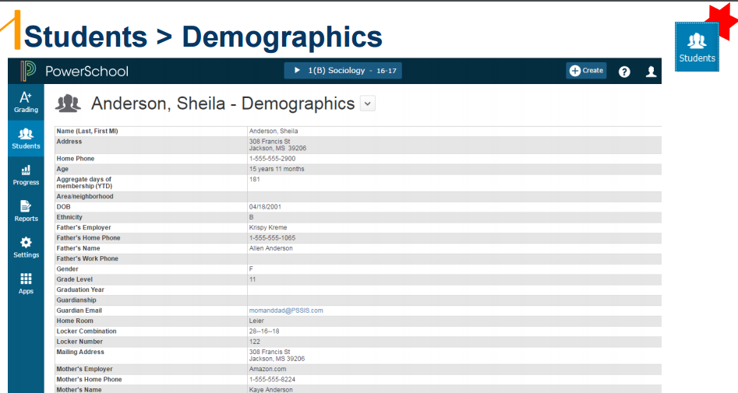

Slide 53
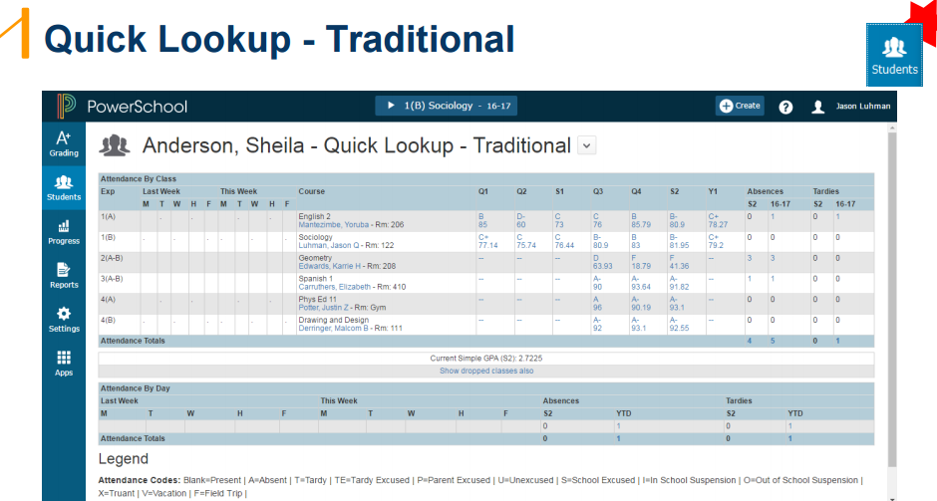

Slide 54
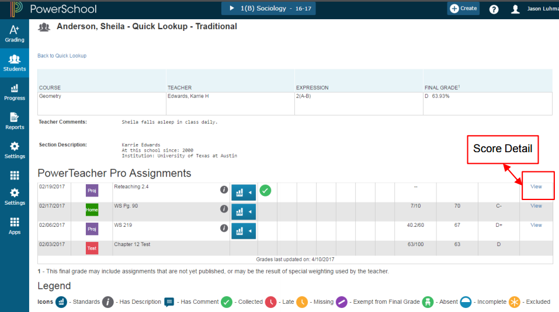
Anything on the page that is blue, can be clicked to drill down for more information.

Slide 55

Parents will be able to see the student’s schedule.

Slide 56


Slide 57


Slide 58


Slide 59


Slide 60


Slide 61


Slide 62


Slide 63
Questions or Concerns?
Debby Penland……………………dpenland@caldwellschools.com
Elizabeth Keller………………….ekeller@caldwellschools.com
Keith Hindman…………………..kehindman@caldwellschools.com
Katrina McEllen………………….kmcellen@caldwellschools.com

