Slide 1

Fair labor standards act
A Few Facts
Presented by
US Department of Labor • Wage and Hour Division

Slide 2
disclaimer
The Department of Labor is providing this presentation as a public service. This resource provides general information and does not carry the force of law or legal opinion. The United States Code Federal Register and the Code of Federal Regulations remain the official sources for statutory and regulatory information from the Department of Labor.

Slide 3
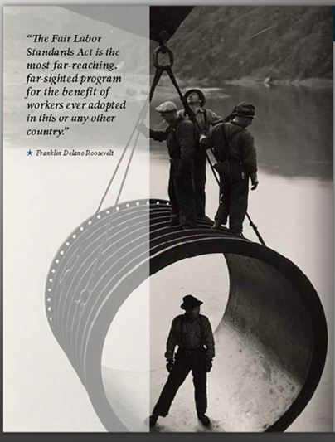
Mission: compliance
To promote and achieve compliance with labor standards to protect and enhance the welfare of the nation’s workforce.

Slide 4
A Little Perspective
1938
2018
10 bills failed before the 11th passed
Signed into law on June 25, 1938
Established the first minimum wage of 25¢ and overtime after 44 hours/week
More than 5,000 complaints in the first 6 months
More than 20 amendments
Overtime due after 40 hours/week
Most recent update to minimum wage was in 2009: Increased to $7.25
More than 143 million workers are protected by the FLSA (That’s almost every worker!)
Over $322million back wages recovered in 2019

Slide 5
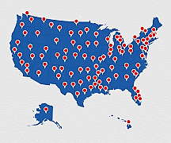
Here, There, Everywhere
More than 200 offices nationwide

Slide 6
Who and How Many
Laws administered by WHD cover more than 9.8 million employers and 143 million workers
Coverage based on engagement in interstate commerce
Employees are protected regardless of immigration status
More than half of investigators are bi-lingual

Slide 7

Laws enforced by whd
Fair Labor Standards Act
Family and Medical Leave Act
Davis Bacon and Related Acts
Service Contract Act
Polygraph Protection Act
Consumer Credit Protection Act: Wage Garnishment
Labor Provisions for some Work Visa Programs

Slide 8
FLSA requirements
Minimum Wage of $7.25 per hour for all time worked
Tipped Employees: $2.13/hr cash wage + tips = $7.25
Deductions may not cut into minimum wage or overtime pay
Most training time is work time and must be paid
Overtime=time and a half the regular rate after 40 hrs worked

Slide 9
FLSA Does Not require
Vacation, holiday, severance, sick pay
Meal or rest periods, holidays off, vacations
Premium pay for weekend or holiday work
Discharge notice, reason for discharge
Limit on number of hours or days employees 16 years or older may work
Pay raises, fringe benefits

Slide 10
Knowledge check
What did you learn?

Slide 11
What does flsa stand for?
Federal Labor Support Association
Fair Labor Standards Act
Federal Labor Standards Act
Free Labor Suppression Act

Slide 12
What does flsa stand for?
B. Fair Labor Standards Act

Slide 13
What is the official source for statutory & Regulatory DOL Information?
Federal Register and the Code of Federal Regulations
United States Code
Neither A or B
Both A and B

Slide 14
What is the official source for statutory & Regulatory DOL Information?
D. Both A and B
Federal Register and Code of Federal Regulations, and the United States Code

Slide 15
How many proposed versions of the flsa failed in congress before the FLSA was passed?
4
10
11
20

Slide 16
How many proposed bills failed in congress before the FLSA was passed?
B. 10

Slide 17
What year was the FLSA signed into law?
1922
1932
1938
1955

Slide 18
What year was the FLSA signed into law?
C. 1938

Slide 19
Which president signed the FLSA into law?
Herbert Hoover
Franklin D. Roosevelt
Harry S. Truman
Dwight D. Eisenhower

Slide 20
Which president signed the FLSA into law?
B. Franklin D. Roosevelt

Slide 21
How much was the first minimum wage?
10¢
25¢
40¢
75¢

Slide 22
How much was the first minimum wage?
B. 25¢

Slide 23
How much is the current minimum wage?
$1.25
$2.13
$4.25
$7.25

Slide 24
How much is the current minimum wage?
D. $7.25

Slide 25
What is the minimum wage for a tipped employee?
$2.13 wage + tips = $7.25/hour
$4.40 wage + tips = $7.25/hour
$2.13/hour wage
$7.25/hour wage

Slide 26
What is the minimum wage for a tipped employee?
A. $2.13 wage + tips = $7.25/hour

Slide 27
Which does the flsa require?
Paid training/meeting time
30 minute lunch break
Extra pay for working on holidays
Yearly pay raises

Slide 28
Which does the flsa require?
A. Paid training/meeting time
Notes:
Subject to the exceptions in CFR 785.27

Slide 29
When is an employee due overtime?
After working 8 hours/day
After working 80 hours/pay period
After working 40 hours/week
After working 44 hours/week

Slide 30
When is an employee due overtime?
C. After working 40 hours/week

Slide 31
Knowledge check
How did you do?

Slide 32
Fair labor standards act
Youth Employment
Presented by
US Department of Labor • Wage and Hour Division

Slide 33
Federal child labor rules: Purpose
Ensure that when young people work, the work is safe and does not jeopardize their health, well-being, or educational opportunities
Serve as a platform from which young workers can explore the “World of Work” while attempting to limit some risk

Slide 34
Federal child labor rules: Reasons
Every year, Tens of thousands of youth under the age of 18 are injured on the job in America
About 1/3 of those typically suffer injuries serious enough to require emergency room treatment
In 2017 (most recent statistic available), BLS reported 22 workplace fatalities for workers aged 17 and under

Slide 35
Federal child labor rules Do Not:
Require minors to obtain work permits
Limit hours or restrict time worked for minors 16 years of age or older
Require breaks or meal periods for minors
STATE LAWS MAY DIFFER !

Slide 36
What if Federal and State Laws Are Different?
Where Federal and State laws differ,
the more protective standard applies

Slide 37
Federal child labor rules: Hazardous Occupations
The FLSA provides a minimum age of 18 years for any nonagricultural occupations which the Secretary of Labor declares to be particularly hazardous for 16- and 17-year-old persons or detrimental to their health and well-being.
Currently there are
17 Hazardous Occupations Orders

Slide 38
HO 1:
Manufacturing or Storing Explosives
Bans youth working where explosives are manufactured or stored.

Slide 39
HO 2:
Driving or Outside motor vehicle helper
minors under age 17 may not drive on public roads as part of their job.

Slide 40

HO 2:
Driving or Outside motor vehicle helper
No employee under 17 may drive motor vehicles on public roads
17 year olds may drive under limited, occasional, incidental circumstances (daylight, less than 20% of work hours, seat belt use, drivers ed, etc.)
Bans driving for delivery work
Bans driving for route sales
Bans driving that involves towing
Bans driving of golf carts, ATVs, and motorcycles on public roads
Prohibits the transportation of others
Bans working as an outside helper on motor vehicles (riding on motor vehicles outside the cab for the purpose of assisting in transporting or delivering goods)

Slide 41
HO 3: coal mining
bans most jobs in coal mining.

Slide 42
HO 4:
Logging and sawmilling
bans most jobs in logging, timbering (including cutting firewood), and in sawmills.

Slide 43
HO 5:
Power Driven Woodworking machines
bans the operation of most power driven woodworking
machines, including saws, stapling machines, nailing
machines, and sanders.
*This HO provides a limited exemption for 16-and 17-year-olds who are bona-fide student learners and apprentices.

Slide 44
HO 6: exposure to radioactive substances and ionizing radiation
bans exposure to radioactive materials.

Slide 45
HO 7: power driven hoisting apparatus
bans the operation of and riding on most power driven hoisting apparatus such as freight elevators, bobcats, cherry pickers, boom trucks, cranes, scissor lifts, and most high lift trucks, including forklifts.
Notes:
Exception: 16 and 17-year-olds may ride on a freight elevator operated by an assigned operator.

Slide 46
HO 7: power driven hoisting apparatus
also bans operating and riding on smaller hoists, such as those used for lifting patients in nursing facilities and hospitals except under certain conditions.

Slide 47
HO 8: power driven metal forming, punching, and shearing machines
bans the operation of certain power driven metal working machines, including rolling machines, apron brakes, and drop hammers.
*This HO provides a limited exemption for 16-and 17-year-olds who are bona-fide student learners and apprentices.

Slide 48
HO 9: mining, other than coal
Bans most jobs in mining at metal mines, quarries, and other mining sites including underground work in mines, work in or about open cut mines, open quarries, clay pits, and sand and gravel operations.

Slide 49
HO 10: power driven meat processing machines
Bans the operation of power driven meat processing machines, such as meat slicers, saws, and meat choppers even if used on items other than meat. Also bans all occupations in slaughtering, processing, and packing.
*This HO provides a limited exemption for 16-and 17-year-olds who are bona-fide student learners and apprentices.

Slide 50
HO 11: power driven bakery machines
Bans the operation of power driven machines such as vertical dough mixers, some batter mixers, dough rollers, and dough sheeters.

Slide 51
HO 12: power driven paper products machines
Bans the operation of paper products machines, including balers and compactors.
16- and 17-year-olds can load certain power-driven compactors and balers
*This HO provides a limited exemption for 16-and 17-year-olds who are bona-fide student learners and apprentices.

Slide 52
HO 13: manufacturing of brick, tile, and related products
Bans most involvement in the manufacture of clay construction products and of silica refractory products.

Slide 53
HO 14: power driven saws and other cutting machines
Bans operation of various types of power driven band saws, circular saws, guillotine shears, chain saws, reciprocating saws, wood chippers, and abrasive cutting discs, regardless of the items being cut.
*This HO provides a limited exemption for 16-and 17-year-olds who are bona-fide student learners and apprentices.

Slide 54
HO 15: wrecking, demolition, and ship breaking
Bans all work performed at the site of a building demolition, including clean up and salvage work. Also bans dismantling of a building, bridge, steeple, tower chimney, ships, or other structures.

Slide 55
HO 16: roofing
Bans all work in roofing operations, including work performed on the ground or in close proximity to the roof.
*This HO provides a limited exemption for 16-and 17-year-olds who are bona-fide student learners and apprentices.

Slide 56
HO 17:
Excavation
Bans most jobs in trenching and excavation work, including working in a trench more than 4 feet deep.
*This HO provides a limited exemption for 16-and 17-year-olds who are bona-fide student learners and apprentices.

Slide 57
Knowledge check
What Work Can I Do at Ages 16-17?

Slide 58

On or about roofing
NO

Slide 59
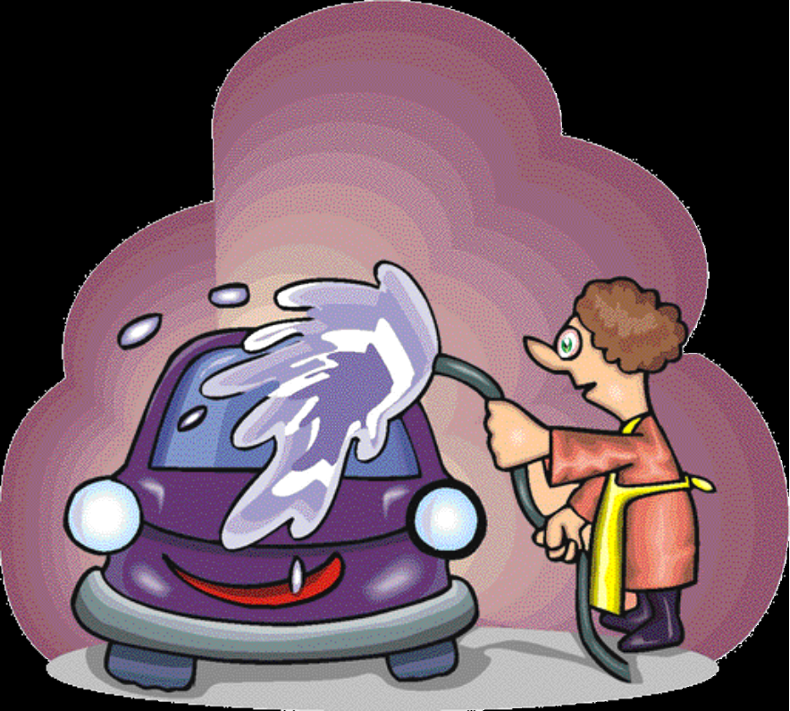
Car wash attendant
Yes

Slide 60

Retail sales & Service
Yes

Slide 61

demolition
NO

Slide 62

Pizza Delivery Driver
NO

Slide 63

Chain saw
NO

Slide 64

Community pool Lifeguard
Yes

Slide 65

Grocery bagger
Yes

Slide 66

Clerical worker
Yes

Slide 67

dishwasher
Yes

Slide 68

server
Yes

Slide 69

Meat slicer
NO
Notes:
16 and 17-year-olds may operate bacon slicers.

Slide 70

Golf attendant
Yes

Slide 71

excavation
NO

Slide 72

Scissor lift
NO

Slide 73

tutor
Yes

Slide 74
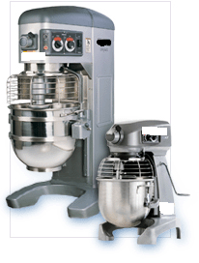
Dough mixer
NO
Notes:
There is an exception for 16 and 17-year-olds to operate small counter top mixers similar to those used in households.

Slide 75

forklift
NO

Slide 76
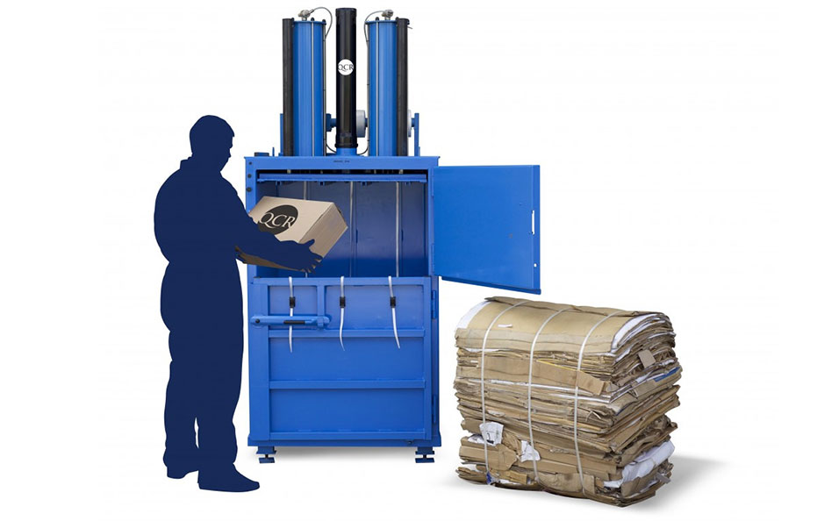
Compactor or baler
NO
Notes:
16- and 17-year-olds cannot operate, but may load certain power-driven compactors and balers.

Slide 77

Wood chipper
NO

Slide 78
Knowledge check
How did you do?

Slide 79
SPECIAL RULES FOR WORKERS UNDER 16
14 and 15 year olds
  May work outside school hours and for limited periods of time; only non-manufacturing,
  non-hazardous jobs, and specific conditions apply
Children under 14
  With limited exceptions, no employment permitted in covered, non-agricultural occupations

Slide 80
14 and 15-year olds may work only…
Up to 3 hours on a school day, including Fridays;
Up to 18 hours during a week when school is in session;
Up to 8 hours on a non-school day;
Up to 40 hours during a week when school is not in session.

Slide 81
Times When 14- and 15-Year-Olds May Work
Between 7 AM and 7 PM; or
Between 7 AM and 9 PM from June 1 through Labor Day; and
Outside school hours

Slide 82
Jobs 14 and 15-year olds can do
If an occupation is not specifically permitted, it is prohibited for youth ages 14 and 15. Jobs that are allowed include:
Office and clerical work
Cashiering and selling
Price marking, assembling orders, packing
Bagging and carrying out customers’ orders

Slide 83
More allowable jobs…
Errands and deliveries by foot, bike, bus or train
Certain clean-up work and yard work
Pumping gas and hand cleaning cars
Kitchen work, preparing and serving food (but very limited cooking)

Slide 84
More allowable jobs…
Most cooking is prohibited, but 14- and 15-year-olds may:
  Cook with electric or gas grills that do not entail cooking over an open flame, and
  Cook with deep fryers that are equipped with and utilize automatic devices that raise and lower the baskets in and out of the hot oil or grease.

Slide 85
Work 14 and 15-year-olds may not do:
Manufacturing and Mining
Most processing occupations
Operating power-driven equipment
Transportation and Communications
Warehousing and storage
Construction

Slide 86
Work 14 and 15-year-olds may not do:
Work in or about boiler or engine rooms
Maintenance or repair of a building or equipment
Work in freezers and meat coolers
Outside window washing
Baking

Slide 87
Work 14 and 15-year-olds may not do:
Work involving power-driven food slicers and grinders, choppers or cutters and bakery mixers
Loading and unloading goods to and from trucks, railcars or conveyors
Work in areas where meats are prepared for sale
All occupations declared to be hazardous for 16- and 17-year-olds

Slide 88
If you’re under 14…
If you are under the age of 14, you are only allowed to do the following jobs:
deliver newspapers to customers
babysit on a casual basis
work as an actor or performer in movies, TV, radio, or theater
work as a homeworker gathering evergreens and making evergreen wreaths; and
work for a business owned entirely by your parents as long as it is not in mining, manufacturing, or any of the 17 hazardous occupations.
Be sure to check your state’s work laws, as states have different rules and employers must follow both: https://www.dol.gov/agencies/whd/state

Slide 89
Tips for young workers
Know your rights as an employee
Know what you legally may and may not do
Be aware of your surroundings
Politely say “No” when asked to do something that is illegal or something you don’t feel you can do safely

Slide 90

Get more info
www.YouthRules.dol.gov
www.dol.gov/whd
1-866-487-9243 (1-866-4US-WAGE)

