Slide 1
Caldwell County
Volunteer Tracker Login
How can I sign up to chaperone field trips?
How can I sign up to volunteer for the school?

Slide 2
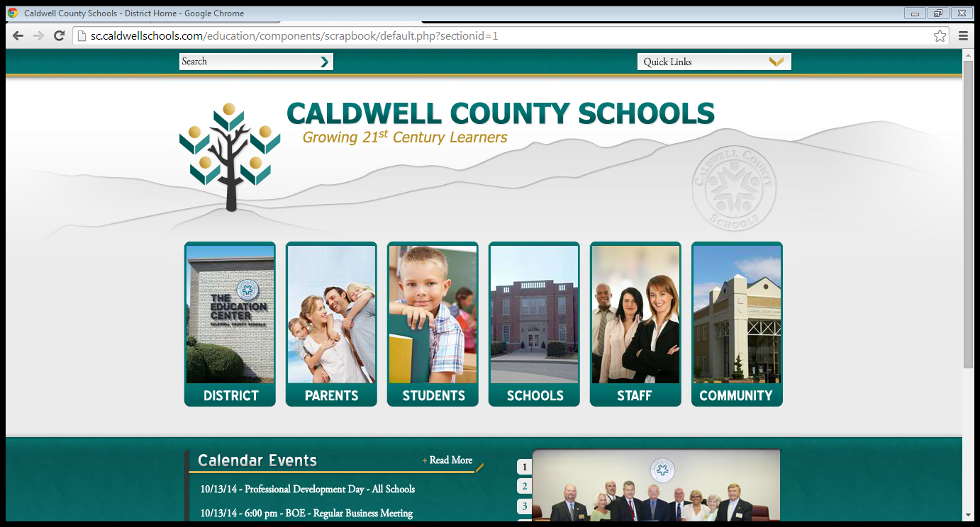
Step 1 - Log on to Caldwell County Schools website
Step 2 – Find the column labeled Community
Step 3 – Click on the link for “Volunteers” inside the Community column

Slide 3
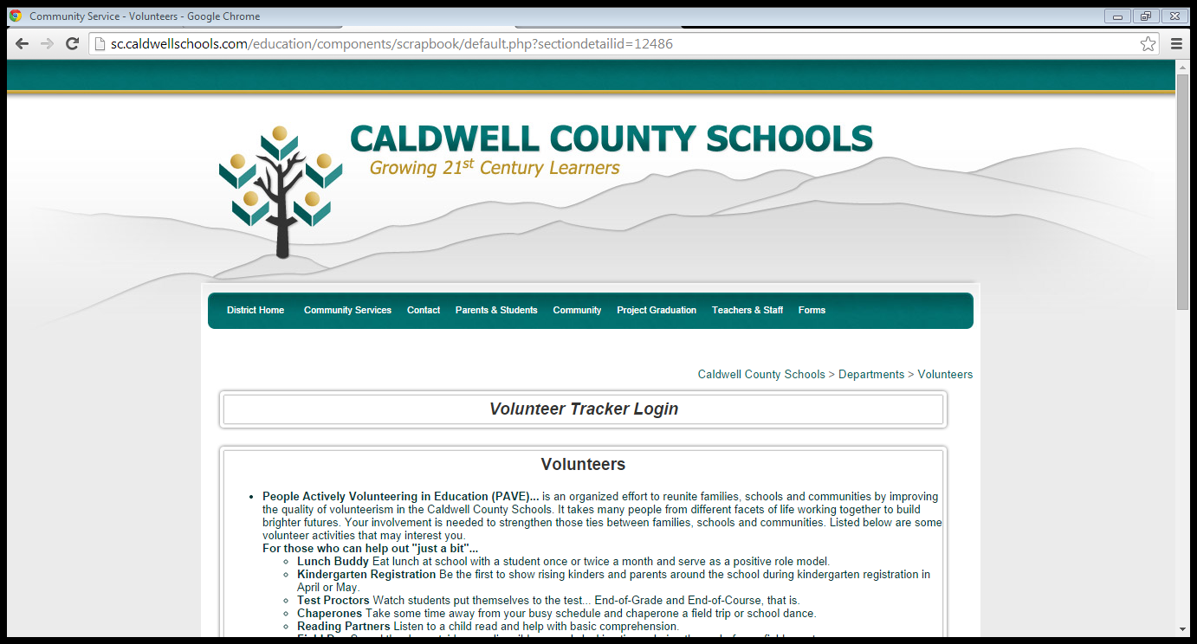
Step 4 – Click on Volunteer Tracker Login

Slide 4
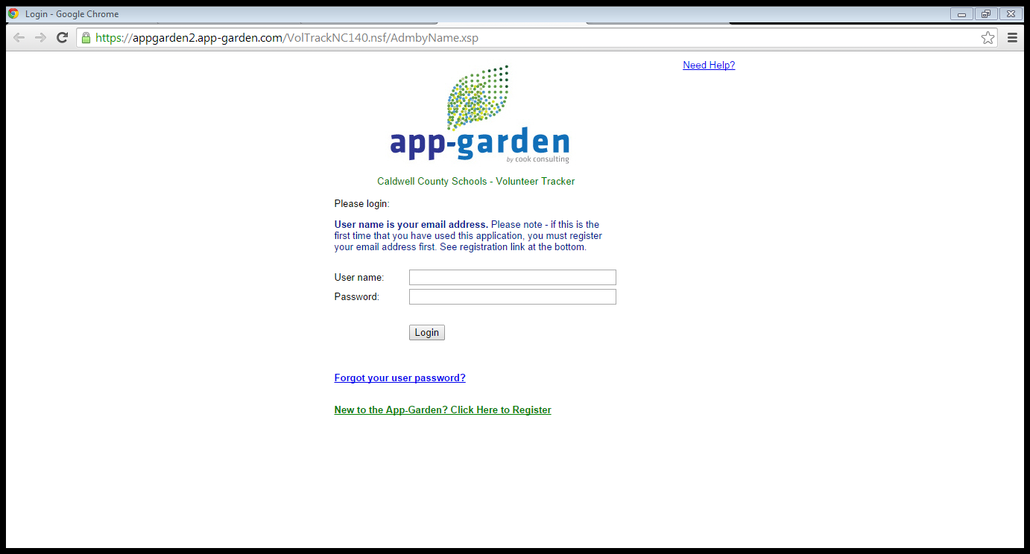
Step 5 – If you have already signed up go ahead and log in with your username and password.
If you have NOT signed up click on the link below to register.

Slide 5
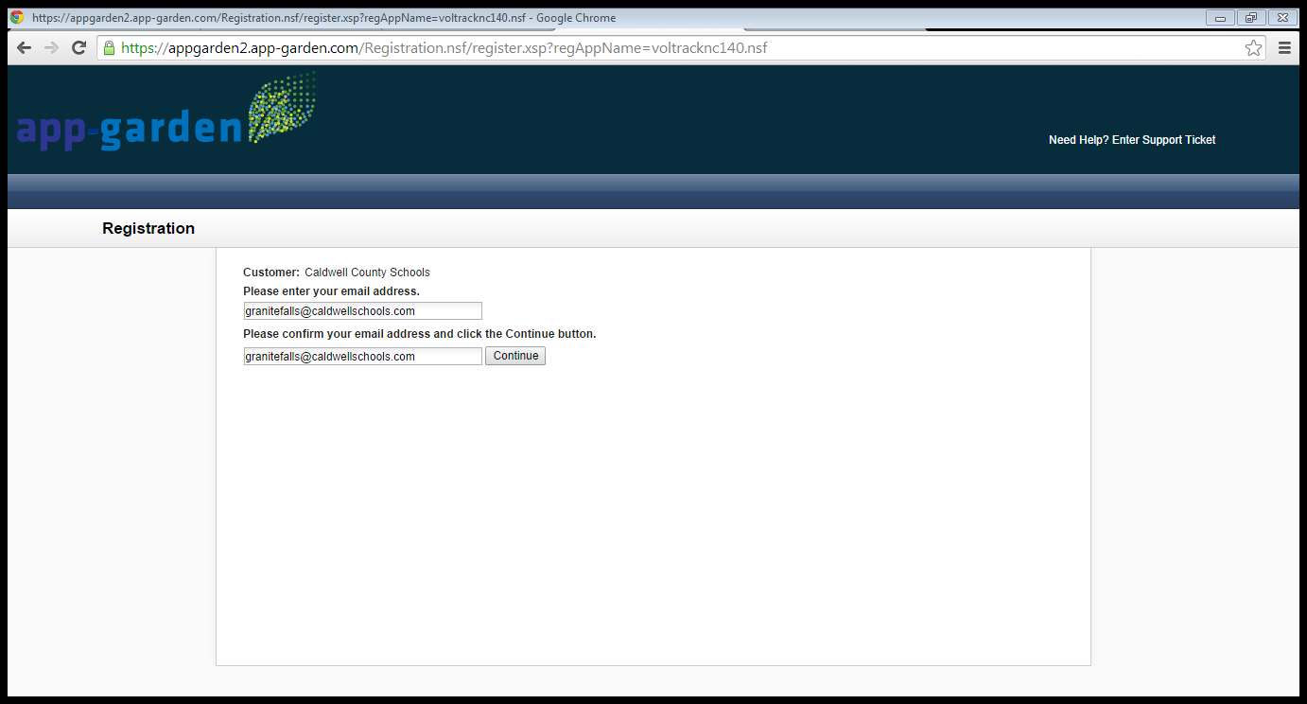
The link for registration will bring you to the screen below.
Type in your preferred email address and click “continue”.
You will then receive an email to validate your registration.
Log in to your preferred email account and follow the instructions given.

Slide 6
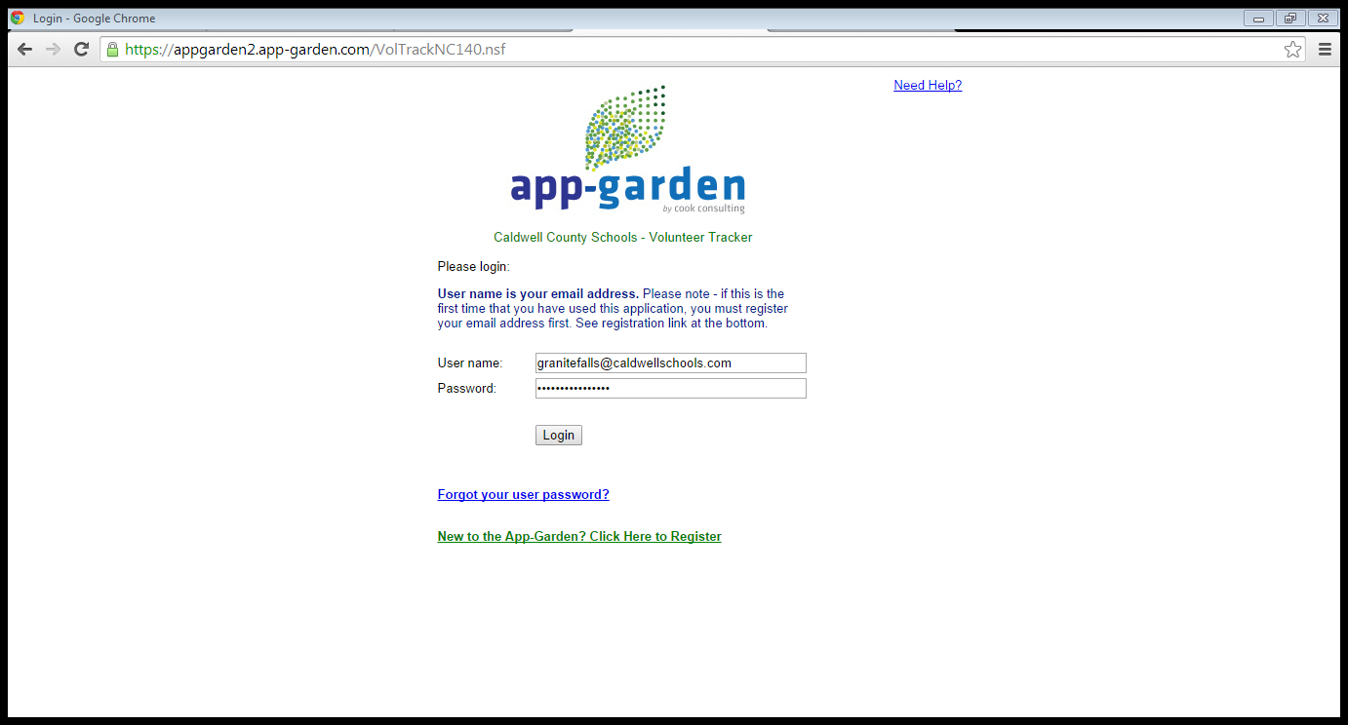
Once you have activated your account via the link sent to your email account the program will take you to the screen below.
Step 7 – Enter your email address as your username and your personally created password. Then click on login.

Slide 7
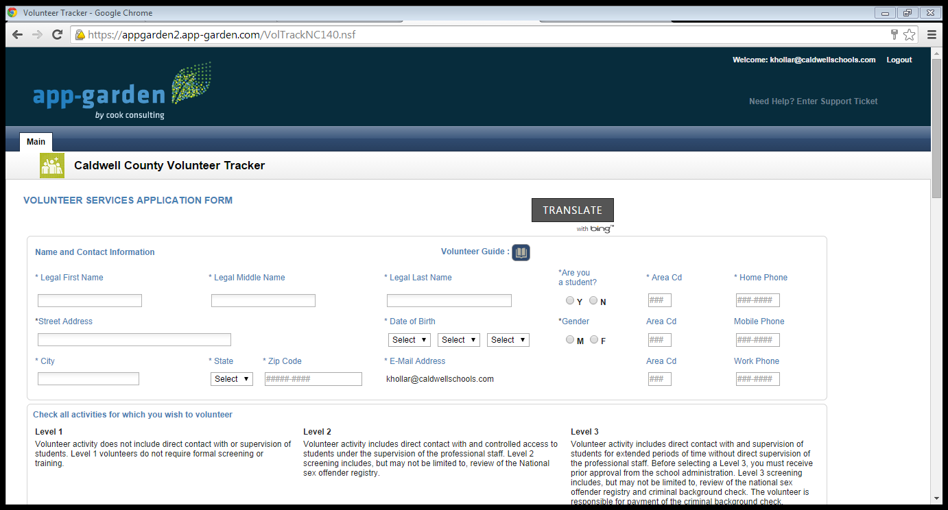
This screen will allow you to sign up as a volunteer for a variety of activities. There are 3 levels that you can choose to participate. Levels 2 and 3 require screenings and/or a background check. Level 3 is the level you would click to volunteer as a field trip chaperone. It is listed as “Chaperone for School Activity”.
Step 8 - Fill out all information on this screen. Remember to click all boxes that interest you. Please remember that Level 3 requires a background check. The cost of the background check is the parent’s responsibility.

Slide 8
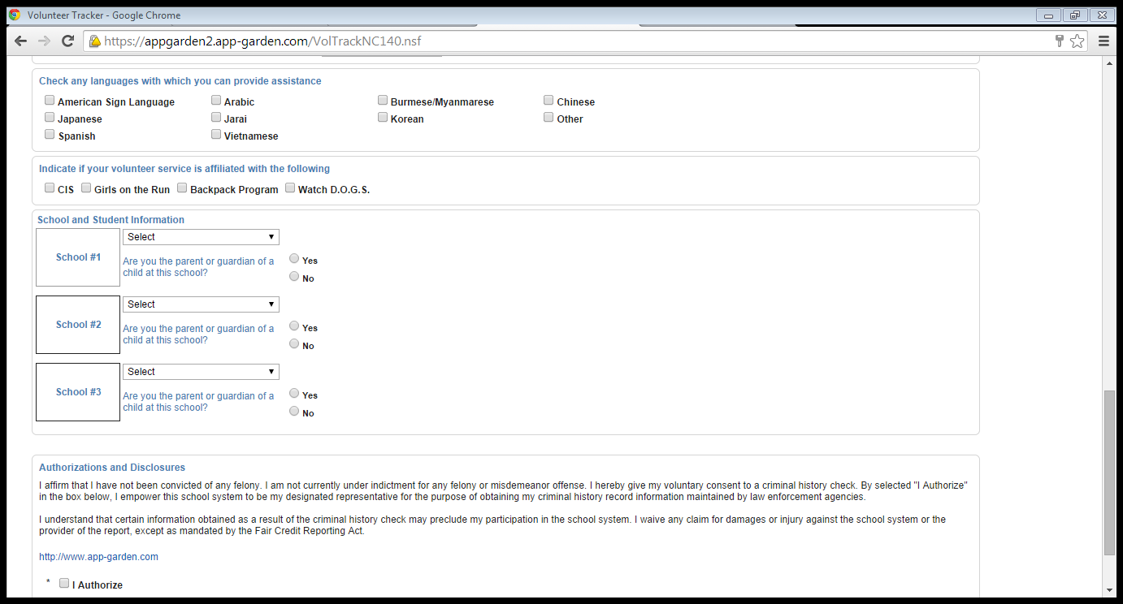
Continue to scroll down and fill out all information.
Notice that you can volunteer for up to 3 different schools. This makes the process much easier if you have students in different levels or at different schools.

Slide 9
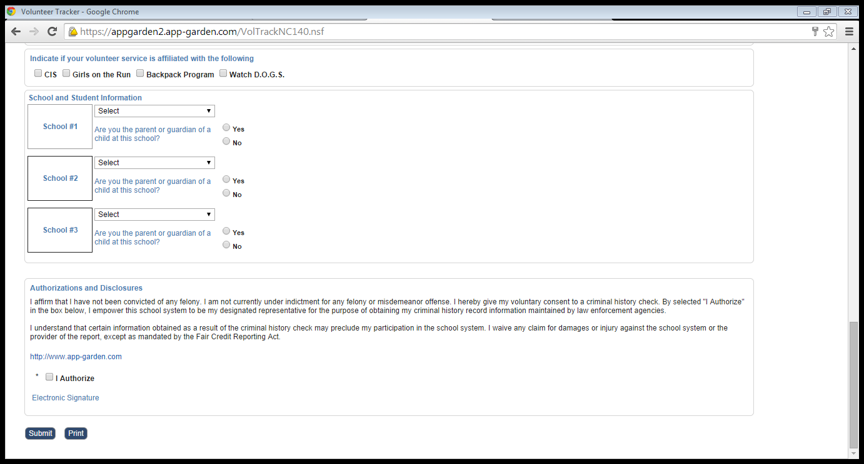
Once you have completed all information requested, notice the last box.
Step 9 - Check the “I Authorize” box once reading the authorizations and disclosures portion. Remember that by checking this box and submitting this request the cost is your responsibility if approved.
Step 10 – Click “Submit”. You are finished!
Please be patient with the background checks as they may take longer to process.

Slide 10

Thank you for supporting Granite Falls Elementary School. If you have any questions about this program please call 828 – 396 – 2222.

