Slide 1
Caldwell County
Volunteer Tracker Login
How Do I Renew My Background Check?

Slide 2
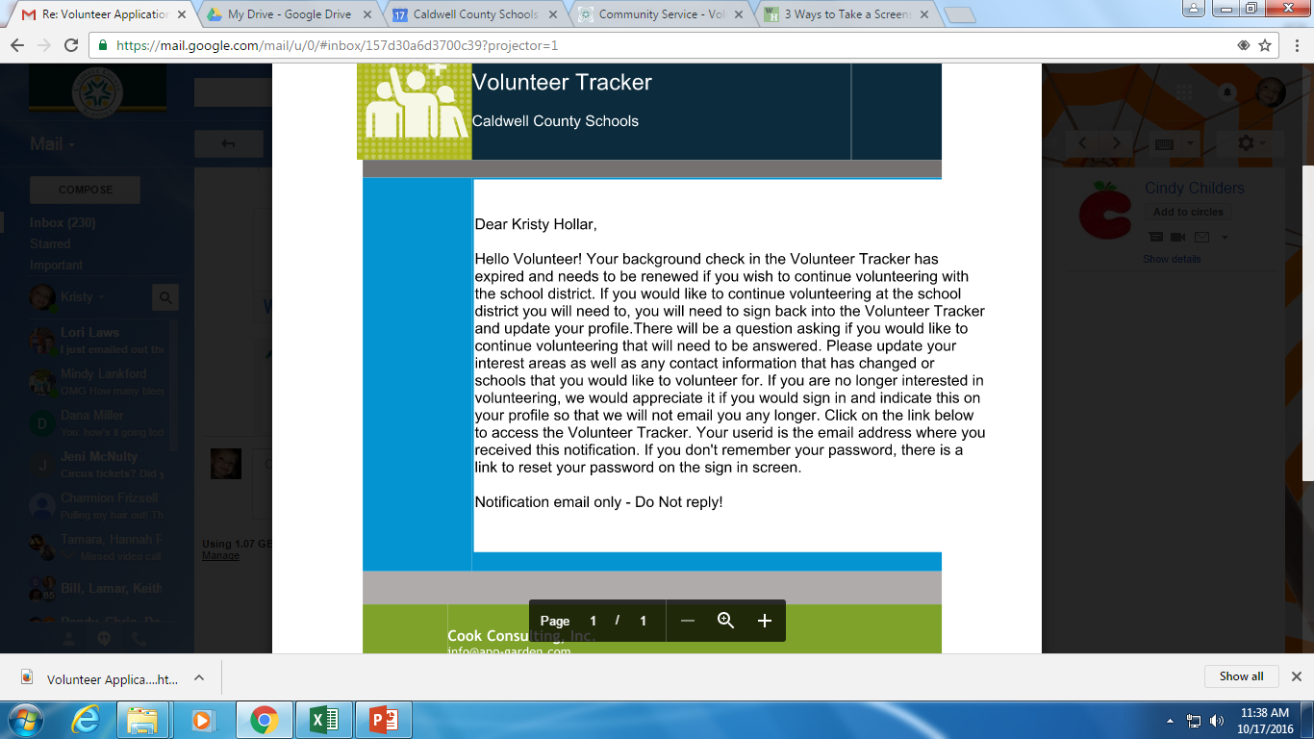
You should have received an email from Volunteer Tracker letting you know that your background check has expired. This is what mine looked like as an example.

Slide 3
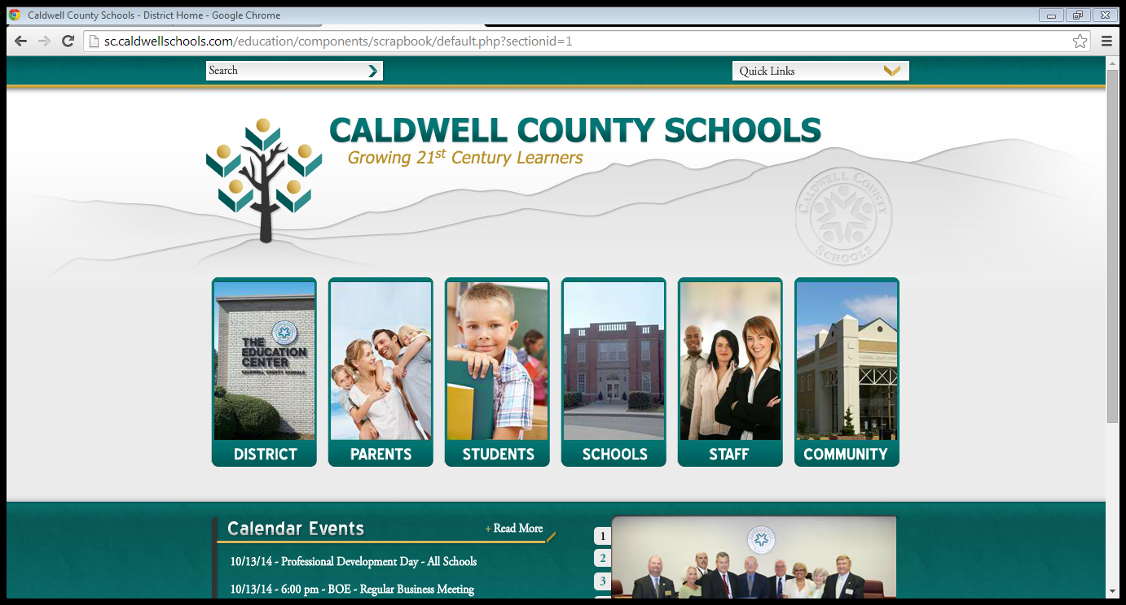
Step 1 - Log on to Caldwell County Schools website
Step 2 – Find the column labeled Community
Step 3 – Click on the link for “Volunteers” inside the Community column

Slide 4
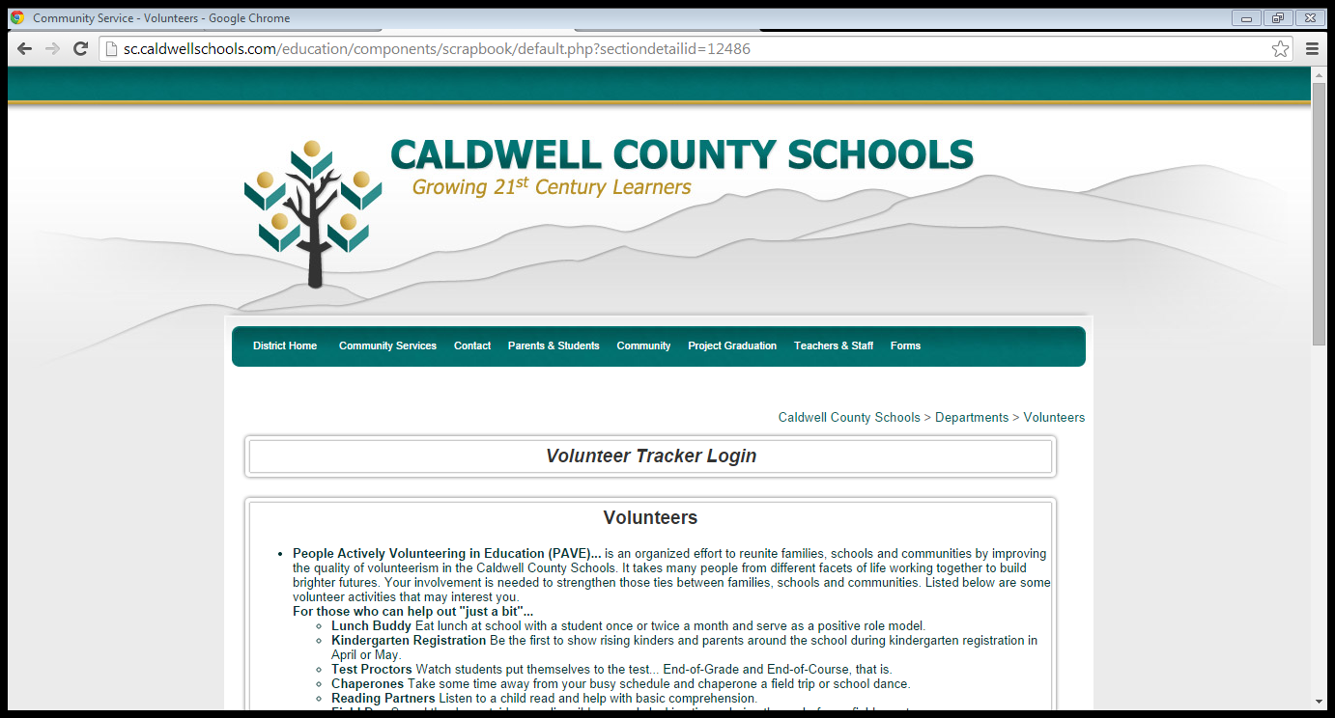
Step 4 – Click on Volunteer Tracker Login

Slide 5
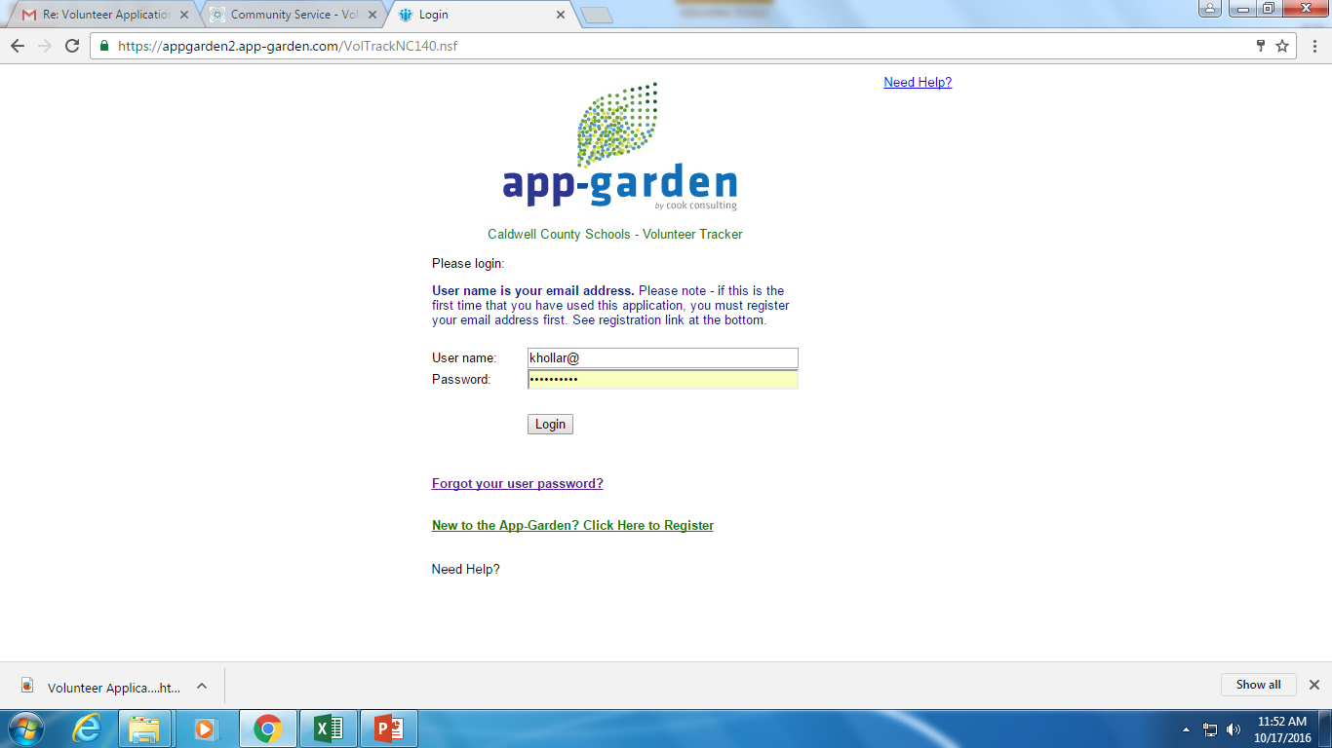

Slide 6
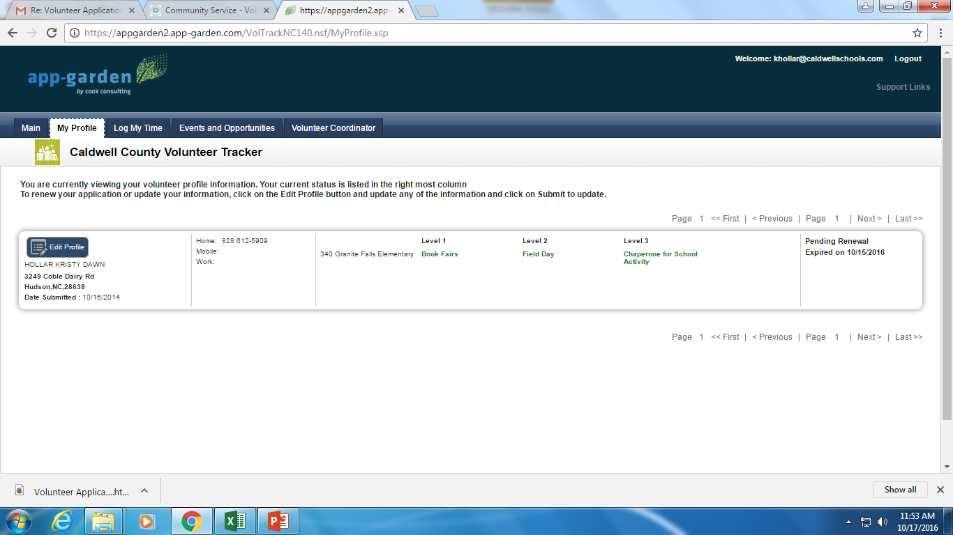
Once you have entered the main site click on “My Profile”. Then click on “Edit Profile”.

Slide 7
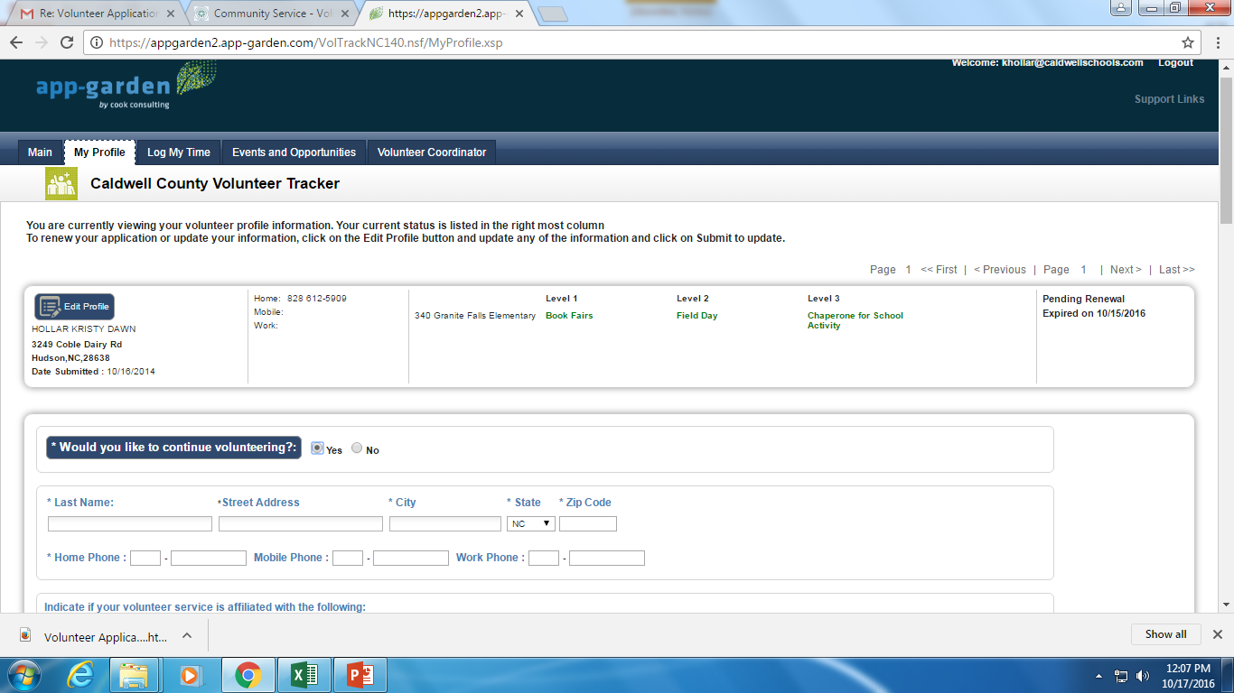
Continue to edit your profile, making sure that all of the information is still correct. If anything has changed or if you would like to add any activities please make sure that you do so at this time. ***Do not move forward without clicking YES to the question circled in red if you still want to volunteer.

Slide 8
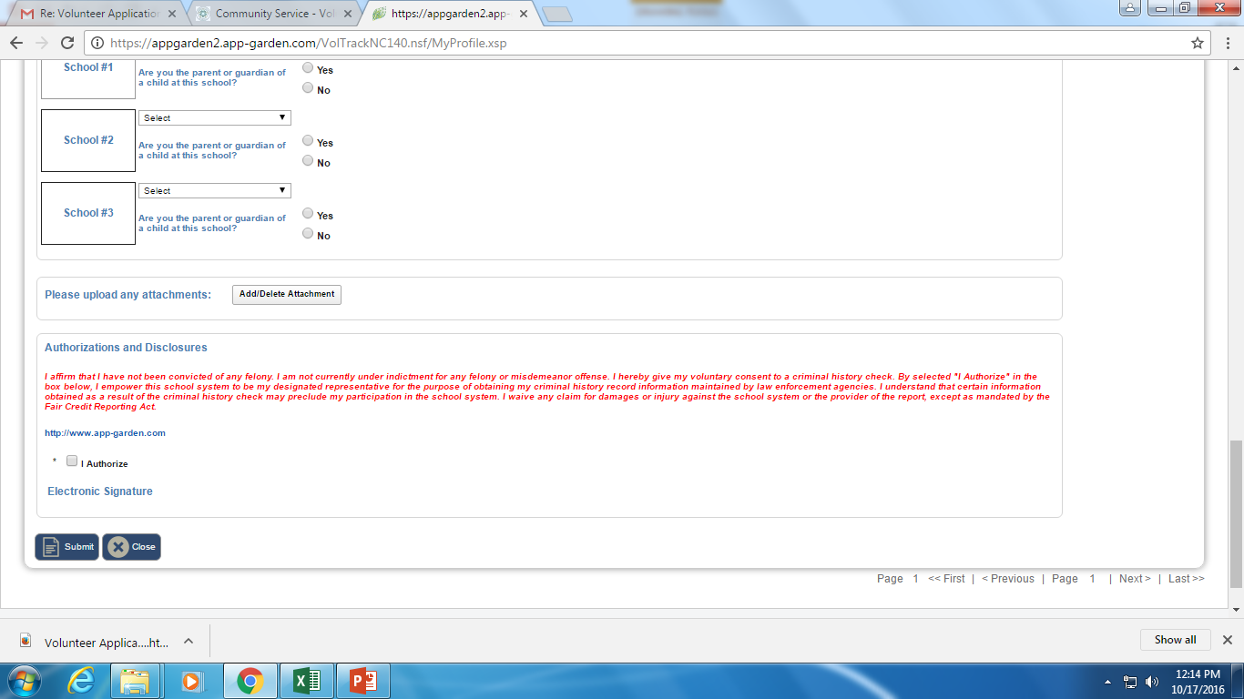
Last Steps to Follow:
Select ALL of the schools where you have children in attendance.
If you want to chaperon a field trip click the box beside of “I Authorize”
Click on Submit and you have renewed for two more years! ☺

