Slide 1
T
F
L
O
S
S
Value
Means light and dark

Slide 2
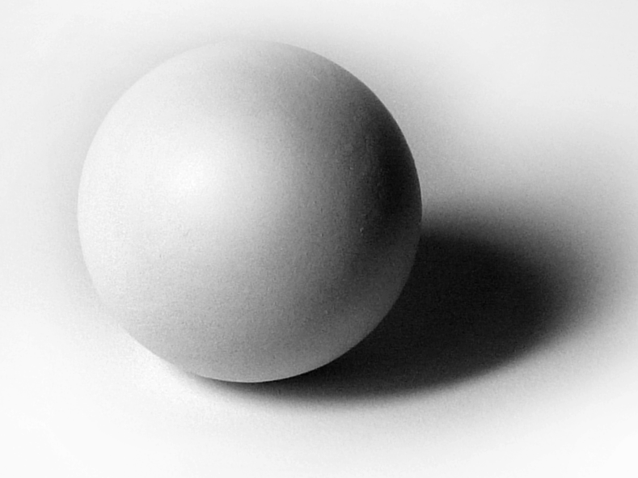
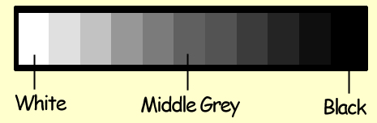
Forms are defined by values. Without value they would appear to look flat and unrealistic.

Slide 3

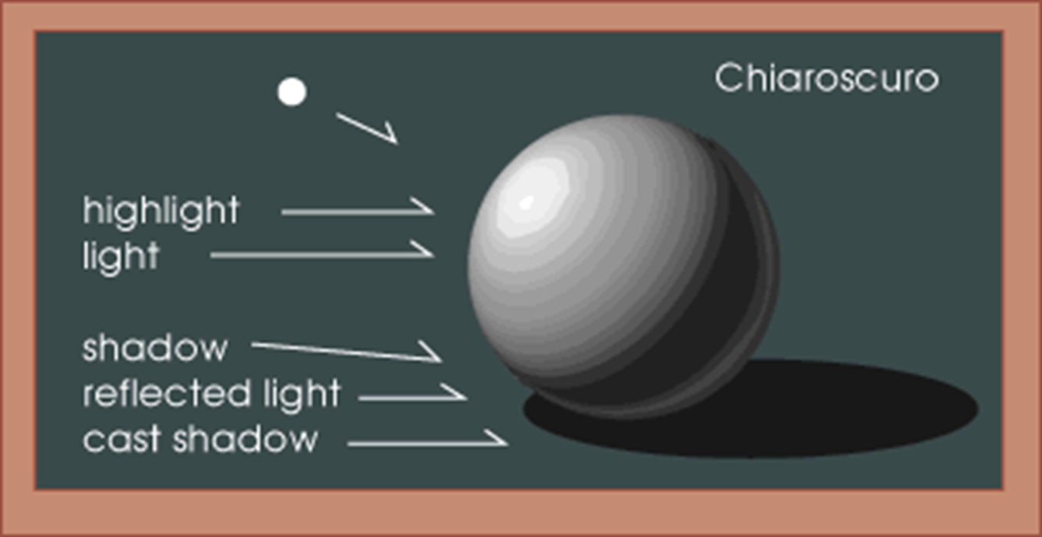
When using value to create a form there should be a smooth transition as well as a refractive light and a cast shadow.

Slide 4
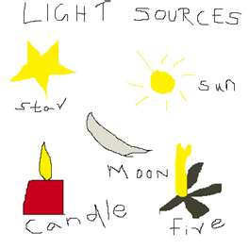

Everything we SEE is somehow illuminated or lit by some light source.
Without light we see NOTHING!
Most people can distinguish 30-40 value gradations between black and white.

Slide 5
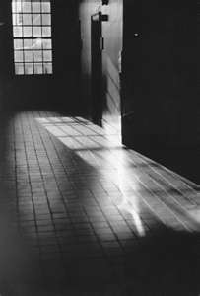
Value is also known as Chiaroscuro
Chiaroscuro - Italian term meaning light and dark values.
value is often described visually by a scale with varying shades of gray arranged between black and white. But remember that colors have values also.

Slide 6
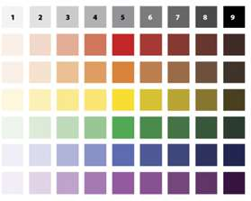
Another way to think about a grey scale…
It is a series of spaces filled with the tints and shades of one color, starting with white or the lightest tint on one end, and gradually changing into the darkest shade or black on the other.

Slide 7
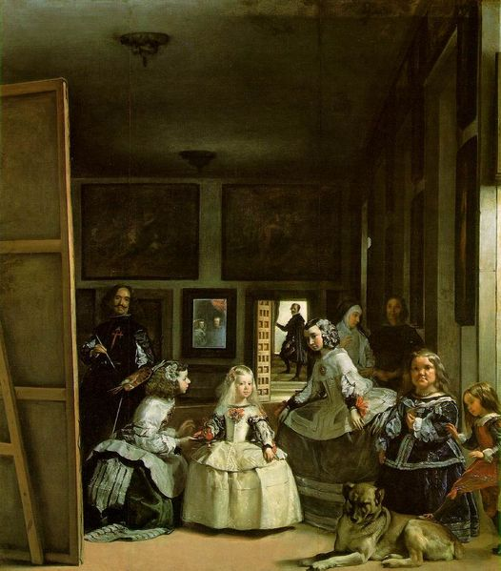
Diego Velazquez, Las Meninas, 1656
Value demonstrates depth. Objects in the foreground appear to have greater variety in value. (more whites and extremely darker values)
Objects in the background have little variety in value and increases in lightness.

Slide 8
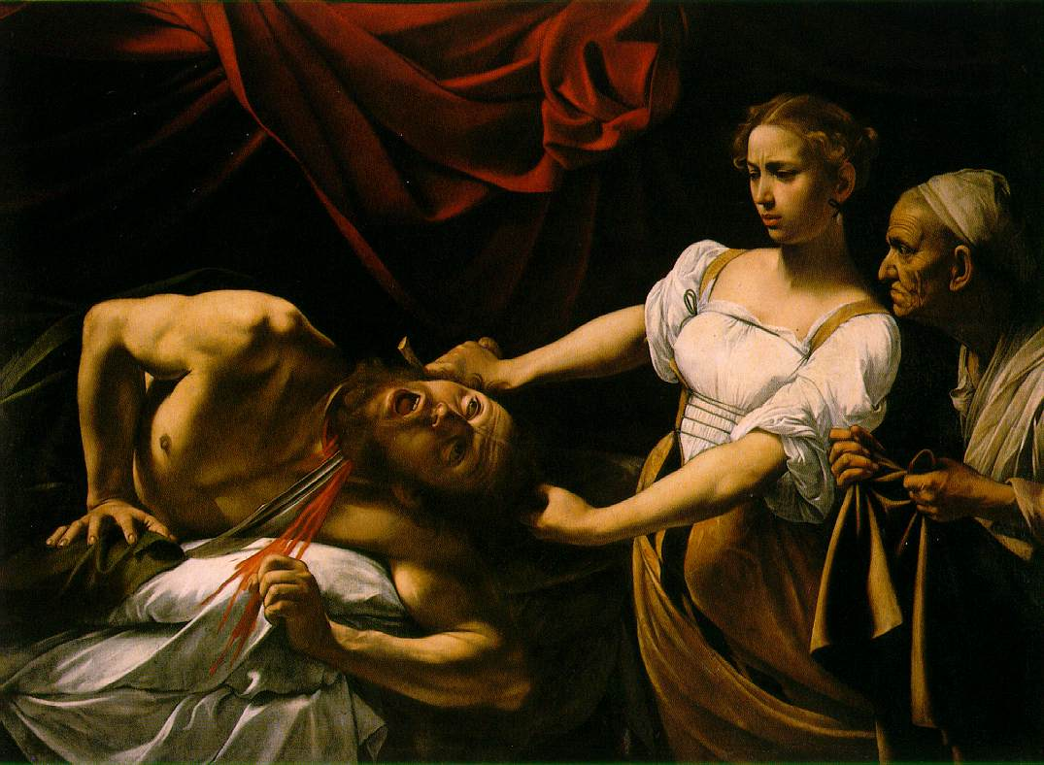
Judith Beheading Holofernes, 1598-1599

Slide 9
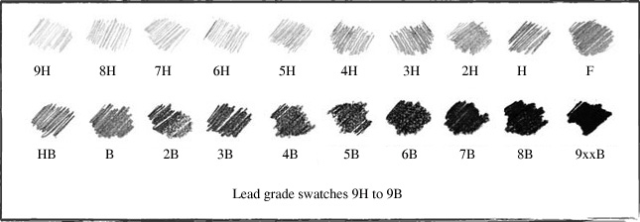
Drawing Pencils
The softer leads (B’s) appear darker.
The harder leads (H’s) appear lighter.
These pencils provide greater craftsmanship and no matter the type of lead, should be used with the same amount of pressure.

Slide 10
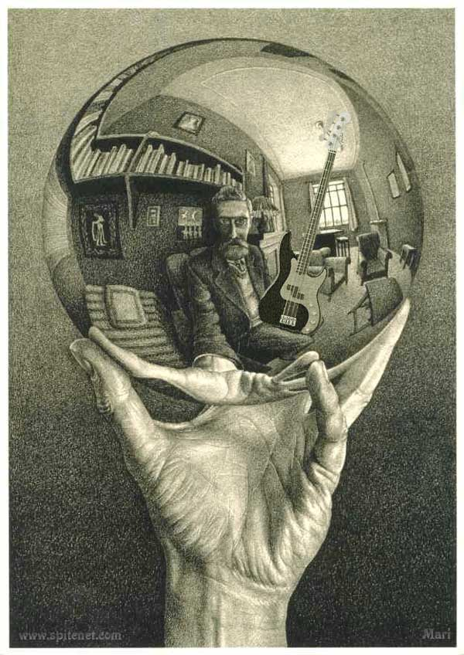
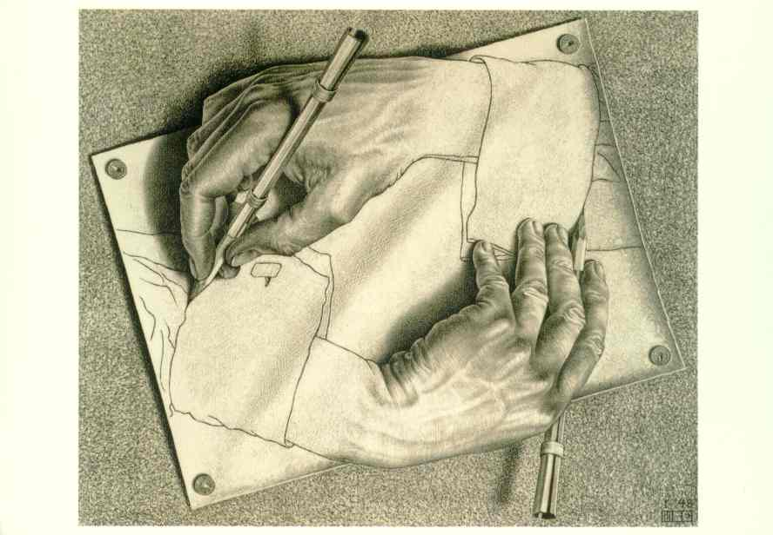
M.C Escher
Drawing Hands, 1948 (above)
Hand with Reflecting Sphere, 1935
(left)

Slide 11
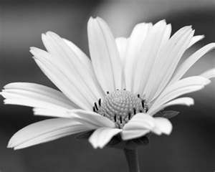
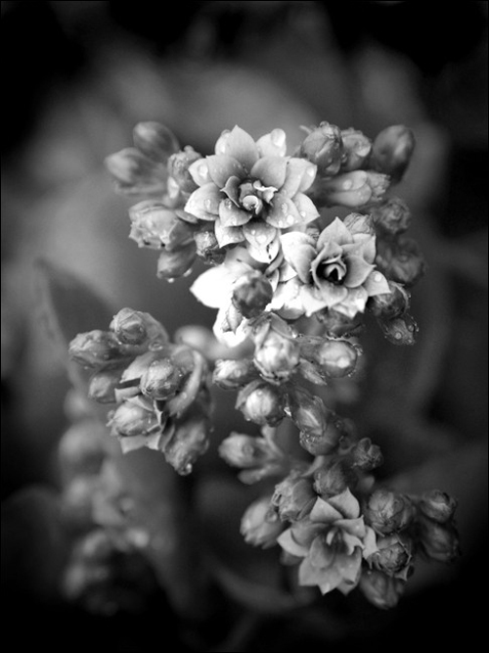
For a more realistic image…
….Define objects and space with value differences, rather than a defined outline!

Slide 12
Today…
In your sketchbooks create a 10-step value scale. Use only your pencil to achieve the values. Remember the amount of pressure will give you different values.
Draw at least two forms showing a light source, cast shadow, and multiple values

Slide 13
Tomorrow…
We will talk about different techniques that allow us to achieve values using pen and ink.
Create 6 different value scales with these new techniques.
Draw a double bubble map that will compare and contrast graphite vs. pen and ink, individually and as a group.

