Slide 1
Vocabulary for Plants
6th Grade Science

Slide 2
Vocabulary: click for definition
1. petals: one of the often colored segments of a ?flower.
2. stem: the stalk that supports a leaf, flower, or ?fruit, which ordinarily grows in an opposite direction ?to the root.
3. sepals: One of the usually separate, green parts ?that surround and protect the flower bud and extend ?from the base of a flower after it has opened.
4. stamen: the pollen-bearing organ of a flower, ?consisting of the filament and the anther. It is the male part of the flower.
5. anther: the pollen-bearing part of a stamen.

Slide 3
Vocabulary: click for definition
6. ovules: the part of the plant, which after fertilization, develops into a seed. It is the egg of the flower.
7. pistils: the seed-bearing parts of a flower. It is the female part of the flower.
8. fertilization: the union of parts of a plant to reproduce cells. It’s what causes plants to grow. Products like Miracle Grow cause fertilization at a quicker speed.
9. pollination: the transfer of pollen from the anther to the stigma.
10. pollen: the fertilizing element of flowering plants, consisting of fine, powdery, yellowish grains or spores, sometimes in masses.

Slide 4
Vocabulary: click for definition
11. photosynthesis: the process by which plants, algae, and some bacteria use sunlight, carbon dioxide and water to make food.
12. cellular respiration: the process by which cells use oxygen to produce energy from food.
13. chlorophyll: a green pigment that captures light ?energy for photosynthesis.
14. glucose: The most common form of sugar, found extensively in the bodies of living things; a molecule ?composed of carbon, oxygen, and hydrogen.
15. stomata: slits in the outer layer of leaves, stems, etc., through which gases are exchanged

Slide 5
Vocabulary: click for definition
16. transpiration: the process by which plants release water vapor into the air through stomata; also the release of water vapor into the air by other organisms.
17. carbon dioxide: colorless, odorless, incombustible gas, CO 2, that is used by plants in photosynthesis.
18. oxygen: a waste product of green plants and photosynthesis
19. guard cells: cells surrounding each stoma that help to regulate the rate of transpiration by opening and closing the stomata.

Slide 6
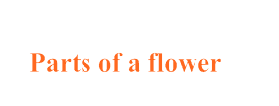
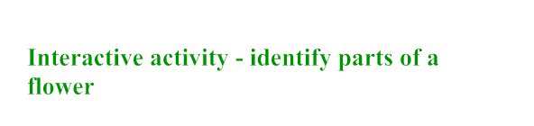
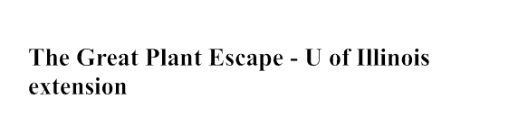
Try each one of these links...

