Slide 1
Charcoal
Plant Study
Materials: photo reference, charcoal, 18 x 24 paper

Slide 2
Students will…
Compose a 18x24 charcoal drawing of plant life using a photo reference.
Utilize a personal reference with a strong composition. (cropping may be used to enhance composition.)
Create a flat wash of watercolor in the back ground. Use watercolor to enhance the composition.
Focus will be placed on the Elements of LINE, SPACE, TEXTURE, AND VALUE, as well as the Principles of CONTRAST, UNITY, and BALANCE.
A focal point will be established through textural detail and/or value contrast.
Forms are defined by a change in texture and value, not outline.

Slide 3
Catching and Keeping Your Viewers’ Eye
Rules for Creating an Intriguing Composition:
ﻼ No Attention to Corners
ﻼ No Direct Attention to Middle
ﻼ Odd # of Objects
ﻼ Keep Viewers’ Eye Moving THROUGHOUT the Composition, not OFF the Composition.
ﻼ Crop Objects (If cropped too much, then the eye has less shape and positive/negative space to keep it interesting.)
ﻼ Offer a Detailed Focal Point (Place in which a viewer’s eye is naturally drawn.)

Slide 4
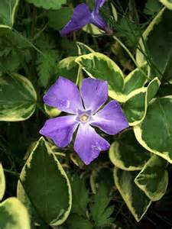
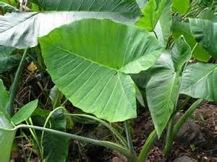

Slide 5
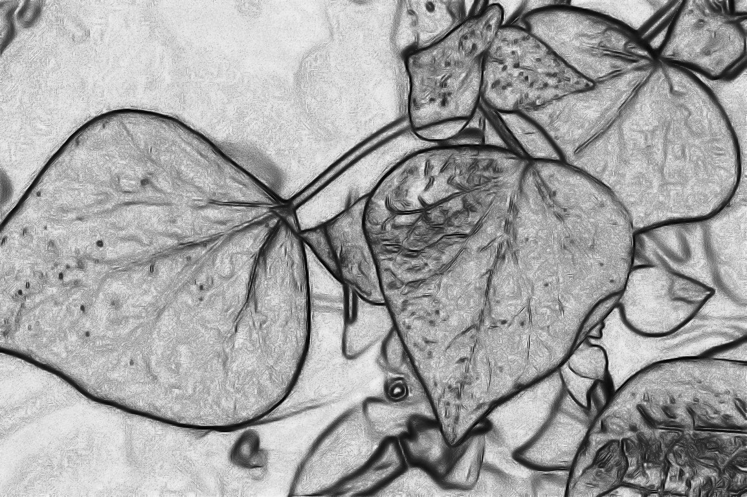
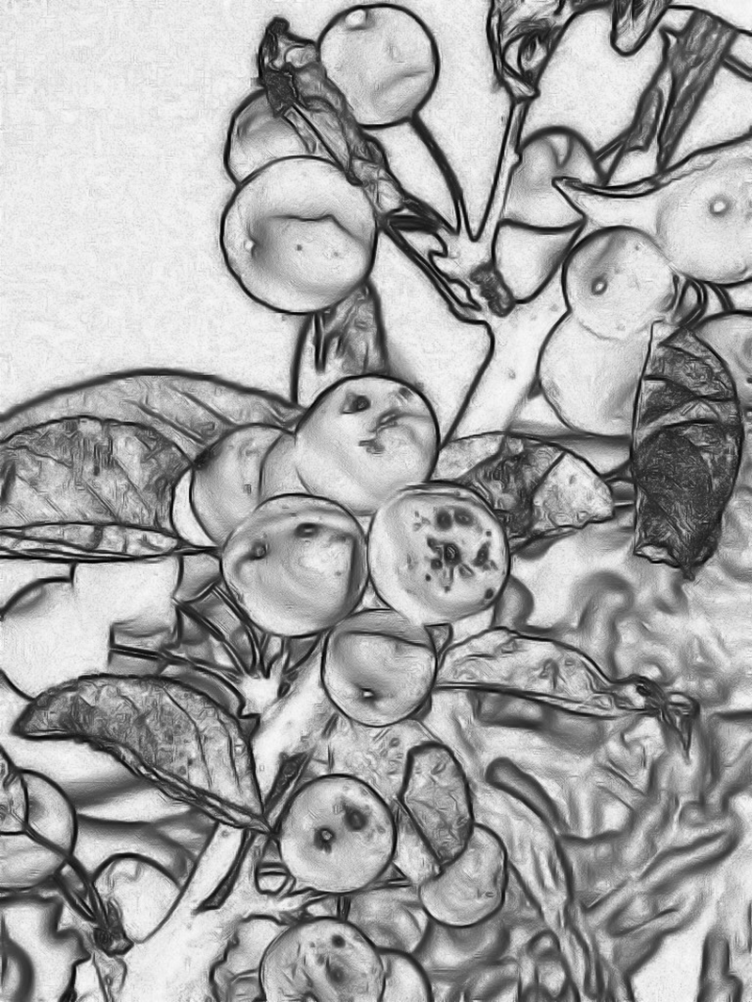

Slide 6
