Slide 1
5th grade warm-up this week:
Contest Book 3
Set 4 Olympiad 1E
4th grade warm-up this week:
Contest Book 3
Set 3 Olympiad 4A
4. January 1, 1990 was a Monday. What day of the week was February 1, 1990?
4. In all how many whole numbers between 400 and 600 are divisible by 9?
Notes:
These are examples of math warm-ups that we do once a week. They are from the Math Olympiad program. Coltrane has a great standing tradition of winning at the county wide Mathlete competition.

Slide 2

Program Overview for Parents
Notes:
*

Slide 3

Academically gifted: student performs well above grade level in one or more academic areas. “Strong student”
Intellectually gifted: student possesses a high I.Q./ aptitude score in comparison to peers. Has the ability to learn new information quickly.
Gifted programs VARY by county/state. Each has unique placement criteria.
“One program does not fit all”
Notes:
*

Slide 4
The Powerschool Identifiers
AIG Academically & Intellectually Gifted | Student has high aptitude and elevated math and reading achievement
AM Academically Intellectually Gifted Math Only | Student has high aptitude and elevated math achievement
AR Academically Intellectually Gifted Reading Only | Student has high aptitude and elevated reading achievement
IG Intellectually Gifted | Student has extremely high aptitude (98-99%ile)
Notes:
Talking Points: Students may not have demonstrated high achievement in the missing area at this point- but they will have chances each year on the EOG. Sometimes students are truly only gifted in only one academic area- and parents and teachers need to be aware of that and accommodate accordingly. Students may also be gifted in areas like science, history, or arts but these are not measured on standardized tests
IG- students may not have had a chance yet to demonstrate high achievement (particularly in 3rd grade after NNAT, before EOGs) or the student may be underachieving compared to their demonstrated achievement. This should be monitored carefully and goals need to be set to improve academic achievement.

Slide 5
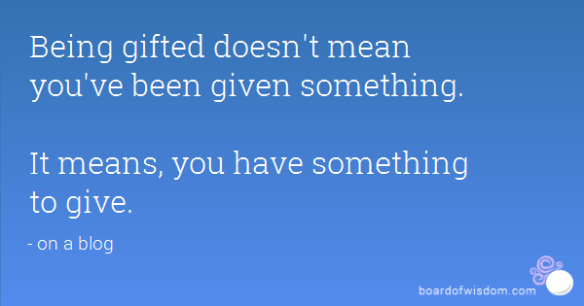
The Implications of being GIFTED… something to ponder….
Giftedness is a mix of “something you ARE” and ”something” you DO.
Dr. Annemarie Roeper
The Gifted Teen Survival Guide
Gifted children must be taught SKILLS- not just content, so that they can adapt to a future of inevitable career changes.

Slide 6

Cabarrus County School is working to meet the unique needs of our gifted learners in a variety of ways…
Let’s take a look…

Slide 7

Navigate units are being added to 3rd, 4th and 5th grade AIG curriculum
4th grade | 5th grade
Neuroplasticity Multiple intelligences Growth Mindset ”My Gifted Brain” poetry | Research Real World PBL 6 Profiles of Gifted Learners Advocacy

Slide 8

How Neuroplasticity Supports Growth Mindset
Neuroplasticity is the brain’s ability to change, adapt, and “rewire” itself throughout our entire life.
The brain creates new connections, and strengthens them with increased use.

Slide 9

How do I teach my child about brain function?
Children should be reminded frequently that they have the ability to learn new and diverse skills, and that every brain has an “elastic” quality to it. They also need to be reminded that mistakes are GOOD because they are a vital part of learning.

Slide 10
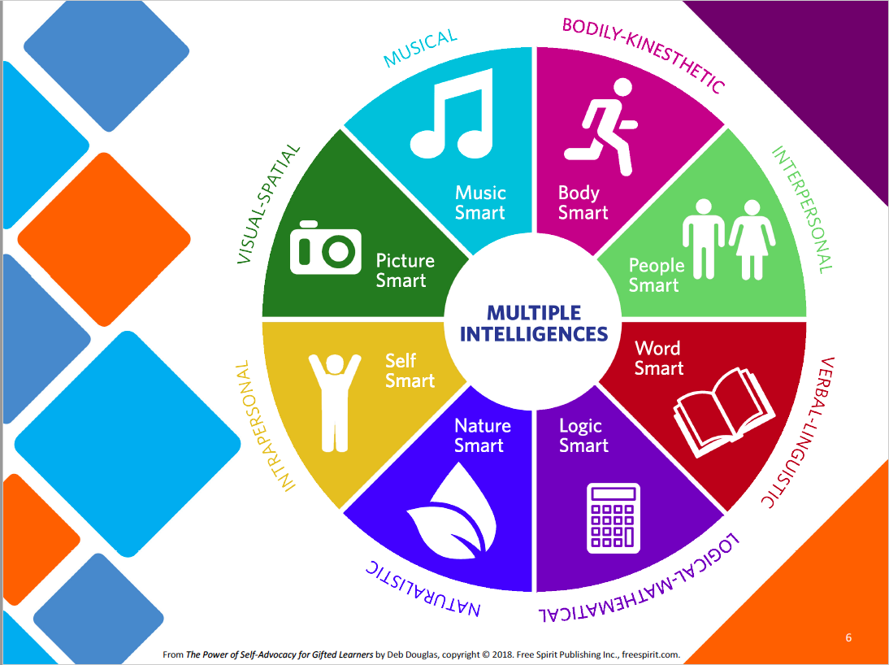
Notes:
Students will take a look at their multiple intelligences this year. Parents can support their gifted learner at home by being aware of their child’s interests and skills as they relate to the multiple intelligences. We will encourage our gifted learners to set goals for practicing some of their “weaker intelligences” this year.

Slide 11
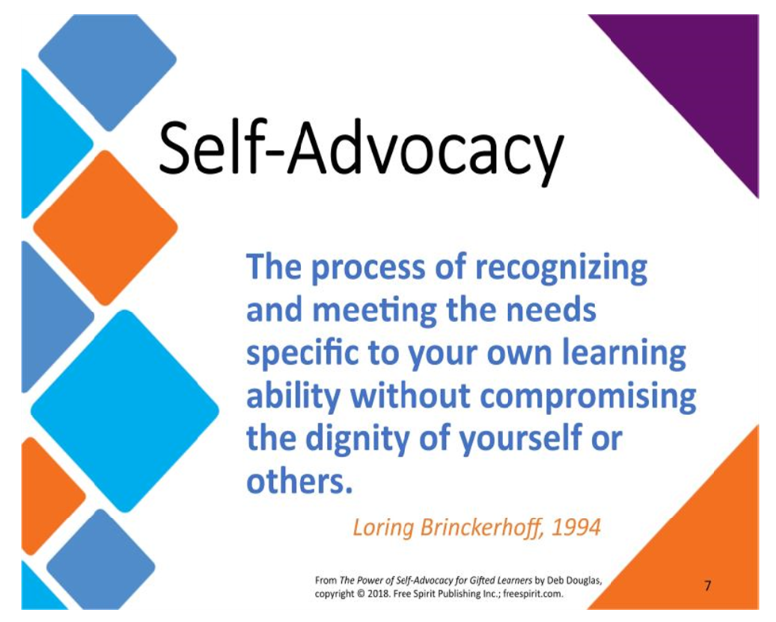
Notes:
Advocacy can be a delicate thing- especially for children. We have to teach them that they do have the RIGHT to have their educational needs met as much as anyone else, but that there are MANY types of learners that also have a right to have their needs met too. We are all equally entitled to this- and when we advocate we must be respectful and mindful of that fact. We do not want to isolate ourselves or polarize ourselves in the process.

Slide 12
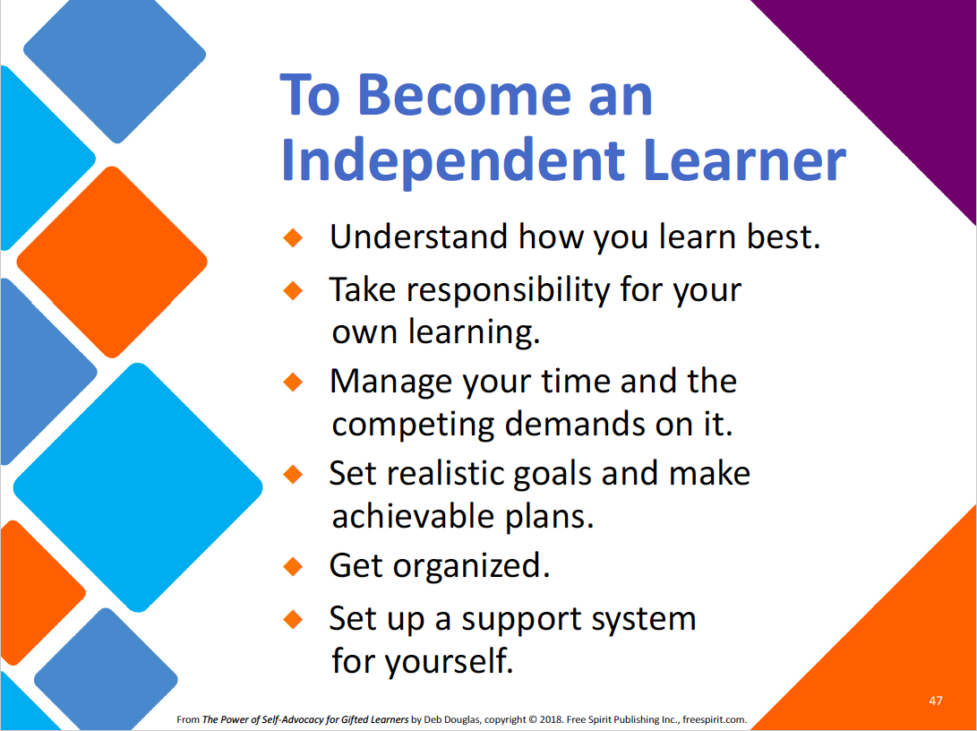

Slide 13
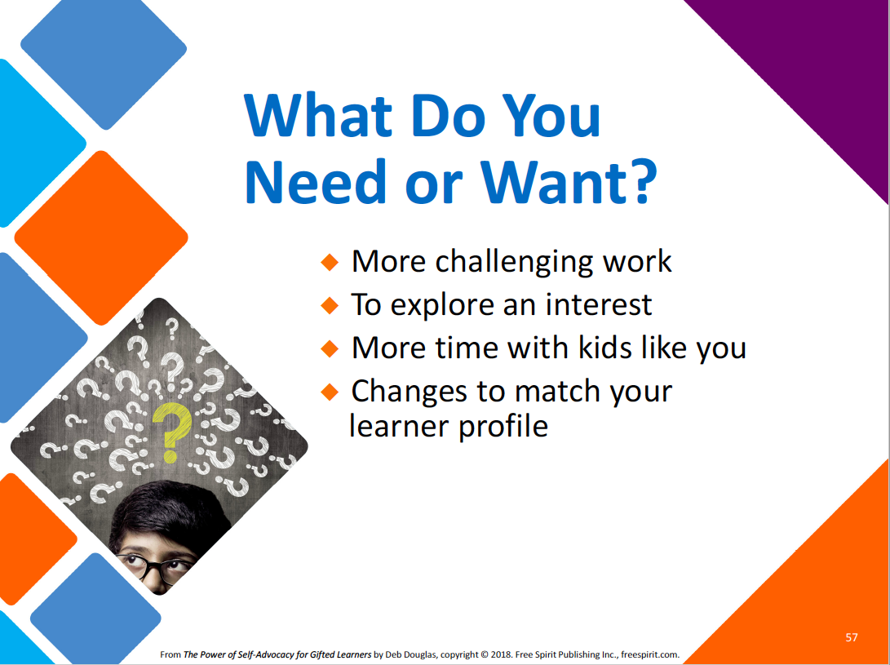
Notes:
What are your goals to grow yourself personally and intellectually? You have to really know yourself first in order to answer this question.

Slide 14

Gifted children must master the art of being PROACTIVE!
Notes:
One of the big topics we will address in the 5th grade Navigate curriculum is how to advocate for your needs as a gifted person moving forward into middle and high school years.

Slide 15
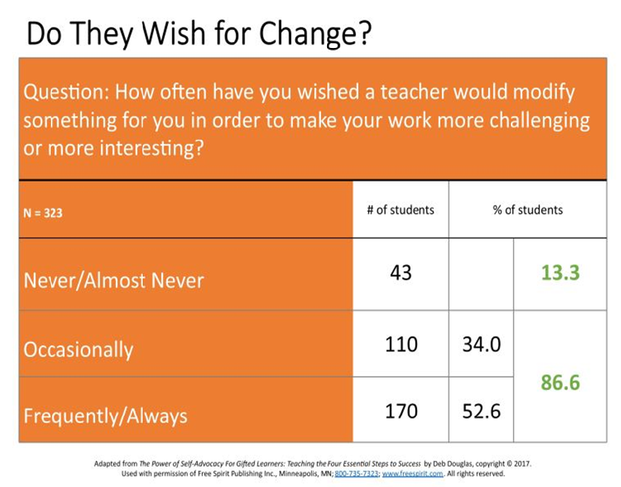

Slide 16
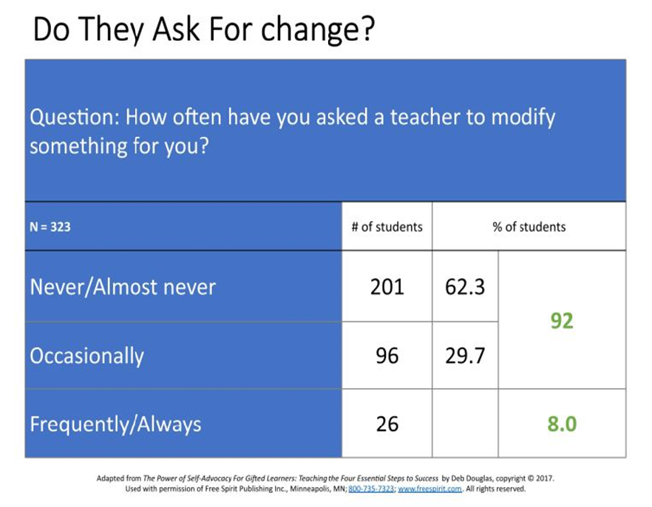

Slide 17
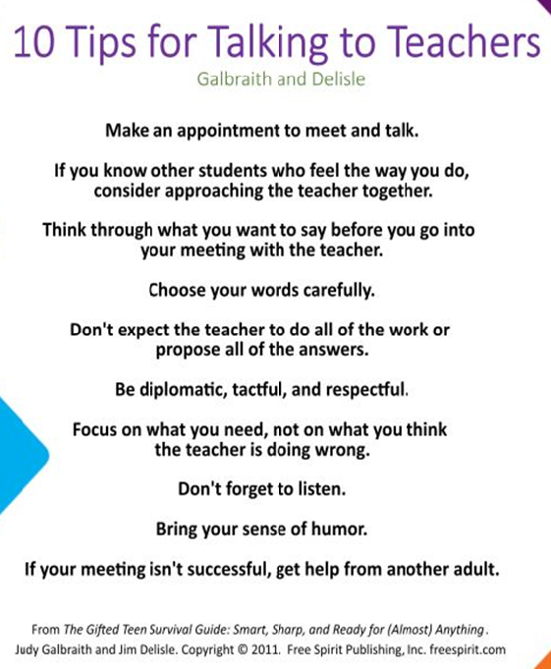
Notes:
When supporting your child in approaching their teacher- here are some handy tips.

Slide 18

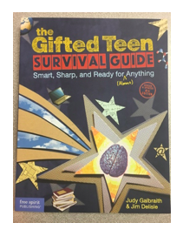
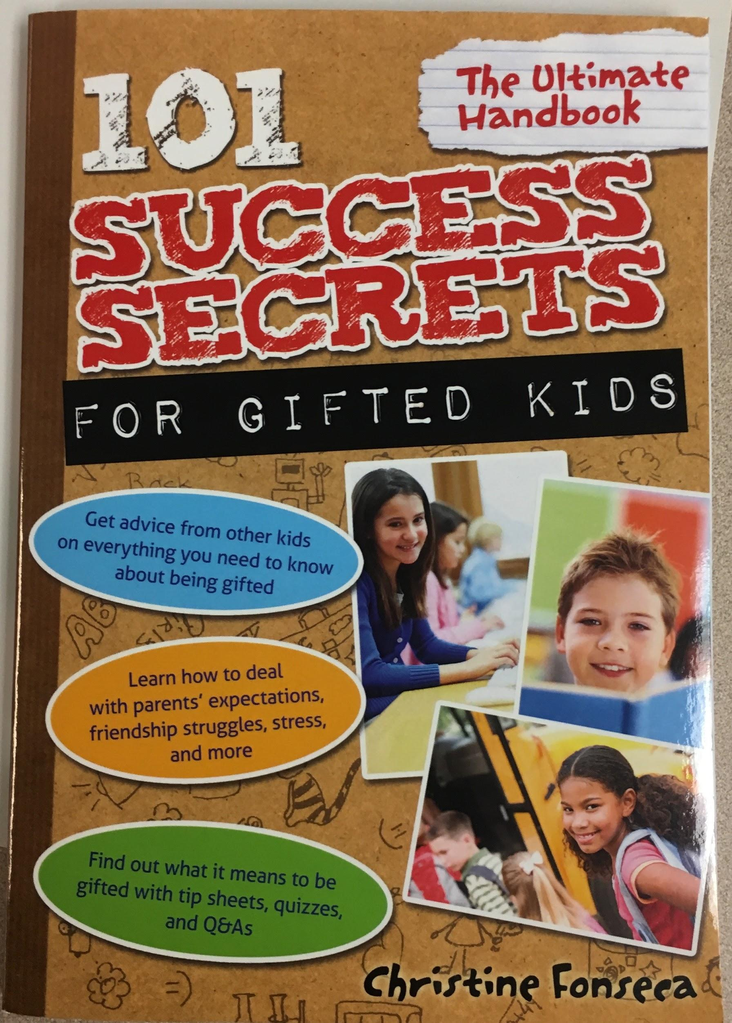
Gifted Survival guides and other reading materials are suggested to CCS AIG students.
Survival Guides for Gifted Kids and Teens
Notes:
Resources available for check-out from Mrs. Smith

Slide 19

A Gifted Local Endorsement course is now in ALL schools (K-12) for teachers to learn more about these unique needs.
Our GLEE teachers at Coltrane-Webb:
  Ms. Henry
  Mrs. Walters
  Mrs. Beaver
  Ms. Espinoza
  Mrs. Brooks
  Ms. Henderson
  Mrs. Thaxton
  Ms. Boone
Teacher who are completing GLEE this year:
  Mrs. Wells-Zeigler
  Mrs. Wallace
  Mrs. Archambault
  Mrs. Auerbach

Slide 20

Gifted programming in
Cabarrus County Schools
What to expect?

Slide 21
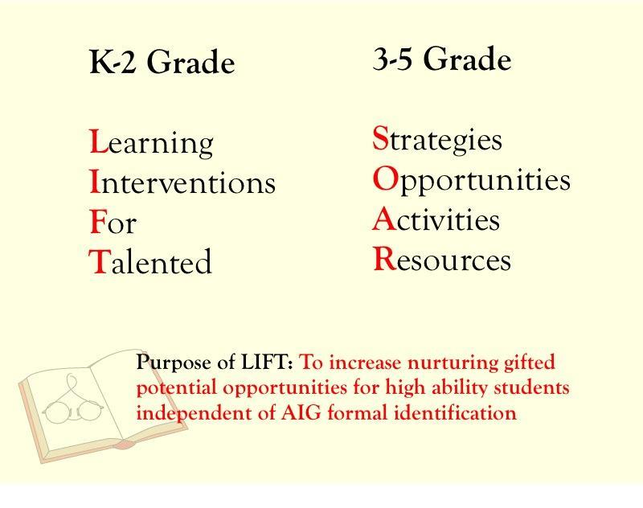
1st & 2nd
3rd, 4th, 5th

Slide 22
A Few FYI’s ….
Once a student qualifies for AIG Resource, he/she is served without further testing until the end of 5th grade.
Students should continue to perform at an elevated level in the classroom to be pulled out for AIG services.
AIG students will receive Progress Reports from the SOAR teacher at the end of each SEMESTER.
Meetings will be held at the beginning of each new school year for parents of current AIG Students, as well as NEW AIG students, to discuss the AIG plans for the year.

Slide 23
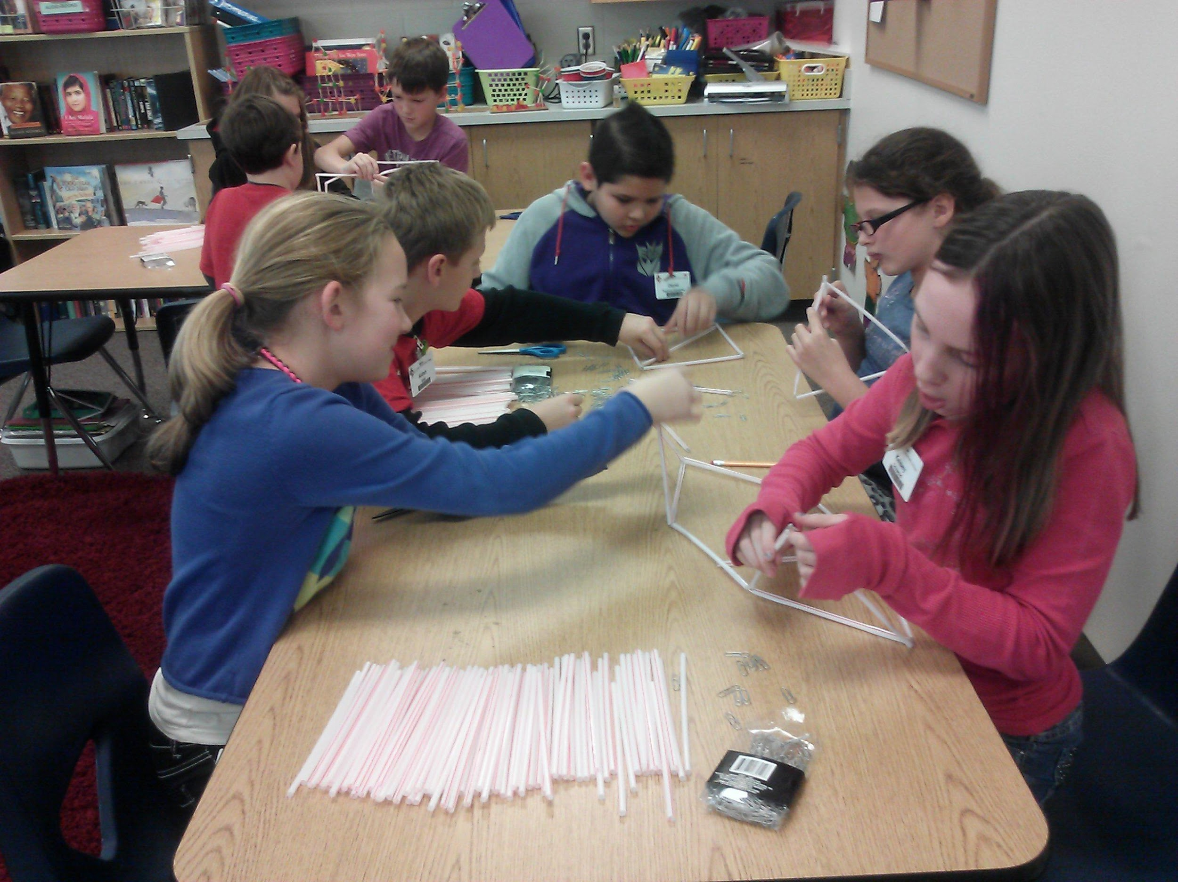
3-5 SOAR Service Details
Students attend resource class in the AIG classroom with other AIG peers and a certified AIG teacher
2 hours/week
Project Based and/or Interdisciplinary units of study that extend/enrich the curriculum
Focus on the CCS AIG Curriculum goals and objectives
Notes:
*

Slide 24
A.I.G. Warm-ups
Math Olympiad
Greek & Latin Word Roots
Weekly math warm-up from retired Math Olympiad Contest problems
5th grade students can choose to participate in Math Olympiad Contests--- starting mid-October.
Weekly word root to expand vocabulary building through 3 years.
“Hot Seat” game to review words and word roots

Slide 25
A.I.G. Units
4th grade
5th grade
*nAvIGate- Neuroplasticity, Multiple Intelligences, Growth Mindset
*Architecture: 7 Wonders of Ancient World, 7 Wonders of New World, 7 Wonders of NC PBL--- 3D printing landmarks
*Robotics- Level 2 sensors
*nAvIGAte- research famous individual to create a Pecha Kucha presentation
*Robotics- NASA space challenge
*Hummingbird Robotics
*Rocketry & Newton’s Laws

Slide 26
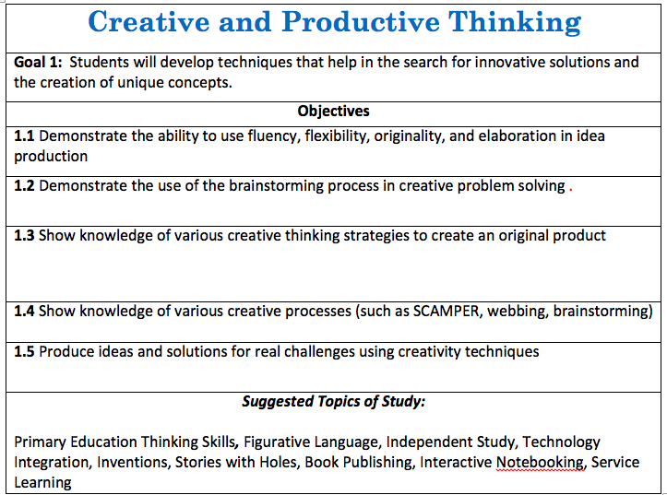

Slide 27
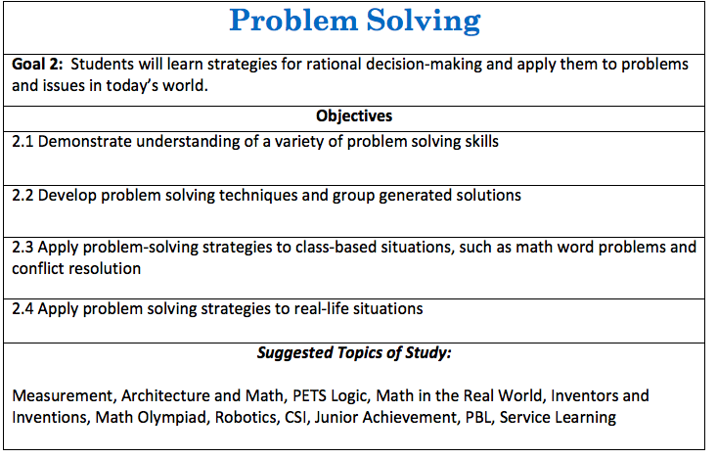

Slide 28
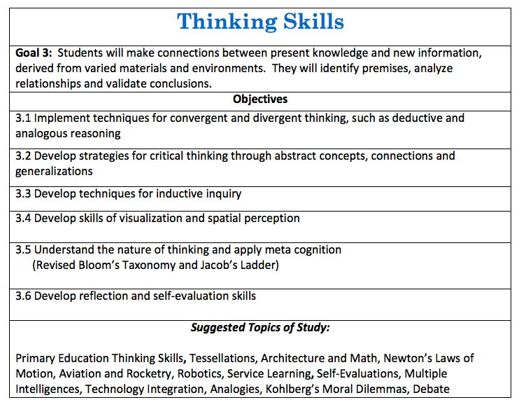

Slide 29
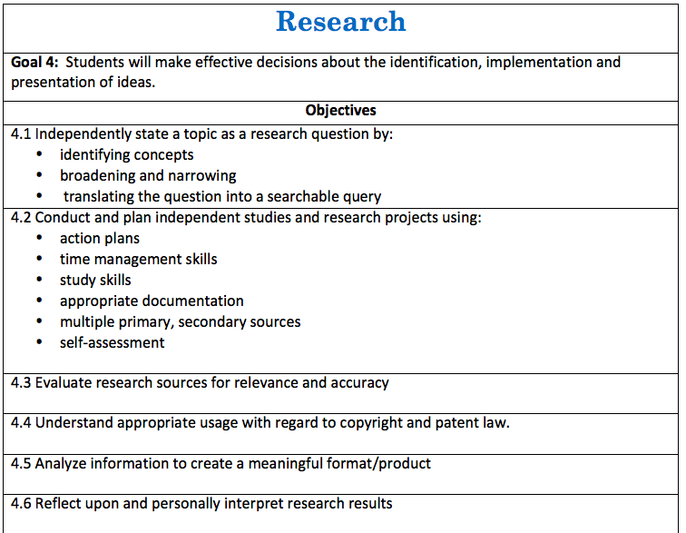

Slide 30
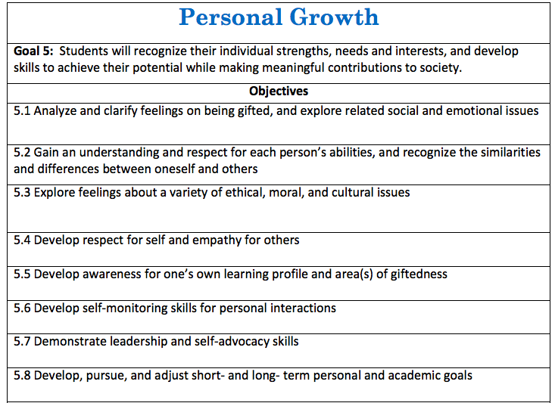

Slide 31
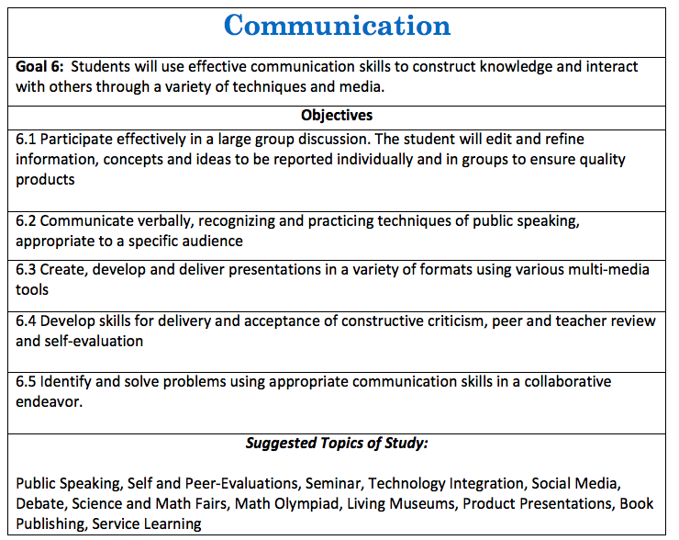

Slide 32
AIG Program Best Practices
Staggered Scheduling
All AIG resource classes are during the I.E. time. Teams are pulled together back to back days.
Missed Classwork
While many classroom teachers do not give AIG students work from time missed, if they do, we must encourage our students to make up this work. The teacher may feel the missed work is an essential concept that needs to be practiced/reviewed.
Classroom work is #1 Priority
Emphasize to students that their performance on regular classroom tests and assignments is critical to their continued participation in AIG Resource. They need to show they can handle it.

Slide 33
AIG Differentiated Education Plan
(D.E.P)
Indicates the special options for learning IN THE REGULAR CLASSROOM available to AIG identified students.
Your child will have a new DEP completed each school year, filled out by the new classroom teacher. This will “flag” the teacher about your child’s learning needs in certain academic areas.
The AIG DEP is to be signed each year by the parent and the classroom teacher. Copies will be provided to parents, and a copy will remain in the student AIG File.
Let’s take a look at the DEP.

Slide 34
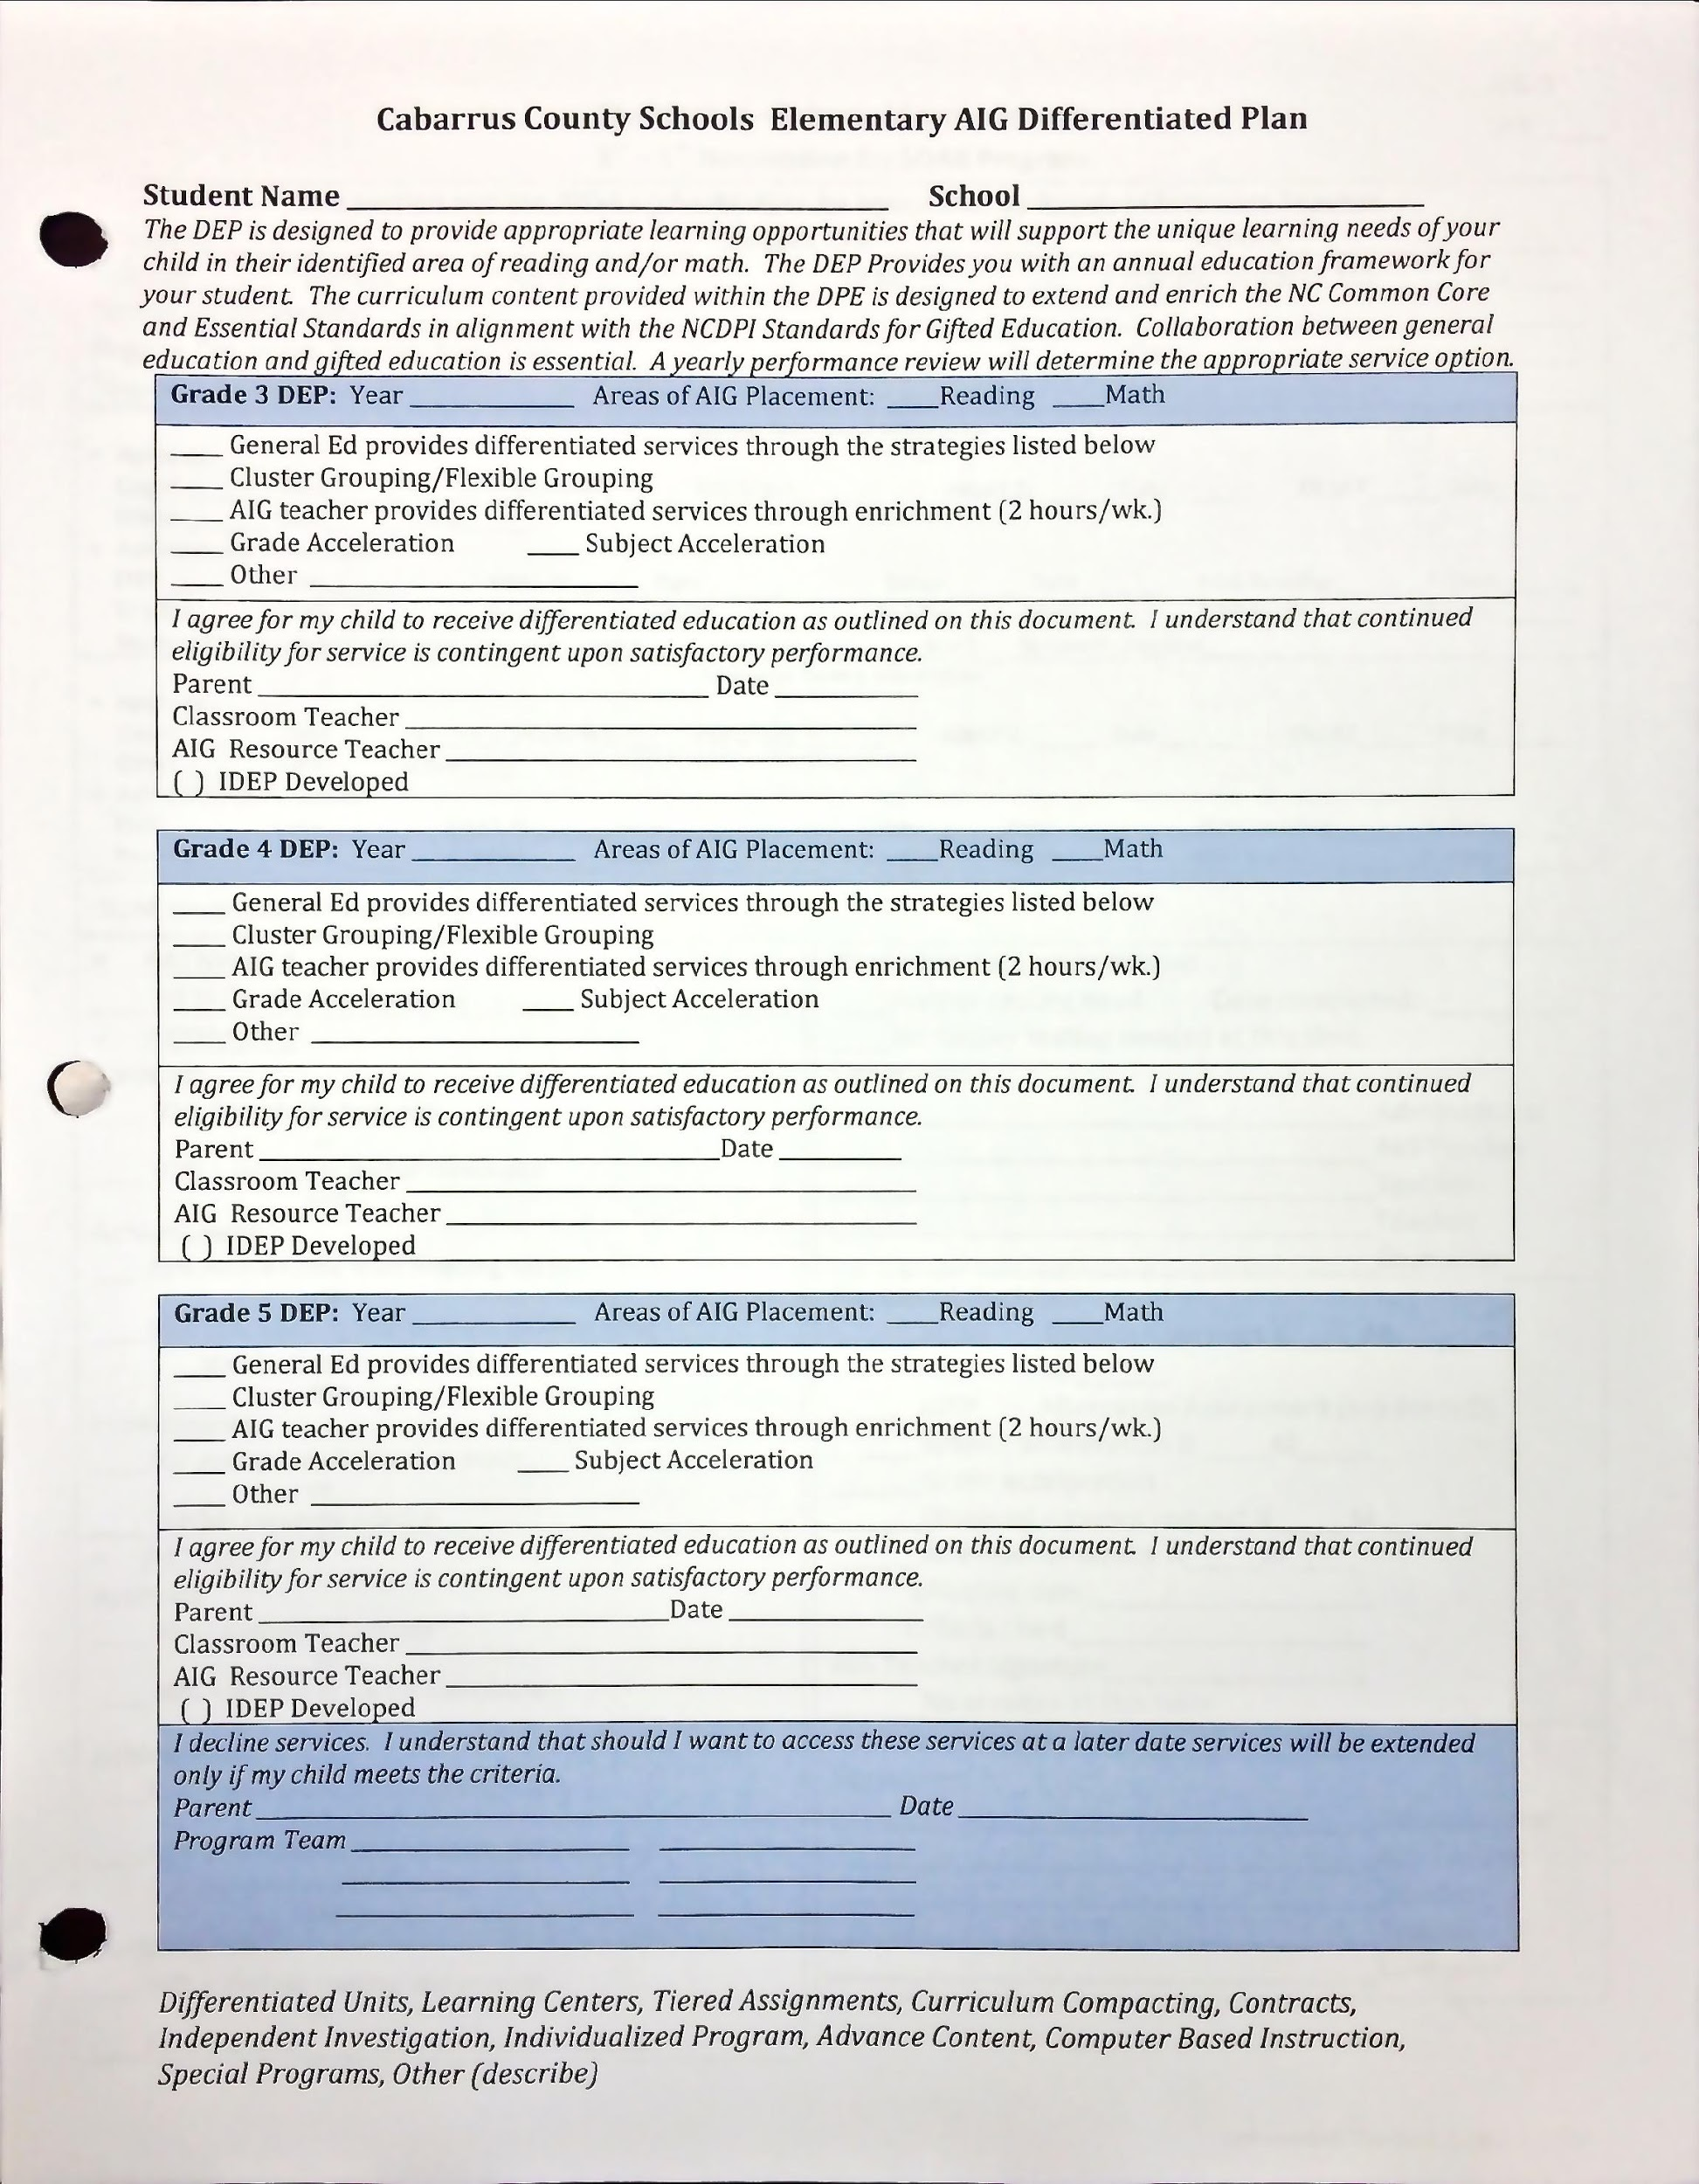
Areas of identification MAY be updated year to year based on EOG scores.
These are some of the strategies classroom teachers may use when working with gifted students. Ask your child’s teacher about specifics related to these strategies.

Slide 35
Advanced Courses in Middle School
ALPS:
Advanced Language Placement
AMPS:
Advanced Math Placement
3 years of math curriculum is covered in 2 years as preparation to take Math 1 in 8th Grade.
Identified Math AIG students will be scheduled for this course with continued high performance in math in 5th grade.
Non-math identified students can still be considered by middle schools for AMPS placement based on grades and available test data.
Identified Reading AIG students will be scheduled for this course with continued high performance in Reading in 5th grade.
Non-reading identified students can still be considered by middle schools for ALPS placement based on grades and available test data.

Slide 36
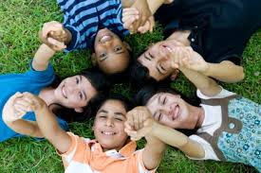
Middle School AIG Practices
Student AIG Files will be transferred to the correlating middle school.
Middle School AIG chairs will meet with AIG parents and review the MS DEP.
AIG students should be cluster grouped together within ALPS and AMPS courses.

Slide 37

For more information about gifted education….
Check out the Cabarrus County Gifted Education Webpage: http://www.cabarrus.k12.nc.us/Page/4272
Like the CCS AIG Facebook page to get tips from district psychologists about strategies to work with your gifted learner at home!
Check out your AIG Teacher’s webpage
SENG Parent Group Information located on CCS Gifted Webpage.
The Survival Guide for Gifted Kids by
Judy Galbraith

Slide 38

THANK YOU!!!
QUESTION/COMMENTS

