Slide 1

What is this?

Slide 2
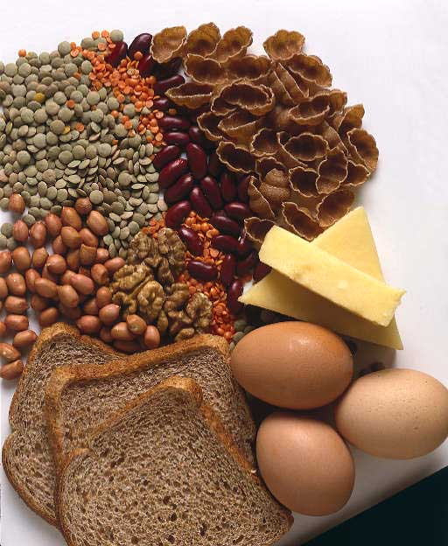

What is this?

Slide 3


What is this?

Slide 4
Nutrients
Carbohydrates
55-60%
Simple
complex
Protein
10-15%
complete
Fat
30%
Provides energy and vitamin storage.
Comes from animal products and solid at room temp. High in cholesterol
Get from eating meats, eggs, dairy products
Digests quickly so used quickly like sugar, fruit, lactose, etc.
Natural alternatives?
Digests slower so used gradually like starch and fiber. Fiber helps decrease constipation.
Main source of energy for the body
Have amino acids that are needed for muscle repair and other body functions
Incomplete
Get from eating nuts/seeds, legumes and grains
*** soybeans contain all 9 essential amino acids
Comes from plant products and liquid at room temperature.
Saturated
Unsaturated

Slide 5


What is this

Slide 6
Nutrients
Vitamin
Found in all foods
Helps with body’s growth and maintenance
Fat soluble: ADEK
Need fat in diet for these to store
Mineral
Found in all foods
Helps with body’s growth and maintenance
Macro:
Needed in larger quantities.
Example Calcium
Micro/Trace:
Need in small amounts.
Example Iron
Water soluble: C and B Complex.
Need water to digest. Need everyday they do not store.

Slide 7
Vitamin or Mineral | Recommended Dietary Allowance (RDA) or Adequate Intake (AI) Nutrients with AIs are marked with an (*) | Upper Tolerable Limit (UL) The highest amount you can take without risk
Boron | Not determined. | 20 mg/day
Calcium | Age 1-3: 700 mg/day Age 4-8: 1,000 mg/day Age 9-18: 1,300 mg/day Age 19-50: 1,000 mg/day Women age 51+: 1,200 mg/day Men age 71+: 1,200 mg/day | Age19-50: 2,500 mg/day Age 51 and up:2,000 mg/day
Chloride | Age 19-50: 2,300 mg/day Age 50-70: 2,000 mg/day Age 70 and older: 1,800 mg/day | 3,600 mg/day
Choline (Vitamin B complex) | Age 70 and older: 1,800 mg/day Women: 425 mg/day * | 3,500 mg/day
Copper | 900 micrograms/day | 10,000 micrograms/day
Fluoride | Men: 4 mg/day * Women: 3 mg/day * | 10 mg/day
Folic Acid (Folate) | 400 micrograms/day | 1,000 micrograms/day This applies only to synthetic folic acid in supplements or fortified foods. There is no upper limit for folic acid from natural sources.

Slide 8
Vitamin or Mineral | Recommended Dietary Allowance (RDA) or Adequate Intake (AI) Nutrients with AIs are marked with an (*) | Upper Tolerable Limit (UL) The highest amount you can take without risk
Iodine | 150 micrograms/day | 1,100 micrograms/day
Iron | Men: 8 mg/day Women age 19-50: 18 mg/day Women age 51 and up: 8 mg/day | 45 mg/day
Magnesium | Men age 19-30: 400 mg/day Men age 31 and up: 420 mg/day Women age 19-30: 310 mg/day Women age 31 and up: 320 mg/day | 350 mg/day This applies only to magnesium in supplements or fortified foods. There is no upper limit for magnesium in food and water.
Manganese | Men: 2.3 mg/day * Women: 1.8 mg/day* | 11 mg/day
Molybdenum | 45 micrograms/day | 2,000 micrograms/day
Nickel | Not determined | 1.0 mg/day
Phosphorus | 700 mg/day | Up to age 70: 4,000 mg/day Over age 70: 3,000 mg/day
Selenium | 55 micrograms/day | 400 micrograms/day

Slide 9
Vitamin or Mineral | Recommended Dietary Allowance (RDA) or Adequate Intake (AI) Nutrients with AIs are marked with an (*) | Upper Tolerable Limit (UL) The highest amount you can take without risk
Vitamin A | Men: 3,000 IU/day Women: 2,310 IU/day | 10,000 IU/day
Vitamin B3 (Niacin) | Men: 16 mg/day Women: 14 mg/day | 35 mg/day This applies only to niacin in supplements or fortified foods. There is no upper limit for niacin in natural sources.
Vitamin B6 | Men age 19-50: 1.3 mg/day Men age 51 up:1.7 mg/day Women age 19-50: 1.3 mg/day Women age 51 up: 1.5 mg/day | 100 mg/day
Vitamin C | Men: 90 mg/day Women: 75 mg/day | 2,000 mg/day
Vitamin D (Calciferol) | Age 1-70: 15 micrograms/day (600 IU, or international units) * Age 70 and older: 20 micrograms/day (800 IU) * | 100 micrograms/day (4,000 IU)
Vitamin E (alpha-tocopherol) | 22.4 IU/day | 1,500 IU/day This applies only to vitamin E in supplements or fortified foods. There is no upper limit for vitamin E from natural sources.
Zinc | Men: 11 mg/day Women: 8 mg/day | 40 mg/day

Slide 10
Toxic verses Deficiency
Toxic:
Maximum intake limits exist for many vitamins and minerals to prevent toxic effects such as cardiac problems, high blood pressure, hemorrhagic stroke and kidney or nerve damage.
http://www.livestrong.com/article/353332-toxic-levels-of-vitamins-and-minerals/#ixzz24fiaVqLl
Deficiency:
A shortage of substances (as vitamins) necessary to health. Lack of can cause birth defects, blindness, osteoporosis, and nerve damage.

Slide 11


What is this?

Slide 12
Water
6-8 8 ounces glasses per day
Helps to regulate body temperature, prevent dehydration, makes up plasma, lubricates joints and keeps kidneys clean.
Where do we get it?
Just a 2% loss of body weight in the form of water weight can cause Dehydration
Mineral
activity

Slide 13
Nutrients Database Questions
Search the field, RDV (recommended daily value) to find out which nutrient(s) have a RDV of 2 mg.
Search in the field, A Chief Source to find out which nutrient(s) supports bone and teeth health.
Search in the field, A Deficiency Symptom to find out which nutrient(s) have anemia as a deficiency symptom.
Search in the field, Stored In to find out which nutrients are stored in the liver.
Sort RDV to find which four nutrients have the lowest recommended daily value amount.
6. Sort A Chief Function to find which
nutrients help metabolize
energy (calories).
7. Sort A Significant Source in
ascending order to find which
source is repeated the most.
8. Sort RDV to find which nutrient has
the highest recommended
daily value.
9. Which nutrient is important in the
process of wound healing?
10. When you often have cracks at
the corner of your
mouth, you may need more of
this nutrient in your
diet.

