Slide 1
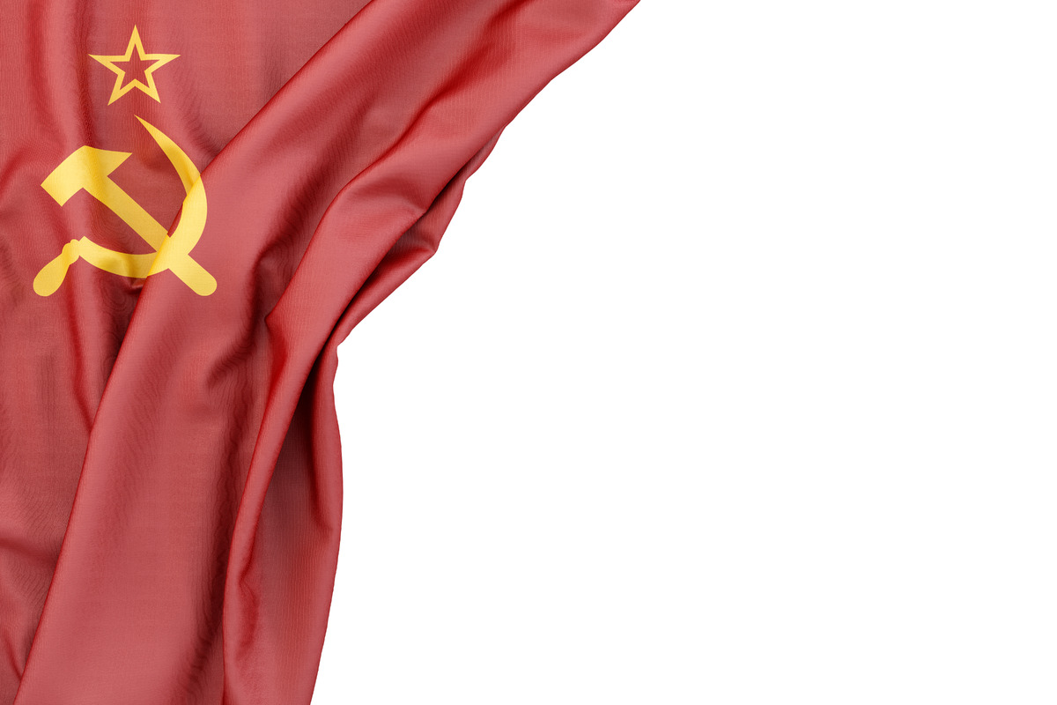
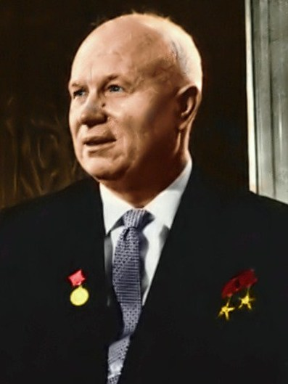
Khrushchev, Nikita the I’m bear who will eat ya!
Back in dah war, I fought in Stalingrad
Against the Nazis, a victory we had
Once a poor metal worker, I now flex like a communist berserker
Uncle Joe kicked it, right in the bucket
Power vacuum I filled, old life I chuck it
Nikita
Khrushchev
HARRY TRUMAN

Slide 2
Now Head of “the Party”, man of the people
I hated Joe Stalin, his policies were evil
Refocus the country, Soviet intention
Weak Americans and tinfoil hats
Ridiculous and silly, make Nikita laugh
Nikita
Khrushchev
HARRY TRUMAN

Slide 3
Nikita
Khrushchev
HARRY TRUMAN

Slide 4
Sputnik my baby, you scare the whole world
Beeping your presence, watch their heads twirl
The Space Race is on, the missiles will fly
Bring on the Cold War, everyone could die
Kennedy is weak, Cuba has bent
Nukes near their soil, the threat is now sent
Nikita
Khrushchev
HARRY TRUMAN

Slide 5
Finger on button, Kennedy too
I back this all down, I don’t see it through
I try to mend fence and U.S. agree
Moscow is now quite mad at me
They shipped me off to retire
A heart attack got me, and now Nikita expired
Nikita
Khrushchev
HARRY TRUMAN

